Slide 1

Concurrency Sync Issues
Solutions using MUTEXes and Semaphores

Slide 2
AGENA
Concurrecny basic definitions
Classical Syncronization issues
Practical demo
References

Slide 3

Basic definitions

Slide 4
Basic definitions
Race Conditions the output is dependent on the sequence or timing of other uncontrollable events. It becomes a bug when events do not happen in the order the programmer intended.
Deadlock – two or more processes are waiting indefinitely for an event that can be caused by only one of the waiting processes
Starvation – indefinite blocking. A process may never be removed from the semaphore queue in which it is suspended
Priority Inversion - Scheduling problem when lower-priority process holds a lock needed by higher-priority process

Slide 5
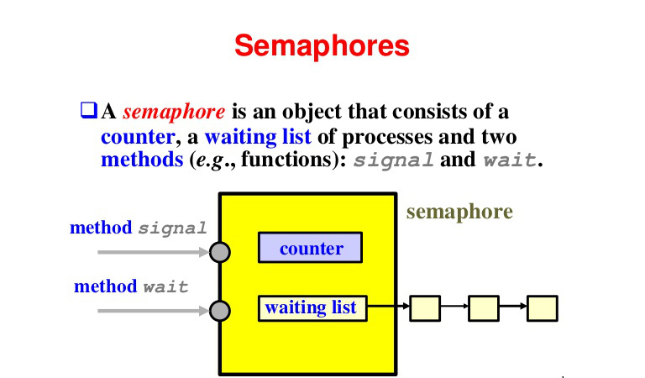
Semaphores and Mutexes
Semphores has three types
Counting Semaphores (takes wider range of values)
Binary Semaphore (takes 0 or 1)
Mutex (Mutual Exclusive) Semaphores
Semphores VS Mutexes
Mutex introduces the concept of ownership
Binary semaphore is to use for synchronization
Notes:
A semaphore is a counting and signaling mechanism. We use it to allow threads access to a specified number of items. If there is a single item, then a semaphore is virtually the same as a mutex.
However, it is more commonly used in a situation where there are multiple items to be managed. Semaphores can also be used to signal between threads or processes. For example, to tell another thread that there is data present in a queue. There are two types of semaphores: named and unnamed semaphores.
Semaphores are used to protect a section of code so that only one thread can run it at the given time. To do this kind of task, a binary semaphore is needed. However, if we want to permit a limited number of threads to execute a piece of code, we may need a counting semaphore.
Mutex:
Is a key to a toilet. One person can have the key - occupy the toilet - at the time. When finished, the person gives (frees) the key to the next person in the queue.
Officially: "Mutexes are typically used to serialise access to a section of re-entrant code that cannot be executed concurrently by more than one thread. A mutex object only allows one thread into a controlled section, forcing other threads which attempt to gain access to that section to wait until the first thread has exited from that section." Ref: Symbian Developer Library
(A mutex is really a semaphore with value 1.)
Semaphore:
Is the number of free identical toilet keys. Example, say we have four toilets with identical locks and keys. The semaphore count - the count of keys - is set to 4 at beginning (all four toilets are free), then the count value is decremented as people are coming in. If all toilets are full, ie. there are no free keys left, the semaphore count is 0. Now, when eq. one person leaves the toilet, semaphore is increased to 1 (one free key), and given to the next person in the queue.
Officially: "A semaphore restricts the number of simultaneous users of a shared resource up to a maximum number. Threads can request access to the resource (decrementing the semaphore), and can signal that they have finished using the resource (incrementing the semaphore)." Ref: Symbian Developer Library

Slide 6

Classic synchronization Problems

Slide 7
Classic synchronization Problems producer Consumer Problem
Producer Consumer Problem (Bounded Buffer problem)
Imagine that: if the consumer thread runs first; it will call get() to get data that hasn't even been produced yet, and thus not function as desired. Things get worse when we add multiple producers or consumers, as there could be race conditions in the update of the use or fill indices.
Then the consumer might get wrong data, or takes from the buffer while it’s empty already

Slide 8
Classic synchronization Problems producer Consumer Problem – Cont.
Producer Consumer Problem (Bounded Buffer problem)
Solution: use two semaphores, EMPTY and FULL, which the threads will use to indicate when a buffer entry has been emptied or filled, respectively
But be Aware of the Race Condition ! WHY ????
Suppose, there are multiple producers and multiple consumers. We now have a problem: a race condition !
Imagine two producers both calling into put() at the same time. Assume producer 1 gets to run first, and just starts to fill the first buffer entry (fill = 0 @ buffer[fill] = value). Before the producer gets a chance to increment the fill counter to 1, it is interrupted. Producer 2 starts to run, and at the same line of code, it also puts its data into the 0th element of buffer, which means that the old data there is overwritten!
WE GOT TO USE MUTEX !
Let’s Run again, BUT It’s not working (DEAD LOCK !)
There is a simple cycle here. The consumer holds the mutex and is waiting for the someone to signal full. The producer could signal full but is waiting for the mutex.
Try to reduce the scope of the lock
Notes:
Why does deadlock occur? Take a moment to consider it; try to find a case where deadlock arises; what sequence of steps must happen for the program to deadlock?Suppose, two threads, one producer and one consumer. The consumer gets to run first. It acquires the mutex, and then calls sem_wait() on the full semaphore. Because there is no data yet, this call causes the consumer to block and thus yield the CPU; importantly, though, the consumer still holds the lock!.
A producer then runs. It has data to produce and if it were able to run, it would be able to wake the consumer thread and all would be good. Unfortunately, the first thing it does is call sem_wait(&mutex;) on the binary mutex semaphore. The lock is already held. Hence, the producer is now stuck waiting too.
There is a simple cycle here. The consumer holds the mutex and is waiting for the someone to signal full. The producer could signal full but is waiting for the mutex.
Thus, the producer and consumer are each stuck waiting for each other: a classic deadlock!!.

Slide 9
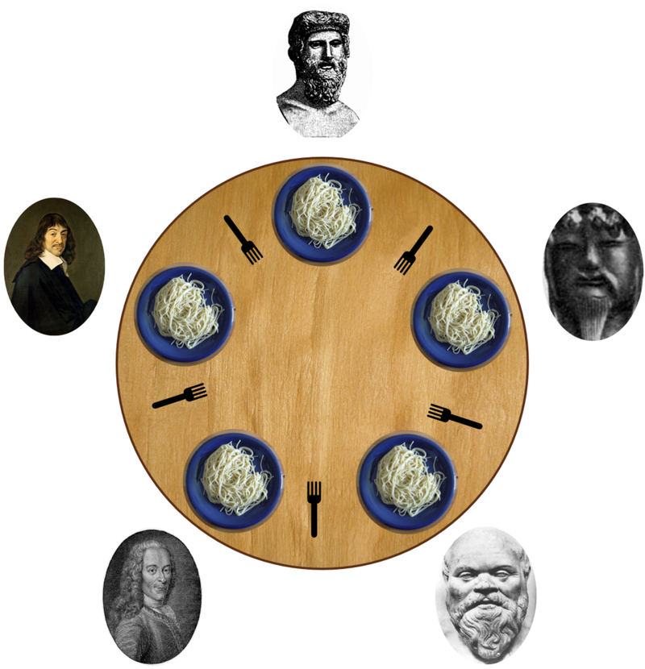
Classic synchronization Problems Dining-Philosophers Problem
Five silent philosophers sit at a round table with bowls of spaghetti. Forks are placed between each pair of adjacent philosophers.
Each philosopher must alternately think and eat. However, a philosopher can only eat spaghetti when they have both left and right forks.
This classical problem is created to identify two problem
Deadlocks
Resource Starvation
Solutions:
Each Chopstick is a semaphore

Slide 10
Explore IT YOURSELF
Rendezvous problem: The rendezvous dilemma can be formulated in this way: Two people have a date in a park they have never been to before
Sleeping barber problem: One barber, multiple chairs

Slide 11
RTOS and resource Management (the use of semaphores)
Semaphores
Priority Ceiling Protocol
Notes:
Reference: 8 Resource management Chapter ()
Vector SafeOS:

Slide 12
SYNC IN HIGH END OS
Windows XP
Uses interrupt masks to protect access to global resources on uniprocessor systems
Uses spinlocks on multiprocessor systems
Also provides dispatcher objects which may act as either mutexes and semaphores
Linux
Prior to kernel Version 2.6,
disables interrupts to implement short critical sections
Version 2.6 and later, fully preemptive
Linux provides: semaphores, spin locks
OSEK; Provides semaphores, OSEK Priority Ceiling Protocol
Pthraeds, It’s a portable thread library
It provides portable solutions: mutex locks, condition variables Non-portable extensions include: read-write locks, spin locks
Notes:
Reference: 8 Resource management Chapter ()
Vector SafeOS:

Slide 13

DEMO

Slide 14
References
Operating Systems Concepts 9th Edition
By Abraham Silberschatz and Peter Baer Galvin

