Slide 1
Credit Card Approval Prediction
Muhammad Ahmed Rao
Senior Data Scientist

Slide 2
To do
Add univariate
Add multivariate
Definition on why emphasis on the Bad applicants
A lot of manual intervention so need of model
add feature importance
y-label distribution
distribution of the important variables
Bivariate
Importance of the output, bad applicant more critical
Features Engineering
ANOVA->F-TEST->T-TEST
Cateogrical to Continuous
L1-NORM
Lasso
If full scale deployment
model development
deployment
automation

Slide 3
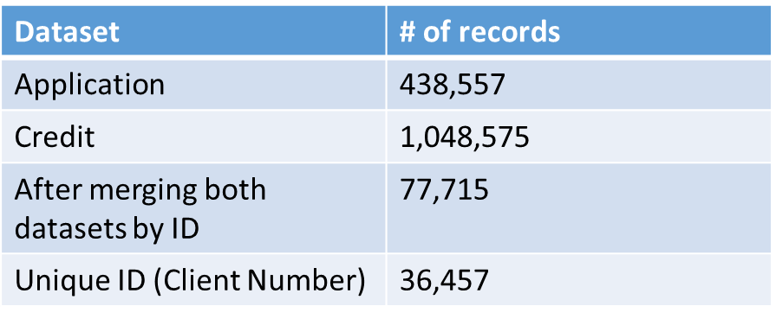
Introduction
This exercise is to analyze customer application and credit information to extrapolate the type of applicants which makes a Good or Bad Candidate for a Credit Card.
The dataset is from Kaggle.
application_record.csv contains appliers personal information, which you could use as features for predicting.
credit_record.csv records users' behaviors of credit card.

Slide 4
Credit Card Approval Process
User Applies for Credit Card
Bank checks with the authority
Authority creates report
Authority reverts User’s Credit Score to Bank
Credit Card request Approved/Rejected

Slide 5
Univariate Analysis

Slide 6
Application Record
33% applications are from Male and 67% are from Female
Most of the applicants do not own a car 63%
69% of the applicants have own property
Applicants having no (69.3%), one (20.2%) or two (9.1%) kids cover large proportion of population
74.3% of the applicants have income ranging from 81K – 135K
Half of the population are the workers, on the 2nd are commercial associate, third are pensioners and 8% State Servant
Large chunk of applicants are qualified (96%).
Married applicants tend to apply for credit card more than Single/Not Married, Civil Marriage, Separated or Widow.
Most of the applicants live in house/apartment (90%)
Applicants age range from 20-69 years
17.17% of the applicants are un-employed
More than half of the applicants have a total of 2 family members.
FLAG_MOBIL contains only one unique value so it won’t be of any use
Positive correlation between Income and Family Members

Slide 7
Data Cleaning
I dropped column FLAG_MOBIL since it only contained 1 constant value which does not give any information to separate Bad and Good application added field.
Occupation type contained 240,048 missing values. I put them with ‘Other’ occupation types

Slide 8
Feature Engineering
Computed following columns:
AGE from DAYS_BIRTH
IS_EMPLOYED from DAYS_EMPLOYED
EMPLOYMENT_YEARS from DAYS_EMPLOYED
EMPLOYMENT_START_DT from DAYS_EMPLOYED (later I removed it since I did not used it in training the model)

Slide 9
Data Labelling and distribution
Status | Description | Label | # Applicants | % Applicants
0 | 1-29 days due | Good | 290,654 | 37.37%
1 | 30-59 days past due | Good | 8,747 | 1.12%
2 | 60-89 days overdue | Bad | 801 | 0.10%
3 | 90-119 days overdue | Bad | 286 | 0.04%
4 | 120-149 days overdue | Bad | 214 | 0.03%
5 | Overdue or bad debts, write-offs for more than 150 days | Bad | 1,527 | 0.20%
C | Paid off that month | Good | 329,536 | 42.37%
X | No loan for the month | Good | 145,950 | 18.77%
Total |  |  | 77,715 | 100%
Good | 774,887 | 99.36%
Bad | 2,828 | 0.36%

Slide 10
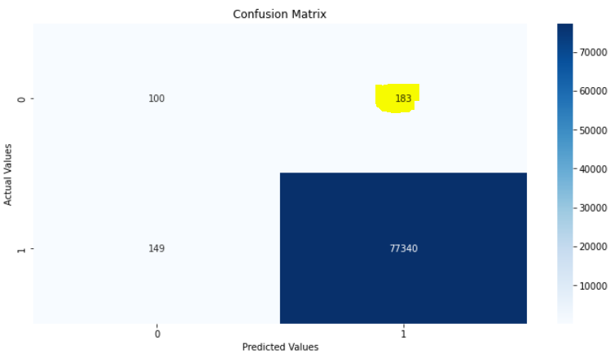
Data Splitting & Model Training
I split the data in train and test in stratified fashion
At first, I trained the un-balanced data using Decision Tree and as expected the model did not classify the 64.66% Bad Applicants correctly.
Train | 699,943
Test | 77,772
Total | 777,715

Slide 11


Random Oversampling
I applied Random Oversampling technique to overcome the un-balance issue. Then I trained Decision Tree and Random Forest.
Decision Tree misclassified 57% of the Bad Applicants whereas Random Forest misclassified 55.8% of the Bad Applicants.
We need further improvement to reduce the misclassification rate
DECISION TREE
RANDOM FOREST

Slide 12

SMOTE
To further improve I used SMOTE method for oversampling since it maps minority class by generating synthetic examples rather than by oversampling with replacement.
The results significantly improved using this technique since all bad applicants were classified correctly.
Decision Tree & Random Forest

Slide 13
Feature Importance
Following attributes had highest importance after training random forest.
AGE
EMPLOYMENT_YEARS
AMT_INCOME_TOTAL
MONTHS_BALANCE
CNT_FAM_MEMBERS

Slide 14
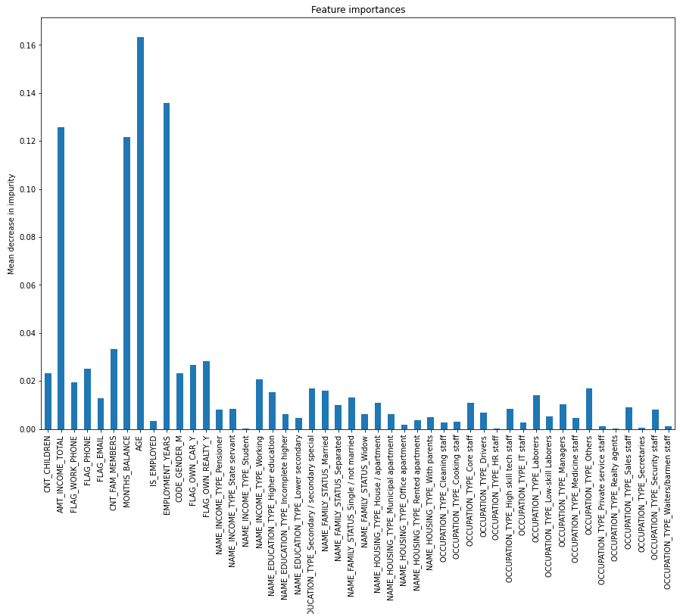

Slide 15
Further Work
If this project had to go on full scale:
I would work on reducing the Good applicants misclassification rate using Hyper-parameter tuning.
Will create automated pipeline of the model and integrate with the system so that this model can supplement them with their decision.

