Slide 1
PWM Drawer
Group: 69
Team members:
Ahmed

Slide 2
What we will take about ?
Introduction
Component
Simulation circuit
Code

Slide 3
Introduction
PWM drawer works as a mini oscilloscope that is responsible for printing the frequency and the waveform of the generated PWM signal.
(PWM) is a modulation technique that generates variable-width pulses to represent the amplitude of an analog input signal. The output switching transistor is on more of the time for a high-amplitude signal and off more of the time for a low-amplitude signal.

Slide 4
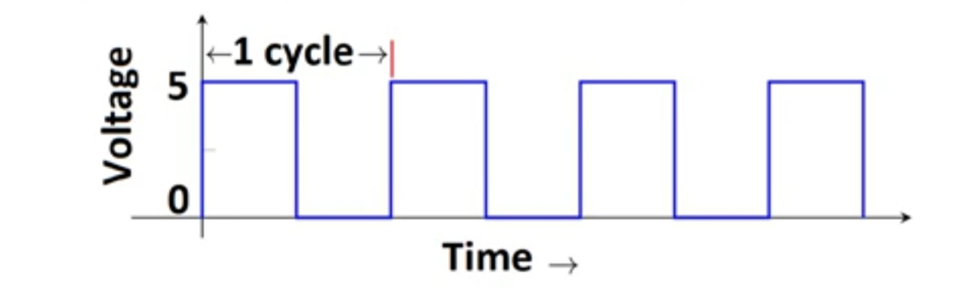
Introduction
Frequency signals, or other waves, expresses the number of cycles of the repetitive waveform per second.
Duty Cycle (In %) = Ton /total period *100
period of a pulse consists of an ON cycle (5V) and an OFF cycle (0V). The fraction for which the signal is ON over a period is known as the duty cycle.

Slide 5
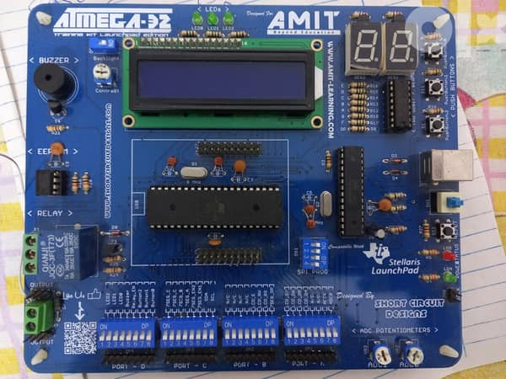
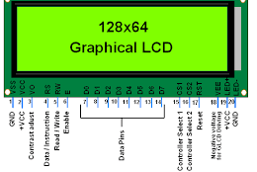
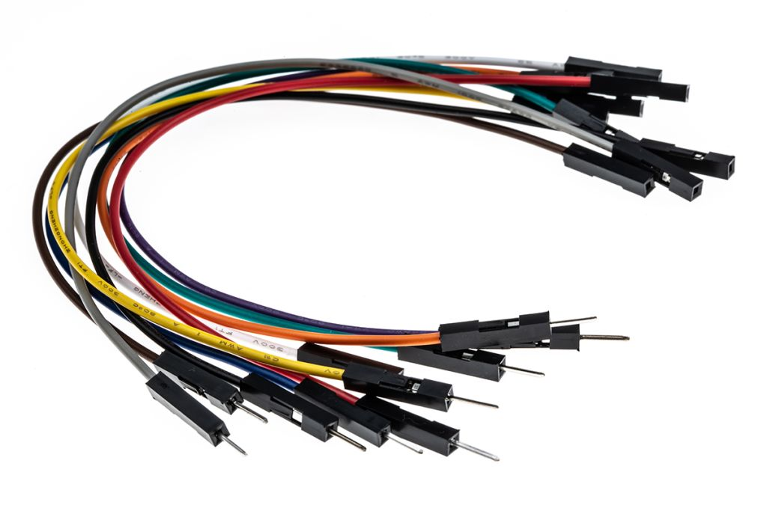
Component
ATmega32 MCU
GLCD
wires

Slide 6
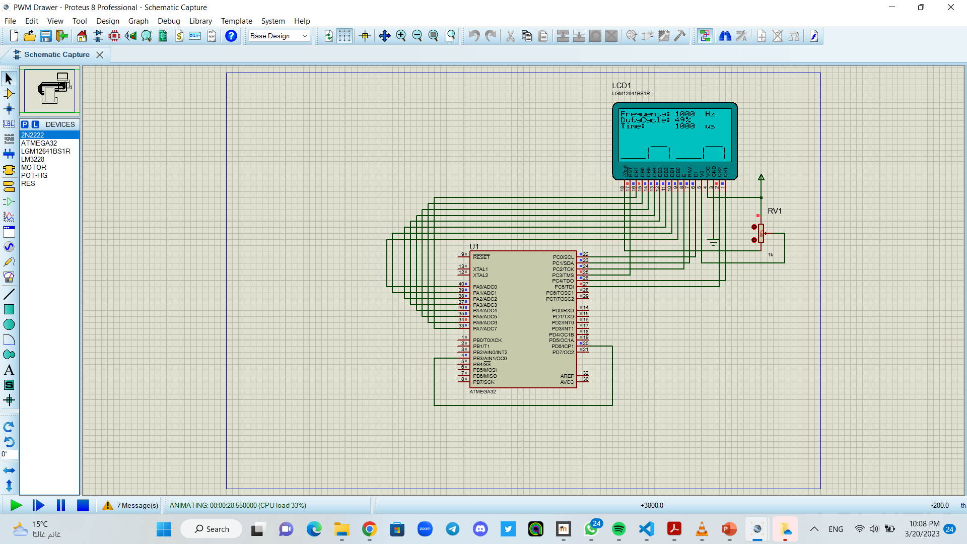
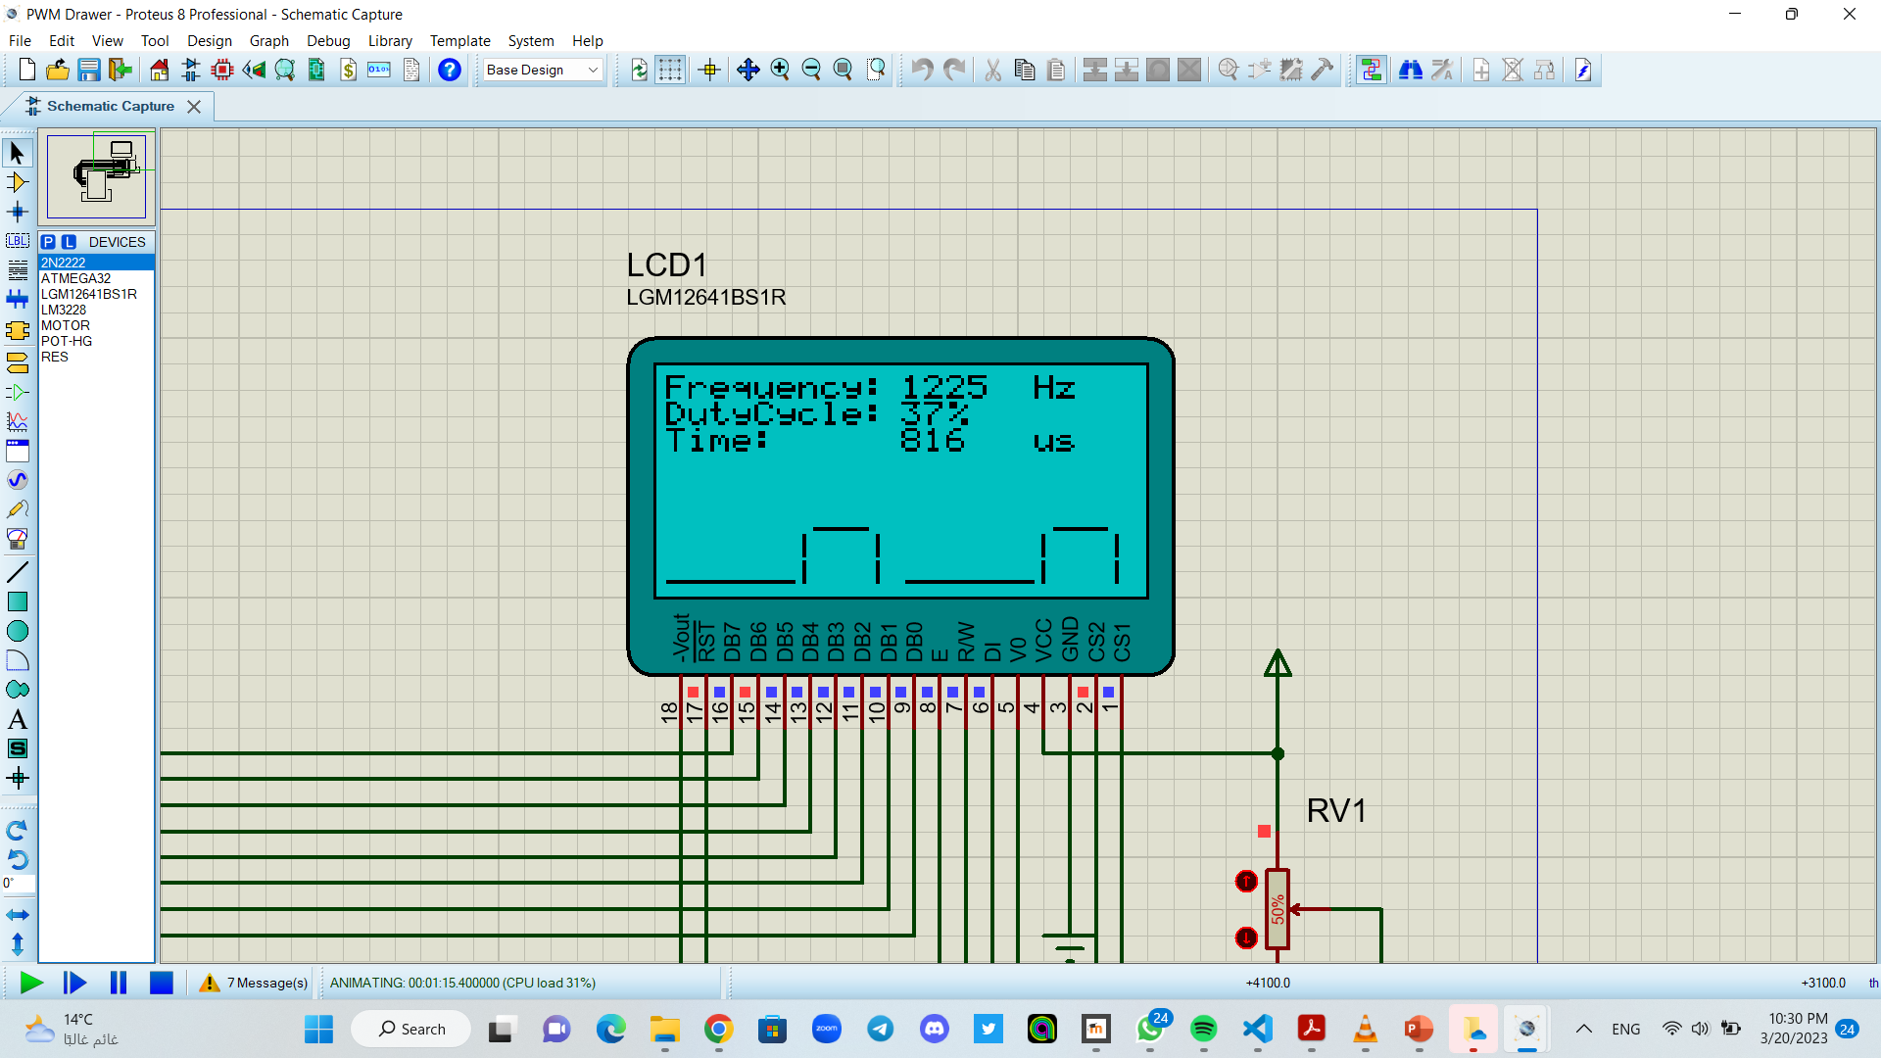
Simulation circuit

Slide 7
Code
Main File
GLCD Files
TIMER Files
https://github.com/ShAwKy10/PWM-Drawer

Slide 8


