Slide 1



bakery_dashboard
View in Power BI
Last data refresh:
9/7/2023 5:01:25 PM UTC
Downloaded at:
9/7/2023 5:03:04 PM UTC

Slide 2
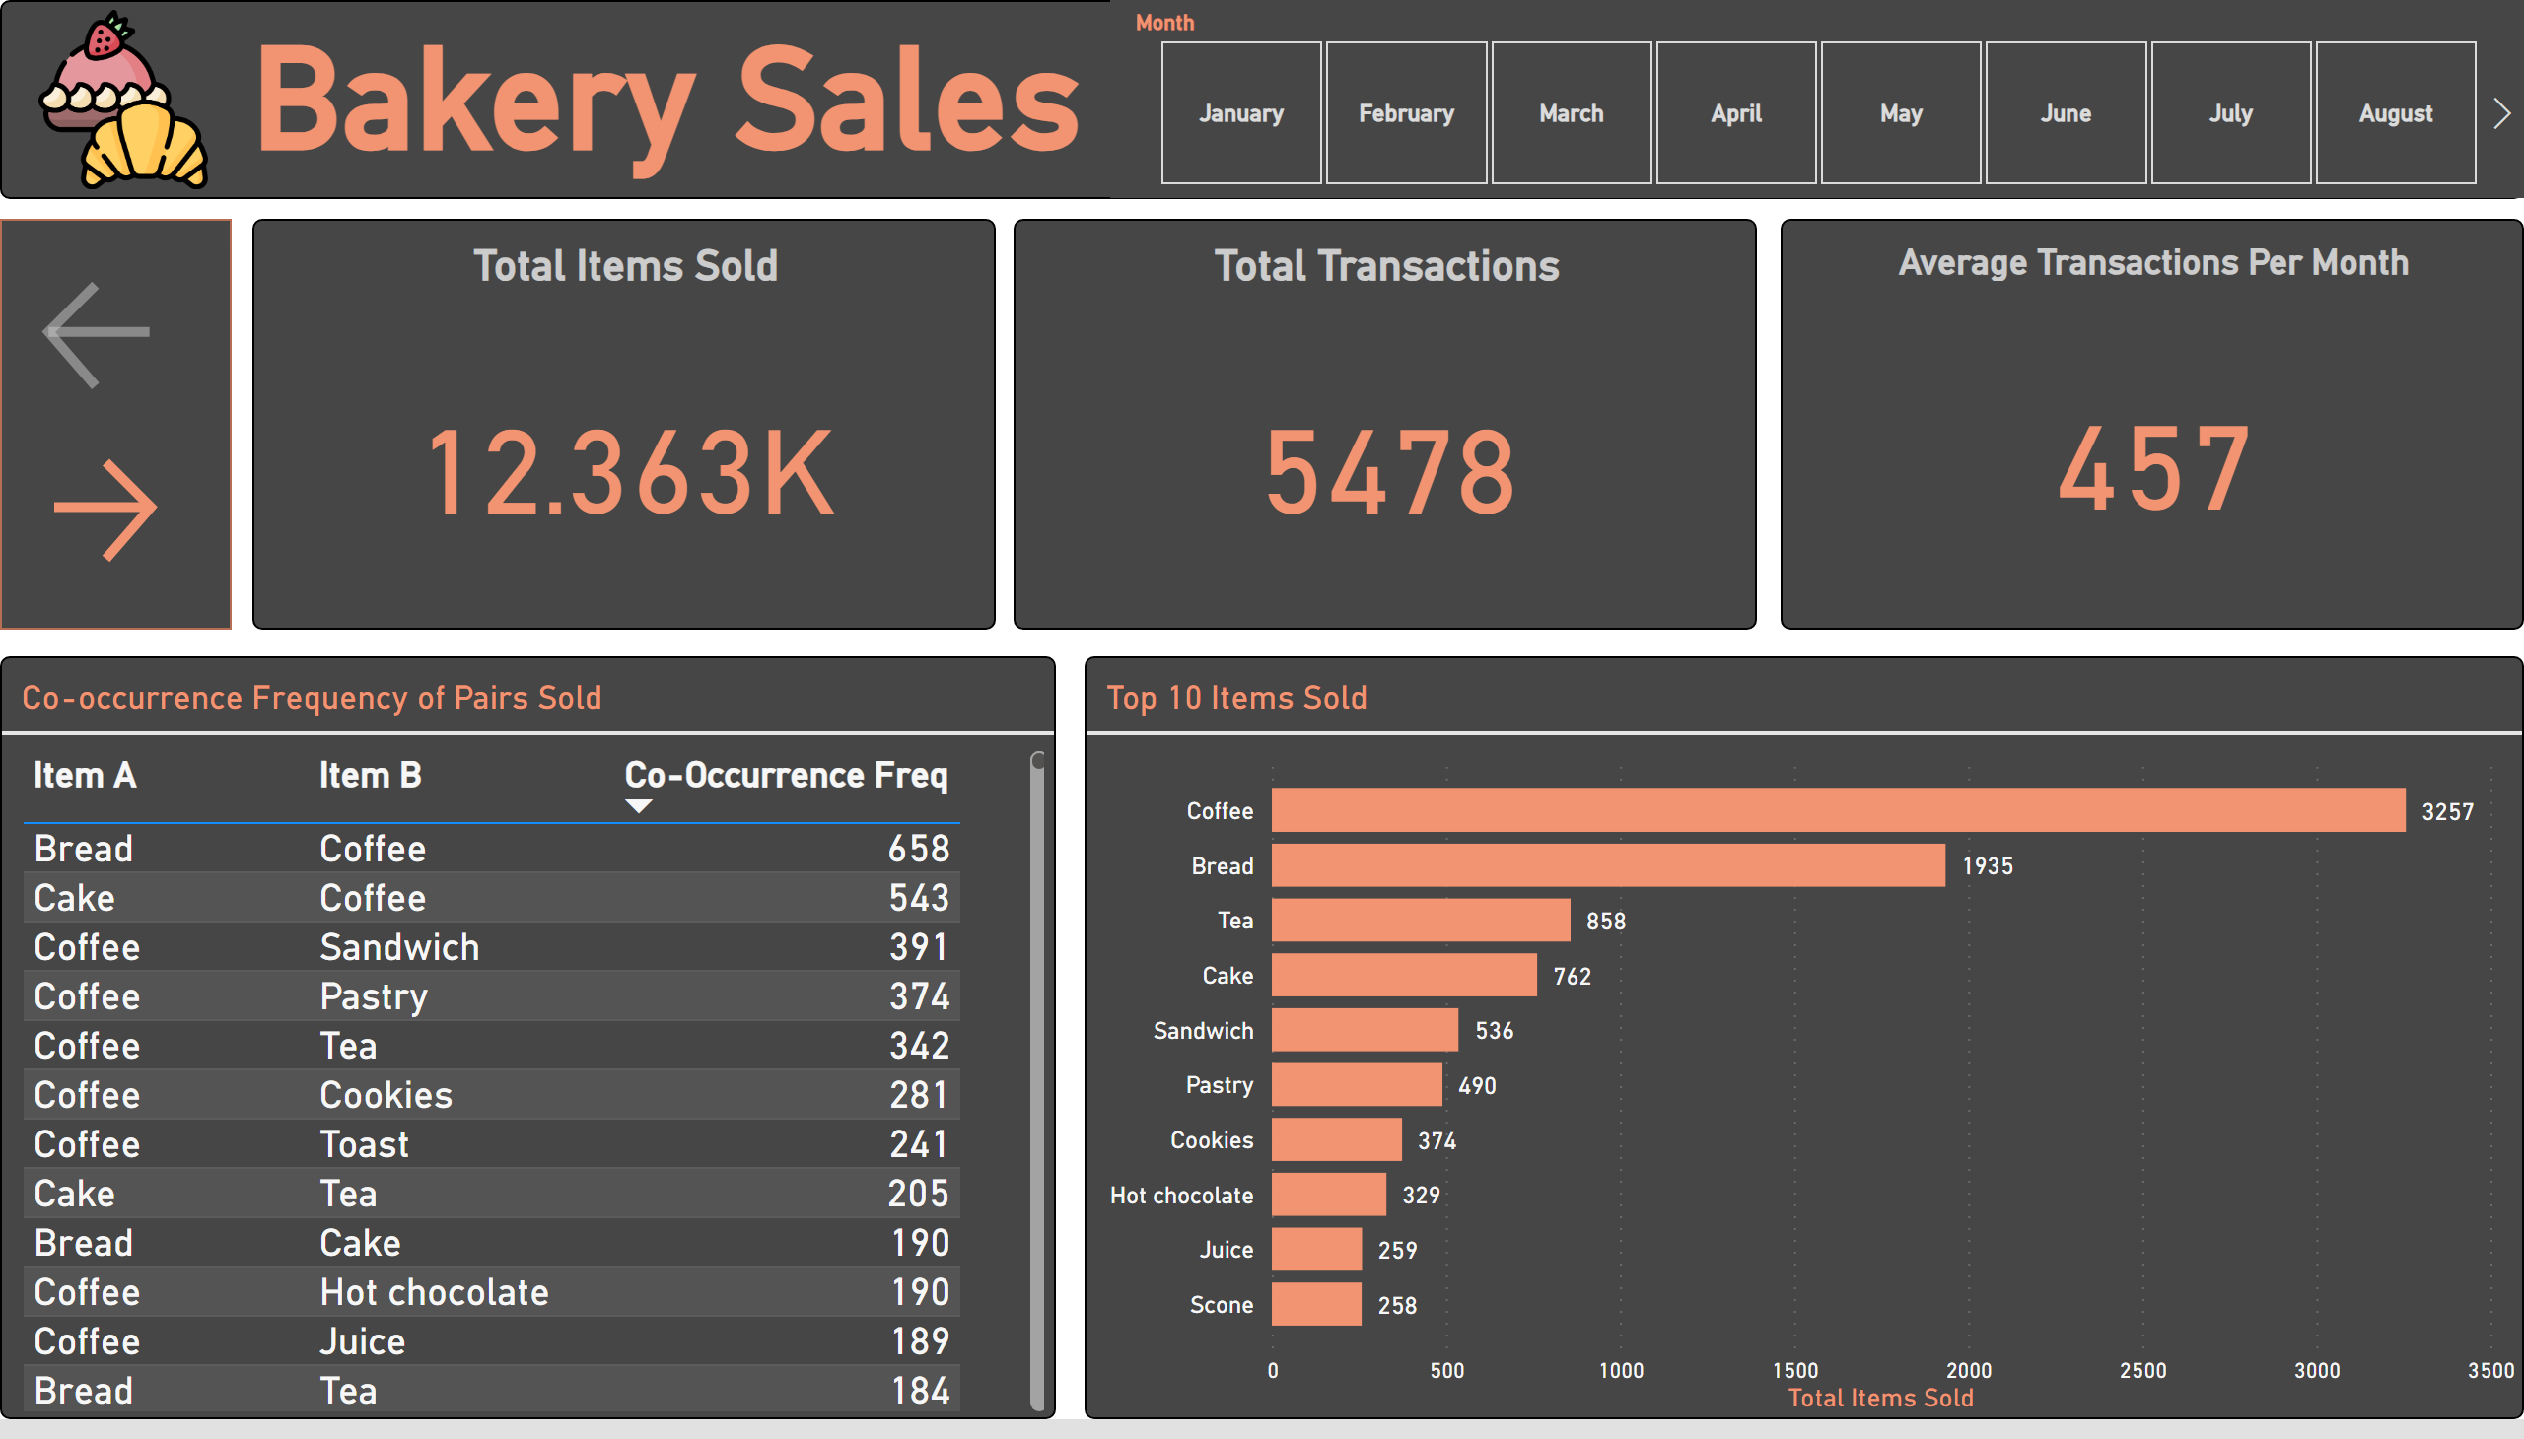
Overview
Notes:
slicer
No alt text provided
Co-occurrence Frequency of Pairs Sold
No alt text provided
textbox
No alt text provided
Total Items Sold
No alt text provided
image
No alt text provided
Total Transactions
No alt text provided
Top 10 Items Sold
No alt text provided
Average Transactions Per Month
No alt text provided
actionButton
No alt text provided
actionButton
No alt text provided
shape
No alt text provided

Slide 3
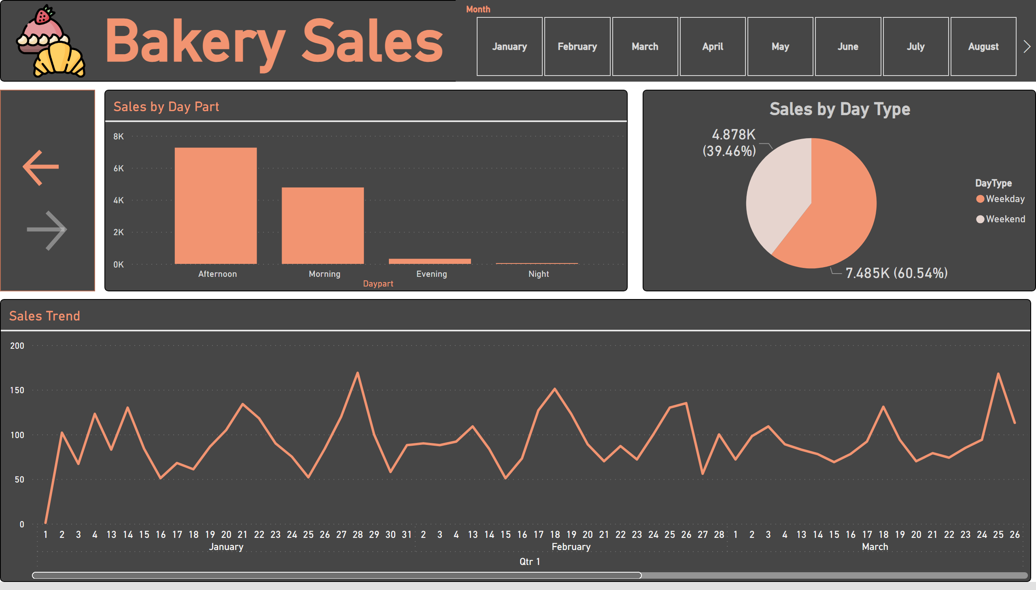
Time
Notes:
slicer
No alt text provided
Sales by Day Part
No alt text provided
textbox
No alt text provided
Sales by Day Type
No alt text provided
image
No alt text provided
Sales Trend
No alt text provided
shape
No alt text provided
actionButton
No alt text provided
actionButton
No alt text provided

