Slide 1



sales_dashboard
View in Power BI
Last data refresh:
9/1/2023 10:36:47 PM UTC
Downloaded at:
9/2/2023 9:03:18 AM UTC

Slide 2
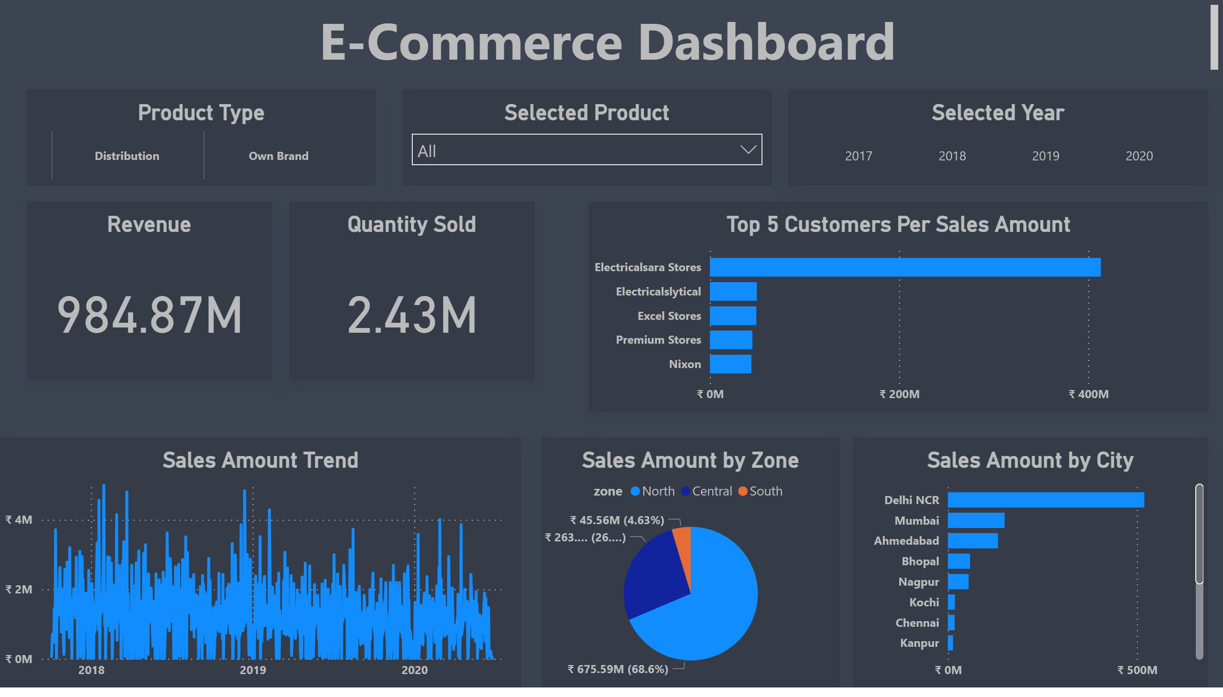
Dashboard
Notes:
Revenue
No alt text provided
Quantity Sold
No alt text provided
Selected Year
No alt text provided
textbox
No alt text provided
Sales Amount Trend
No alt text provided
Top 5 Customers Per Sales Amount
No alt text provided
Sales Amount by City
No alt text provided
Sales Amount by Zone
No alt text provided
Product Type
No alt text provided
Selected Product
No alt text provided

