Slide 1
Cybersecurity In The Healthcare Industry: Protect Patient Data
By: Sahm Ahmed

Slide 2
Why Cybersecurity in Healthcare Matters
The healthcare industry is undergoing a massive digital transformation—from paper charts to Electronic Health Records, online portals, and telehealth services.
Many healthcare systems run on outdated software or lack proper cybersecurity measures, making them easy targets.
Sensitive data such as medical histories, insurance numbers, diagnoses, and even Social Security numbers are now stored and shared online.
Cyberattacks in healthcare can lead to life-or-death situations—like delayed surgeries, missed diagnoses, and canceled appointments.
Cybercriminals are increasingly targeting hospitals, clinics, and insurance providers because healthcare data is incredibly valuable—and harder to replace than credit card numbers.
Cybersecurity in healthcare isn’t just about protecting computers—it’s about protecting people’s lives, privacy, and peace of mind.

Slide 3
The Value of Patient Information
Health records contain a full picture of a person’s life—name, date of birth, address, diagnoses, prescriptions, billing info, and even Social Security numbers.
Unlike credit card info, medical records can’t be canceled or reissued. Once leaked, that information is out there for life.
A single electronic health record can sell for $250–$1,000 on the dark web, compared to just $5–$10 for a credit card.
Hackers may also use medical records to access other services—banking, government benefits, or even impersonate patients for care.
Victims often don’t discover the fraud for months, and it can take years to fix.
They can steal identities and open fraudulent credit lines, File fake insurance claims or obtain prescription drugs

Slide 4
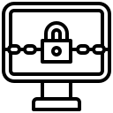
Common Cybersecurity Threats in Healthcare
Insider threats
Ransomware
📧
Phishing attacks
Outdated systems

Slide 5
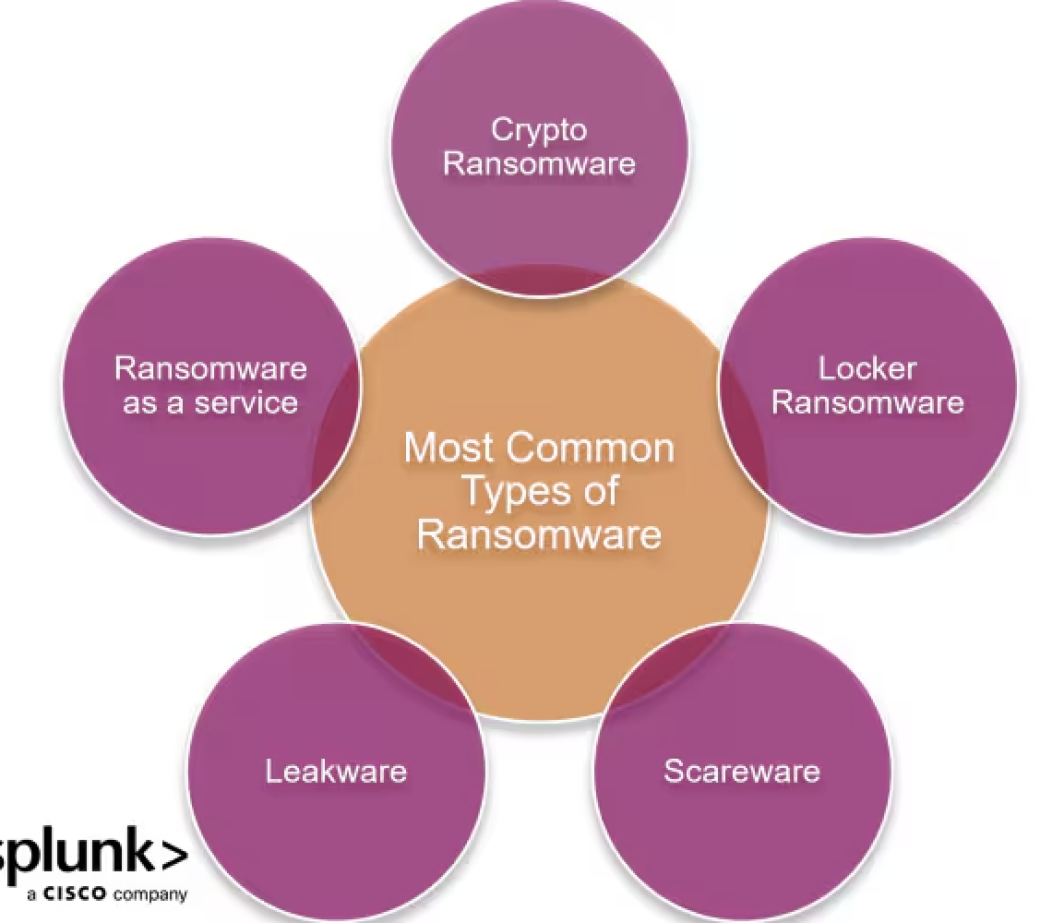
Ransomware
Malicious software that encrypts hospital systems and demands payment (often in cryptocurrency) to restore access.
Can shut down access to patient records, delay surgeries, and disrupt emergency services.
Example: UVM Medical Center (2020) and WannaCry (2017) affected thousands of patients.

Slide 6
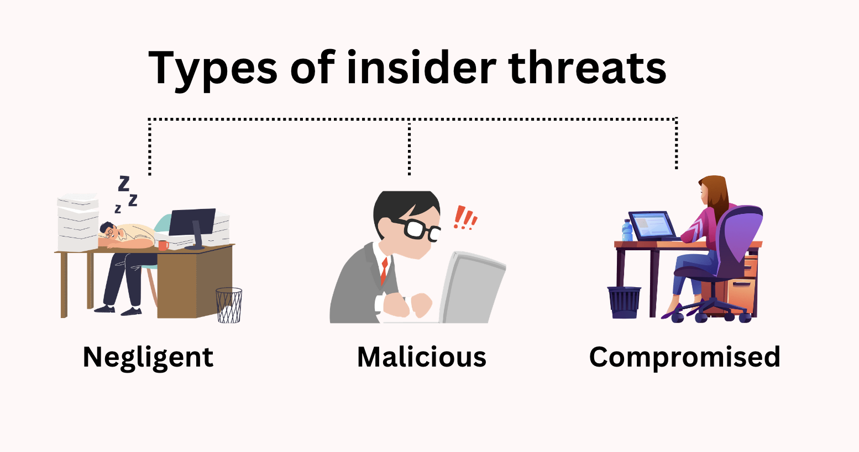
INSIDER THREATS
Breaches caused by employees, either accidentally (e.g., clicking a bad link) or intentionally (e.g., stealing data).
Often overlooked, but insider threats are just as dangerous as external hackers.
Even temporary staff or contractors can cause damage if not properly trained.

Slide 7
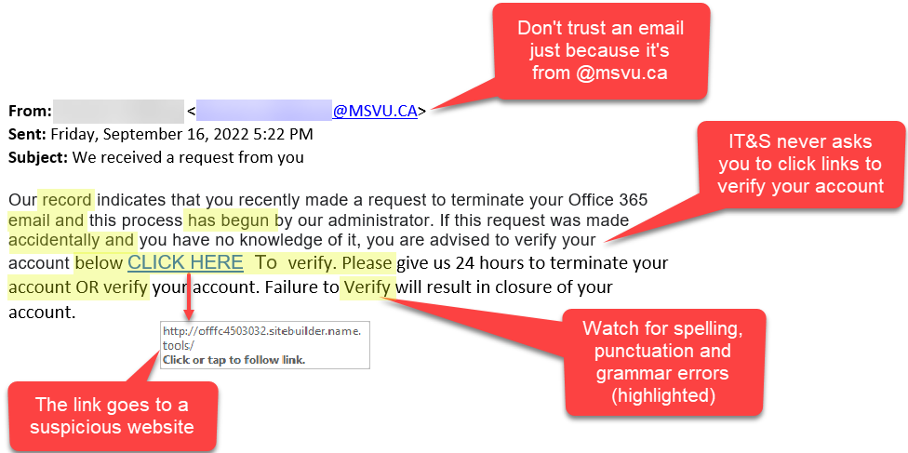
Phishing Attacks
Fake emails or messages that trick staff into clicking malicious links or downloading infected files.
Once clicked, attackers can gain full access to internal systems.
Healthcare staff are often targeted because of their fast-paced environments and large email volumes.

Slide 8
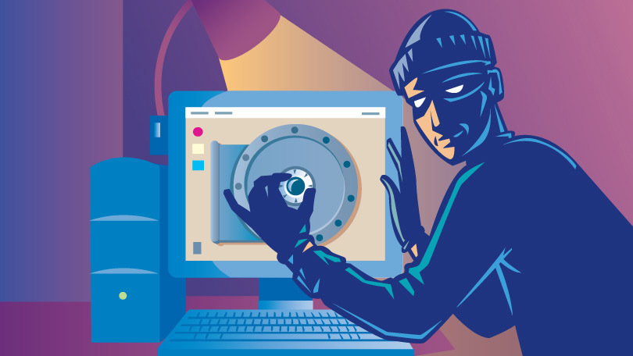
Outdated Systems
Many hospitals still rely on old technology or unsupported software that doesn’t receive security updates.
These “legacy systems” are easy for hackers to exploit.
Budget constraints and the need to avoid downtime often delay system upgrades.

Slide 9
Real-Life Case Studies
Anthem Inc. (2015) | One of the largest healthcare breaches in U.S. history. Hackers accessed personal info of 80 million people—including names, SSNs, and employment data. Resulted in $115 million in settlement costs.
WannaCry (2017) | A global cyberattack that hit over 150 countries. The UK’s National Health Service (NHS) was heavily affected—hospitals had to cancel 19,000 appointments and shut down entire systems.
UVM Medical Center (2020) | A ransomware attack paralyzed hospital systems for nearly a month. Forced staff to switch back to paper charts and delayed cancer treatments. Estimated financial loss: $63 million.

Slide 10
The Consequences of Cybersecurity Breaches
Delayed Surgeries and Treatments
Legal and Financial Consequences
Exposed Patient Privacy
Loss of Public Trust

Slide 11
Laws That Protect Patient Data
HIPAA (Health Insurance Portability and Accountability Act)
Requires healthcare providers to secure electronic records (ePHI) through physical, administrative, and technical safeguards.
HITECH (Health Information Technology for Economic and Clinical Health Act)
Increased penalties for data breaches and made notification to patients mandatory.

Slide 12
Cybersecurity Best Practices
01
02
03
04
Staff training and awareness
Multi-Factor Authentication (MFA)
Encrypting all data
Updating outdated software

Slide 13
Telehealth = New Risks
Millions of people began using telehealth for doctor visits, therapy, and prescriptions due to COVID-19
Apps that don’t use end-to-end encryption can leak conversations and medical data.
Cybercriminals now target smartphones, home Wi-Fi, third-party video platforms, and even fitness trackers.
As telemedicine grows, so must the cybersecurity efforts behind it—or patient safety will suffer.

Slide 14
Thank you!
Cybersecurity in healthcare is about more than just protecting data—it’s about protecting lives. A single breach can delay treatments, expose private information, and damage trust. As healthcare continues to evolve with new technologies like telemedicine and AI, our defenses must grow too. Investing in secure systems and staff training is essential. At the end of the day, the mission to “do no harm” must include keeping patient data safe.

