Slide 1
Pleione
Content provider: None: Pleione is a player and ships no content; the test account serves synthetic test media made for this review

Slide 2
Revision History
Version | Date | Description | Author | Related App Version
1.0 | 2026.11.03 | First submission | Merope | 2.2.1

Slide 3
Contents
UI Structure
Use Cases
Menus and Functions
Remote Control Keys
Language Options

Slide 4
UI Structure
Depth Navigation
1st depth
2nd depth
3rd depth
4th depth
Home
Live
(channel list)
Live player (full screen)
RED / Guide
Guide
Catch-up player
Movies
Movie detail
Movie player
Series
Series detail
Episode player
Search
Search results
A channel or program plays;
a movie or series opens its detail page
Settings
General
Sources
Program Guide
Appearance
Playback
Online Subtitles
Advanced
Data Management
RETURN on Home
Exit confirmation
(Exit Pleione?)
Exit closes the app; Cancel or RETURN stays on Home
OK opens the next level
RETURN goes back one level along every arrow; on Home it opens the exit confirmation

Slide 5
Contents
UI Structure
Use Cases
Menus and Functions
Remote Control Keys
Language Options

Slide 6
Use Cases – Test Account
Pleione ships no content. Every use case uses this test account, which serves synthetic test media made for this review: about 150 live channels in Group 1 to Group 8 and Group HD, a program guide for the past three days and the next two, movies and series.
To add the test account:
  ​On first launch, Home shows Welcome to Pleione with Add Xtream account (selected) and Add M3U playlist. Press OK on Add Xtream account.
  ​Settings opens on Sources with a new account under Xtream Accounts. Press OK on each field, type with the on-screen keyboard, and press DOWN to the next: Label "Test", then Server URL, Username and Password from the table below. Leave Live stream format on TS (compatible).
  ​Select Check: the account shows Active. Select Save Changes: Home opens with Live, Movies, Series, Search and Settings.
Server URL | Login | Password
[Server URL] | [Username] | [Password]
Channel Alpha (number 1) has catch-up. Movie A has two audio tracks (Track 1, Track 2) and several subtitle tracks. Group HD holds the resolution test streams.

Slide 7
Use Cases – Home
Samsung remotes have no pointer: every step uses the remote keys, and each screen opens with an item selected.
  ​Home shows the app name, the clock, the account’s initial in a circle at the top right, and the cards Live, Movies, Series, Search and Settings, with Live selected.
  ​Use the arrow keys to move between the cards. UP reaches the account circle (Switch account), which lists the accounts added.
  ​Press OK on a card to open that section. RETURN from any section comes back to Home, with that section’s card selected.
  ​Press RETURN on Home: Exit Pleione? appears with Exit and Cancel (see Use Cases – Leaving the App).

Slide 8
Use Cases – Live TV and the Guide
Live
  ​On Home, select Live: the groups on the left (All, Favorites, Recently Watched, Group 1 …), the channels with their current and next program, and a preview on the right.
  ​Press DOWN through the channels: the preview plays the selected one. Press LEFT to the groups, DOWN to Group 2, then OK: the list shows that group.
  ​Press GREEN on a channel to add it to Favorites; press GREEN again to remove it.
  ​Press OK to watch full screen. UP/DOWN or CH +/− change channel; number keys tune a channel. RETURN goes back to Live with that channel selected.
The Guide
  ​In Live, press RED (or UP to the Guide button and OK): channels in rows, programs on a timeline. Arrows move between channels and through time.
  ​OK on the program on air plays the channel. OK on a future program sets a reminder ("Reminder set", a bell); OK again removes it. The reminder appears while Pleione is open; with Pleione closed, it appears when Pleione opens while the program is still on air.
  ​Catch-up: on Alpha (1), press LEFT into the past and OK: the program plays from its start. RETURN goes back to the Guide; RED returns to the list.

Slide 9
Use Cases – Player Controls
Live TV
  ​Play Alpha and press OK (or INFO or YELLOW): the controls show the channel name and number, NOW and NEXT, the program’s progress, Toggle Favorite and Channel Info; Audio Track and Subtitles appear when the stream has tracks to choose.
  ​LEFT/RIGHT move between the buttons and OK presses one. UP hides the controls.
  ​Live TV plays at the live point: on Samsung TVs it does not pause or rewind, and PLAY/PAUSE shows the controls.
  ​RETURN hides the controls; RETURN again stops playback and returns to Live.
Movies, episodes and catch-up programs
  ​Play Movie A. LEFT/RIGHT or REWIND/FAST FORWARD skip back and forward; OK or PLAY/PAUSE pauses and resumes.
  ​UP or DOWN shows the controls with the seek bar selected. DOWN reaches Play from start, Play/Pause, Audio Track and Subtitles (for a series, Previous episode and Next episode).
  ​Audio Track: choose Track 2. Subtitles: choose Track 3, then Off; Subtitle Sync shifts them with LEFT/RIGHT.
  ​RETURN hides the controls; RETURN again stops playback and returns to the detail page.

Slide 10
Use Cases – Movies and Series
  ​From Home, select Movies: a preview of the selected title above rows of posters (Continue Watching once something has played, then one row per category, ending in See all).
  ​Press OK on Movie A: its detail page shows the year, length, genre, rating and plot, Play and Watchlist, and the Cast and More like this rows.
  ​Select Watchlist: "Added to Watchlist". Select it again to remove the title.
  ​Select Play; after a minute, press RETURN (twice if the controls show). The page now offers Resume and Play from start, and the title is in Continue Watching.
  ​To take a title out of Continue Watching, hold OK on it for a second and select Remove from Continue Watching; RETURN closes the menu.
  ​From Home, select Series, then OK on Series A: Play, the Season 1 … buttons and the episodes. Choose a season and press OK on an episode to play it; afterwards the page offers Resume S1E1.

Slide 11
Use Cases – Search
  ​From Home, select Search: the search box is selected.
  ​Press OK, type Bravo with the on-screen keyboard and confirm: results appear in rows by type, Channels and Programs. Type Movie instead to see Movies and Series.
  ​Press DOWN into the results. OK on a channel plays it; on a movie or series, opens its detail page; on a program, watches it live, plays its catch-up or sets a reminder.
  ​RETURN from the results goes back to the search box; RETURN again goes Home.
  ​Open Search again: Recent searches lists the last searches.

Slide 12
Use Cases – Settings
  ​From Home, select Settings. The pages are on the left: General, Sources, Program Guide, Appearance, Playback, Online Subtitles, Advanced, Data Management. RIGHT enters a page and LEFT returns to the list.
  ​Save Changes applies the changes and Cancel discards them. RETURN closes an open list first, then goes Home.
Parental controls
  ​Settings › General › Parental controls: select Turn on. Enter a PIN (for example 1234) with the number keys, then again to confirm.
  ​Under What to lock, select Group 2 and press OK: it shows Locked. In Options, set Ask for PIN again to Every time.
  ​Go Home and open Live: Group 2 shows a lock. OK on one of its channels asks for the PIN; a wrong PIN shows "Incorrect PIN. Try again."; 1234 plays the channel.
  ​To turn them off: Parental controls › Manage, enter the PIN, then in Options turn off Use parental controls.

Slide 13
Use Cases – Leaving the App
  ​RETURN goes up one level: from full-screen playback to the screen it started from, from the Guide to the groups, from a detail page to its catalog, from search results to the search box, and from a section to Home.
  ​RETURN on Home asks Exit Pleione?: Exit closes the app; Cancel or RETURN stays.
  ​The remote’s EXIT key closes Pleione at once. HOME leaves it running in the background; opening Pleione again returns to where it was.
  ​Relaunching keeps the account, favorites, reminders and playback progress. Settings › Data Management › Reset App returns the app to its first-launch state.

Slide 14
Use Cases – Resolution and Network
Group HD, after Group 8 in Live and after the last numbered group in Movies, checks playback at each resolution. Each picture shows its resolution.
  ​Live › Group HD: HD 720p (1280 × 720), Full HD 1080p (1920 × 1080) and Adaptive 360p-1080p (HLS: 360p, 720p, 1080p).
  ​Movies › Group HD: HD Movie 720p, Full HD Movie 1080p and UHD Movie 2160p (3840 × 2160).
  ​Play each item full screen. Channel Info in the live controls shows the resolution.
  ​Adaptive: in Settings › Sources, set the account’s Live stream format to HLS (m3u8) or Auto, select Save Changes, and play Adaptive 360p-1080p again: it steps between its variants with the network speed. On TS (compatible) it plays only 360p.
  ​Network loss: unplug the network while a channel plays. "Reconnecting…" shows and the player retries; when the network returns, playback resumes. A movie resumes where it stopped, or after three tries an error stays on screen until RETURN.
  ​A server that cannot be reached at launch shows "Can’t connect to Test" on Home with Try again and Edit account.

Slide 15
Contents
UI Structure
Use Cases
Menus and Functions
Remote Control Keys
Language Options

Slide 16
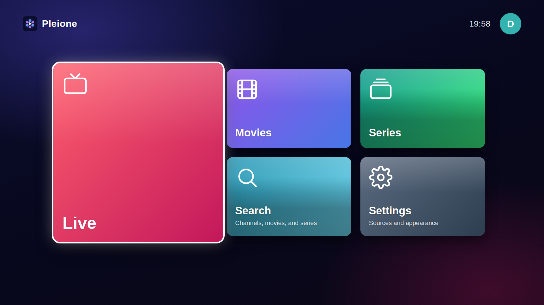
Menus and Functions
Home
The first screen: one card per section. The arrow keys move between them and OK opens one.
6
No. | Description
1 | Live: the channel list, preview and Guide
2 | Movies catalog
3 | Series catalog
4 | Search channels, programs, movies and series
5 | Settings: language, parental controls, sources and appearance
6 | Clock
7 | Switch account: the accounts added (UP from the cards)
7
1
2
3
4
5

Slide 17
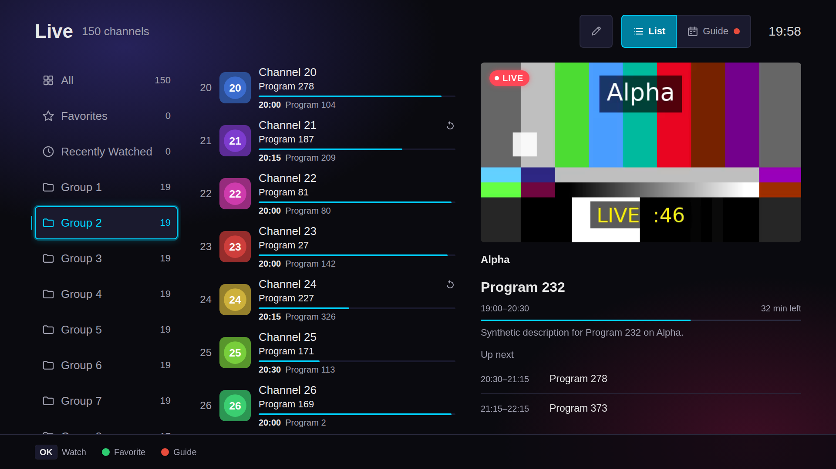
Menus and Functions
Live
The channel list. The preview plays the selected channel; OK watches it full screen.
5
No. | Description
1 | Groups: All, Favorites, Recently Watched, Group 1 …
2 | Channels with the current program, its progress and the next program
3 | Preview of the selected channel
4 | Program details and Up next
5 | Edit Channel List (YELLOW)
6 | List and Guide views (RED)
7 | Key guide: OK Watch, GREEN Favorite, RED Guide
2
6
1
3
4
7

Slide 18
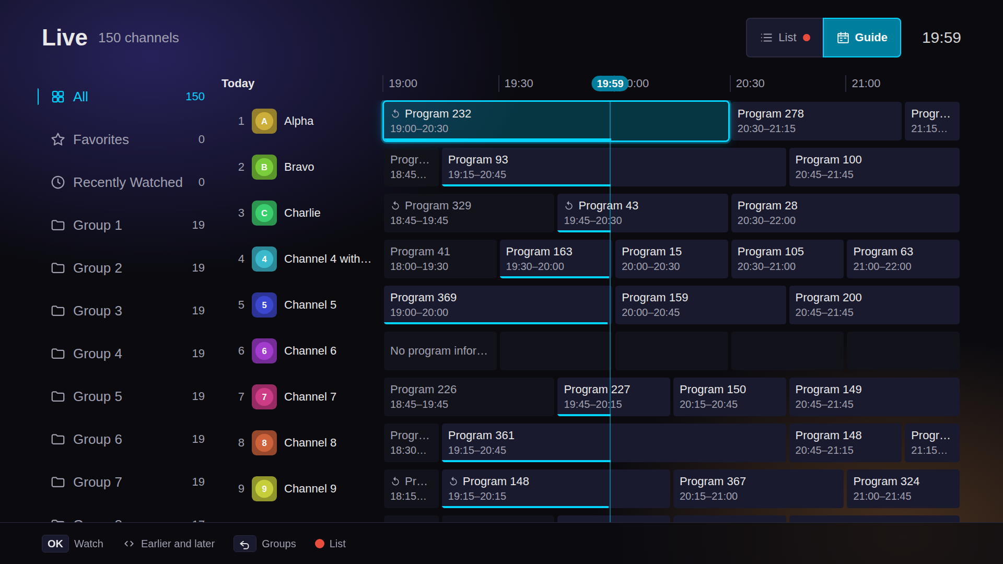
Menus and Functions
Guide
The program guide inside Live: channels in rows, programs on a timeline.
No. | Description
1 | Groups (RETURN moves here)
2 | Channel number, logo and name
3 | Timeline with the current time
4 | Selected program; OK watches it, sets a reminder, or plays its catch-up
5 | Catch-up mark: past programs can be played
6 | Current-time line
7 | List and Guide views
8 | Key guide: OK, Earlier and later, Groups, RED List
1
3
7
2
4
5
6
8

Slide 19
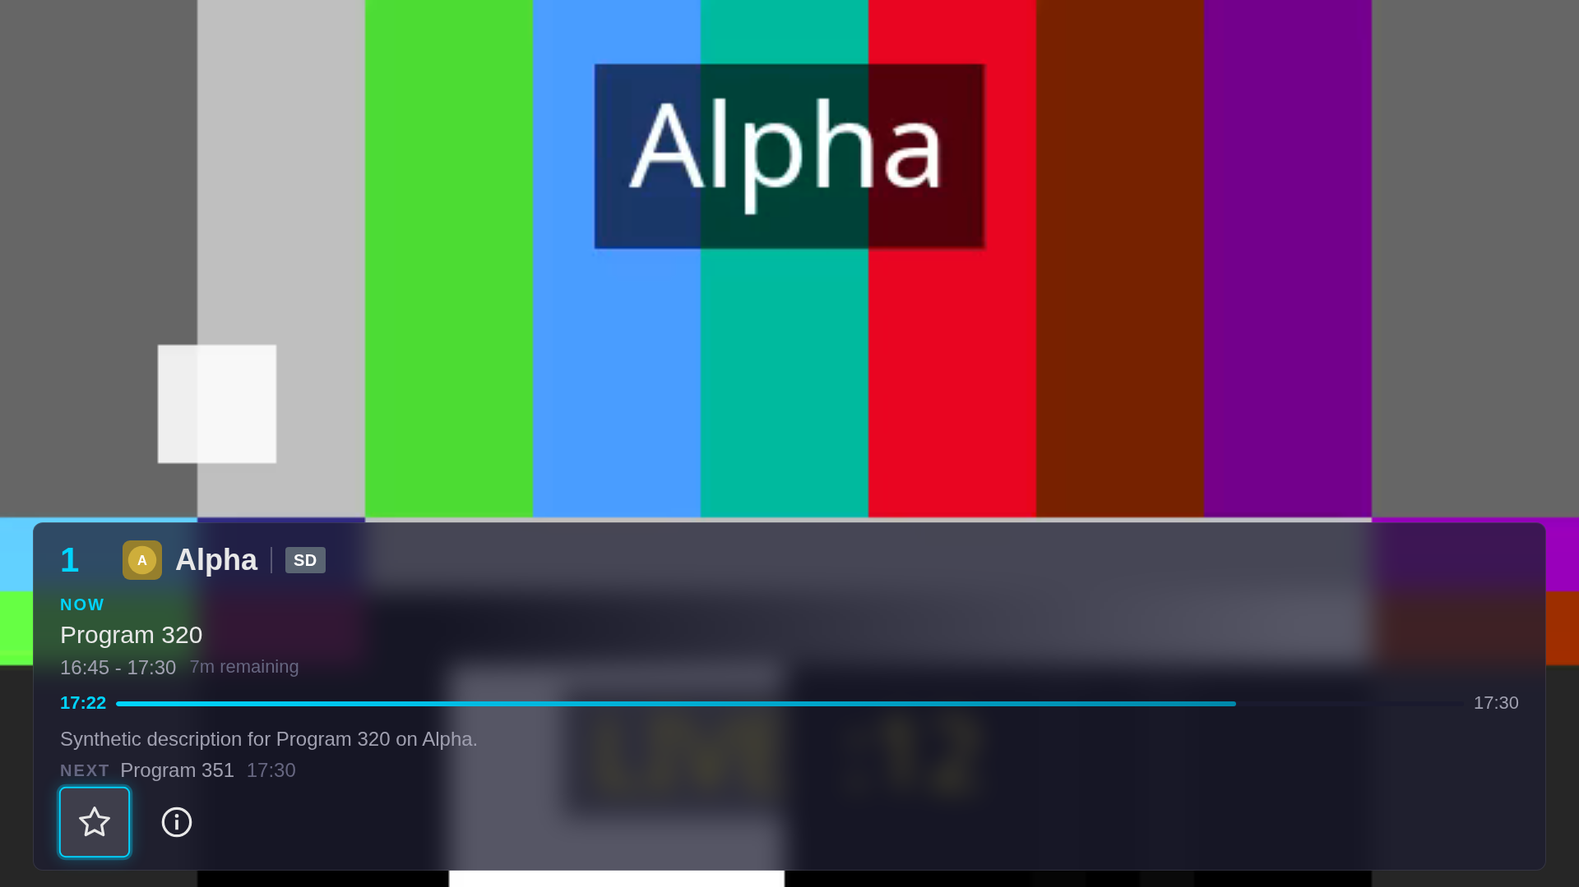
Menus and Functions
Player
Live TV with the controls shown. Live plays at the live point, so there is no seek bar.
No. | Description
1 | Channel number, logo and name, and the stream’s resolution
2 | NOW: the program on air, its time and the time remaining
3 | Program progress, from now to its end time
4 | Program description and the NEXT program
5 | Toggle Favorite and Channel Info buttons
1
2
3
4
5

Slide 20
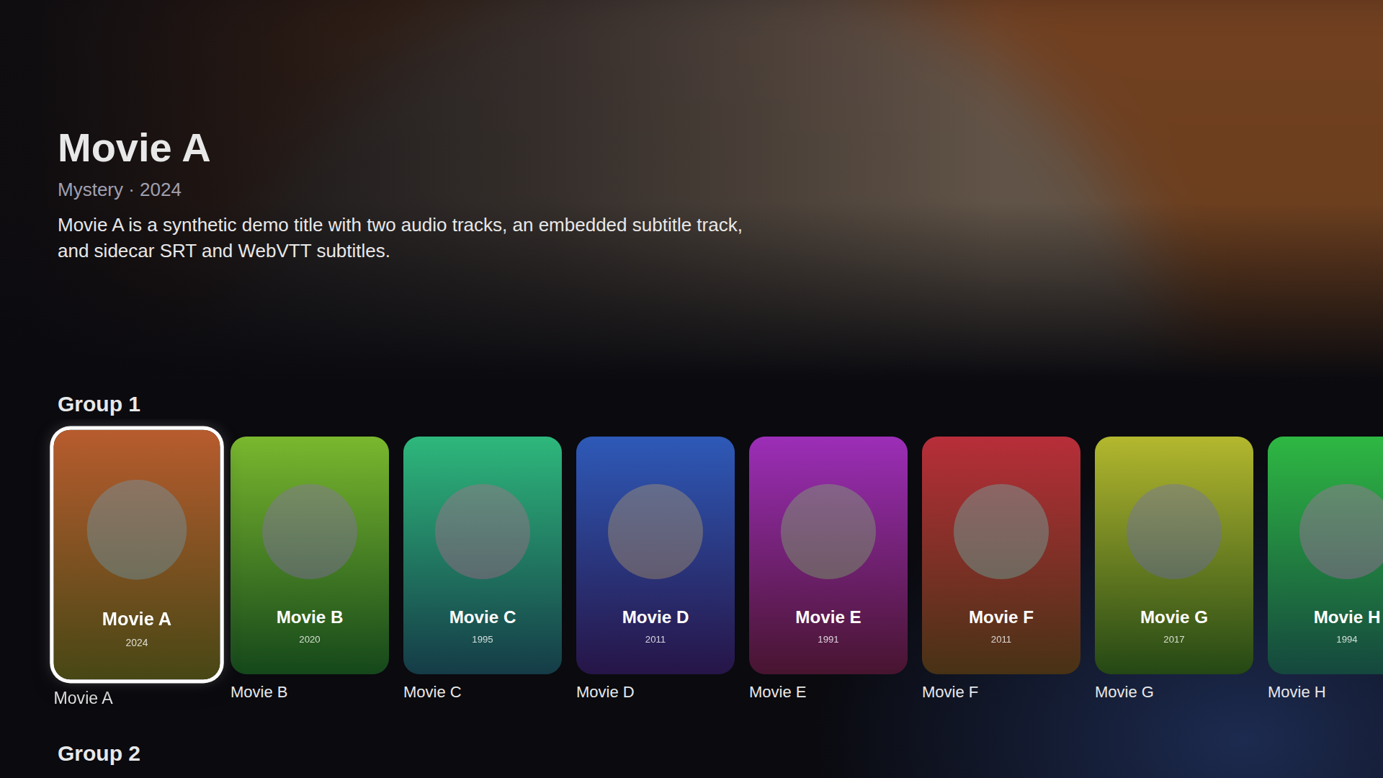
Menus and Functions
Movies
The movie catalog: a preview of the selected title above one row of posters per category.
No. | Description
1 | Preview of the selected title: genre, year and plot
2 | Category row
3 | Selected title; OK opens its detail page
4 | Next category (DOWN)
1
2
3
4

Slide 21
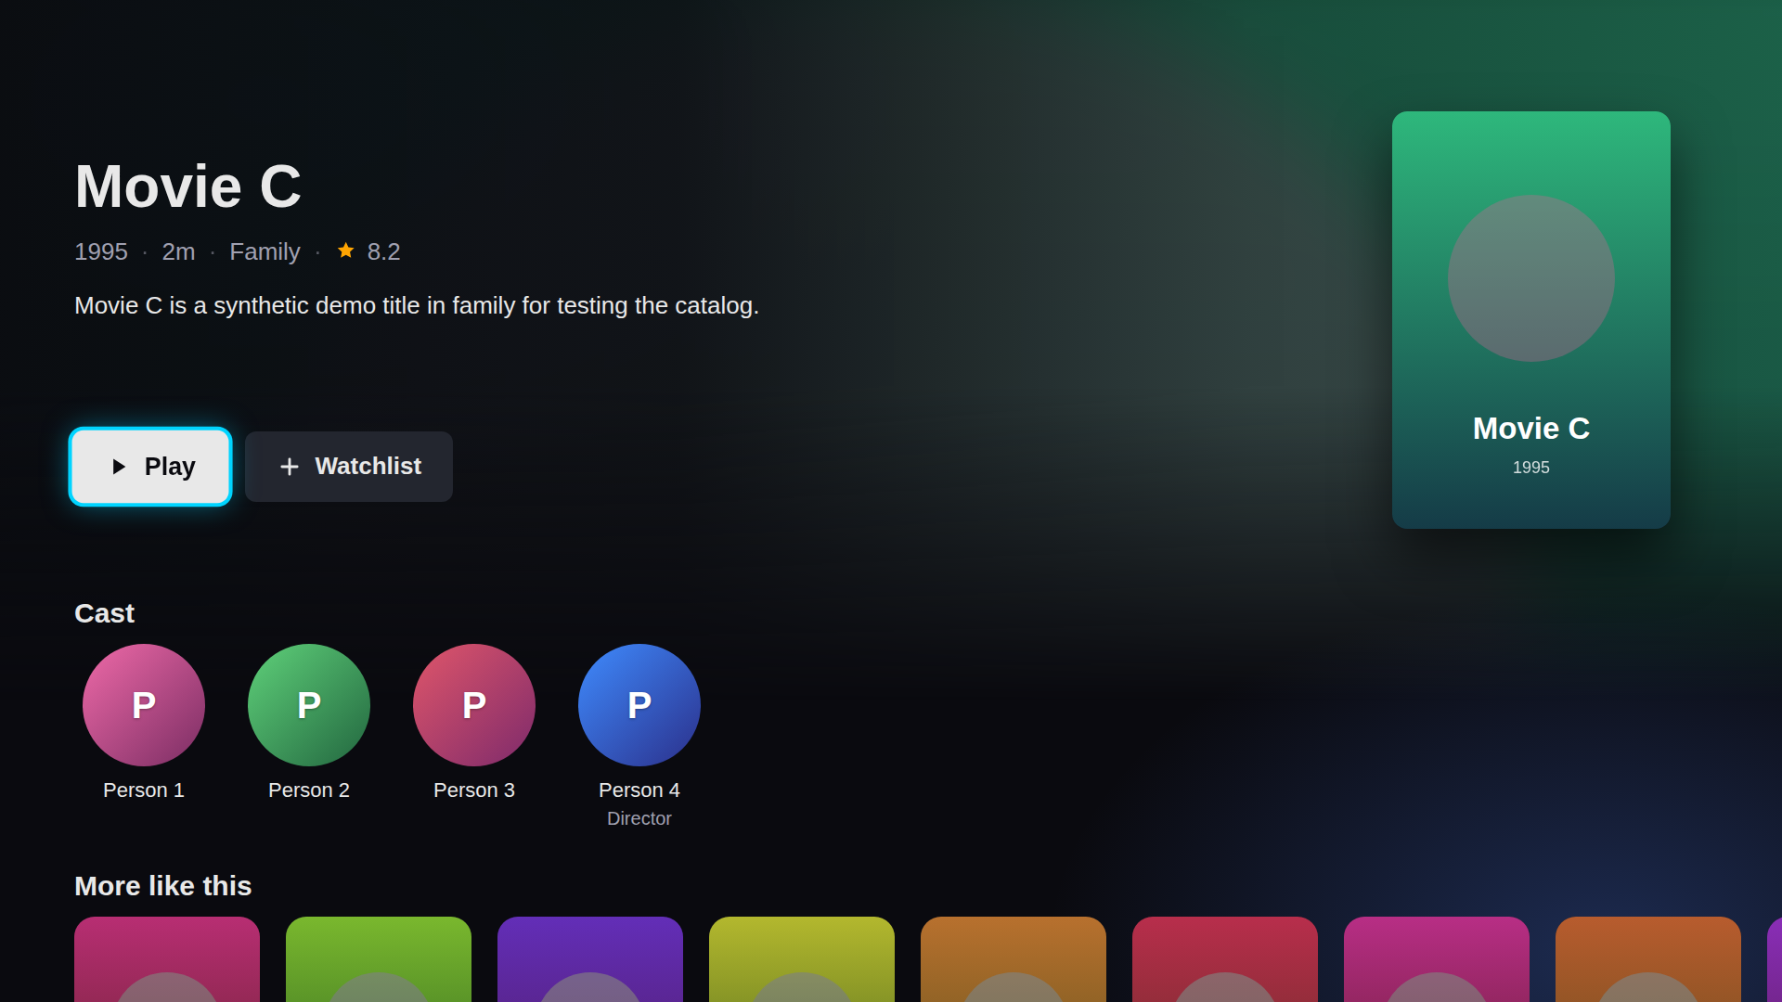
Menus and Functions
Movie Detail
A movie’s detail page, opened with OK on a poster.
No. | Description
1 | Title, year, length, genre and rating
2 | Plot
3 | Play (Resume and Play from start after a first play)
4 | Watchlist: add or remove the title
5 | Poster
6 | Cast
7 | More like this: OK opens that title
5
1
2
3
4
6
7

Slide 22
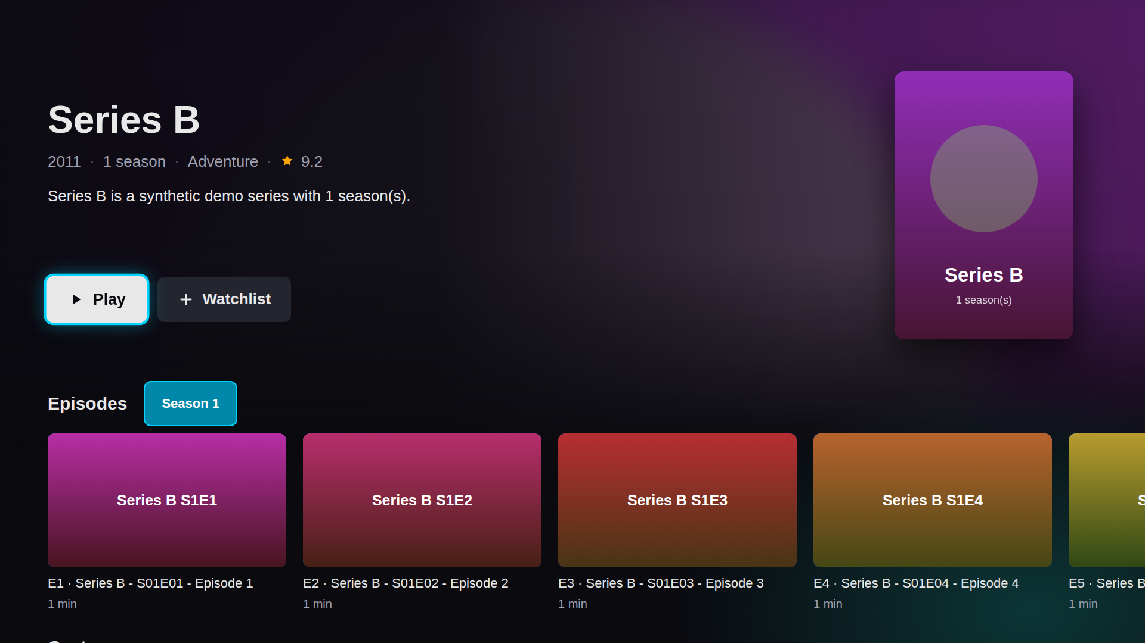
Menus and Functions
Series Detail
A series’ detail page, with its seasons and episodes.
No. | Description
1 | Title, year, seasons, genre and rating
2 | Play (Resume on the last episode watched)
3 | Watchlist: add or remove the series
4 | Season buttons
5 | Episodes of the selected season; OK plays one
6 | Episode number, title and length
7 | Poster
7
1
2
3
4
5
6

Slide 23
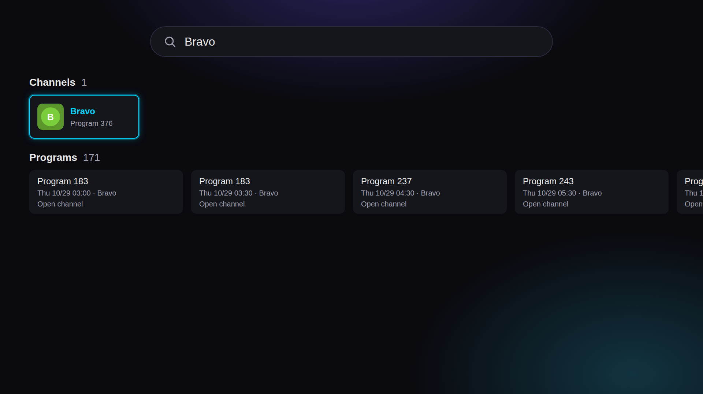
Menus and Functions
Search
Search results for "Bravo", in rows by type.
No. | Description
1 | Search box: OK opens the on-screen keyboard
2 | Channels found
3 | Channel result: OK plays it
4 | Programs found
5 | Program result: watch live, play its catch-up, or set a reminder
1
2
3
4
5

Slide 24
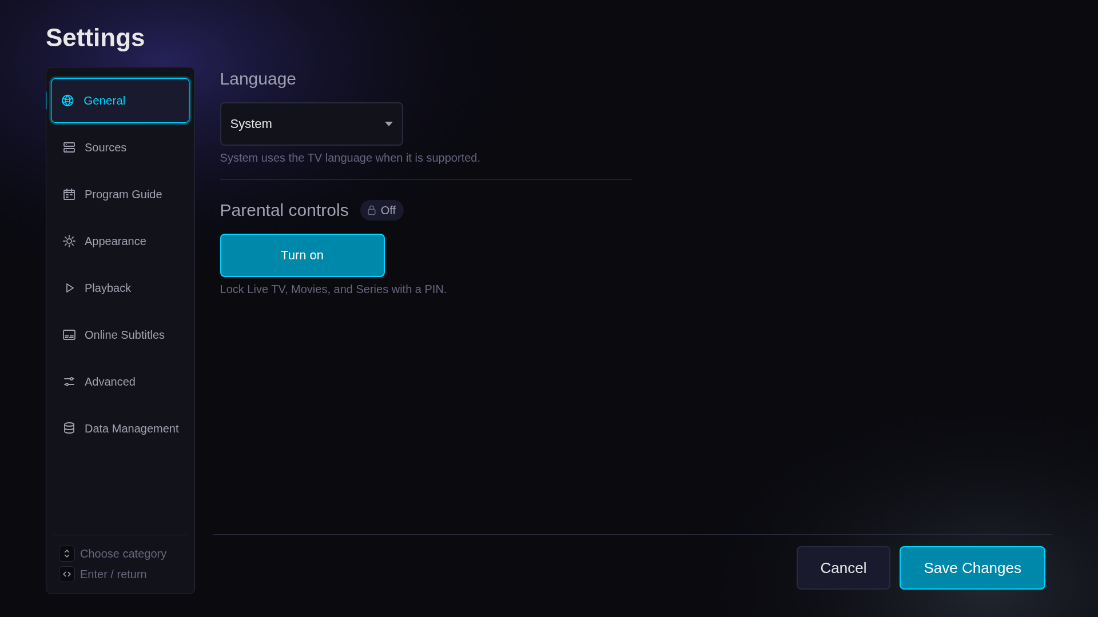
Menus and Functions
Settings
Settings on its General page. LEFT and RIGHT move between the page list and the page.
No. | Description
1 | Page list, with General selected
2 | Language
3 | Language list: System or one of 12 languages
4 | Parental controls and their status
5 | Turn on parental controls (a PIN)
6 | Key guide
7 | Cancel: discard the changes
8 | Save Changes: apply the changes
1
2
3
4
5
7
8
6

Slide 25
Contents
UI Structure
Use Cases
Menus and Functions
Remote Control Keys
Language Options

Slide 26
Remote Control Keys
RETURN and EXIT work as the TV defines them. Pleione maps these keys:
Key | Action | Remarks
RETURN | Move to previous page; on Home, asks Exit Pleione? (Exit / Cancel) | Mandatory. Not modified.
EXIT | Close the application | Mandatory. Not modified.
UP/DOWN/LEFT/RIGHT | Move the selection
ENTER (OK) | Select; while watching, show the player controls
PLAY/PAUSE | Pause or resume a movie, an episode or a catch-up program; on live TV, show the player controls | One key
PLAY, PAUSE, STOP | Play, pause, stop
REWIND, FAST FORWARD | Skip back or forward in movies and episodes
CHANNEL UP/DOWN | Change channel while watching live TV
INFO | Show the player controls while watching
GUIDE | Open the Guide; in the Guide, back to the channel list
0–9 | Tune a channel by its number
RED | Open the Guide, as GUIDE does
GREEN | Add or remove the selected channel from Favorites, in Live
YELLOW | Edit the channel list in Live; show the player controls while watching
BLUE | Open Settings

Slide 27
Remote Control Keys
The Smart Remote has no color or number keys of its own: its 123 button opens the on-screen keypad with them. Every color-key action also has a path with the arrows and OK alone:
Color key | The same with the arrows and OK
RED: Guide | The Guide button in Live’s header (UP from the list)
GREEN: Favorite in Live | OK to watch the channel, OK for the controls, then Toggle Favorite
GREEN: Favorite while watching | Toggle Favorite in the player controls
YELLOW: Edit the channel list | The Edit Channel List button in Live’s header (UP from the list)
YELLOW: Player controls | OK
BLUE: Settings | RETURN to Home, then Settings
Colors in the channel editor, favorites, parental controls and Live categories | The buttons in each screen’s footer, which take focus and OK

Slide 28
Contents
UI Structure
Use Cases
Menus and Functions
Remote Control Keys
Language Options

Slide 29
Language Options
Pleione supports 12 languages: English, Arabic, German, Spanish, French, Italian, Polish, Portuguese (Brazil), Russian, Turkish, Ukrainian and Simplified Chinese.
To switch the application language:
  ​From Home, select Settings. Settings opens on General.
  ​Press RIGHT into the page, then OK on the Language drop-down menu. Choose a language and press OK. System follows the TV language when Pleione supports it.
  ​Select Save Changes. The new language applies at once, with no restart. Arabic mirrors the interface right to left.
In every language but English the heading also reads "Language" (in German, "Sprache / Language"), so it can be found again.

