Slide 1
D210: Part-2 Data Dashboard And Storytelling
Ahmed Nouh

Slide 2

Ahmed Nouh
Background :
Senior Geophysicist.
13 years in Oil and Gas exploration.
MSDA student at WGU.
Data analyst in a popular telecommunications company.

Slide 3
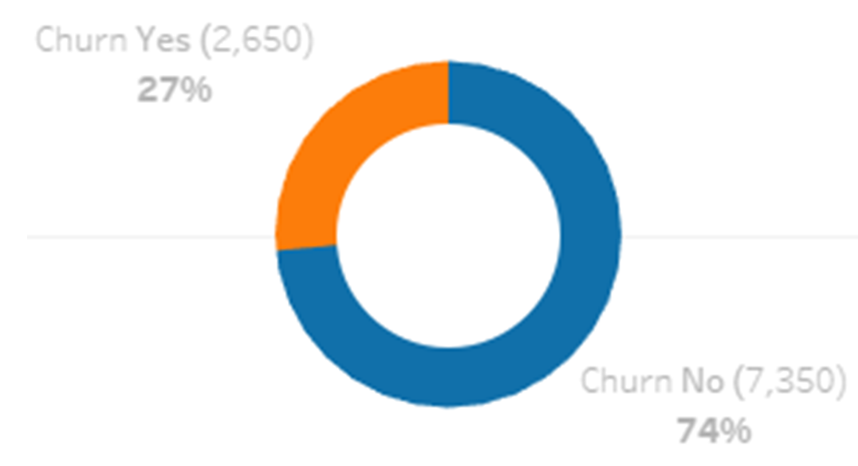
Summary Of Used Data Sets
1st Data Set
Churn_clean.csv , WGU Churn data set.
Consists of 10,000 customers and 50 columns.
Contains customers’ demographic information and services provided by the company.
The main purpose is to study the factors that cause customer churn.
About 27 % of all Customers have left the company until the last month !!

Slide 4
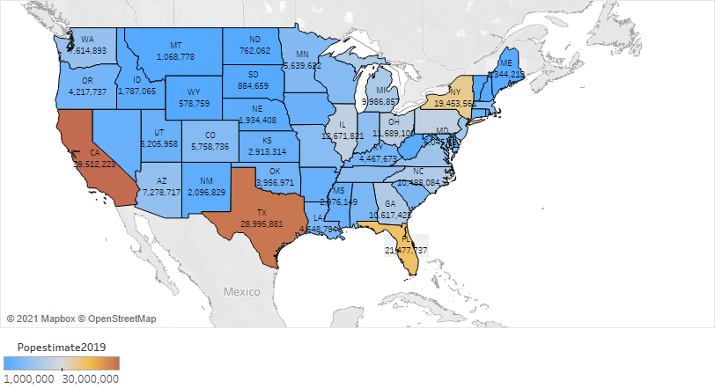
Summary Of Used Data Sets
2nd Data Set
USA population by state, 2019 census.
https://www.kaggle.com/peretzcohen/2019-census-us-population-data-by-state
Contains States names , the population of each state and coordinates.

Slide 5
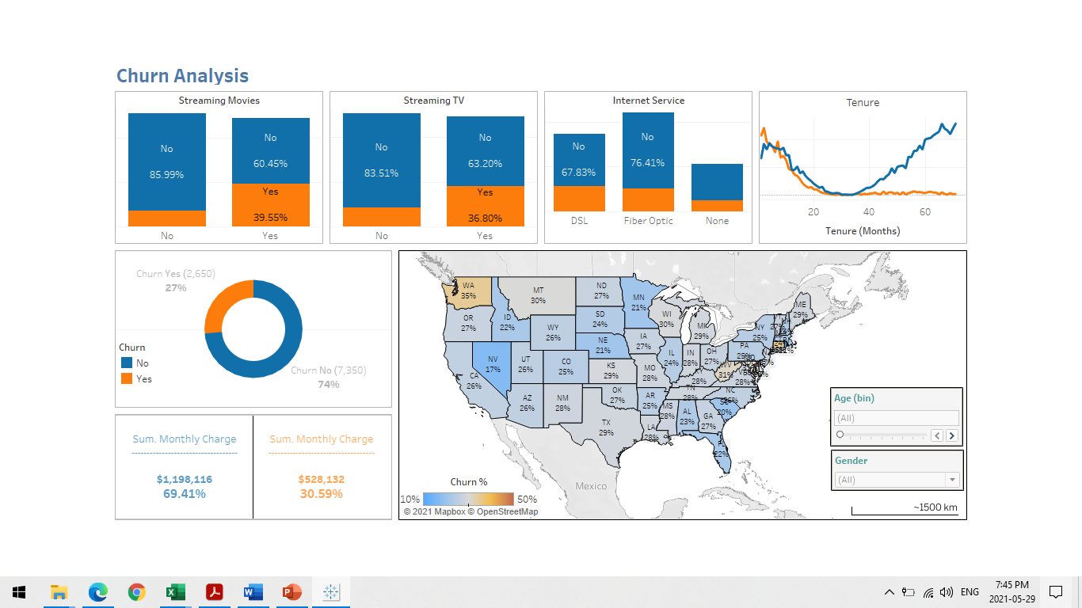
Outline Of Key Results
Until the last month , The Company has already lost :
27 % of Customers !!
30 % of the Total monthly charge !!

Slide 6
Outline Of Key Results
Data Representations
Some services increase the Churn probability !!
14 %

Slide 7
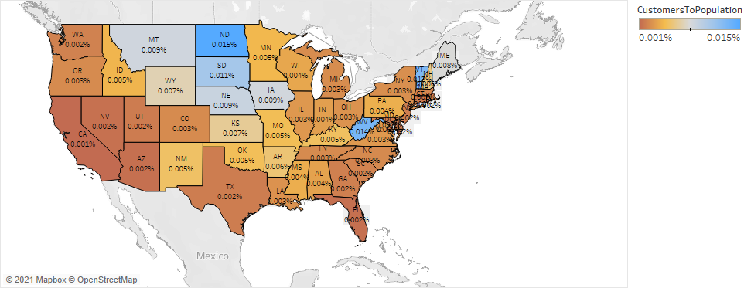
Outline Of Key Results
Great potential for acquiring new customers.
Percentage of Customers to State Population.

Slide 8
Summary Of Actionable Insights
Streaming TV , Streaming Movies and DSL internet service :
Customers who use Streaming TV , Streaming Movies and DSL internet services are more likely to churn.
These services should be reviewed and revaluated, as they negatively affect customer satisfaction.
Tenure :
Company must reconsider higher standards to ensure the satisfaction of new customers (newer than 35 months).

Slide 9

Thank You

