Slide 1
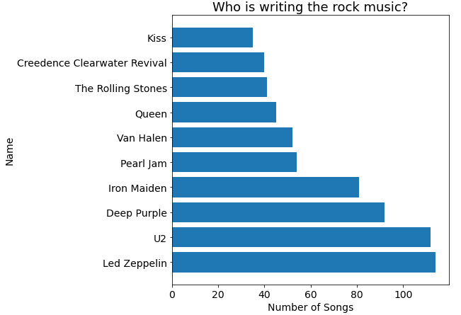
Who is writing the rock music?
<visualization>
the artists who have written the most rock music in our dataset.
These are the top ten on the list
led zeppelin is in the lead, behind him, U2, and they leave a safe distance for those who come after them

Slide 2
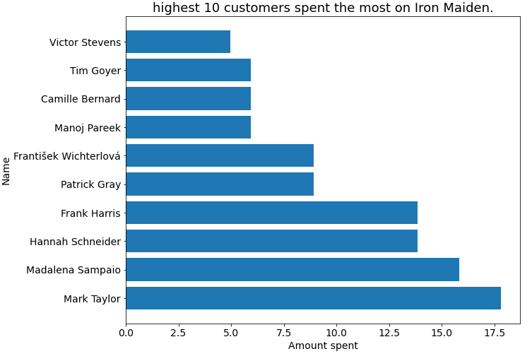
Highest 10 customers spent the most on iron maiden
<visualization>
Highest 10 customers spent the most on iron maiden who has earned the most according to the Invoice Lines

Slide 3
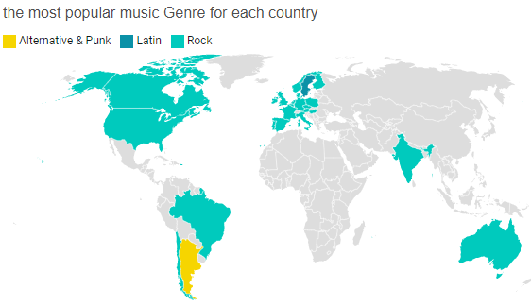
the most popular music Genre for each country
the most popular music Genre for each country. We determine the most popular genre as the genre with the highest amount of purchases.
<visualization>

Slide 4
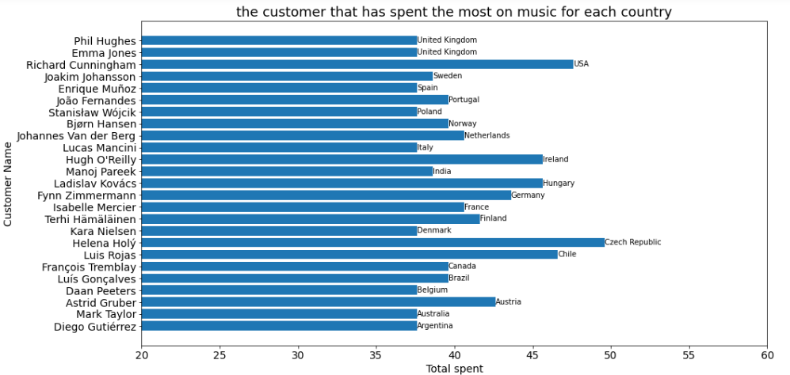
the customer that has spent the most on music for each country
<visualization>
the country along with the top customer and how much they spent

