Slide 1
Web and Cloud development:
index.py
workshop.py
Python’s Classes
and Intro to Databases
Session 3
By Ahmed Salah
STP’22|Engineering

Slide 2
index.py
workshop.py
< “It is important to view knowledge as a sort of a semantic tree. Make sure you understand the fundamental principles, the trunk and big branches, before you get into the leaves, or there is nothing for them to hang on to” >
— Elon Musk
STP’22|Engineering

Slide 3
Table of Contents
index.py
workshop.py
Intro to OOP
Introduction to Databases
Learn OOP basics
Understand what and why databases
Classes in python
Flask-sql-alchemy
Understand the basics of python classes
What is sql-alchemy and why is it used
Example #1
Example #2
Practice python classes
See how sql-alchemy is
used side by side with
flask and flask routes
STP’22|Engineering

Slide 4
Intro to OOP
index.py
workshop.py
STP’22|Engineering

Slide 5
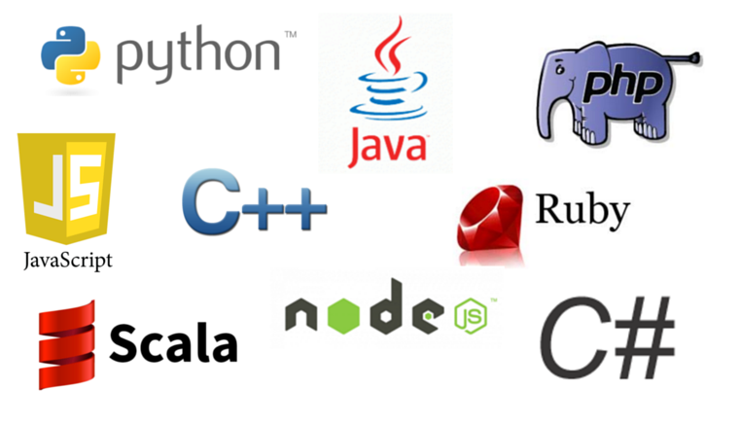
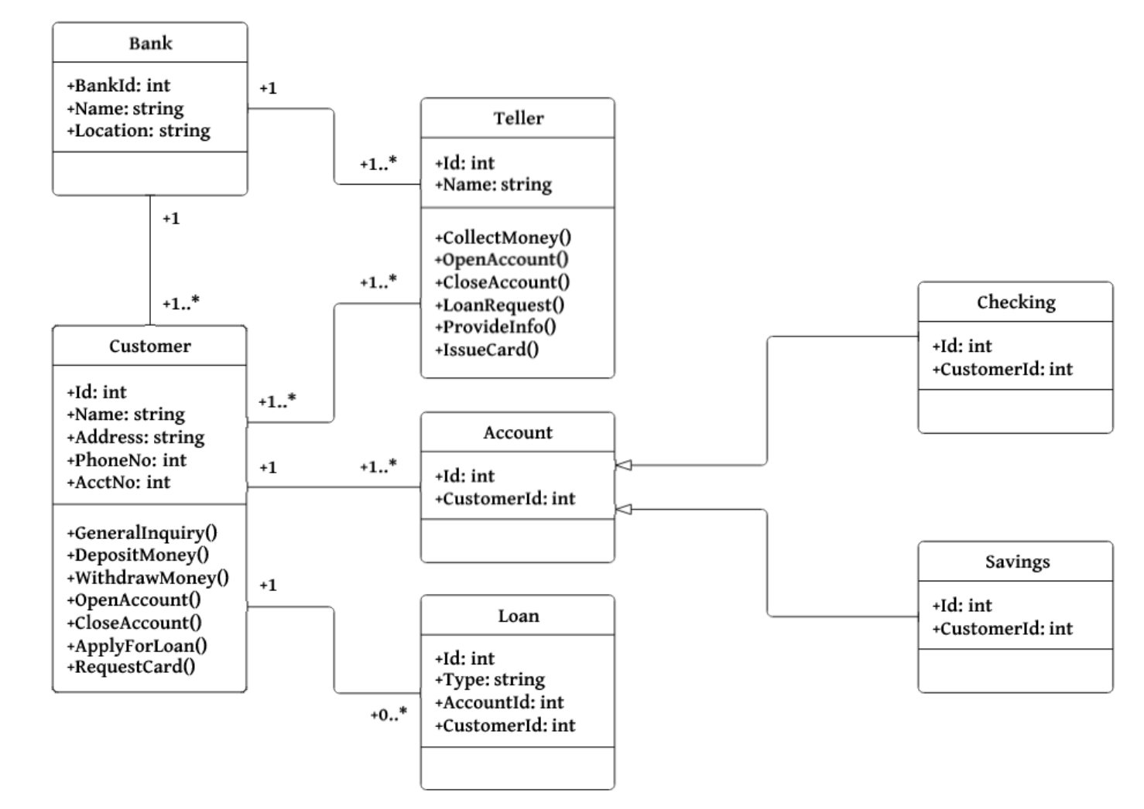

What is OOP :
Workshop.py
Variables.py
<OOP is acronym for Object Oriented Programming. OOP is a technique that was introduced in the early 60s and since the 1990s it is adapted in many programming languages.>
< OOP is all about creating objects that imitate the way that humans percieve the world where objects are entities, and functions are behavior of the object>
<Example: A car can be an object that has some properties (i.e., model, id, color, price, brand, ..etc.) and behavior/function that would be acceleration, deceleration, gear change, ..etc. >
STP’22|Engineering

Slide 6


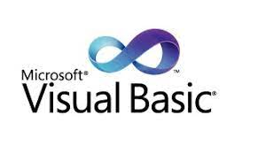
Procedural Programming:
Workshop.py
Variables.py
<Procedure programming has functions that can access all data → Less protection.>
<Huge applications become complexly represented with functions → high complexity and less productivity.>
<Increased redundancy and duplication → high complexity and less productivity.>
<Uncontrolled flexibility → weird behavior.>
Examples: C, PASCAL, BASIC
STP’22|Engineering

Slide 7
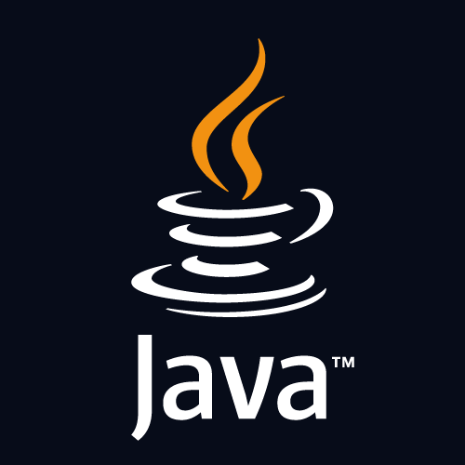
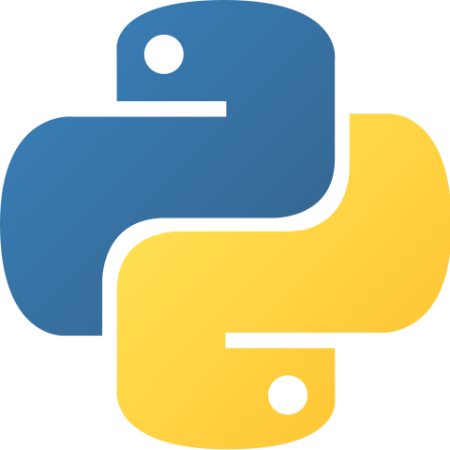
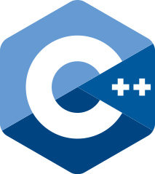
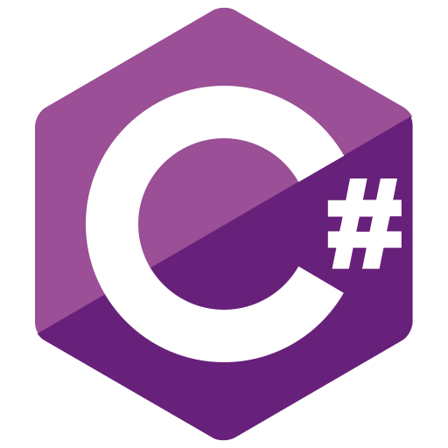
Object Oriented Programming:
Workshop.py
Variables.py
<Encapsulation: Each Object keeps its state private inside a class.>
<Abstraction: Each class exposes a high level mechanism for using it and hiding implementation details>
<Inheritance: Objects that have common logic (very similar) can have a parent in which they can inherit its properties>
<Polymorphism: Means “many shapes” in Greek, gives a way to use a class like its parent without confusion with mixing types and each child keeps its own methods as they are>
STP’22|Engineering

Slide 8
Classes in Python
index.py
workshop.py
STP’22|Engineering

Slide 9

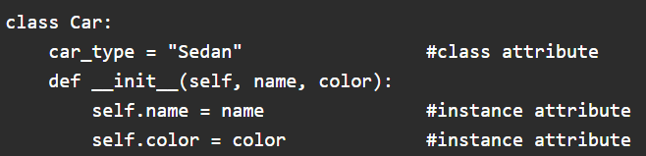
Workshop.py
lists.py
Concepts[1]
Defining a class :
Concepts[2]
Class Constructor:
STP’22|Engineering

Slide 10
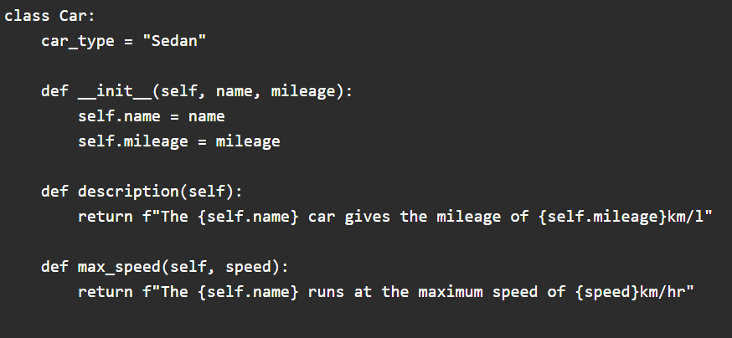
Workshop.py
lists.py
Concepts[3]
Class methods :
STP’22|Engineering

Slide 11
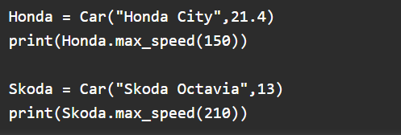
Workshop.py
lists.py
Concepts[3]
Creating Objects:
STP’22|Engineering

Slide 12
Introduction to Databases
index.py
workshop.py
STP’22|Engineering

Slide 13
What are Databases:
Workshop.py
loopsAndConditions.py
Pretty much like excel, has columns representing features and rows representing records.
Why not JSON/EXCEL/TXT FILE:
Database Engine
Queries
Security (not exactly secure)
STP’22|Engineering

Slide 14
Flask SQL-Alchemy
workshop.py
login.py
STP’22|Engineering

Slide 15
What is an ORM:
Workshop.py
dictionary.py
< Acronym for Object Relational Mapping>
< Maps Classes to Entities >
< Clean code and beginner friendly with OK SQL queries for usual queries>
< SQL Alchemy is one of the most prominent in the field>
STP’22|Engineering

Slide 16
# {
Lets see it in practice
Workshop.html
web.js
}
STP’22|Engineering

Slide 17
Thank you
index.html
web.js
STP’22|Engineering

