Slide 1
Grading:
lab work | Grade distribution
Participation | 15pt | 45
Attendance | 15pt
Mini Project | 15pt
Oral Exam | 30
Total Points | 75

Slide 2


Lab #1
ARDUINO AND MATLAB INTEGRATION

Slide 3
Outline
Arduino Basics
Sketch Structure
Digital I/O
Analog Input
PWM Output(Analog Output)
Serial Communication (Arduino side)
Matlab ∫󠆗 Arduino
Serial communication (Matlab side)
Using Arduino support package :
Installing the package on Matlab
Controlling Arduino using Matlab Code !!!!!!
Using Simulink to model Arduino

Slide 4
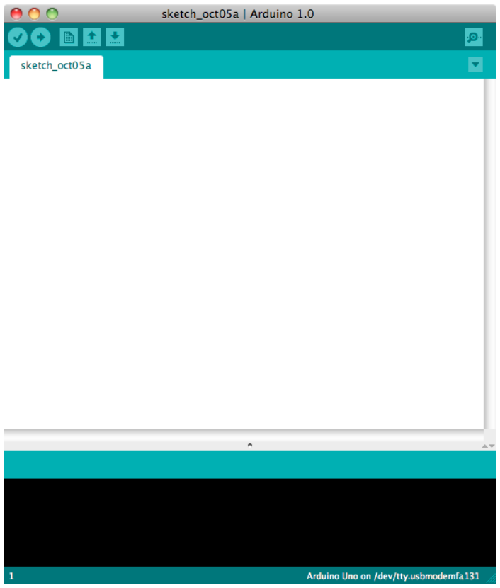
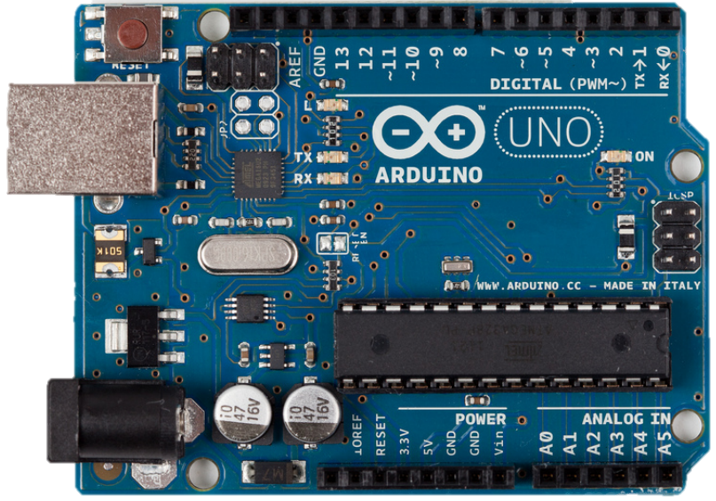
Arduino Basics
To start with Arduino we need :
Hardware(Arduino Uno)
Software(Arduino IDE)
This where we can write Arduino programs
Notes:
وظيفة السوفت وير انى اكتب فيه أوامر للهاردوير بتاعى (برنامج او سكتش) وبعد كده ارفع الأوامر دى على الkit بتاعتى
وظيفة الهارد وير انه ينفذ الأوامر اللى انا كتبتها في السكتش بتاعى

Slide 5
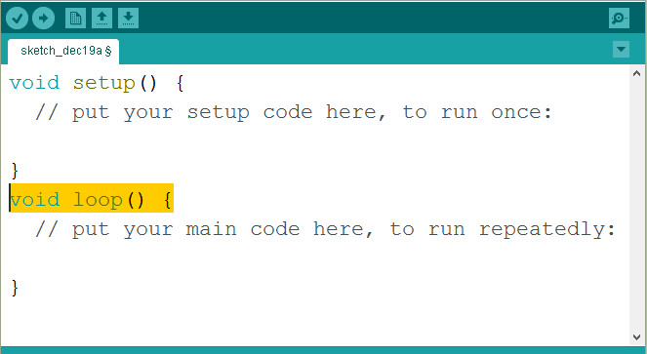

Sketch Structure
Any Arduino Sketch must have two functions:
The setup function:
Have code that needs to run only once. (do initialization)
The loop function:
Have code to be run continuously after Initialization.

Slide 6
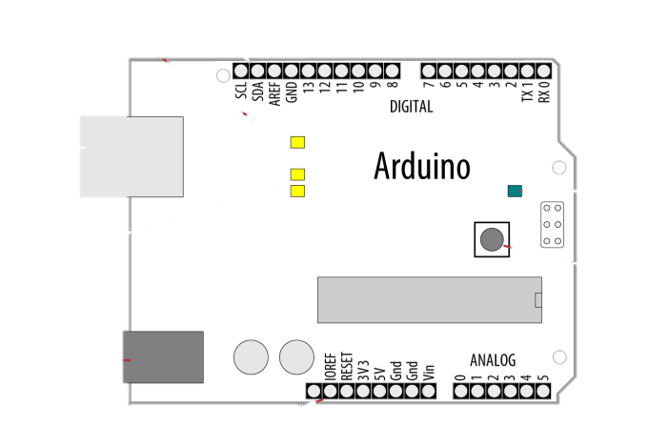
Digital i/o
Arduino Uno Have (13) digital i/o pins
To set any pin to be input or output we use:
pinMode function:
Syntax: pinMode(pinNo,In_OR_Out);
Ex: pinMode(13,OUTPUT);
To Write a digital value to any pin we use :
digitalWrite function:
Syntax: digitalWrite(pinNo,TRUE_OR_FALSE);
Ex: pinMode(13,OUTPUT);
digitalWrite(13,HIGH);
To read a digital value from any pin we use :
digitalRead function:
Syntax: digitalRead(pinNo);
Ex: pinMode(13,INPUT);
bool switch =digitalRead(13);
How to activate the pull-up resistor for any pin???

Slide 7
Digital i/o challenge
Write a program to toggle a LED once every time a push button is pressed. If you pressed the button and hold pressing it is treated as one push.
The program should also toggle another led continuously every 100 msec.

Slide 8
Analog input
Arduino Uno has 6 analog pins (A0-A5)
Only one pin can be used at a time (how many cycles it take?)
These pins are helpful if we want to get data from sensors
We don’t need to specify them as input.
To read an analog voltage between 0- 5 volt we use:
The analogRead function
Syntax: analogRead(pinNo);
Ex : int analogVar= analogRead(A0);
If the voltage =0v analogRead returns zero
If the voltage =5v analogRead returns 1023
If we want to get the actual analog voltage we must do some calculation first: as following:
int analogVar= analogRead(A0);
float actualVoltage = analogVar*(5.0/1023);

Slide 9
Analog Out
Arduino Uno has 6 PWM pins(3,5,6,9,10,11)
These pins can be used to produce analog output between 0-5 volt
To produce analog voltage we use:
The analogWrite function
Syntax: analogWrite(PWMpin,val_0_255);
Ex: analogWrite(11,255);//produce 5 volt
analogWrite(11,0);//produce 0 volt
These pins can be used to control the speed of motor , brightness of led ,….etc.

Slide 10
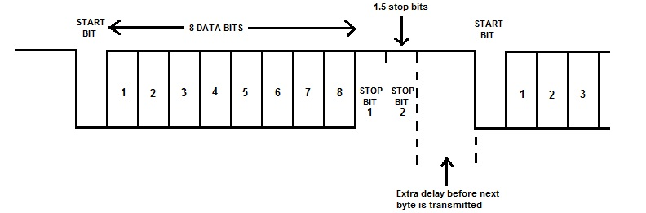
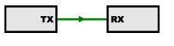
Serial Communication
Arduino Uno has one serial port on pins(0,1)
It is a protocol to exchange data between to remote devices using only 3 wires(Tx , Rx, GND) ;
Serial protocol takes a byte of data and send it serially bit by bit as pulses.
We can use it to let Arduino communicate with other devices such as Pc another Arduino,…etc.
You can communicate with Arduino IDE directly using Serial monitor.

Slide 11
Serial communication
We will use Arduino built-in serial library to program serial port.
How can you initialize serial port?
You must initialize the port in setup function as following:
Serial.begin(baudRate) ; //baudRate=9600;
baudRate is the number of transmitted bits per second.
The two communicating devices must have the same baudRate.
How cam you send data to serial port?
Using the following functions:
Syntax:
Serial.print(strig_OR_numder);
Serial.println(strig_OR_numder);//add new line
Serial.write(val);//sen binary data
Ex:
Serial.print(“Hello Arduino” );
Serial.print(100);

Slide 12
Serial communication
How cam you receive data from serial port?
To receive data you must check first if there is available data or not using the following code
// Check to see if at least one character is available
if ( Serial.available()) {
//read one character. } To read one character use the following code:
char ch = Serial.read();
Ex:
if ( Serial.available()) {
char ch = Serial.read();
}
More information can be found on Arduino website:
https://www.arduino.cc/en/Serial

Slide 13
Matlab ∫󠆗 Arduino
We can integrate Matlab with Arduino in 3 ways
Communication using serial port
Control Arduino using Matlab code
programming and simulating Arduino using Simulink
The last two methods need the installation of Arduino support package on Matlab.

Slide 14
Using serial port in Matlab
To use serial port from Matlab you need first to ensure that no other program is using it.
This can be done using the following statement:
delete(instrfind); //release serial port if other program uses it.
Second you need to create serial object and initialize it as following:
arduino1 = serial(‘com4','BaudRate',9600, 'timeout', timeout);
Third open that object for communication using :
fopen(arduino1);
After that you can
write data to serial port using: fwrite(arduino1,'c');
Check if there bytes available at serial port using: if(arduino1.BytesAvailable>0) % read from serial port end
Read data from serial port using: data_received = fscanf(arduino1);
Don’t forget to close serial port after using it : fclose(arduino1);

Slide 15
Task 1
Each group has to :
build the circuit shown next slide.
Write the code (Arduino & Matlab) that perform the following actions:
Arduino side : When the button is pressed it starts to read the temperature sends it continuously to Matlab script via serial port every 10 ms.
If the button is pressed again it stops communication.
Matlab side : the script should receive that data and plot it on a graph.

Slide 16
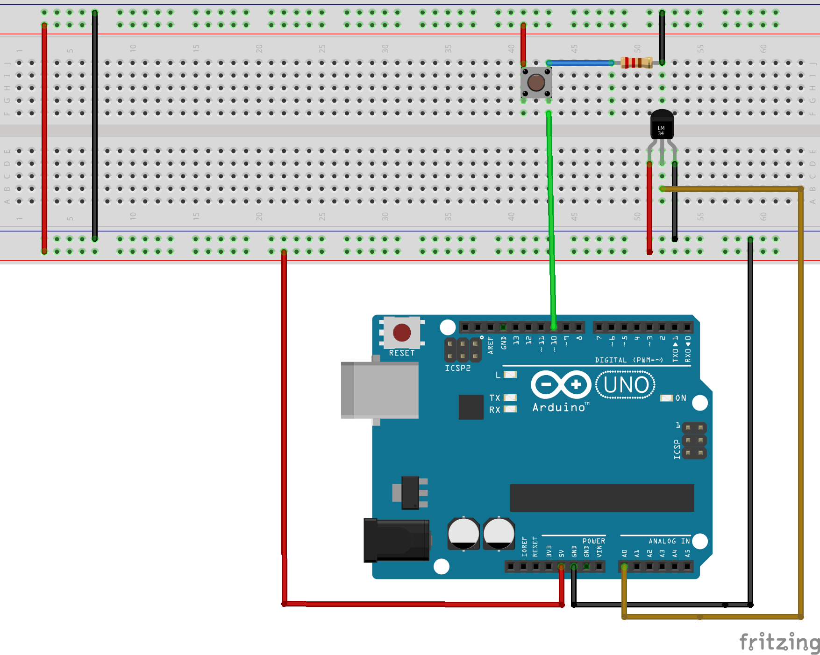
Task 1

Slide 17
MATLAB Support Package for Arduino Hardware
We can perform basic and advanced operations on the Arduino hardware such as blinking LEDs, playing sound on a speaker, etc. using only Matlab code!!!!.
But first you need to add support for Arduino devices as following:
Install the MATLAB® Support Package for Arduino® Hardware.
Setup and Configure Arduino Hardware to do this type arduinosetup in Matlab command window.
Connect Arduino hardware via USB, and choose the connection type USB.
Follow the instruction until you see finish to complete the hardware setup.

Slide 18
MATLAB Support Package for Arduino Hardware
To start interacting with Arduino board you need first to create an Arduino object
This can be done using the following statement:
myArduino = arduino('ArduinoCOM', 'BoardType');
Ex: myArduino = arduino(‘COM4', 'uno'); % creating arduino uno on com4
After that you can use that object with matlab builtin functions to achive your task
example | Arduino function | function
configurePin(myArduino,'D3',‘DigitalInput'); | Arduino pin mode | configurePin
readDigitalPin(myArduino,'D13'); | Read data from digital pin on Arduino hardware | readDigitalPin
writeDigitalPin(myArduino, 'D13', 0); | Write to digital pin on Arduino hardware | writeDigitalPin
writePWMDutyCycle(myArduino, 'D11', dutycycle); | Set digital pin PWM duty cycle | writePWMDutyCycle
writePWMVoltage(myArduino, 'D11', voltage); | Write digital pin PWM voltage value | writePWMVoltage
voltage = readVoltage(myArduino, 'A0'); | Read Arduino analog pin voltage | readVoltage
Don’t forget to clear arduino object after finishing( use clear myArduino; )

Slide 19
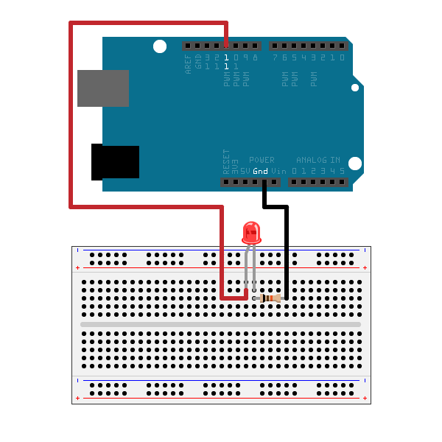
EXAMPLES: Blinking a led
myArduino = arduino('COM4', 'Uno');
for i = 1:10
writeDigitalPin(myArduino, 'D11', 0);
pause(0.5); % stop for 0.5 second
writeDigitalPin(myArduino, 'D11', 1);
pause(0.5);
end

Slide 20
EXAMPLES: Brighten and dim LED
myArduino = arduino('COM4', 'Uno');
step = (5-0)/20;
for i = 1:20
writePWMVoltage(myArduino, 'D11', step * i);
pause(0.1);
end
for i = 20:1
writePWMVoltage(myArduino, 'D11', step * i);
pause(0.1);
end

Slide 21
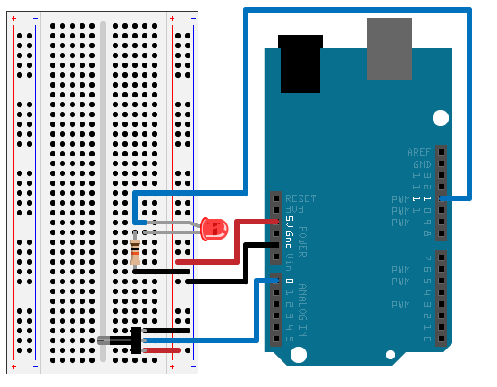
Task2: Control an LED using a potentiometer
Each group has to :
build the circuit shown below.
Write the code (Matlab only!!!) that perform the following actions:
Controlling the brightness of the led based on the potentiometer value

Slide 22
THANKS

