Slide 1
TrainMate
AI-Powered Mobile Smart Gym Assistant
Group 6
222100081 Ahmed Sameh | 222100194 Adham Allam
B20000006 Ahmed Wael | A20000011 Ibrahim Mohamed
222100305 Amira Yasser
SUPERVISOR: Associate Professor Mohamed Ghetas

Slide 2
Table of Contents
1
Abstract
2
System Architecture & functions
3
Related work
4
Features
5
Results
6
Tools
7
Running
8
Future works
9
Key Challenges & Limitations
2

Slide 3
Abstract
TrainMate is an intelligent mobile fitness assistant that helps users exercise correctly without needing a personal trainer at all times.
It uses real-time pose estimation and a BiLSTM model to classify exercises, count repetitions, and provide instant form feedback through the phone camera.
The platform includes personalized workout plans, session tracking, before/after body progress analysis, and a context-aware AI fitness chatbot.
By combining on-device ML, live coaching, and cloud-based AI services in one mobile app, TrainMate helps users train safely and track progress through a simple, interactive, and bilingual (English/Arabic) interface.
3

Slide 4
System Architecture & functions
4

Slide 5
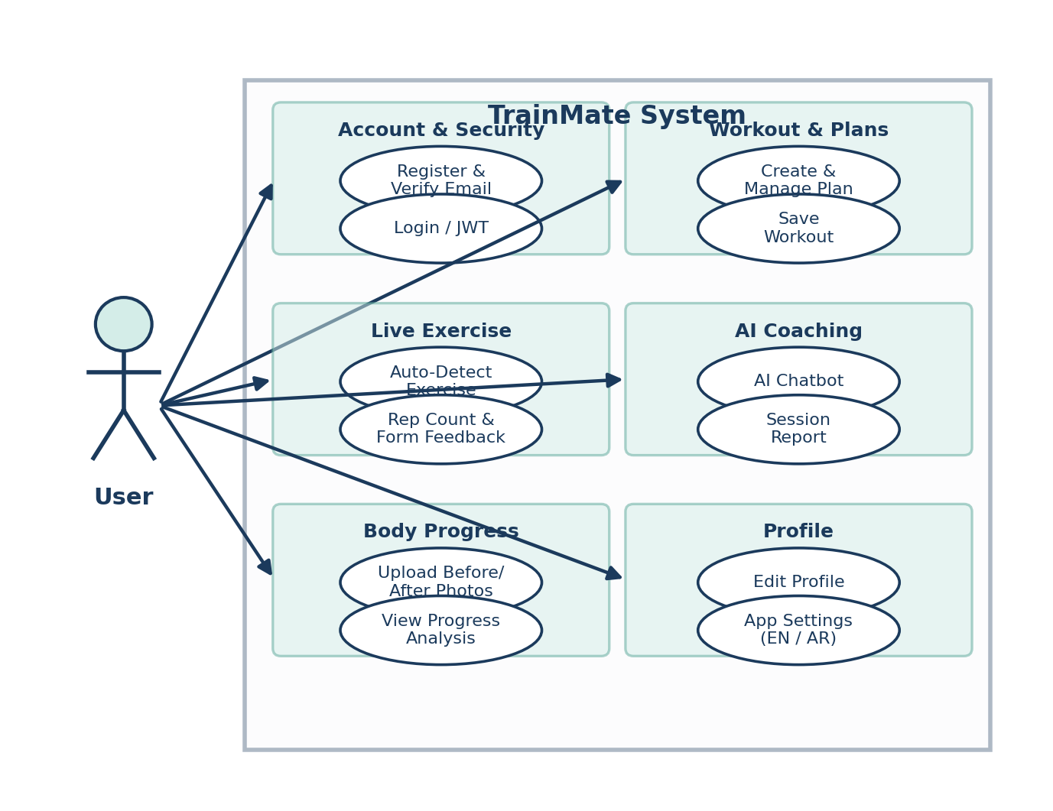
System Architecture & functions
Use Case Diagram — Full Application
The user interacts with TrainMate through one mobile app.
Account module: registration, email verification, and secure login.
Workout module: create plans, start sessions, and save results.
Live exercise module: auto-detect movement and count reps with form feedback.
AI coaching module: chatbot answers and optional session reports.
Body progress module: upload before/after photos and view analysis scores.
5

Slide 6
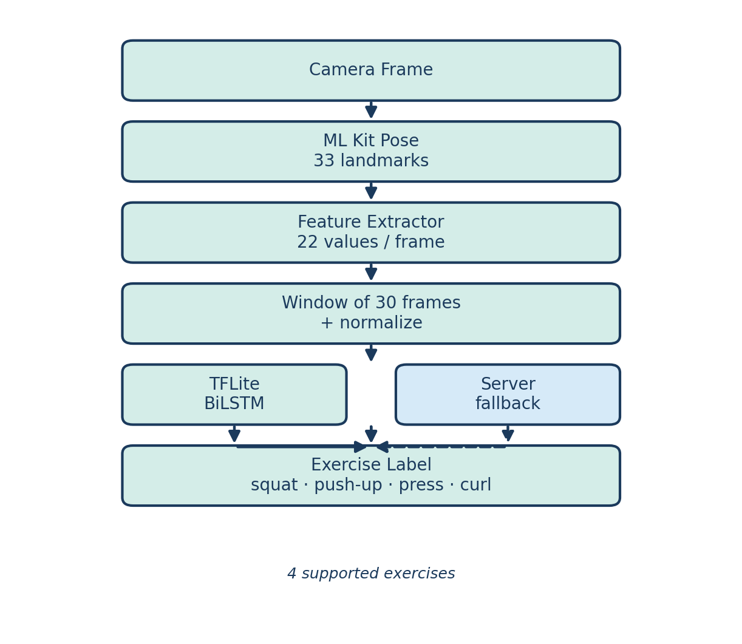
System Architecture & functions
Exercise Detection System
The phone camera captures live video during each workout.
ML Kit detects 33 body landmarks on every processed frame.
22 numeric features are extracted and grouped into 30-frame windows.
A BiLSTM model classifies the exercise in real time on the device.
If TFLite is unavailable, the same request falls back to the server.
Supported classes: squat, push-up, shoulder press, and biceps curl.
6

Slide 7
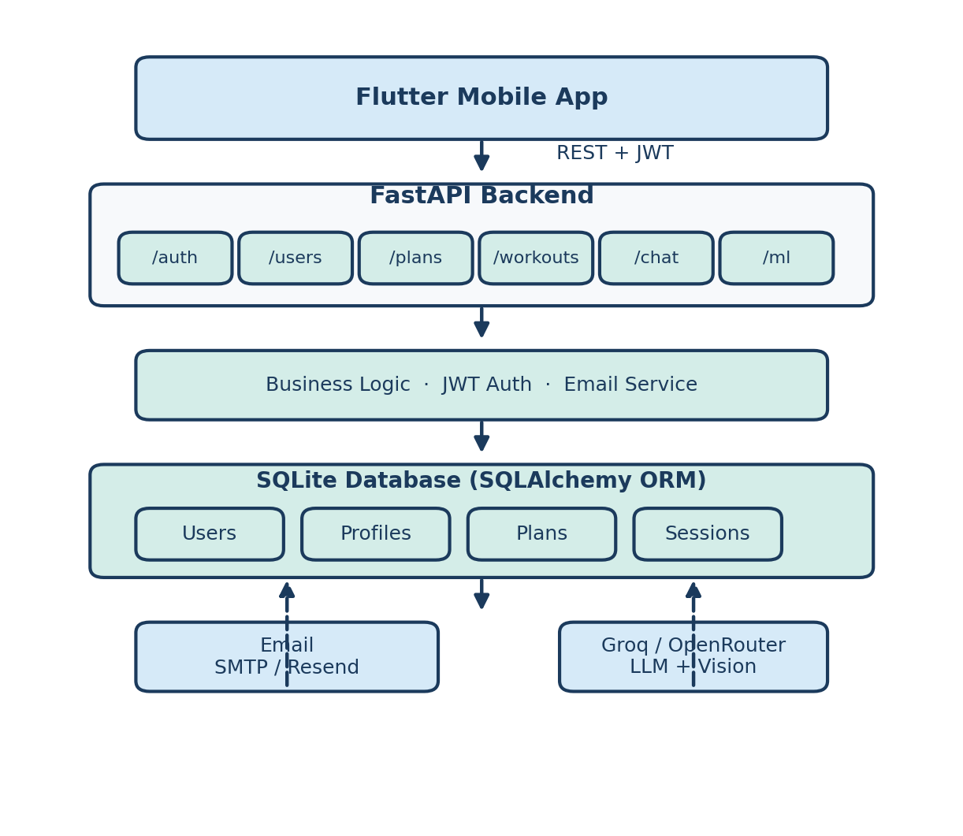
System Architecture & functions
Backend System
The Flutter app communicates with a FastAPI REST backend using JWT tokens.
Separate routers handle auth, users, plans, workouts, chat, and ML endpoints.
Business logic validates requests, sends emails, and estimates calories.
SQLAlchemy stores users, profiles, workout plans, and session history in SQLite.
External services provide email delivery and LLM-powered AI features.
This layer connects all mobile features to persistent data and cloud AI.
7

Slide 8
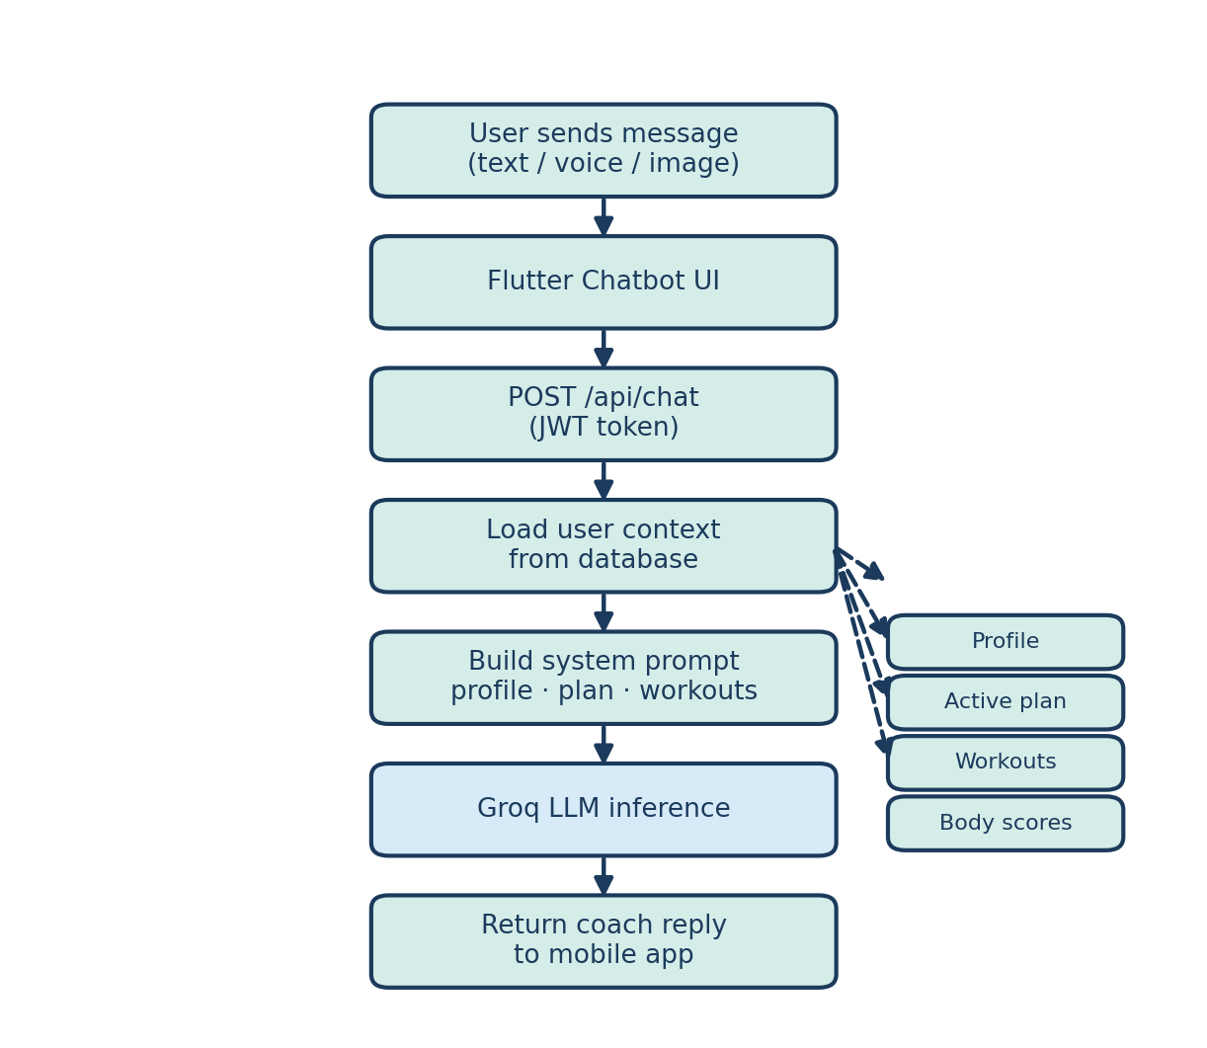
System Architecture & functions
Chatbot System
The user opens the in-app chatbot and sends text, voice, or an image.
The mobile app forwards the message to POST /api/chat with the JWT token.
The backend loads the user's profile, active plan, and recent workouts.
A system prompt is built so the AI knows the user's training context.
Groq LLM generates a personalized coach reply in English or Arabic.
The response is returned to the app and displayed in the chat UI.
8

Slide 9
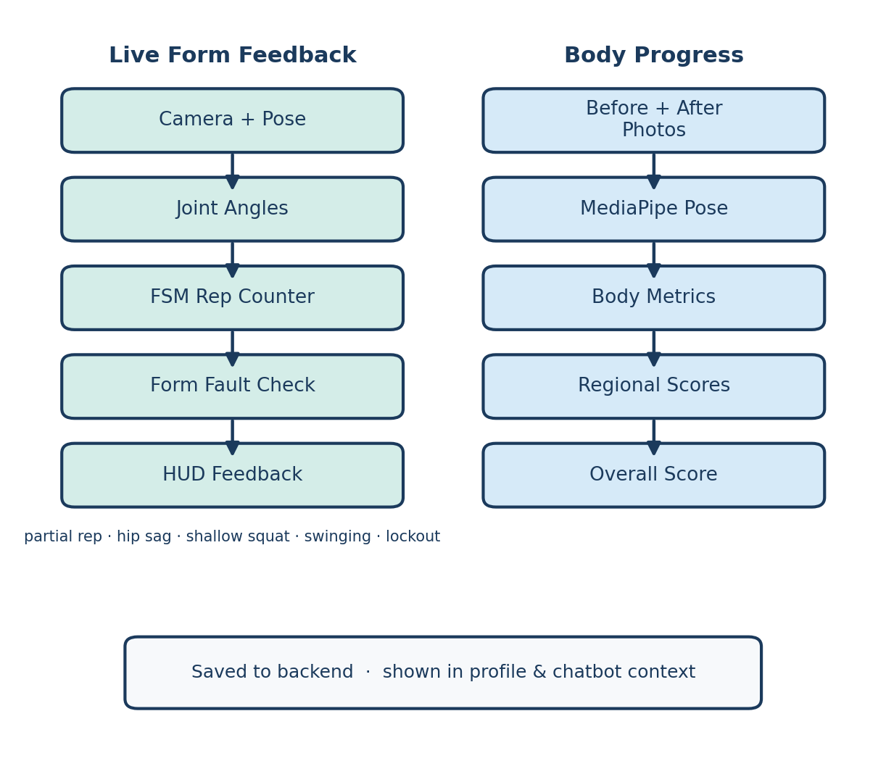
System Architecture & functions
Form Feedback & Body Progress
Live feedback runs on the phone: pose → angles → rep counter → HUD.
A finite-state machine counts reps when the user completes each movement.
Form faults such as partial reps or hip sag are detected in parallel.
Instant messages guide the user to correct their technique during the set.
After plan completion, before/after photos are analyzed on the server.
MediaPipe extracts body metrics and returns regional progress scores.
9

Slide 10
Related Works
10

Slide 11
Related Works
Feature | TrainMate (Our Project) | Freeletics | Nike Training Club | Fitbod
Real-time Pose Tracking | Yes | Limited | No | No
Auto Exercise Classification | Yes (BiLSTM) | No | No | Limited
Rep Counting & Form Feedback | Yes | No | No | No
AI Fitness Chatbot | Yes (context-aware) | No | No | No
Body Progress Analysis | Yes (Before/After) | No | No | No
Personalized Workout Plans | Yes | Yes | Yes | Yes
On-device ML Inference | Yes (TFLite) | No | No | No
Bilingual UI (EN/AR) | Yes | No | Partial | No
11

Slide 12
Features
Live Pose-Based Exercise Tracking: Real-time body landmark detection via camera.
AI Exercise Classification: Auto-detect squat, push-up, shoulder press, biceps curl.
Rep Counting & Form Feedback: FSM-based counting with fault messages.
Personalized Workout Plans: Built-in templates with session targets and completion flow.
User Authentication System: Secure registration, email verification, JWT login.
Body Progress Analysis: Before/after photo comparison with regional scores.
AI Fitness Chatbot: Context-aware coaching using plan and workout history.
Bilingual Interface: Full English and Arabic UI support.
Session Reports: Optional AI-generated summary after each workout.
12

Slide 13
Tools
Technology | Purpose
Flutter / Dart | Mobile app UI, camera integration, on-device TFLite inference, bilingual interface.
FastAPI / Python | REST API backend: authentication, plans, workouts, chatbot, and ML endpoints.
SQLite / SQLAlchemy | Database for users, workout plans, sessions, and progress history.
TensorFlow / Keras | BiLSTM exercise classifier training and optional server-side inference.
Google ML Kit Pose | Real-time 33-landmark body pose detection from the phone camera.
TFLite | On-device exercise classification for low-latency auto-detect mode.
MediaPipe / OpenCV | Body progress analysis from before/after photos on the server.
Groq API (LLM) | AI fitness chatbot, session reports, and optional vision narrative.
13

Slide 14
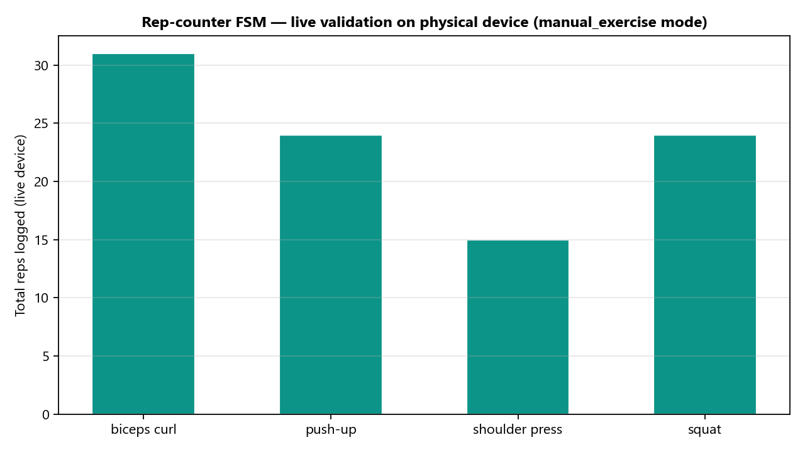
Results
Functional end-to-end mobile application developed (Flutter + FastAPI)
100% BiLSTM exercise classification accuracy on validation set (4 exercises)
Live rep counting validated on physical Android device (94 reps across 10 sessions)
Real-time form fault detection (partial reps, hip sag, shallow squat, etc.)
AI chatbot with user plan and workout context integration
Body progress analysis with regional scores and plan alignment
14

Slide 15
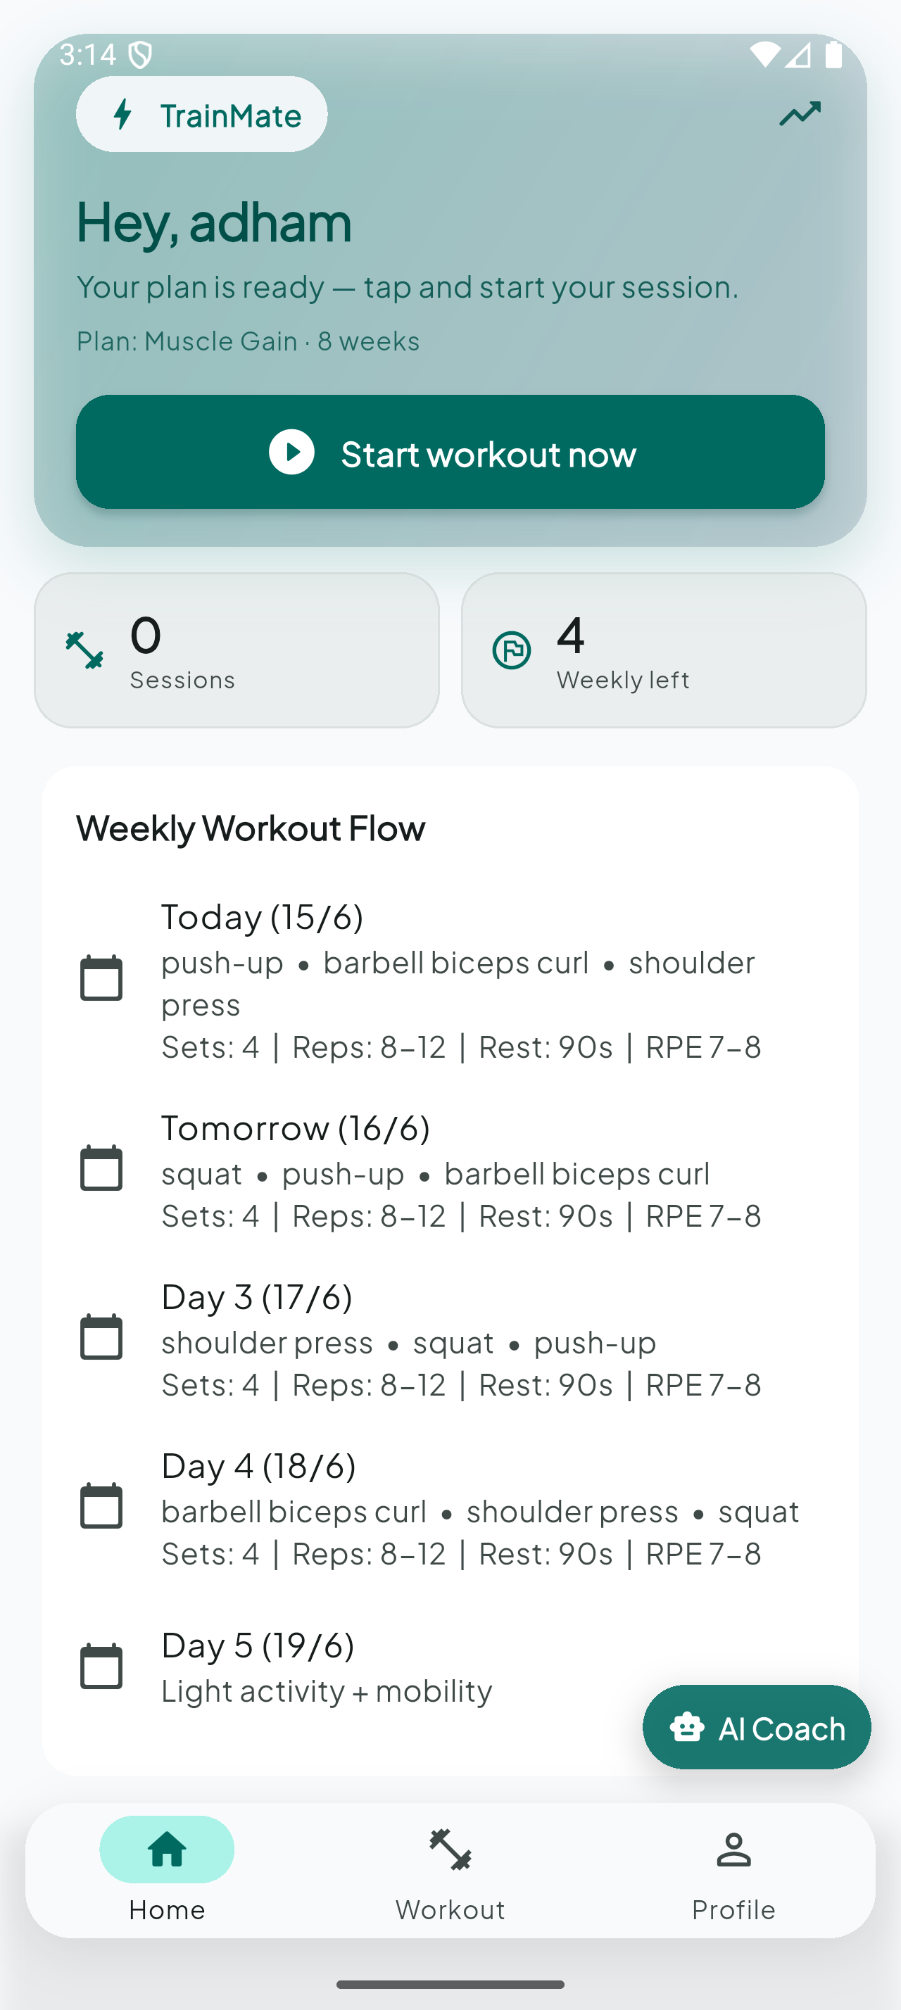
HOME PAGE
15

Slide 16
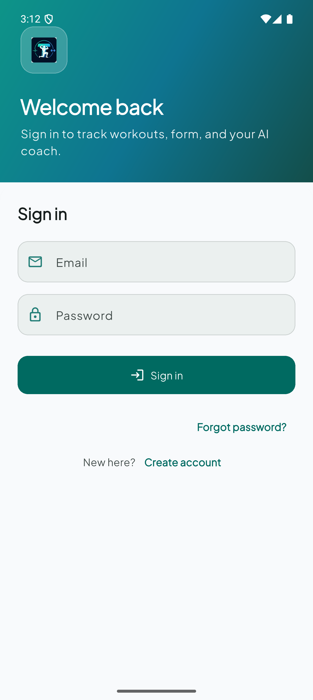
USER REGISTRATION
16

Slide 17
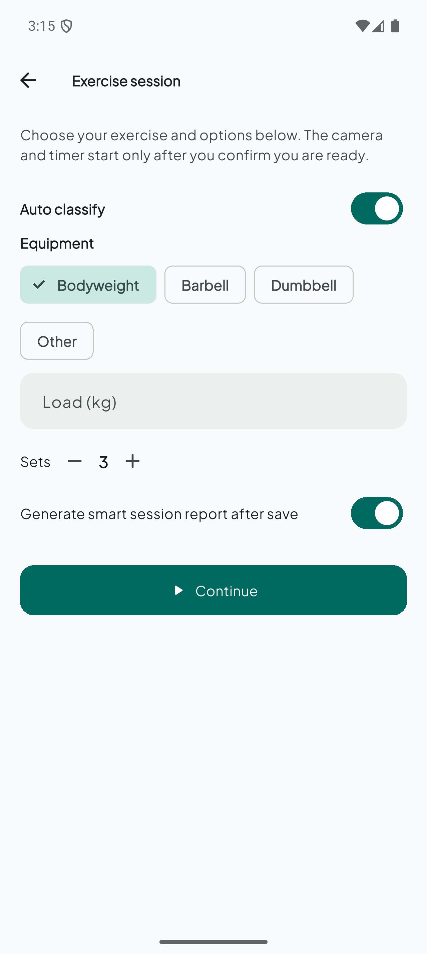
EXERCISE SETUP
17

Slide 18
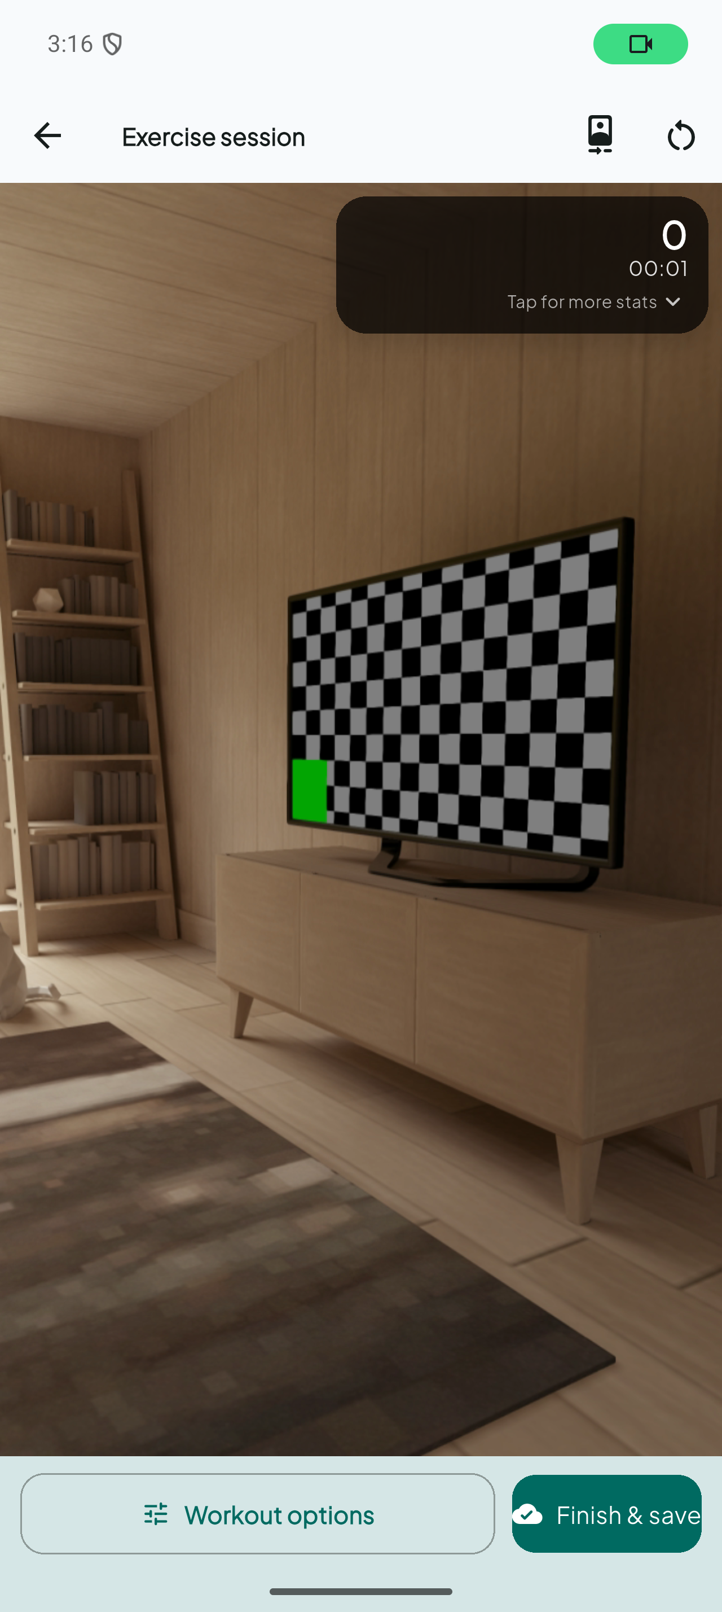
LIVE EXERCISE TRACKING
18

Slide 19
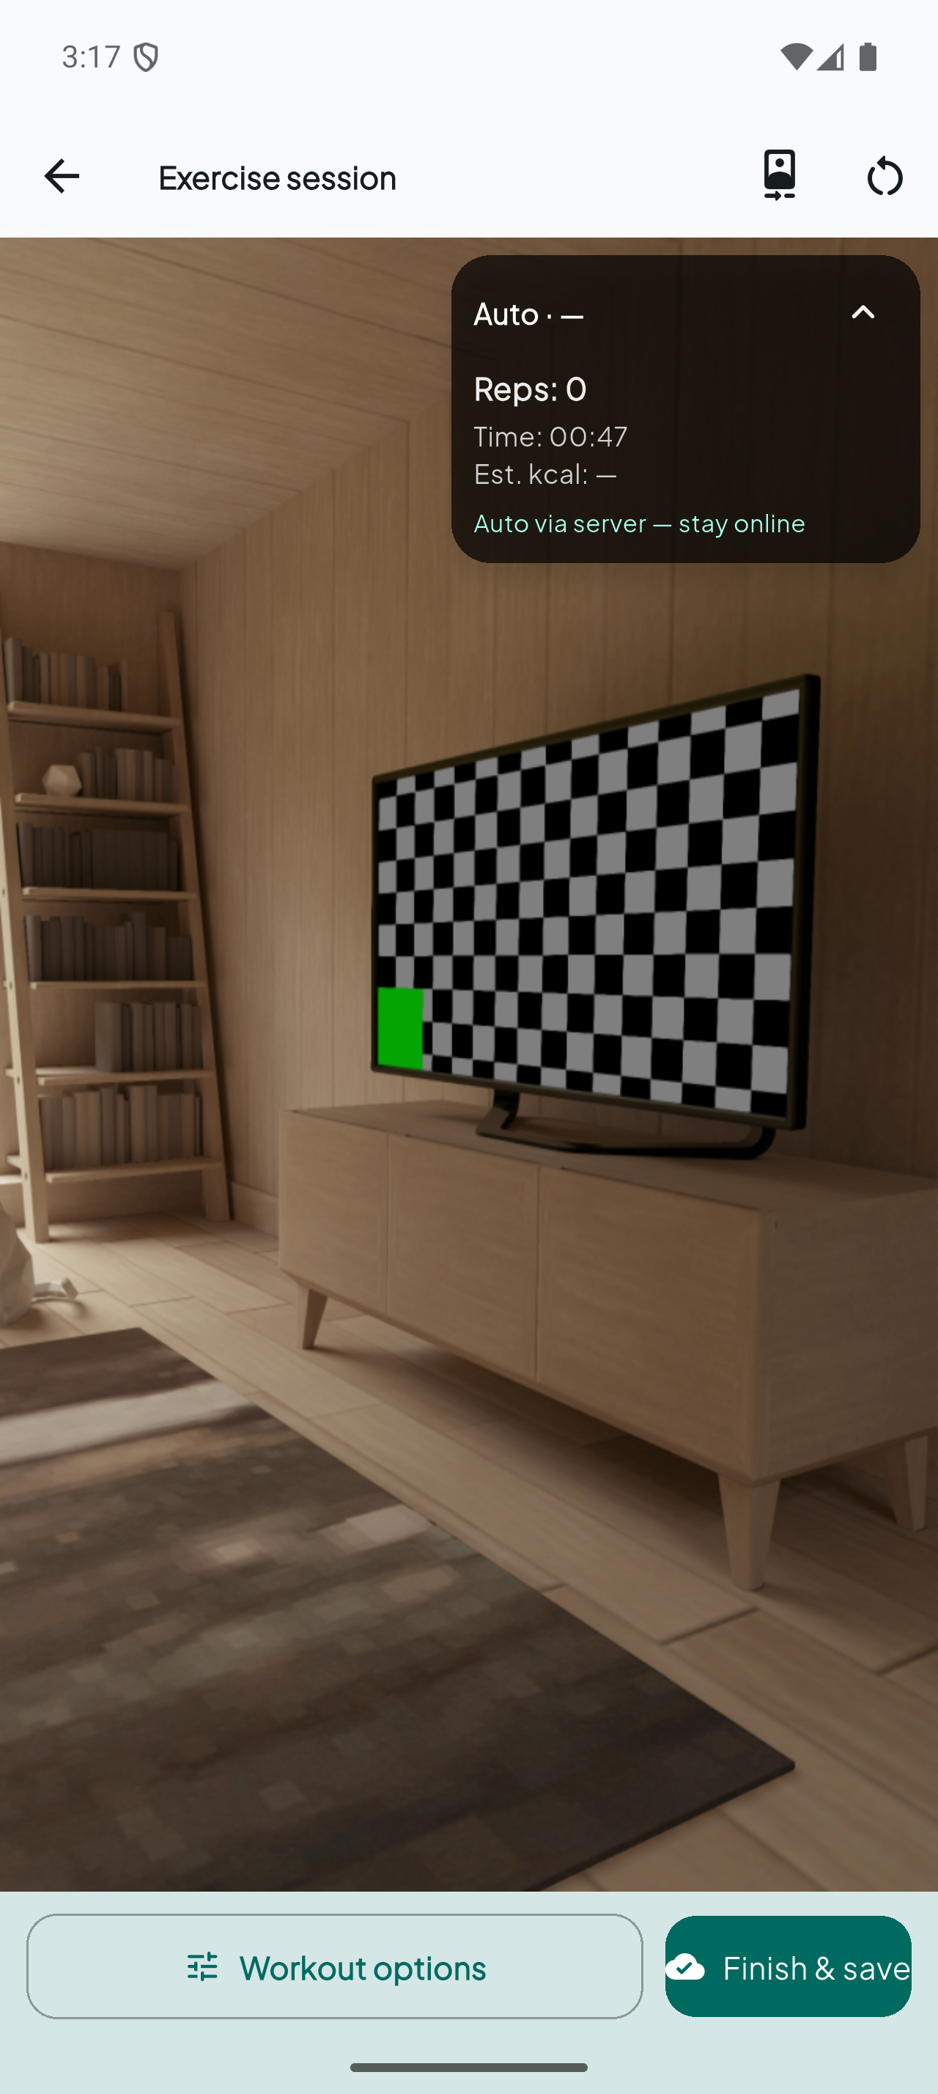
FORM FEEDBACK HUD
19

Slide 20
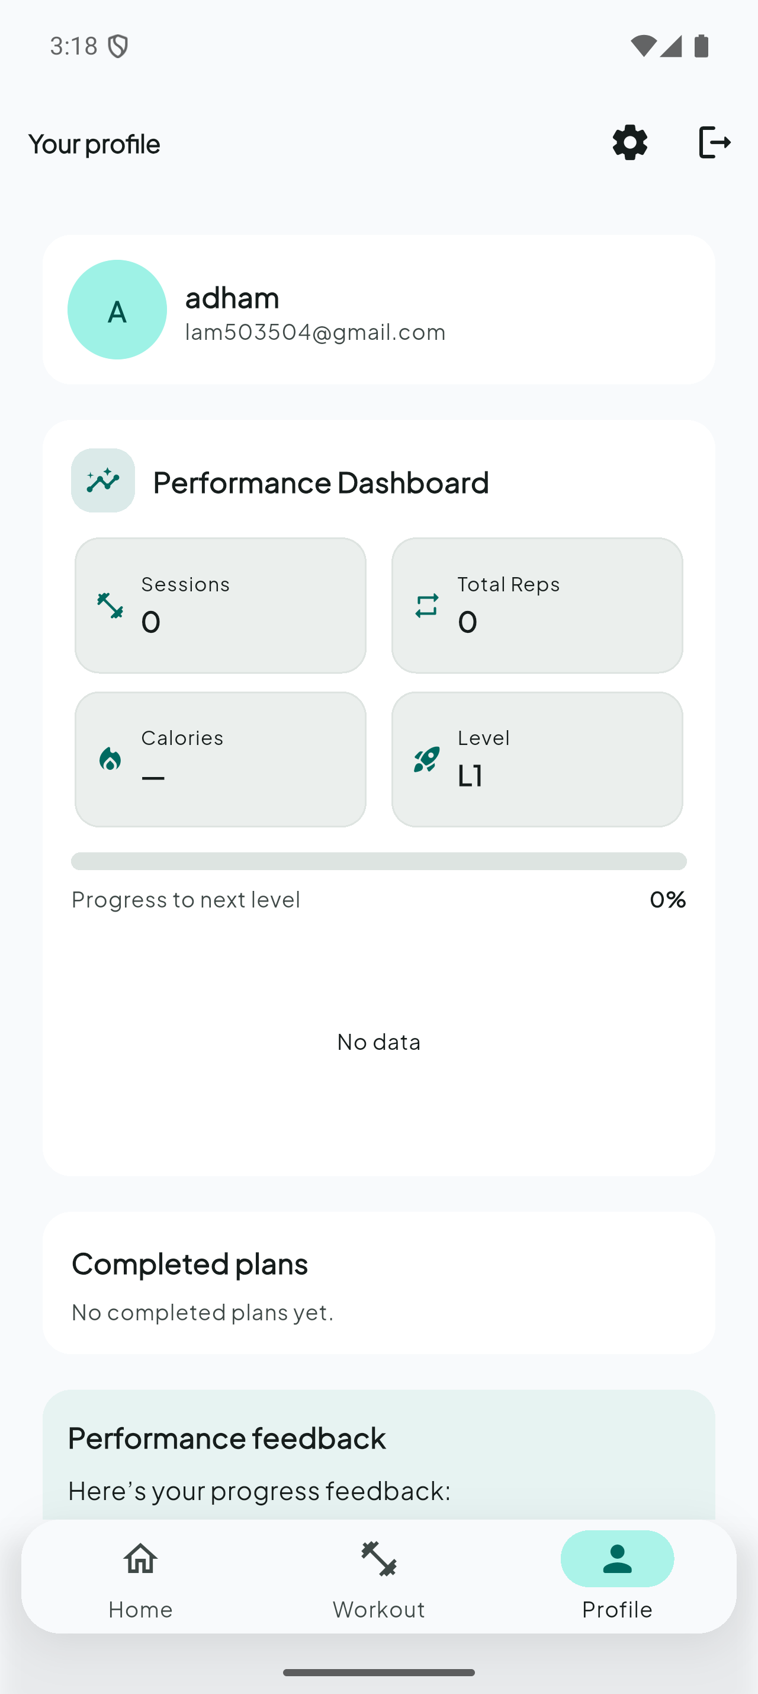
PROFILE MANAGEMENT
20

Slide 21
Running
The following screenshots demonstrate the complete workflow of TrainMate, from user registration to live exercise tracking, AI coaching, and body progress analysis.
21

Slide 22
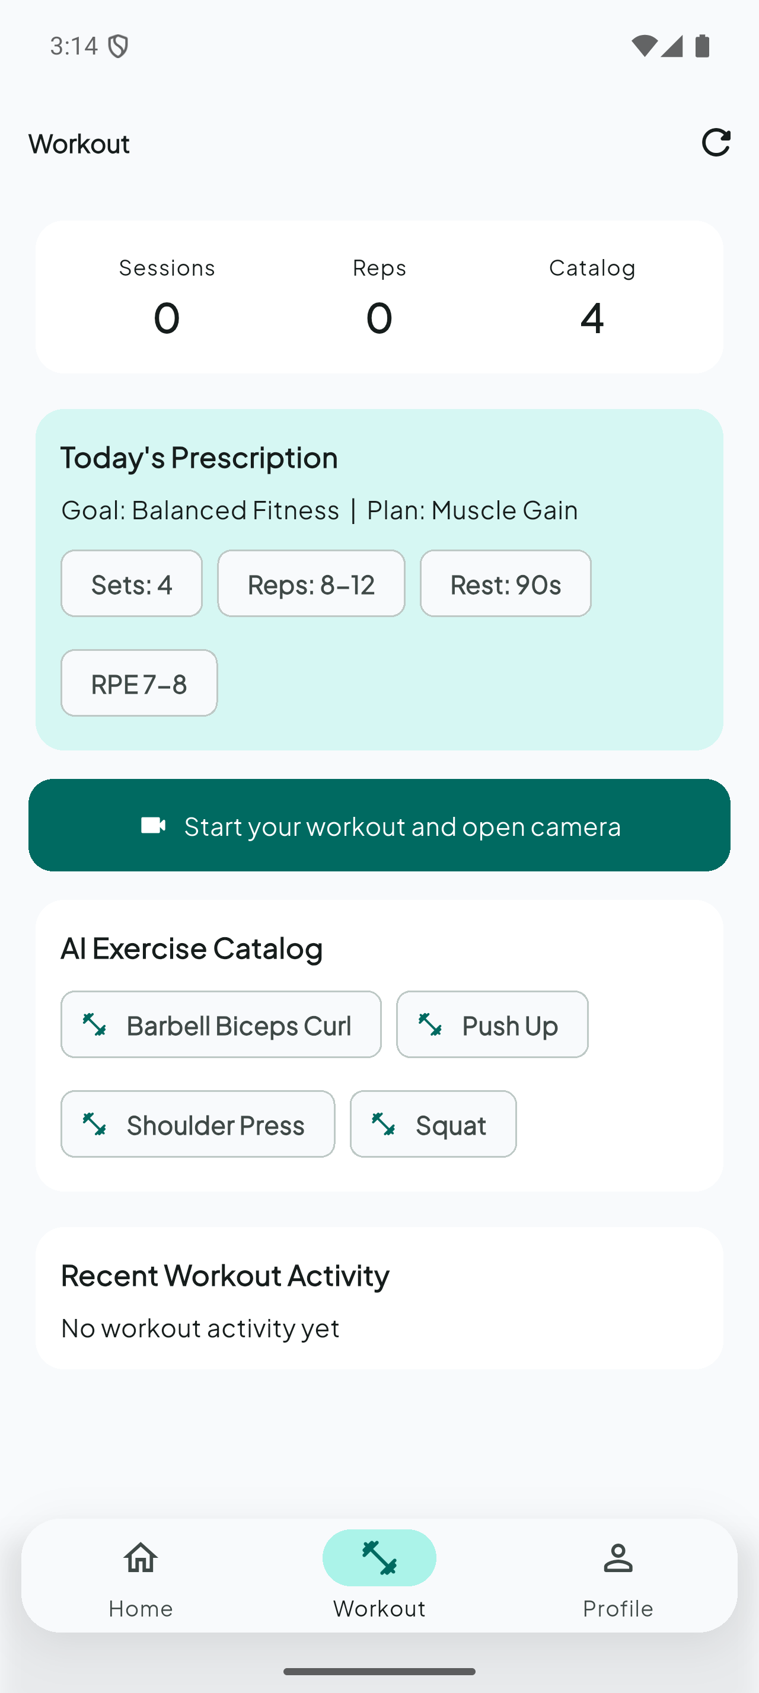
WORKOUT HUB
22

Slide 23
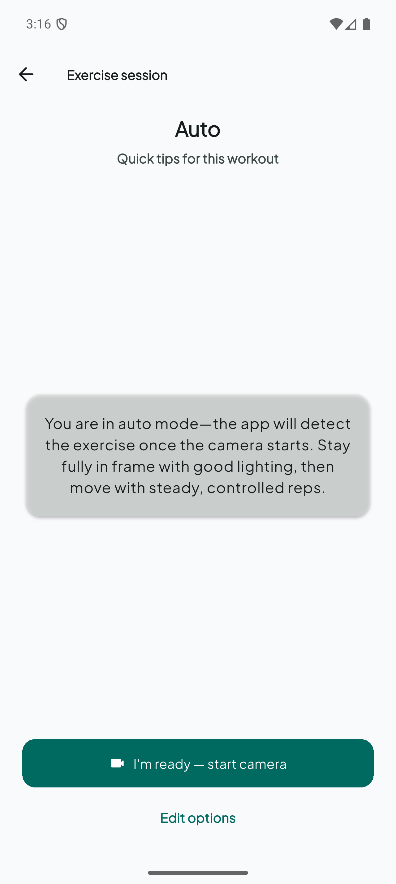
EXERCISE COACHING
23

Slide 24
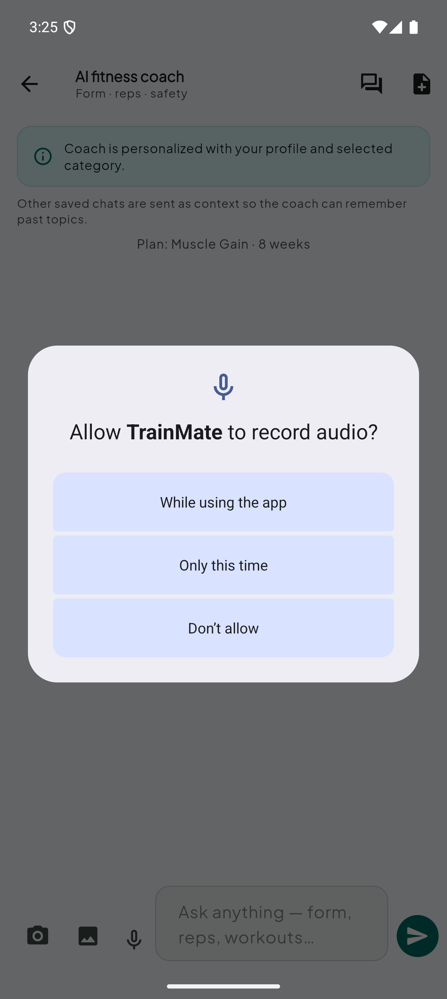
AI CHATBOT
24

Slide 25
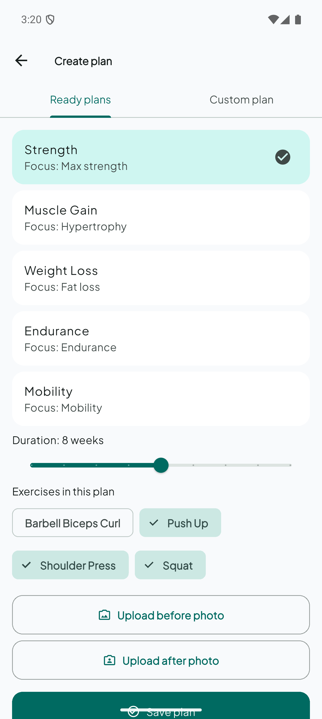
BODY PROGRESS ANALYSIS
25

Slide 26
Key Challenges & Limitations
Support tool only — not a replacement for professional fitness coaching.
Pose detection accuracy varies with lighting, camera angle, and clothing.
Classifier trained on 4 exercises only — other movements are not supported.
Rep counting depends on clear full-body visibility in the camera frame.
Body progress analysis requires valid before/after full-body photos.
Complex multi-module integration (mobile ML + backend + LLM APIs).
26

Slide 27
Future Work
Expanding support to additional exercises and equipment types.
Training on larger and more diverse real-world pose datasets.
Improving form feedback with deeper learning-based analysis.
Adding wearable sensor integration (heart rate, calories).
iOS release and cross-platform optimization.
Enhanced offline mode for workouts without network connectivity.
27

Slide 28
Thank You

