Slide 1



Intelligent System For Insulin Resistance Diagnosis & Personalized Nutritional Management
Jana Mahmoud Bedawy
22510688
SUPERVISOR:RAMADAN BEBARS
Notes:
1

Slide 2

Table of Contents
1
Abstract
6
Results
2
System Architecture &
functions
7
Running
3
Related work
8
Key Challenges
& Limitations
4
Features
9
Future works
5
Tools
2
Notes:
4

Slide 3
InsulinSense is an intelligent web-based healthcare system for early detection and management of insulin resistance.
It uses machine learning to analyze clinical and laboratory data, predict insulin resistance severity, and provide personalized low-glycemic meal recommendations.
The platform also includes OCR-based lab report extraction, health dashboard monitoring, secure user accounts, and PDF report export.
By combining prediction, tracking, and dietary guidance in one platform, InsulinSense helps users make informed health decisions through a simple and interactive interface.
Abstract
3
Notes:
2

Slide 4
  Frontend (React): Handles user interaction, data input, and result visualization.
  Backend (Flask): Processes requests, authentication, and connects system modules.
  Machine Learning Model: Predicts insulin resistance using clinical data and HOMA-IR.
  OCR Module: Extracts medical values from uploaded lab reports.
  Meal Recommendation Engine: Generates personalized low-GI meal plans.
  Database (SQLite): Stores users, predictions, meal plans, and progress history.
  Analytics Dashboard: Displays health trends and AI insights.
System Architecture & functions
4
Notes:
3

Slide 5
Related Works
5
Notes:
9

Slide 6
Feature | InsulinSense (Our Project) | DIB-PREDICT | Diabetes Prediction & Food Recommendation | NutriSense
Prediction Type | Multi-level insulin resistance classification | Binary diabetes prediction | General diabetes prediction | No prediction model
OCR Support | Yes | No | No | No
Personalized Meal Plan | Yes | No | Limited | Limited
Dashboard Monitoring | Yes | No | No | Yes
PDF Report Export | Yes | No | No | No
Technology | Flask, React, Random Forest, OCR API | Python + ML | Python + ML | Mobile App + CGM
6
Notes:
16

Slide 7
  AI-Based Insulin Resistance Prediction:Predicts insulin resistance using clinical data and HOMA-IR analysis.
  OCR Lab Report Upload:Extracts medical values automatically from uploaded lab reports.
  Personalized Meal Recommendations:Generates low-glycemic meal plans tailored to the user’s condition.
  User Authentication System:Secure registration and login for personal account access.
  Health Progress Tracking Dashboard:Visualizes HOMA-IR trends, prediction history, and health improvements.
  AI Insights & Analytics:Provides smart interpretations and health recommendations.
  Prediction History Storage:Saves previous assessments for future comparison.
  PDF Report Export:Allows users to download their health reports.
Features
7
Notes:
5

Slide 8
Technology | Purpose
Flask | Used as the backend server that will process API requests and enable communication between different system components.
React | Used to create an interactive front-end user interface for data entry and visualization.
Python | Used as the major coding language.
SQLite | Used as the database management system for storing various types of data such as account information, prediction history, meal plan and progress tracking.
Scikit-learn | Used for building, training, and evaluating the machine learning prediction model.
OCR Technology | Used to automatically detect values from medical reports and limit the need for data entry by users.
Charting Library | Used to chart and visualize trends and progress of HOMA-IR.
Tools
8
Notes:
8

Slide 9
1
Functional end-to-end web application developed
2
93% ML prediction accuracy
Results
Reduced manual data entry through automated OCR extractionPersonalized meal recommendations
3
4
Interactive health tracking dashboard
9
Notes:
6

Slide 10
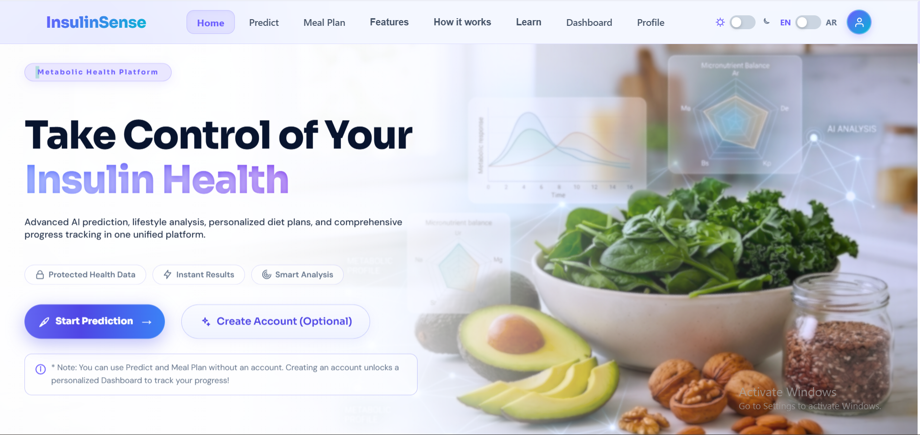
HOME PAGE
Emphasize your
main benefit
7
10
Notes:
7

Slide 11
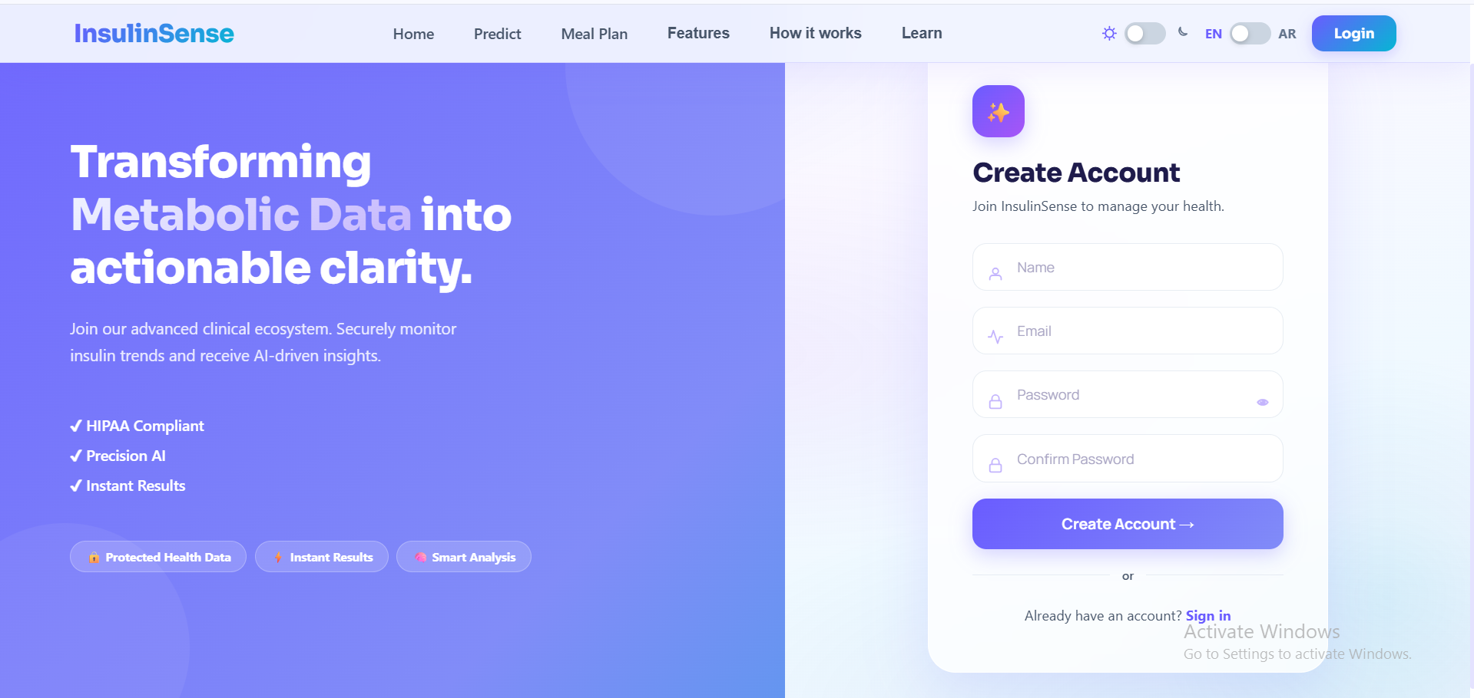
USER REGISTRATION
Emphasize your
main benefit
7
11
Notes:
7

Slide 12
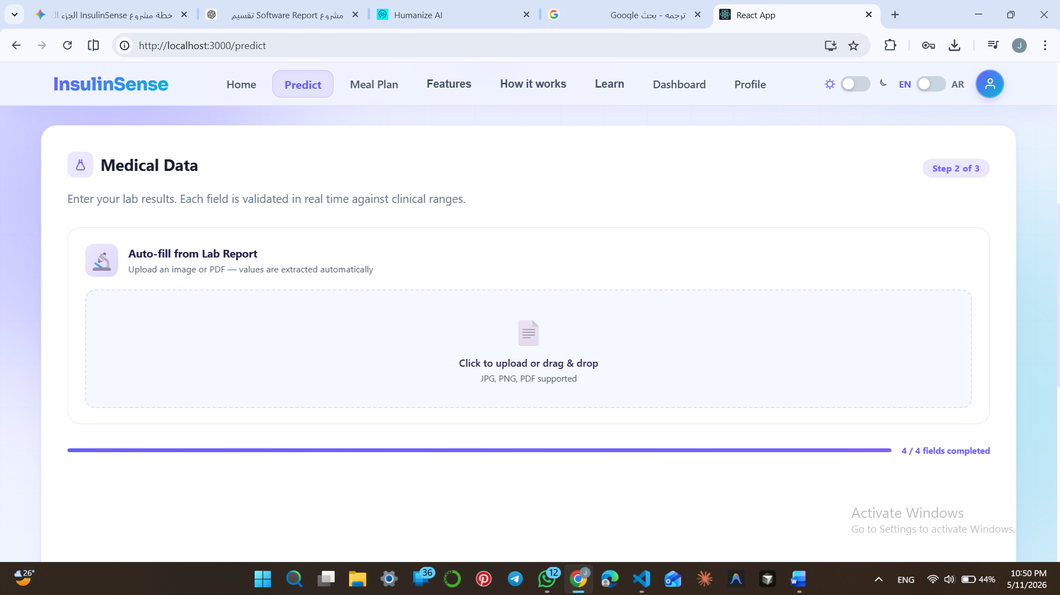
OCR LAB UPLOAD
Emphasize your
main benefit
7
14
Notes:
7

Slide 13
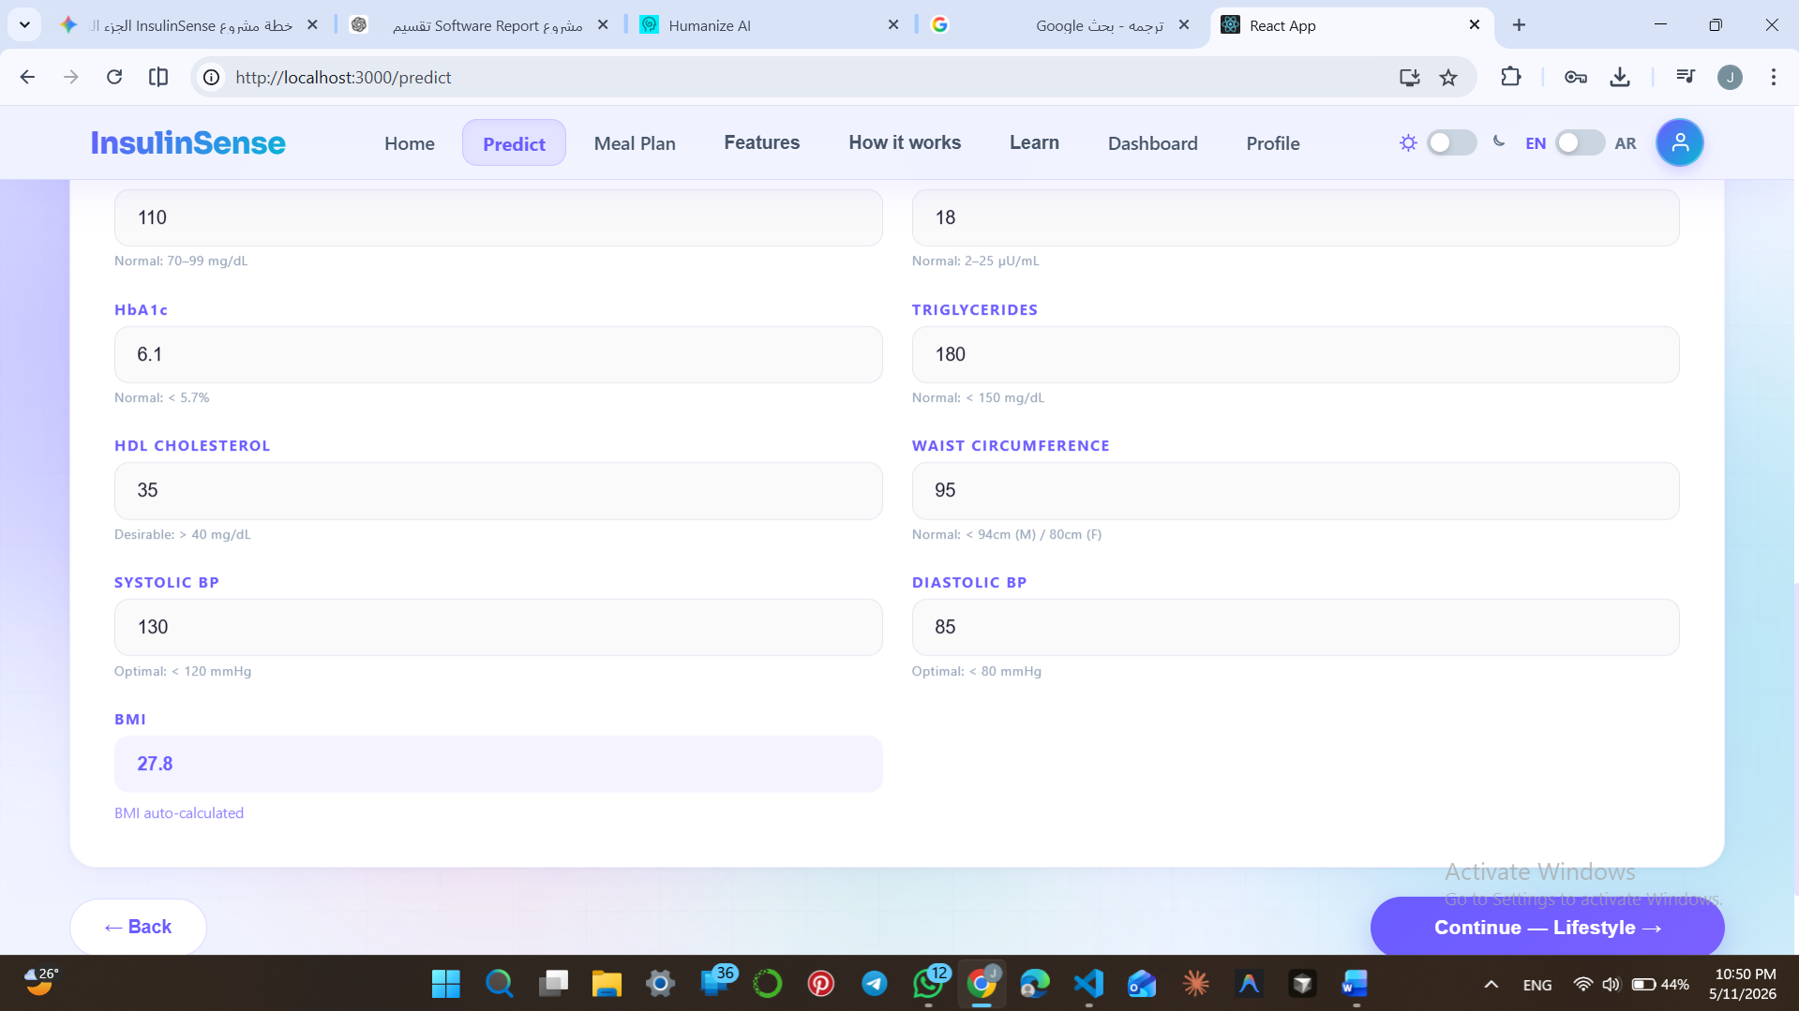
PREDICTION PAGE
Emphasize your
main benefit
7
12
Notes:
7

Slide 14
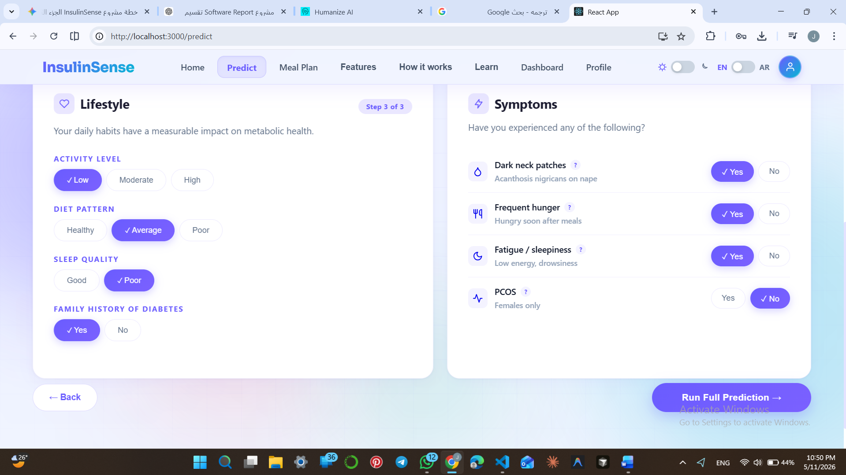
PREDICTION PAGE
Emphasize your
main benefit
7
13
Notes:
7

Slide 15
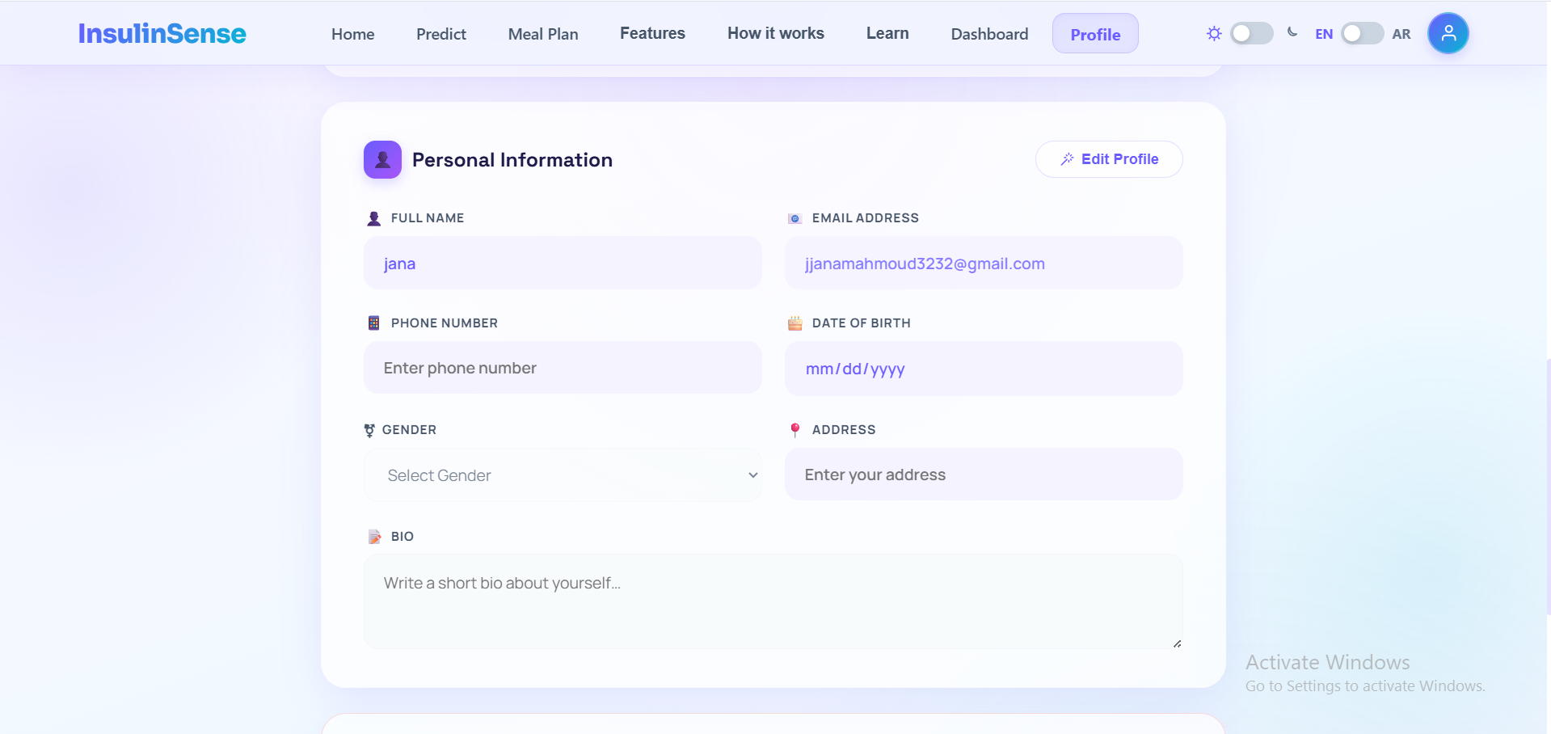
PROFILE MANAGEMENT
7
15
Notes:
7

Slide 16
The following screenshots demonstrate the complete workflow of InsulinSense, from user input to prediction, personalized recommendations, and progress tracking.
Running
16
Notes:
9

Slide 17
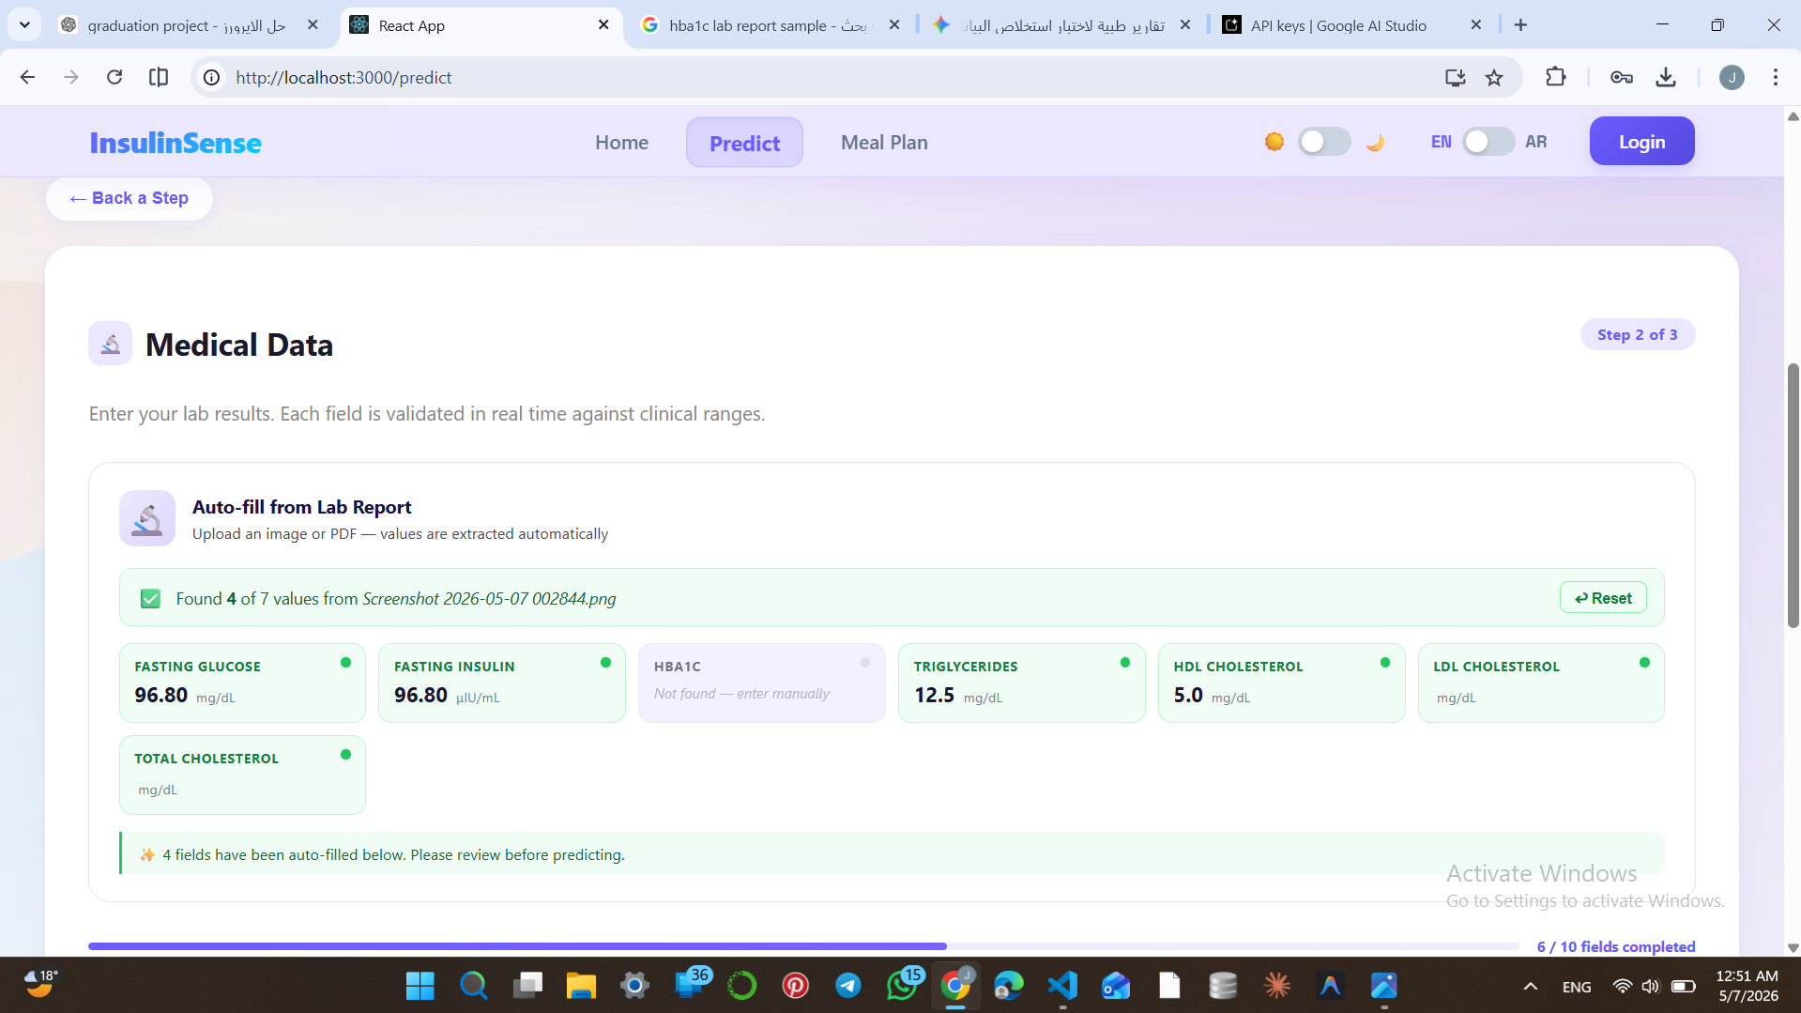
OCR UPLOAD
Emphasize your
main benefit
7
17
Notes:
7

Slide 18
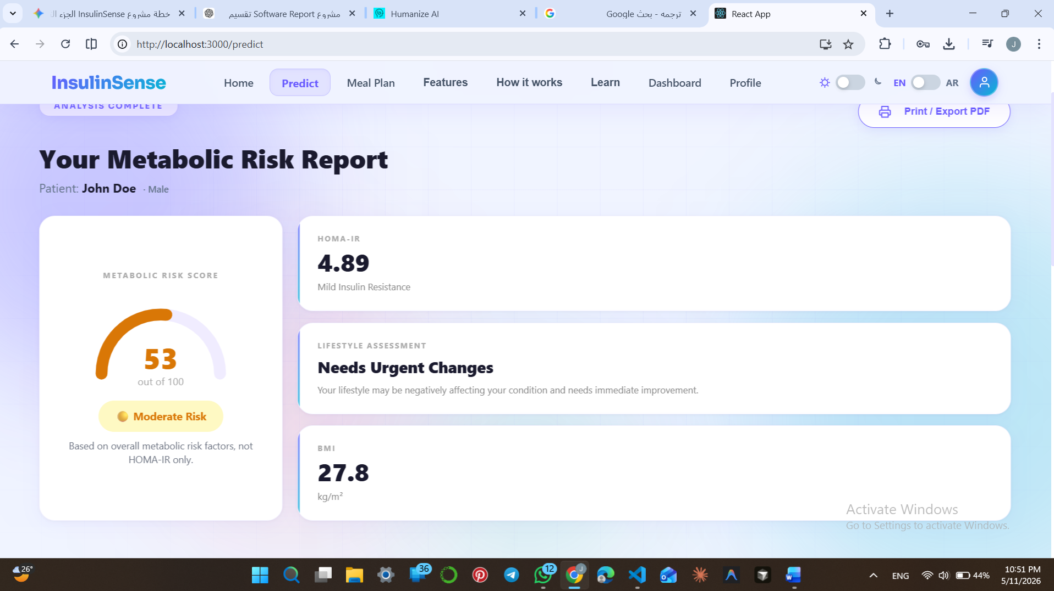
PREDICTION RESULT
Emphasize your
main benefit
7
18
Notes:
7

Slide 19
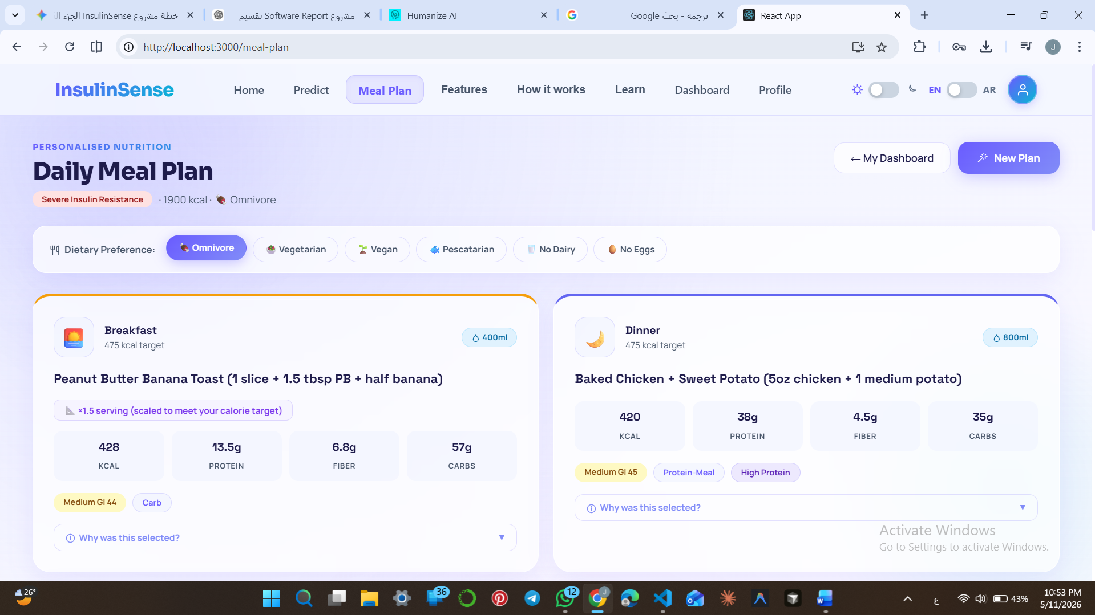
MEAL RECOMMENDATION
Emphasize your
main benefit
7
19
Notes:
7

Slide 20
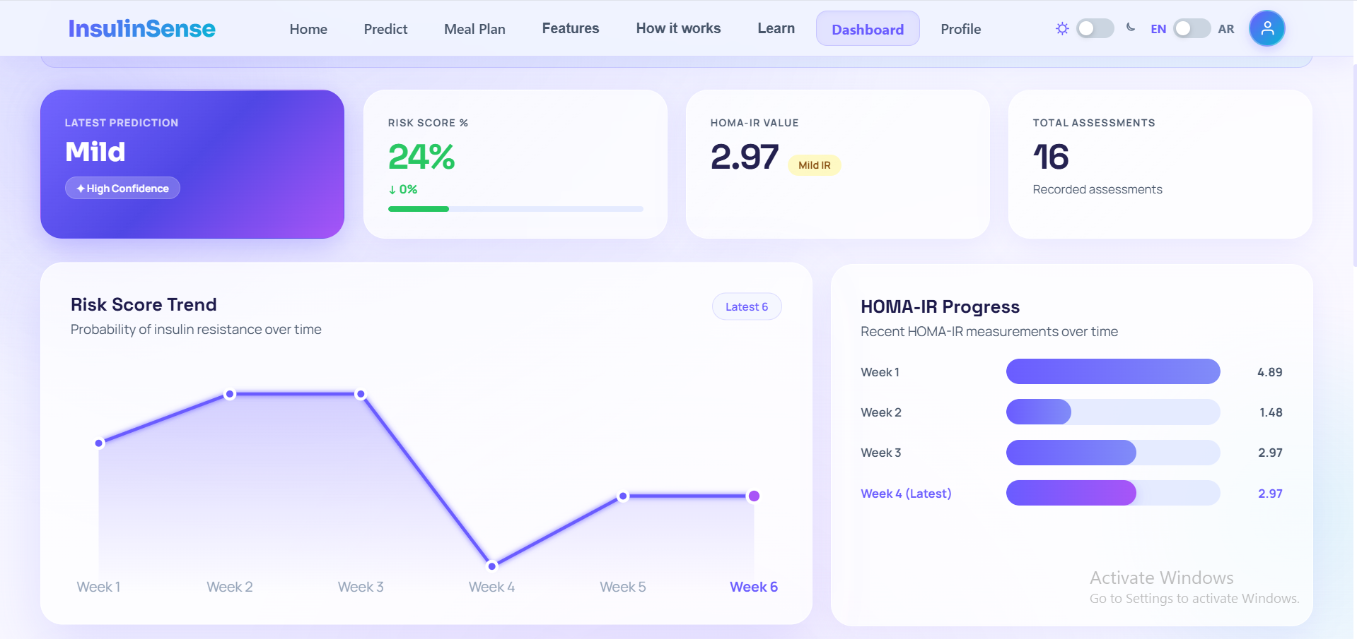
ANALYTICS DASHBOARD
Emphasize your
main benefit
7
20
Notes:
7

Slide 21
1.
Key Challenges & Limitations
Model trained on public dataset, not real clinical hospital data
5.
2.
Meal planning uses rule-based logic
4.
OCR accuracy varies with report quality
3.
Complex multi-module system integration
Support tool only, not a clinical diagnostic system
21
Notes:
12

Slide 22
Future Work
1.
2.
3.
4.
Creating an improved meal recommendation system based on artificial intelligence
Application of actual data from clinics for better generalization of models.
Expanding the system to support additional metabolic health conditions.
Improving accuracy of optical character recognition in poor quality reports.
22
Notes:
12

Slide 23
Thank You
Notes:
23

