Slide 1
Let’s connect 🔌
Introducing socket programming

Slide 2
Who am I?

Slide 3
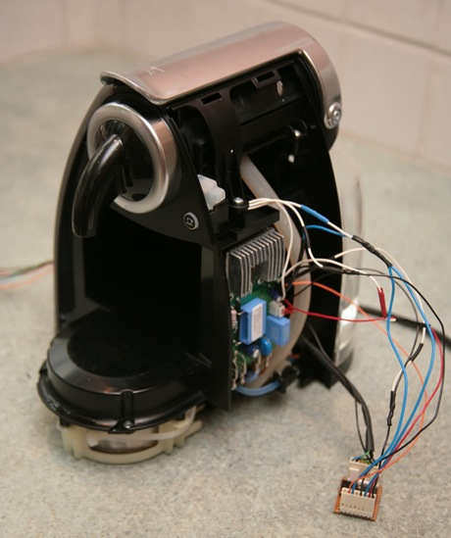


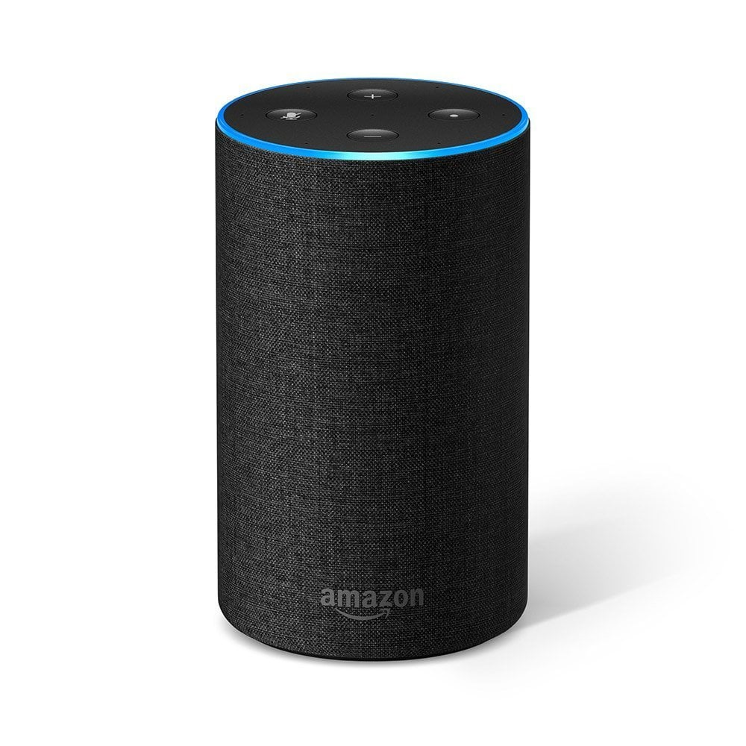
Is it fun? 😬
Notes:
Sockets is what powers internet

Slide 4

From A to Z 🚠
Notes:
Mention that a socket is a wire between two PROCESSES, so it needs to be defined using IP for the machine and port for the process on the machine.

Slide 5
UDP vs TCP
Notes:
TCP is for through internet
UDP across LAN, because it’s fast

Slide 6
Datagram💧vs Stream 💦
Notes:
Datagram is packet oriented
Stream is a stream, you don’t know where it starts and where it ends

Slide 7
The UDP RFC 📚
Notes:
Please note that the RFC clears all possible ambiguity in the description of the protocol

Slide 8
Let’s code 🖥

Slide 9
Something is going wrong?
How can we find the errors? 🤔

Slide 10
🦈 Sharks on the wire!

Slide 11
Filtering packets 🔍

Slide 12
Get your IP
🐧 ifconfig | ipconfig 🏠

Slide 13
Chat with your friend!

Slide 14
Steps
Client
Define a socket
Send to server
Receive from server
Server
Define a socket
Bind to an address
Receive from client
Send to client
Repeat

Slide 15
Don’t worry about the first lab
We just want you to learn 🎓, not to be tortured 😭

Slide 16
Project(s?) to be released soon! 😈

Slide 17
References
Python code for UDP here (remember; do NOT copy, type it yourself)
Beej’s guide to network programming here (essential if you want to be good)
Stuff with extra cruft here

