Slide 1
AASTMT · DATA TRUST PLATFORM
PULSE
A coworker for staff and students
Pulse
a next-generation
coworker
DATA TRUST
One base — clean data, all apps, AI engines
DOMAIN APPS
Incl. AI apps & engines · Carbon (live) · Performarc
on the Data Trust platform —
the base that fixes data quality
and hosts every app.

Slide 2
PULSE · THE COWORKER
02 / 10
A coworker that does the work, not a chatbot
Bottom line: It runs whole business processes on our own data, recovers when a step fails, and gets better with use.
1
2
3
4
Knows our world
Runs real workflows
Learns and grows
Resilient and safe
Works from AASTMT's own approved data and rules — not the open internet.
Executes multi-step tasks and specific business processes, end to end.
Remembers context, learns our terms, and improves with every use.
Recovers when a step fails; suggests and lets a person approve.

Slide 3
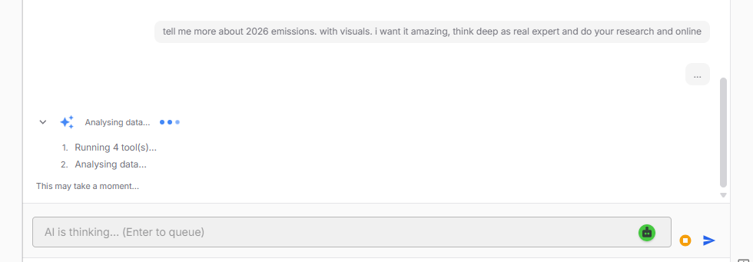

Slide 4
PULSE · VALUE FOR STAFF
03 / 10
Give staff back a day a week
Bottom line: The repetitive desk work is done for them — they spend time on people, not paperwork.
● Answers routine questions from our rules and data — no more repeating replies.
● Runs whole processes — multi-step tasks done end to end, not just answers.
● Drafts reports and letters from real data; a person reviews and approves.
● Resilient and safe — recovers from failures; every action needs a human yes.
THE SAME TASK, TWO WAYS
TODAY
WITH PULSE
Hours in emails, forms, and repeated reports.
Review one clean draft. Done.
Value: most repeated-question and report time returns as time for real work.

Slide 5
PULSE · A COACH FOR STUDENTS
04 / 10
The right answer, at the right moment
Bottom line: A guided coach on our website — the President can test it personally.
● Answers any time — admissions, courses, deadlines, rules — in plain language.
● Guides step by step instead of leaving students lost in menus.
● Hands off to the right office when a person is needed.
● Fewer dropped applications, lighter load on advising staff.
Which courses do I need next term?
3 core courses. Deadline: May 2.
→ Go to enrolment

Slide 6
PULSE · WHY IT IS NEXT-GENERATION
05 / 10
The class of system top organisations now expect
Built here, on our own systems — not a subscription that reads our private data.
Grounded
Runs workflows
Reasons & self-checks
Works only from our approved data — with the source shown.
Executes multi-step business processes end to end — agentic.
Checks its own work before acting — fewer wrong answers.
Learns & grows
Resilient
Controlled & ours
Remembers, learns our terms, and improves with use.
Recovers from failures and keeps the task moving.
Human approval for sensitive actions; runs inside AASTMT.

Slide 7
DATA TRUST · THE DATA-QUALITY SOLVER
06 / 10
It fixes the data problems that break reports and AI
Bottom line: Bad data is the root cause of wrong reports and unreliable AI — Data Trust removes it at the source.
✕ Scattered data
✕ No one trusts the numbers
✕ “Where did this come from?”
→ One governed place — every dataset has an owner and a version.
→ Automatic quality checks; a clear pass/fail on each dataset.
→ Full history — always able to show which data produced a result.
✕ Duplicate, inconsistent codes
✕ Months lost cleaning data
✕ Stale data slips through
→ Shared reference lists keep everyone on the same values.
→ Approved datasets are reused, not rebuilt each time.
→ Freshness rules flag data that is too old to use.

Slide 8
DATA TRUST · ONE BASE FOR EVERY APP AND AI ENGINE
07 / 10
Domain apps — including the AI apps and engines — all run on one trusted base
Bottom line: Clean data is owned and checked once — every app and every AI reuses it, so nothing is built twice.
Carbon
live app
Performarc
planned app
Sustainability
planned app
Pulse AI engine
live · AI engine
DATA TRUST — clean · approved · versioned data
Owner + quality checks + version on every dataset · domain apps INCLUDE the AI apps and engines · one source of truth for reports and AI
Value: add a new app cheaply, and trust every result — because the data underneath is already clean.

Slide 9
CARBON · PROOF, ALREADY LIVE
08 / 10
Defensible emissions numbers for rankings and accreditation
Bottom line: The easiest value to see — it runs today and produces reports without manual rebuilding.
● Tracks emissions with a clear, recognised standard.
● Evidence attached to every number, with full history.
● Reports for rankings & accreditation — no manual rebuild.
● Lower risk of a wrong figure in an official submission.
SPREADSHEET
CARBON APP
Manual, scattered, an error waiting to happen.
One clean, sourced, defensible number.
● LIVE TODAY
Running for AASTMT now — the working proof that the base and the apps deliver.

Slide 10
THE ASK
Start where it shows fast
Student coach + Data Trust office first.
Approve
to start.
One or two departments
Partners for the staff coworker.
Use the computing we own
Access to existing systems for research.
We already own the platform
and the computing.
First working result within
the first stage.
A small dedicated team
No new hardware spend.

