Slide 1



What are we going to do? Python + data analysis methods + papers/reports
Main Goal :
Replicate papers and reports &
Hopefully be able to chase our own ideas and get it published

Slide 2
Python Essentials (variable & data types, iteration, selection, files)
NumPy, Matplotlib, etc
Statistical exercises
reports & research works (hopefully papers)

Slide 3
Why python?
For scientific purposes, when writing a small specialized script, Python may often be the second best choice: for linear algebra, MATLAB may have nicer syntax;
For statistics, R is probably nicer.
For heavy regular expression usage, Perl (ugh) might still be nicer.
If you want speed, Fortran or C(++) may be a better choice.
To design a webpage; perhaps you want JavaScript.
Python is not perfect for any of these, but is acceptable for all of them.
https://metarabbit.wordpress.com/2013/10/18/why-python-is-better-than-matlab-for-scientific-software/

Slide 4
Why python?
Fortran (Formula Translation) : Numerical models / no visualization / compiled language
NCL : NCAR Command Language. [built in functions &compiled & visualization, Python enabled [pyNIO, PyNgl].].
Grads : Grid Analysis and Display System. [visualization]
C /C++ : Difficult to learn.
MatLab : Matrix Laboratory. [Robust but closed source]
IDL : Interactive Data Language [Robust but closed source]

Slide 5
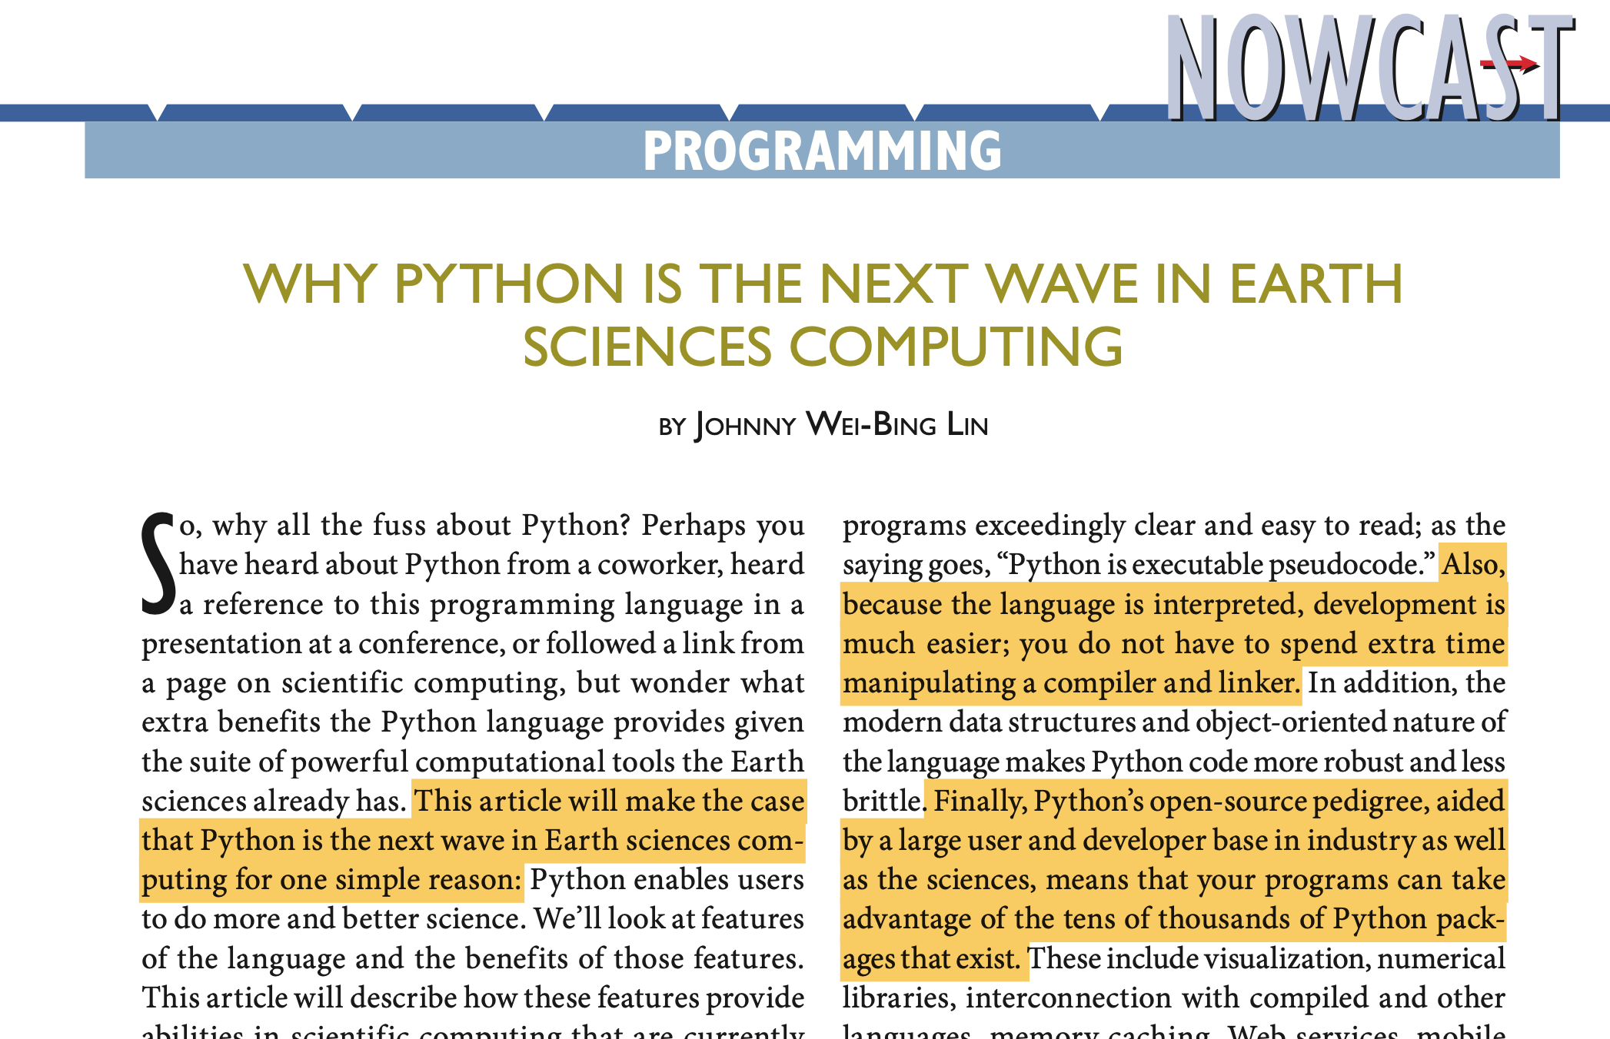
Why Python? http://journals.ametsoc.org/doi/abs/10.1175/BAMS-D-12-00148.1

Slide 6
Why Python?
Interpreted.
Used for both computation and visualization.
Computation : support arrays, math /statistics function.
Visualization : plotting contours, maps ….
Free

Slide 7
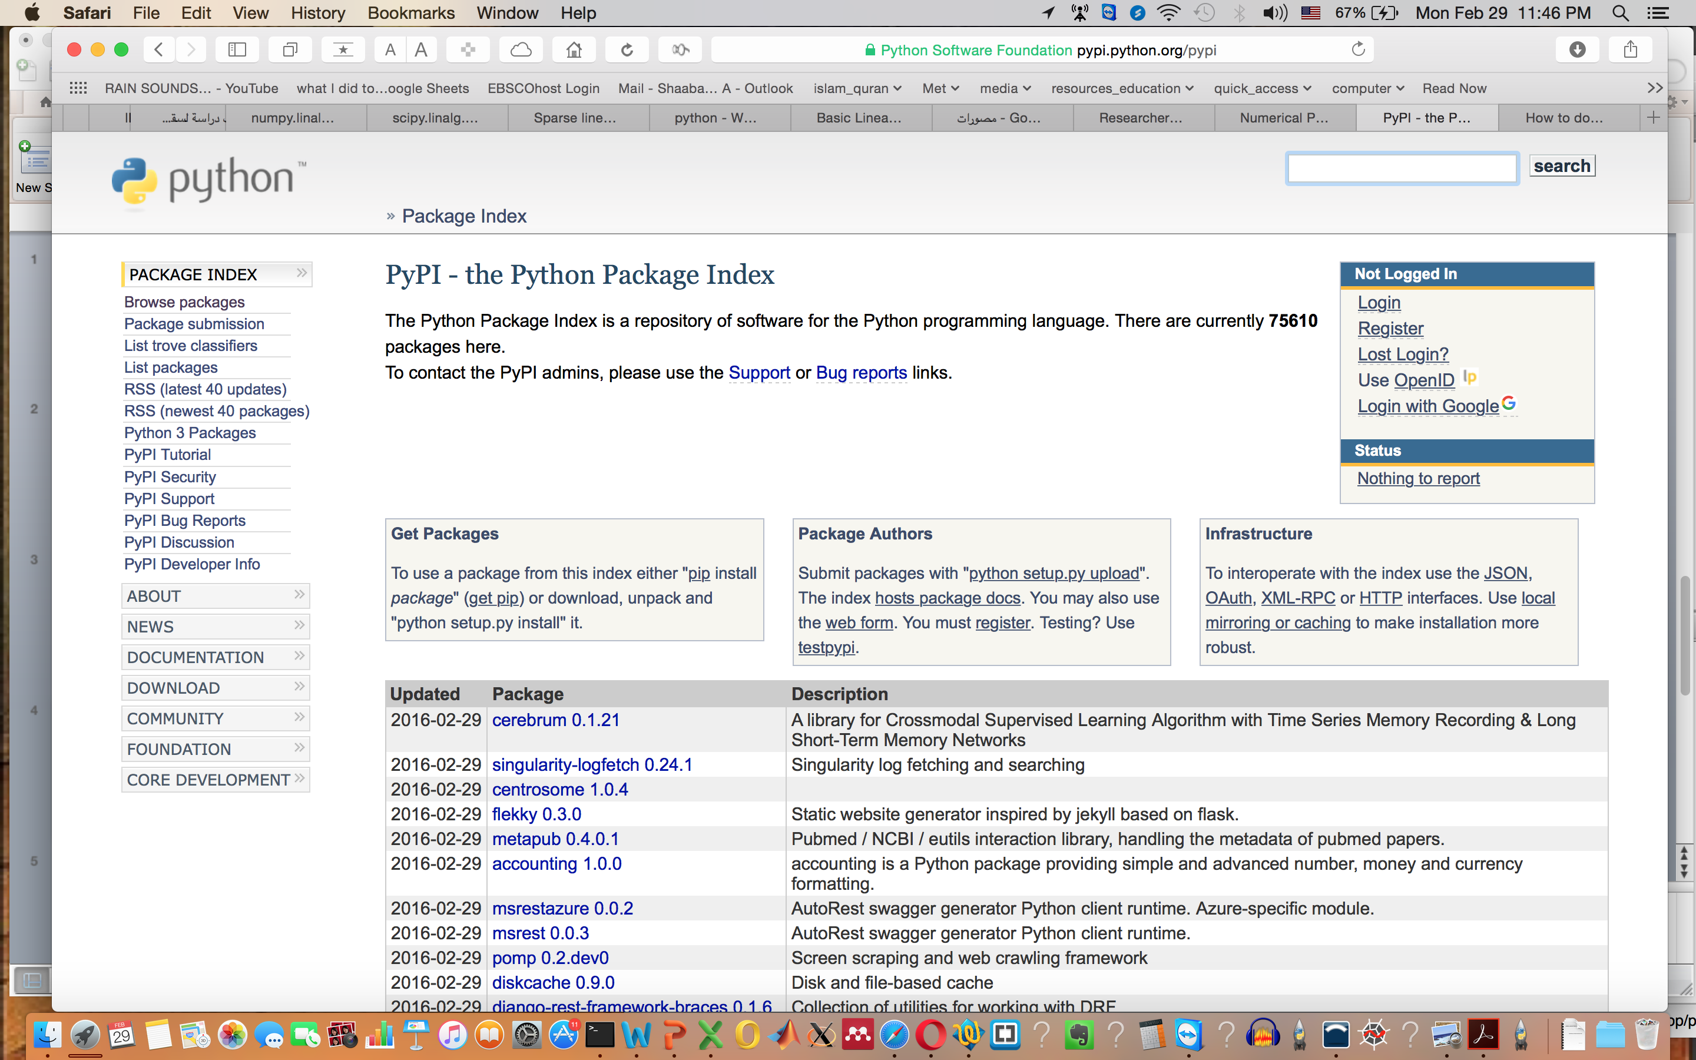
75610 Packages

Slide 8
Packages for Met. application
https://github.com/jjrennie/GHCNpy
https://pyaos.github.io (see the list of libraries)
https://unidata.github.io/MetPy/latest/examples/index.html
https://www.pyngl.ucar.edu/
https://wrf-python.readthedocs.io/en/latest/

Slide 9
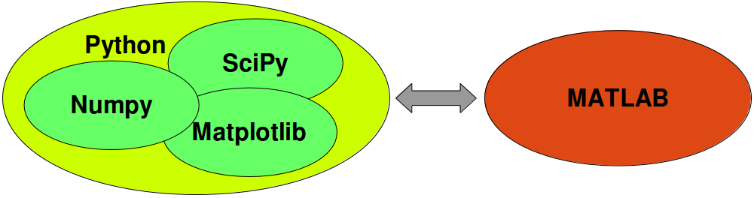
Main packages to use for Earth Sciences applications
Numpy Numerical Python ➔ array oriented operations.
SciPy scientific python ➔ Linear System, Statitiscs, FFT,…
MatplotLib Matlab plot library ➔ Visulaizations.
Pandas ➔ data and time series operation.
Matplotlib is a pure python plotting library with the goal of making publication quality plots using a syntax familiar to matlab users.

Slide 10
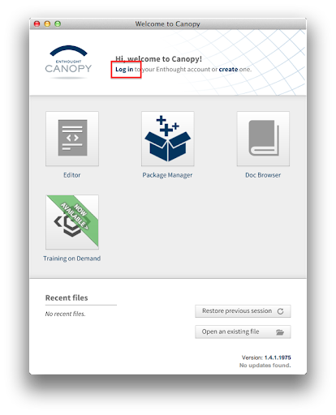
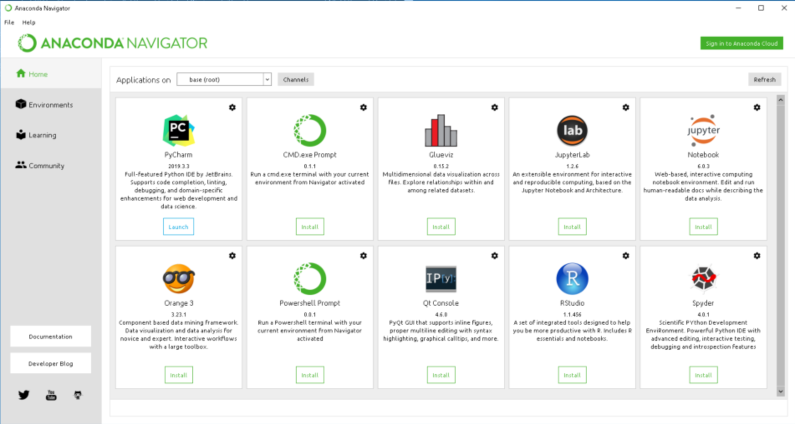
Anaconda IDE : Spyder
Python distributions
Enthought
IDE:Canopy
Notes:
https://www.quora.com/How-does-Enthought-Canopy-compare-to-Anaconda
https://support.enthought.com/hc/en-us/articles/360038600051-Canopy-GUI-end-of-life-transition-to-the-Enthought-Deployment-Manager-EDM-and-Visual-Studio-Code

Slide 11
GUI Vs. Notebook
Both use the same engine
GUI might be preferred when writing script for the background

Slide 12
Some tutorials:
https://www.python-course.eu/index.php
https://www.w3schools.com/python/default.asp
Videos
SciPy and others (Enthoughts) https://www.youtube.com/c/enthought/playlists
MetPy Monday (Unidata) https://www.youtube.com/watch?v=-fOfyHYpKck&list=PLQut5OXpV-0ir4IdllSt1iEZKTwFBa7kO
Udacity, Coursera, Kaggle, …..

Slide 13
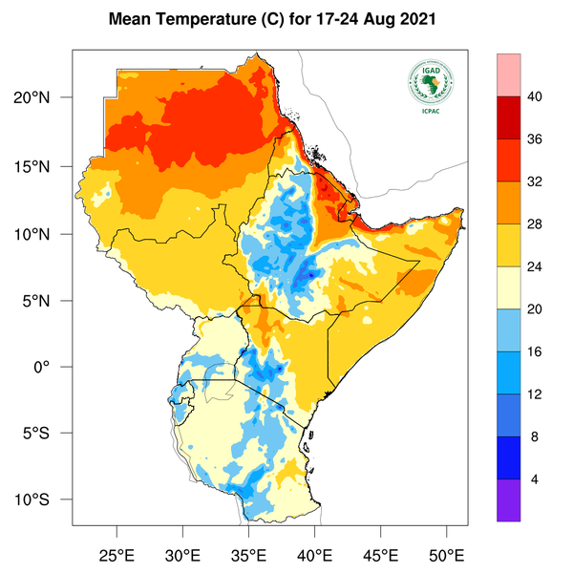
https://www.icpac.net/weekly-forecast/

Slide 14
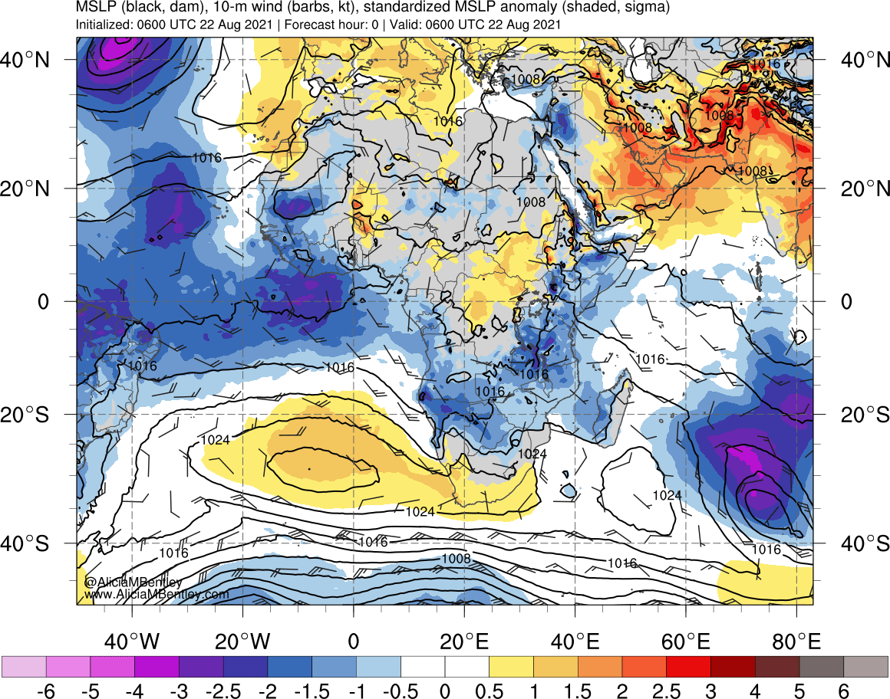
Notes:
http://www.atmos.albany.edu/student/abentley/realtime/anom.php?domain=africa&variable=mslp_anom

Slide 15
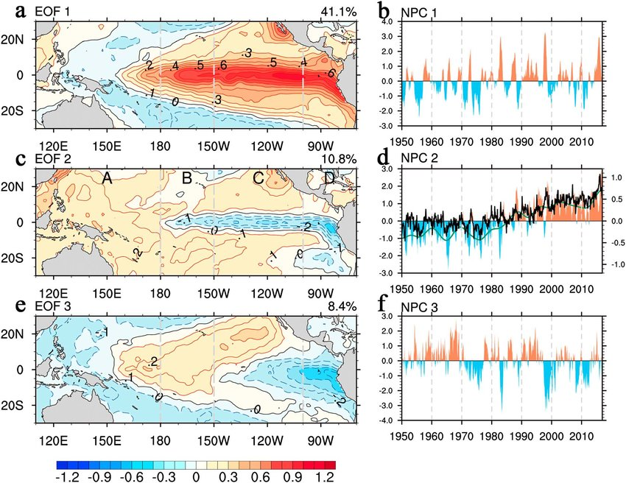

Slide 16
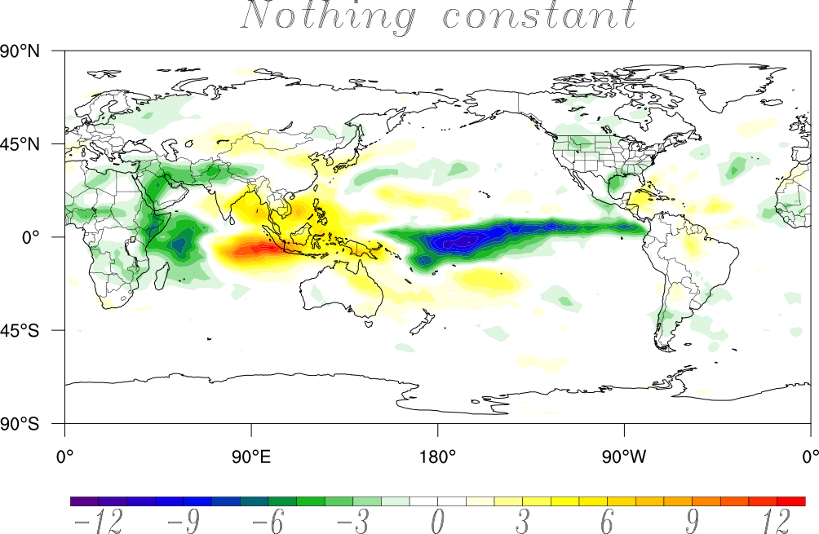
OLR associated with East Africa Precipitation during October

