Slide 1
Python for Earth Sciences applications.
Ahmed Shaaban
Scientific Research Department
Egyptian Meteorological Authority

Slide 2

If this is the first time for you to play with a programming language, then this crash course is probably not for you !!!!!
This crash course is basically for those who wanna to migrate from Matlab, NCL, Fortran & grads,…to Python. In other words, audience should have at least rough idea about basic programming skills (loops, array, function, …)

Slide 3
Why to use/migrates to Python?
AMS conferences.
Next wave (AMS paper)
Communities (Ualbany)
NCL & Matlab.
composites

Slide 4
Python !!
For scientific purposes, when writing a small specialized script, Python may often be the second best choice: for linear algebra, Matlab may have nicer syntax;
For statistics, R is probably nicer.
For heavy regular expression usage, Perl (ugh) might still be nicer.
If you want speed, Fortran or C(++) may be a better choice.
To design a webpage; perhaps you want JavaScript.
Python is not perfect for any of these, but is acceptable for all of them.
https://metarabbit.wordpress.com/2013/10/18/why-python-is-better-than-matlab-for-scientific-software/

Slide 5
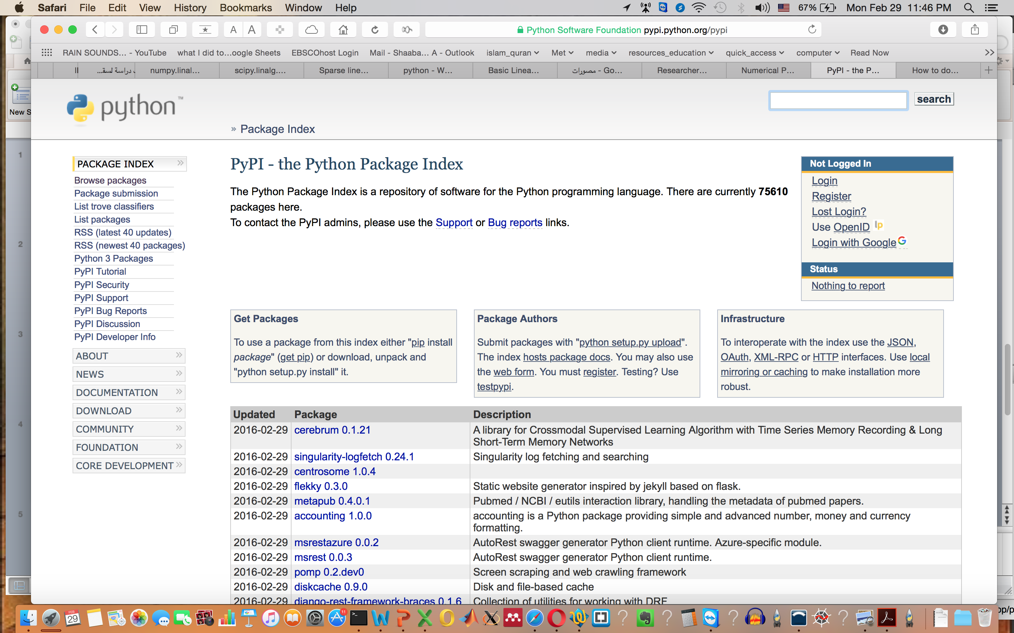
75610 Packages

Slide 6
If your are migrating from MatLab
file://localhost/Volumes/master/data_analysis/codes_center/lecture_python/NumPy_for_Matlab_Users - SciPy wiki dump.pdf
If your are migrating from R

Slide 7
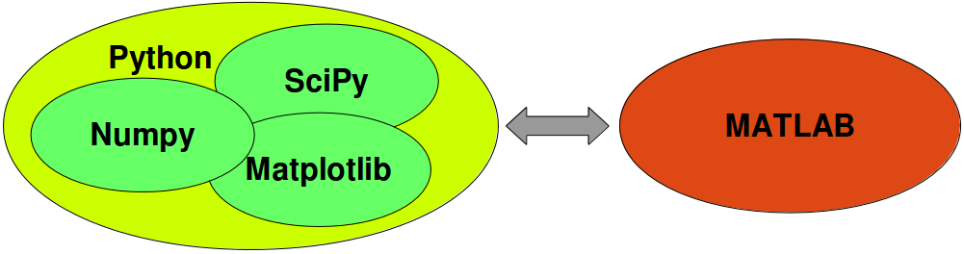
Main packages to use for Earth Sciences applications
Numpy Numerical Python ➔ array oriented operations.
SciPy scientific python ➔ Linear System, Statitiscs, FFT,…
MatplotLib Matlab plot library ➔ Visulaizations.
Pandas ➔ data and time series operation.
Matplotlib is a pure python plotting library with the goal of making publication quality plots using a syntax familiar to matlab users.

Slide 8
Another package for Earth Sciences applications

