Slide 1
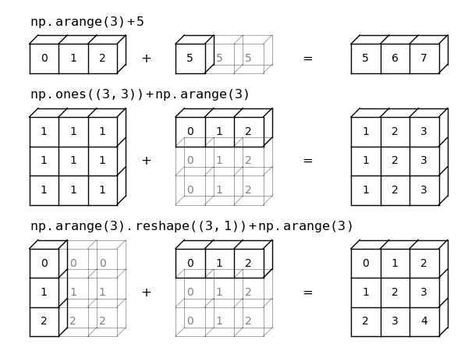
Pytorch/Numpy Broadcasting
Broadcasting describes how numpy treats arrays with different shapes during arithmetic operations. The smaller array is “broadcast” across the larger array so that they have compatible shapes. It does this without making needless copies of data and usually leads to efficient algorithm implementations.
Rules of Broadcasting:
Rule 0: each tensor has at least one dimension(trivial).
Rule 1: if the two arrays differ in their number of
dimensions, the shape of the one with fewer dimensions
is padded with ones on its leading (left) side.
Rule 2: if the shape of the two arrays does not match in
any dimension, the array with shape equal to 1 in that
dimension is stretched to match the other shape.
Rule 3: if in any dimension the sizes disagree and neither
is equal to 1, an error is raised.

