Slide 1


V I S U A L I Z E
Education
Conflict
Ahmed Shah - Umair Qazi - Sannan Tariq

Slide 2
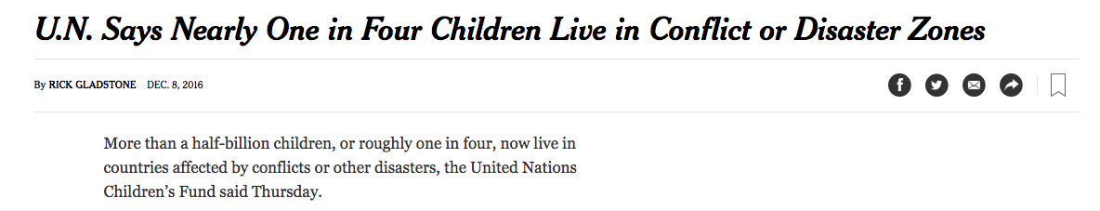
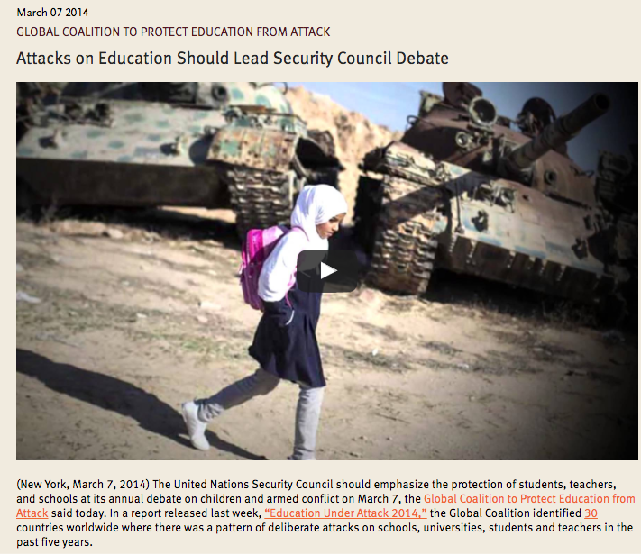
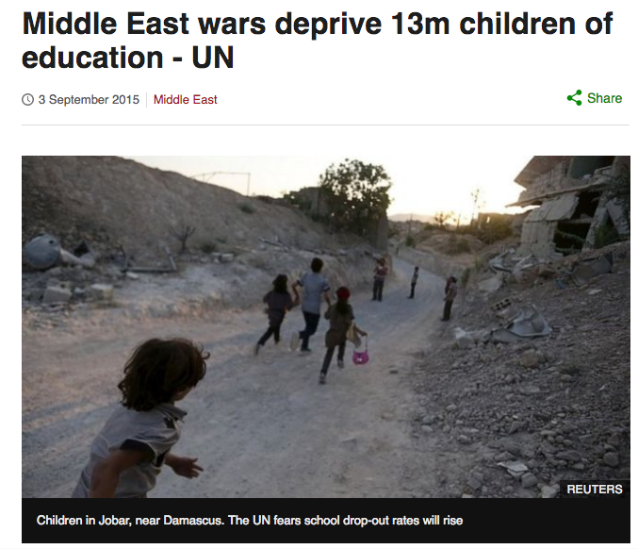
Problem

Slide 3
Some figures
1 3
Million children deprived of Education
5 0
Million uprooted from their homes

Slide 4

Solution
Data Collection
Data Visualizations
Standard Global Platform
Data Analytics

Slide 5


VAL
Education
Conflict
Protecting Education across the World

Slide 6



Solution
Analytics
Visualize
Learning
VAL

Slide 7

VAL
Protecting Education across the World
Data collection from multiples sources
Data Analytics using Machine Learning
Data visualizations using graphs
Easy to use
Multilingual support
VAL

Slide 8

Notes:
Prof. George White about Entrepreneurship

Slide 9

Technologies used
VAL

Slide 10
Time to protect. Education is a basic right
Launch in Qatar
Collaborate with Organizations
Scale and go global
VAL

Slide 11
Thank you! Try it out at umairqazi.com

