Slide 1
CREDIT CARD CUSTOMER ATTRITION (CHURN) PREDICTION
CAPSTONE PROJECT TWO
DATA SCIENCE CAREER TRACK
SPRINGBOARD
SHAHJAHAN AHMED
OCTOBER 27, 2021

Slide 2
Problem Statement
Predict the credit card customer attrition rate and find the potential churning customers by analyzing data for a specific period (last twelve month) of time to minimize churn rate by providing better service for company’s growth and financial stability.

Slide 3
Introduction
Churn Prediction is one of the most popular Big Data use cases in banking sector. It consists of detecting account holders who are likely to close their account or stop using the services.
The ability to predict that a particular credit card holder is at a high risk of churning, while there is still time to do something about it, represents a huge additional potential revenue source for a Bank.
It helps the stakeholders to make proactive changes to the retention efforts that drive down churn rates.

Slide 4
Stakeholders
Board of Directors
Chief Executive Officer
Chief Financial Officer
Territorial Heads
Branch Managers
Financial Analyst

Slide 5
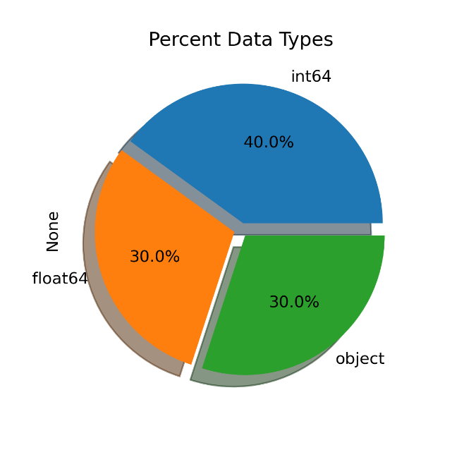
Dataset Summary
The pie chart showing the distribution of attributes Based on Data Type.
Approximately 70% of the attributes contained numerical data.
30% of the attributes contained categorical data.
Among numerical attributes, few columns are discrete.

Slide 6
Exploratory Data Analysis Steps
Distribution of Numerical Attributes
Finding Normality
Distribution of Categorical Attributes
Visualizing Outliers
Visualizing Correlations

Slide 7
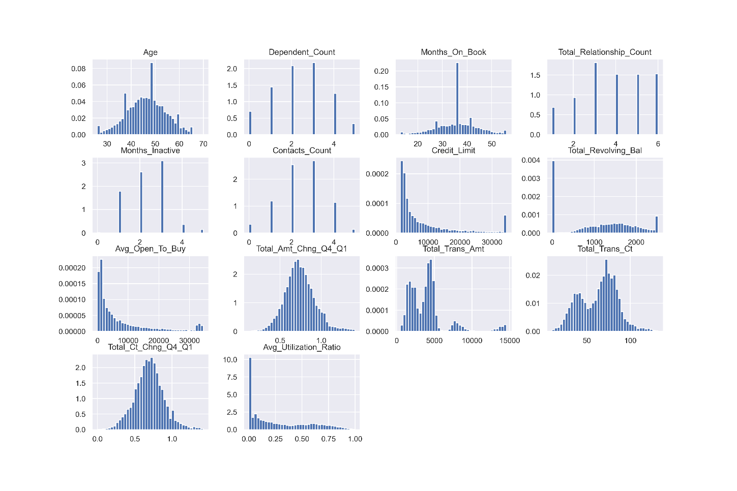
Numerical Attributes
The histogram is showing the distribution of numerical attributes.
The distribution of few attributes are approximately normal.
Few attributes are skewed to the right.
Few attributes are bimodal, and the rest does not have any relationship at all.

Slide 8
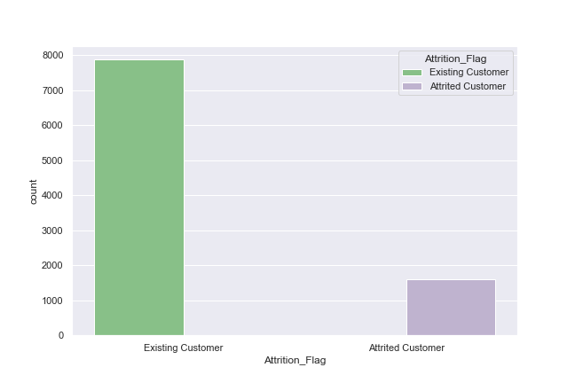
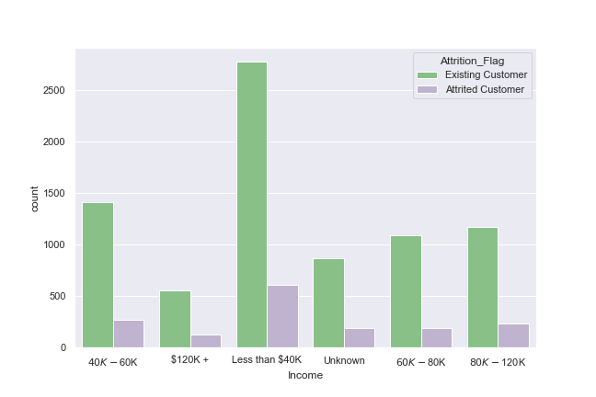
Distribution of Categorical Attributes
The distribution of categorical attributes
The target attributes contained class imbalance data
A significant number of customers Income is below $40K.

Slide 9
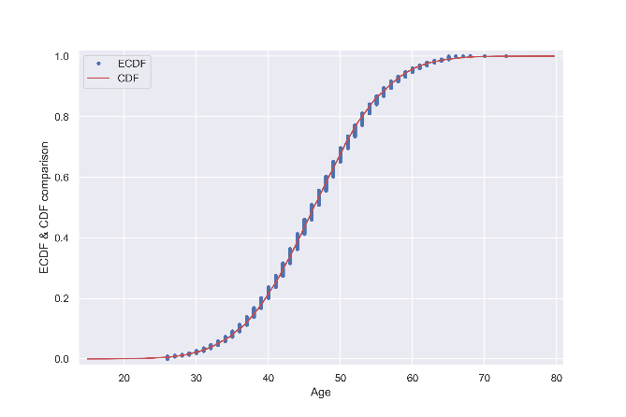
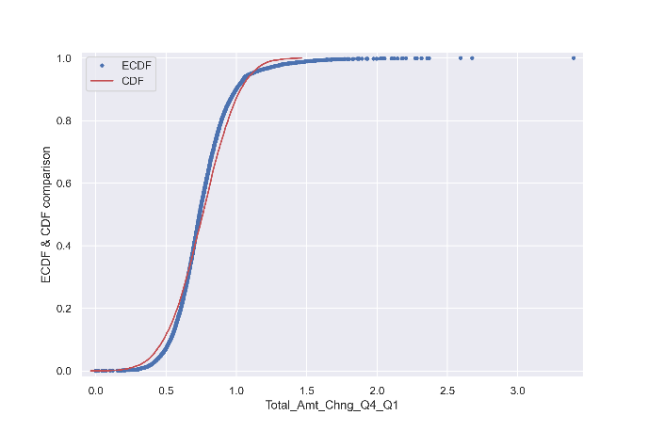
Visualizing Normality using ECDF
The distribution of Age is normal.
Few other columns distribution are also approximately normal.
The rest of the attributes have no normality.
Fig. Theoretical cdf and ecdf comparison of numerical columns

Slide 10
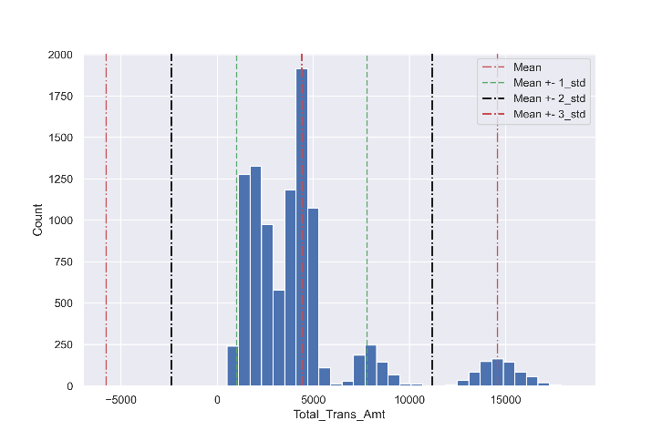
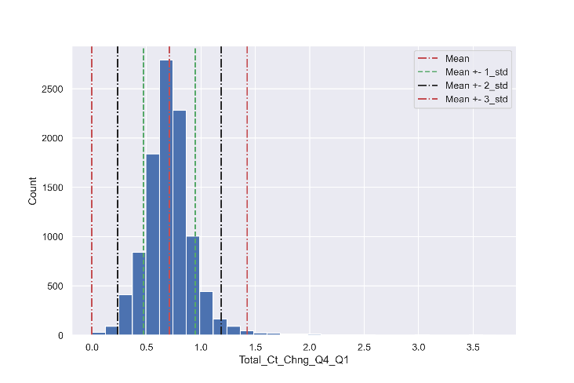

Visualizing Outliers
Standard deviation ($Mean±3∗Standard_Deviation)$ based outlier detection.
By observing the histogram and vertical lines (Mean, $Mean±3∗Standard_Deviation$) it is clear that some numerical attribute contains outliers.
Fig. $Mean±3∗Standard_Deviation$ based outlier detection.

Slide 11
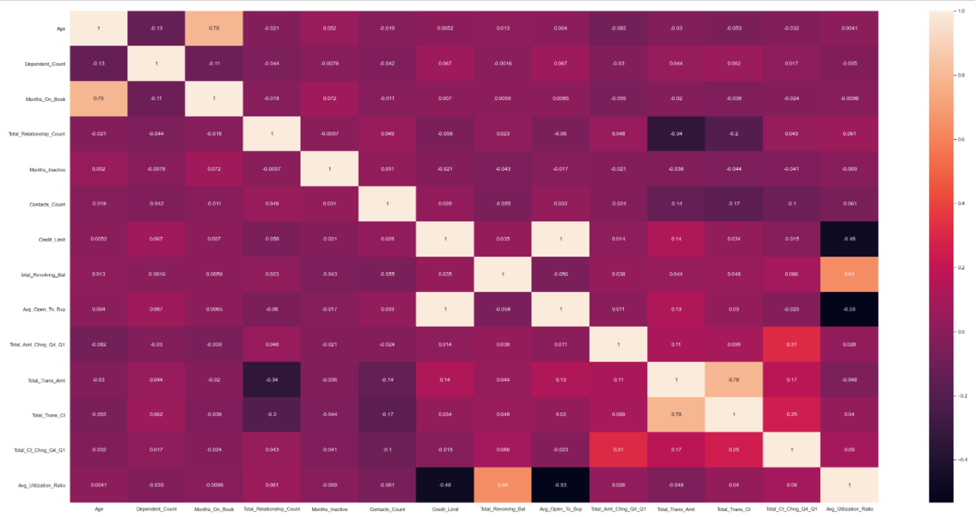
Visualizing Correlations
Heatmaps are essential for visualizing the correlation between columns.
Few columns have significantly high positive correlations
Few others have correlations, that are not too high.
Fig. Correlation between numerical attributes

Slide 12
Modeling Steps
Preprocess the data
Tuning hyperparameters for each model
Train and Test each model using best hyperparameters
Evaluate using evaluation metrics
Find the best model

Slide 13
Preprocessing
Encoded the target attribute ‘Attrition_Flag’ to binary 1 and 0 (‘1’ for 'Attrited Customer' and ‘0’ for 'Existing Customer’).
Separated the dependent variable y, and the independent variables X from the dataset.
Split the data (X and y) into train and test for performing training and evaluation for each classifier.
Used StandardScaler() function for scaling the training and test set separately.
Used the pandas get_dummies() function for one hot encoding of the categorical attributes.

Slide 14
ML Models used for Customer Churn prediction
KNN Classifier
Logistic Regression Classifier
Decision Tree Classifier
SVM Classifier
Random Forest Classifier
Gradient Boosting Classifier
XGBoost Classifier

Slide 15
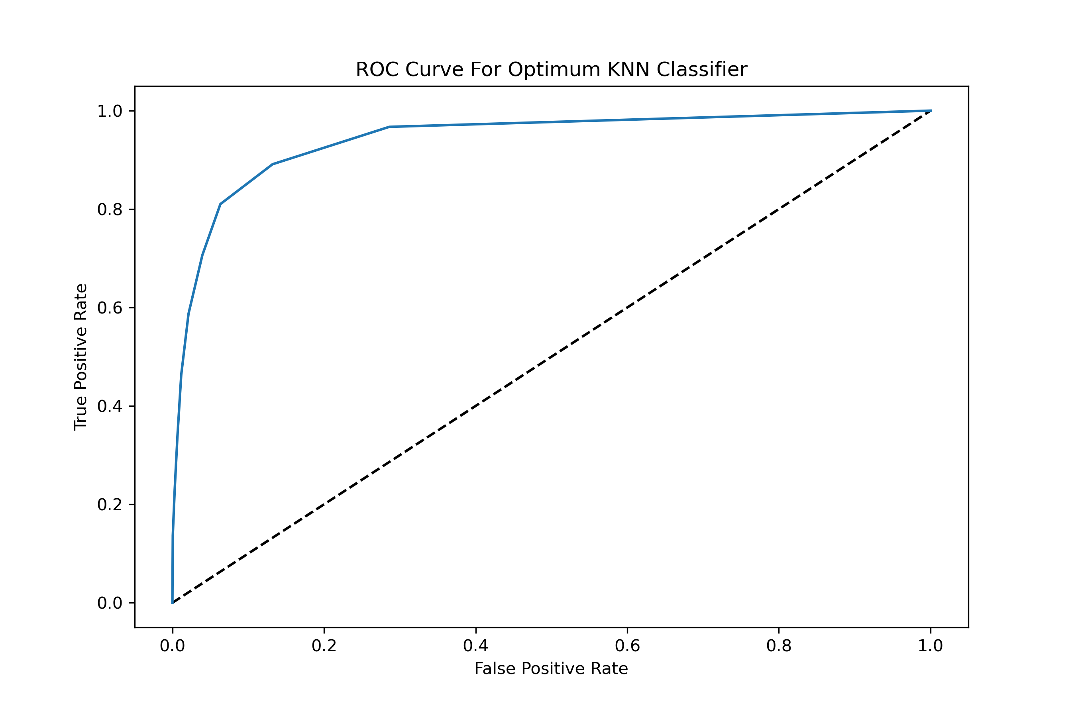
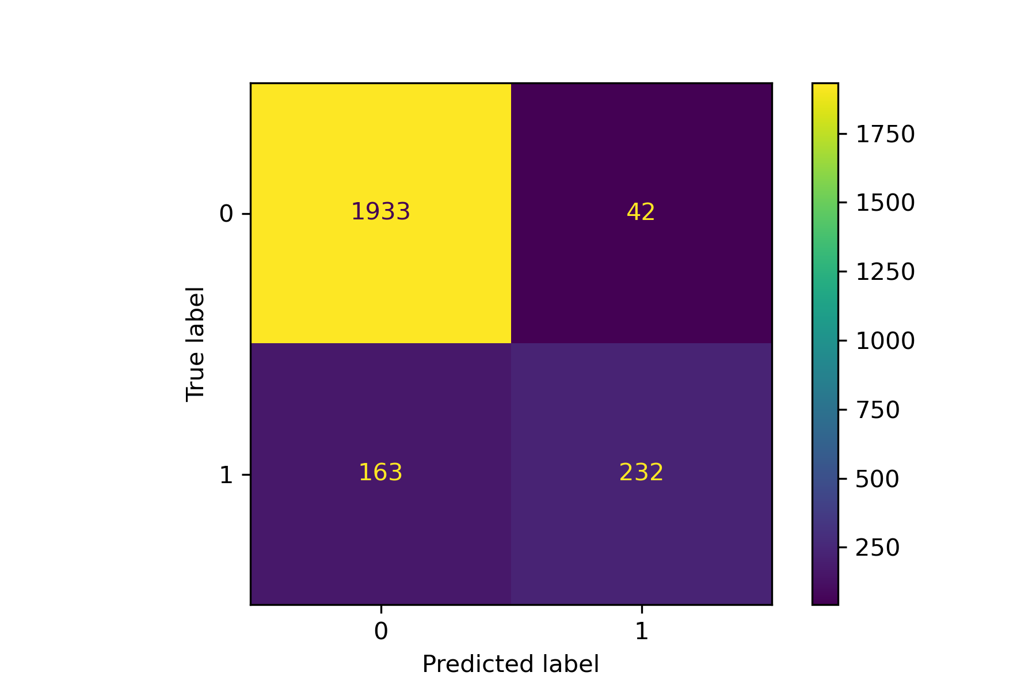
Customer Churn Prediction using KNN Classifier
Training Accuracy: 0.951
Test Accuracy: 0.904
Precision Score: 0.791
Recall Score: 0.603
F1 Score: 0.902
Area Under ROC: 0.895

Slide 16
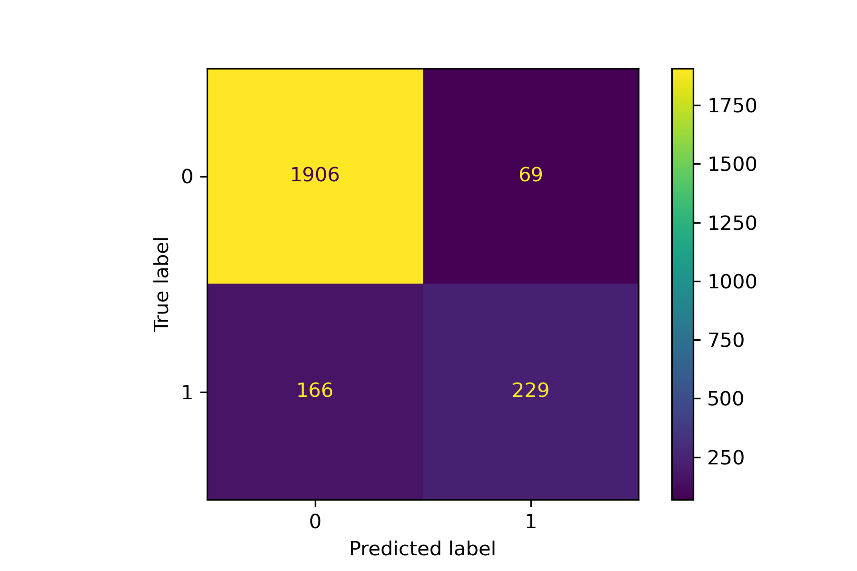
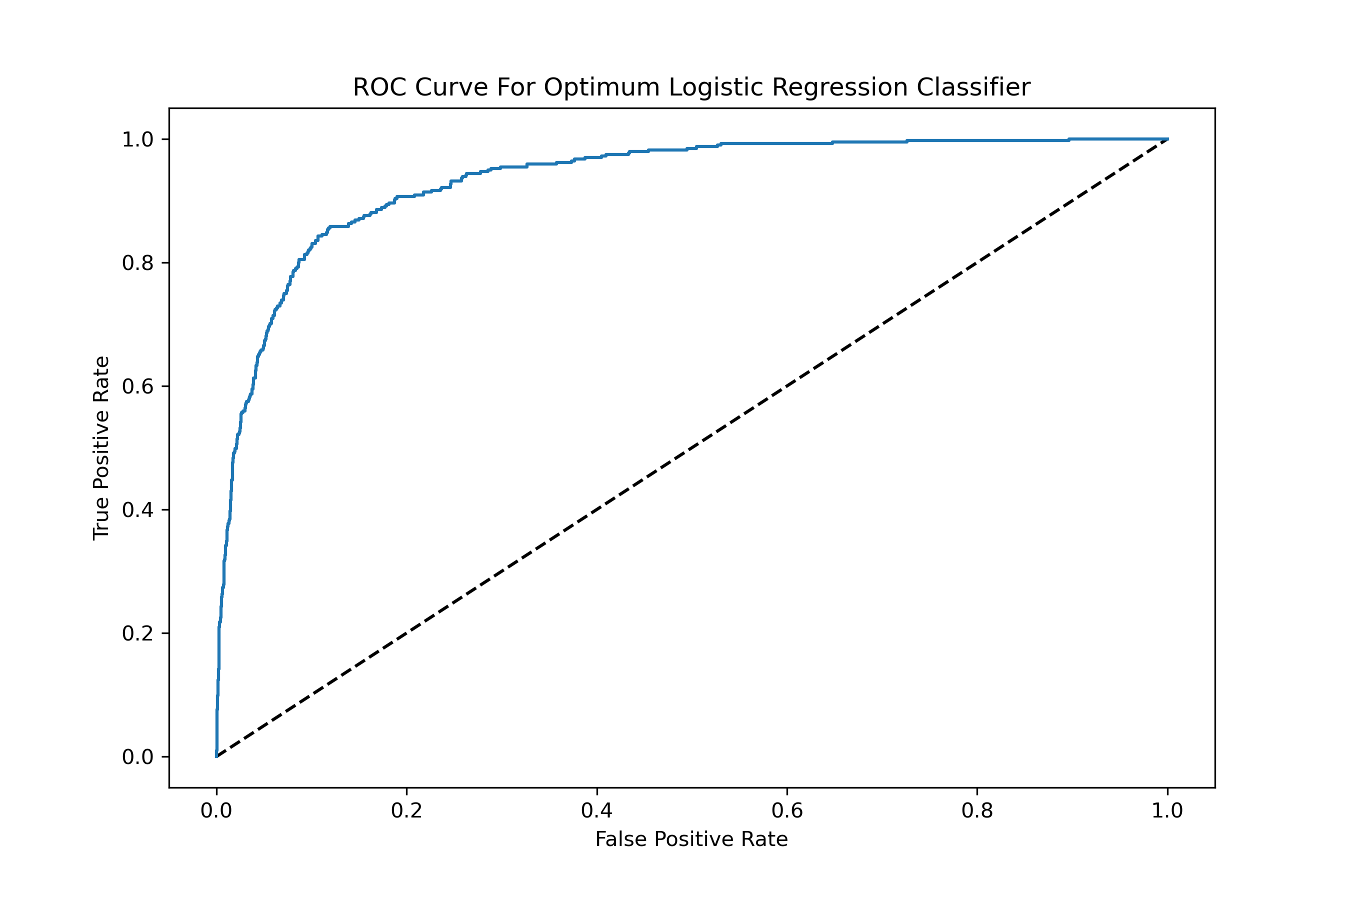
Customer Churn Prediction using Logistic Regression Classifier
Training Accuracy: 0.900
Test Accuracy: 0.901
Precision Score: 0.768
Recall Score: 0.580
F1 Score: 0.895
Area Under ROC: 0.934

Slide 17
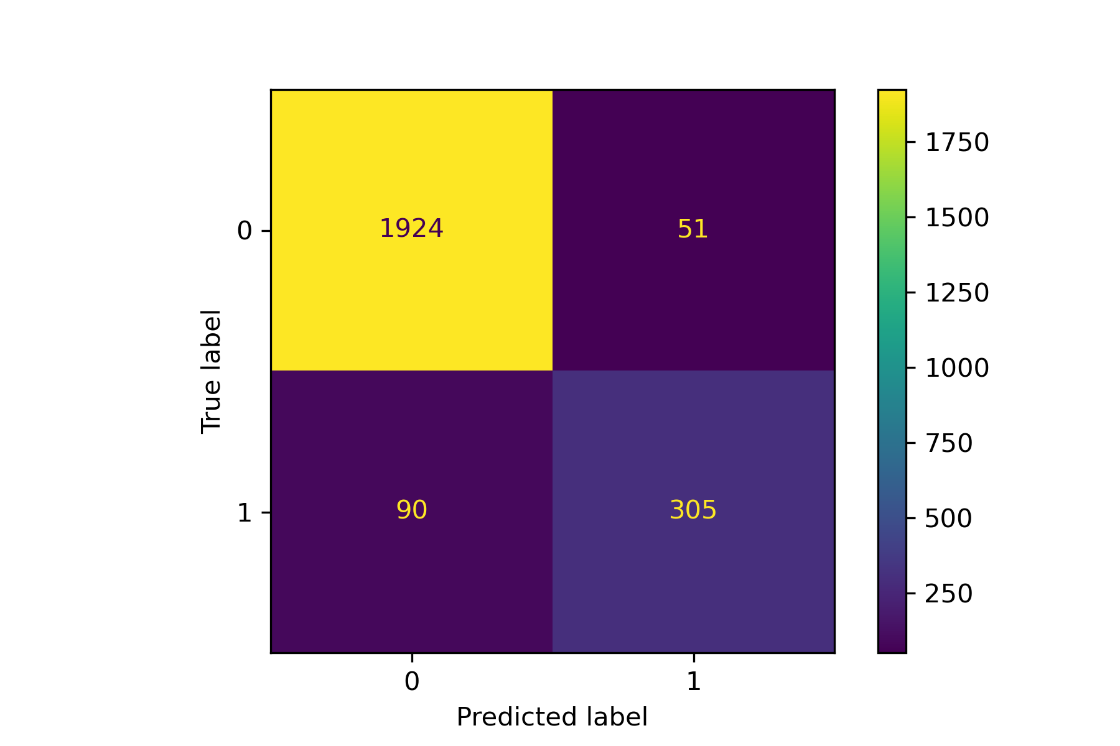
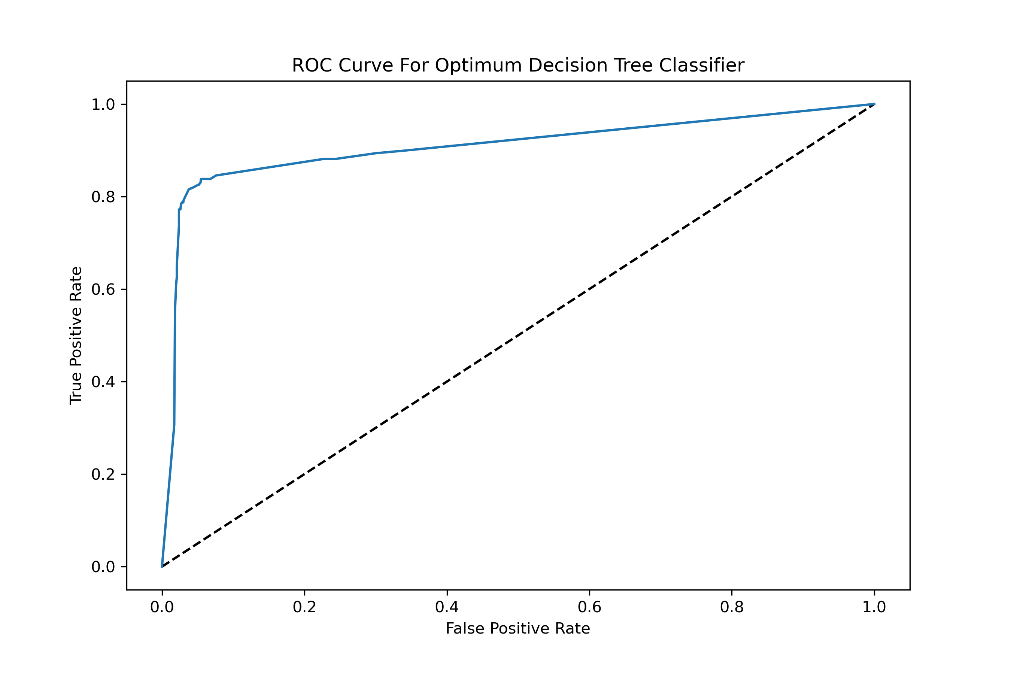
Customer Churn Prediction using Decision Tree Classifier
Training Accuracy: 0.982
Test Accuracy: 0.938
Precision Score: 0.853
Recall Score: 0.762
F1 Score: 0.937
Area Under ROC: 0.900

Slide 18
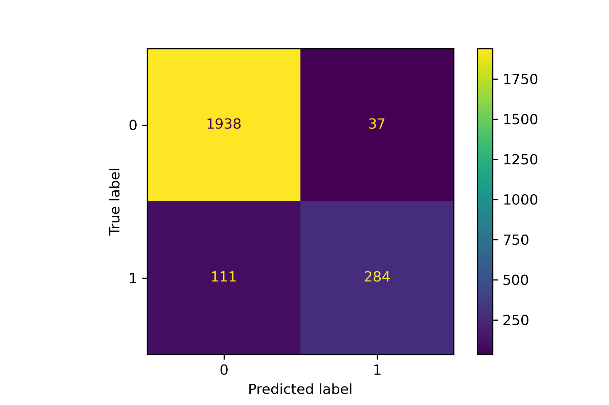
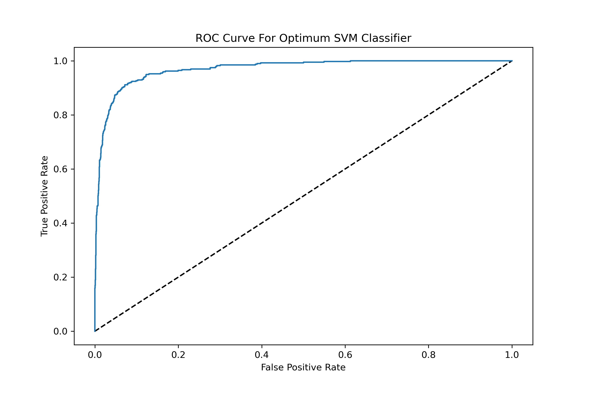
Customer Churn Prediction using SVM Classifier
Training Accuracy: 0.966
Test Accuracy: 0.938
Precision Score: 0.885
Recall Score: 0.719
F1 Score: 0.935
Area Under ROC: 0.970

Slide 19

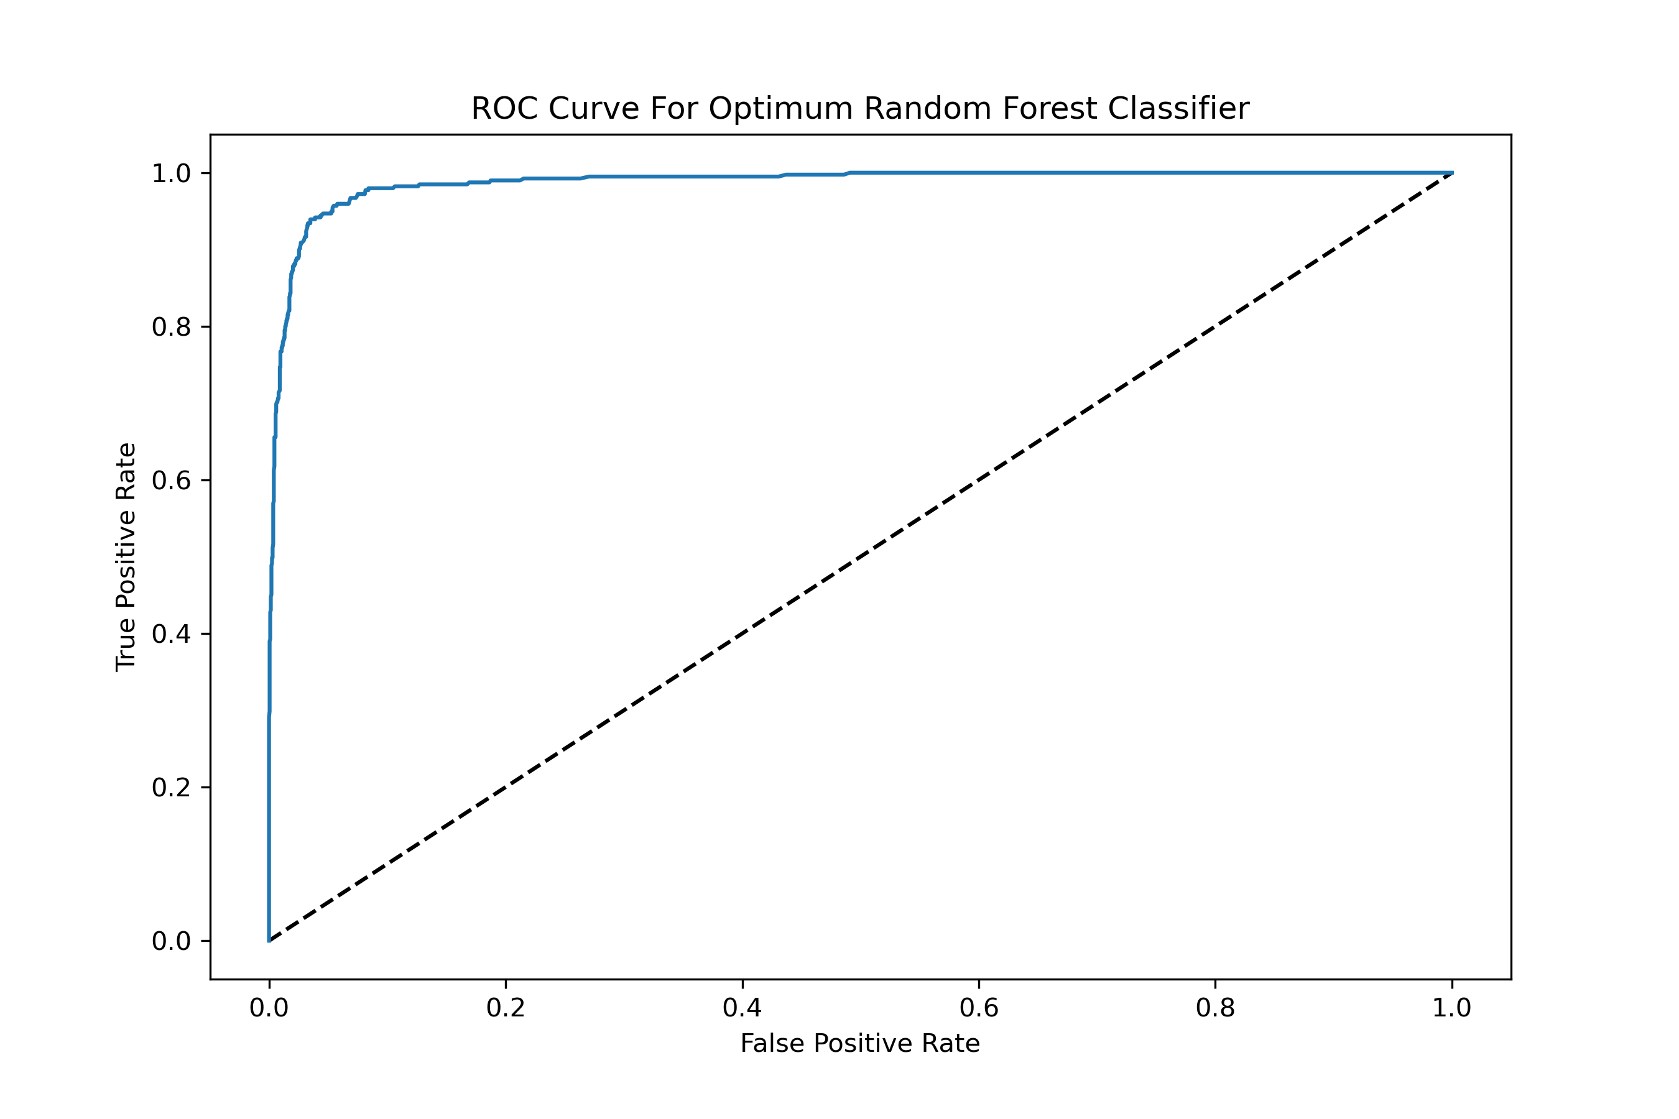
Customer Churn Prediction using Random Forest Classifier
Training Accuracy: 1.000
Test Accuracy: 0.958
Precision Score: 0.909
Recall Score: 0.830
F1 Score: 0.957
Area Under ROC: 0.987

Slide 20


Customer Churn Prediction using Gradient Boosting Classifier
Training Accuracy: 0.997
Test Accuracy: 0.973
Precision Score: 0.934
Recall Score: 0.901
F1 Score: 0.973
Area Under ROC: 0.994

Slide 21

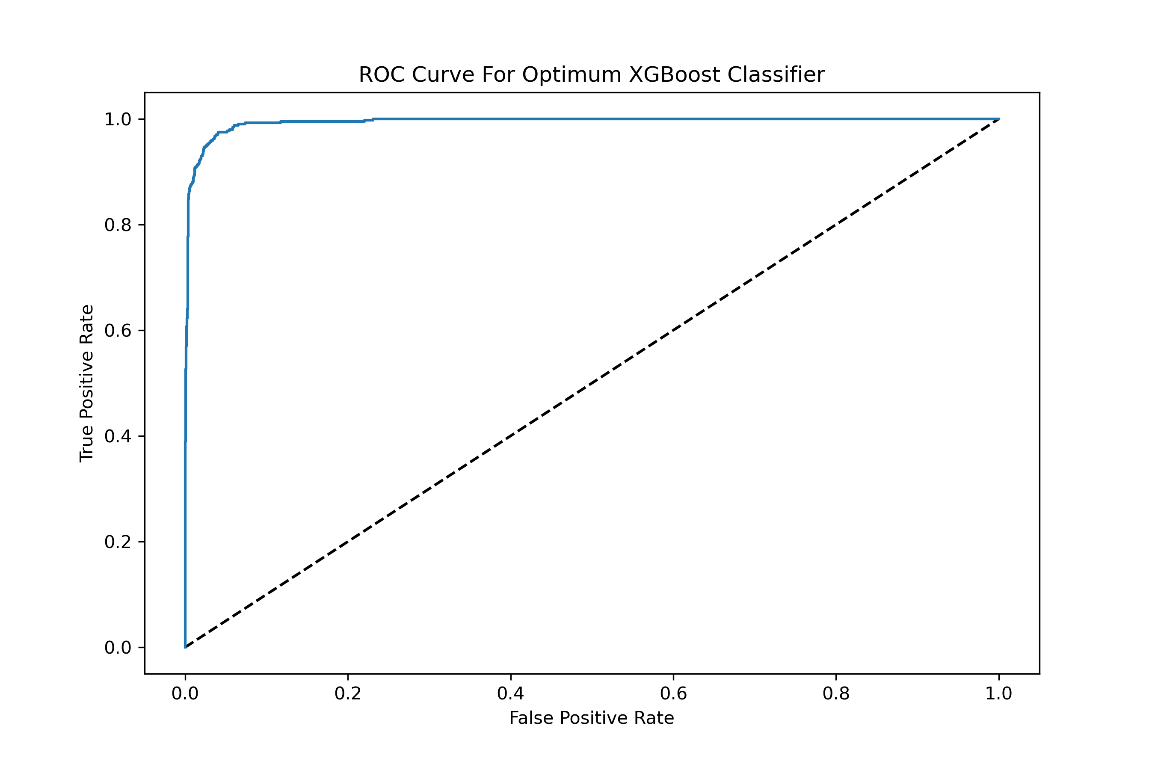
Customer Churn Prediction using XGBoost Classifier
Training Accuracy: 0.999
Test Accuracy: 0.974
Precision Score: 0.935
Recall Score: 0.909
F1 Score: 0.974
Area Under ROC: 0.994

Slide 22
Best Model for Predicting Customer Churn and Findings
The XGBoost Classifier outperformed well based on all model evaluation metrics I have used.
I have used the metric ‘Recall’ as my main evaluation metric.
To predict all possible churning customer the false negatives should be low, and recall should be high.
Despite the class imbalance data, the ‘Recall’ value of 0.909 or 91% indicates that my model worked well on predicting possible churning customers.
Also, the ‘F1 Score’ of 0.974 and the Area under roc curve of 0.994 indicates that my model performed well.

Slide 23
Table showing the comparison among all Models Outcome
Evaluation Metrics | Training Accuracy | Test Accuracy | Precision Score | Recall Score | F1 Score | Area Under ROC
ML Models
KNN | 0.951 | 0.907 | 0.791 | 0.603 | 0.902 | 0.895
Logistic Regression | 0.900 | 0.901 | 0.768 | 0.580 | 0.895 | 0.934
Decision Tree | 0.982 | 0.938 | 0.853 | 0.762 | 0.937 | 0.900
SVM | 0.966 | 0.938 | 0.885 | 0.719 | 0.935 | 0.970
Random Forest | 1.000 | 0.958 | 0.909 | 0.830 | 0.957 | 0.987
Gradient Boosting | 0.997 | 0.973 | 0.934 | 0.901 | 0.973 | 0.994
XGBoost | 0.999 | 0.974 | 0.935 | 0.909 | 0.974 | 0.994

Slide 24
Conclusion
The target attributes have class imbalance data, and approximately 16% of the customers are labeled with ‘Attrited Customer’ and the remaining 84% customers are labeled with ‘Current Customer’.
Despite of the class imbalance, the ‘Recall’ value of 0.909 or 91%, ‘F1 Score’ of 0.974, and AUROC of 0.994 indicates that the XGBoost classifier accurately predicted the possible churning customers.

Slide 25
Future Work
There are also few correlations, and outliers in the dataset
Due to those irregularities my model did not get 100% accuracy on all the metrices.
Spending more time on preprocessing to tackle those issues will be helpful to get better accuracy on each of the evaluation metrics I have used.

Slide 26
Thank You

