Slide 1
Ds_job
Salaries
Let’s see my project

Slide 2
WHAT IS THIS
PROJECT?

Slide 3
This project is about
That there is database with data jobs data and my goal is to get what are best data jobs

Slide 4






Tools I have used
1: Visual studio code
4: pandas library
2: Python language
2: sql language
3: jupyter notebook
3: Matplotlib library

Slide 5
Analysis steps
1
Gathering Data
3
Cleaning Data
2
Investigating Data
4
Visualizing Data

Slide 6
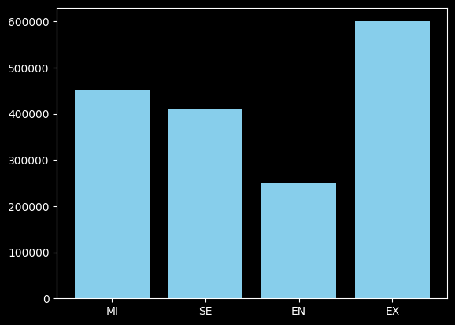
First insight:
When you experience level increase the salary increase

Slide 7
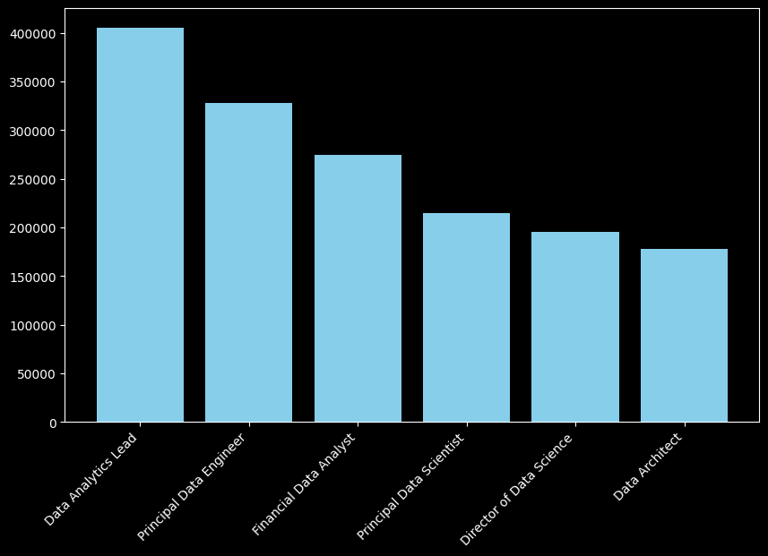
Second insight:
Data Analytics Lead jobs is the most job in salary

Slide 8
conclusion:
1 Iwork hard to increase the experience level
2 choose a job from the top 10 jobs

Slide 9
Thanks for your time
👋

