Slide 1
Diabetes Project
Let’s see my project

Slide 2
WHAT IS THIS
PROJECT?

Slide 3
This project is about
That there is diabetes dataset and my goal is to see what factors affect on diabetes existence

Slide 4





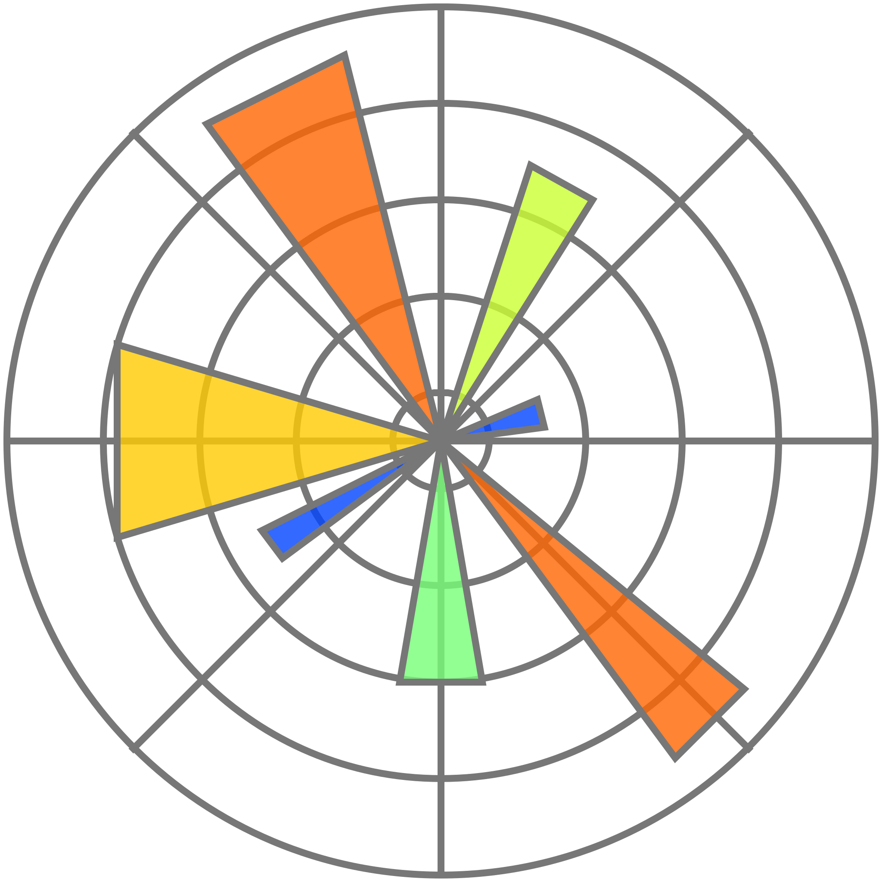
Tools I have used
1: Visual studio code
4: pandas library
2: Python language
2: Numpy library
3: jupyter notebook
3: Matplotlib library

Slide 5
Analysis steps
1
Gathering Data
3
Cleaning Data
2
Investigating Data
4
Visualizing Data

Slide 6
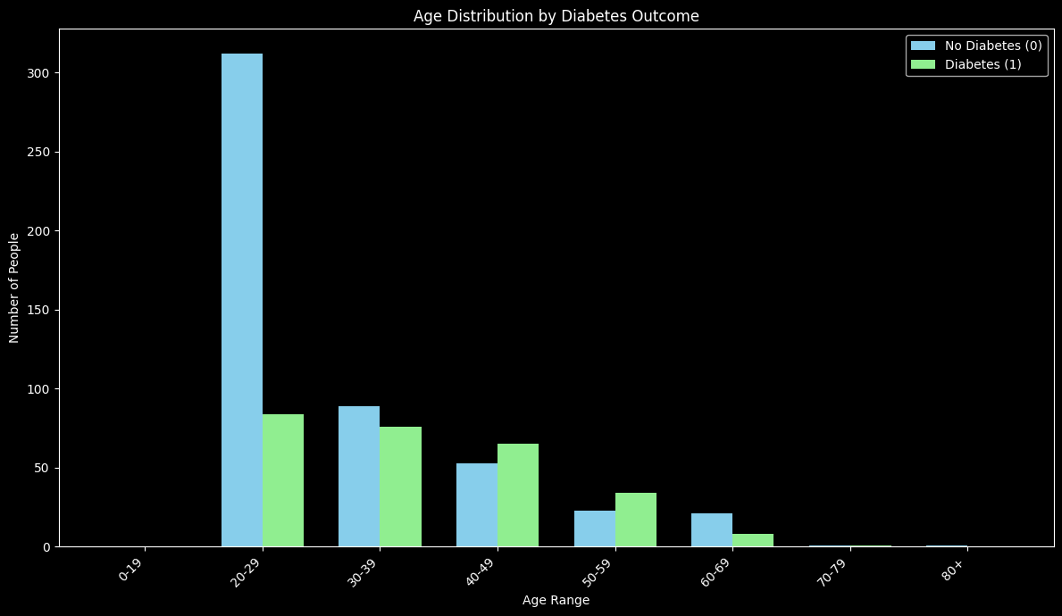
First insight:
When age increase the diabetes existence increase

Slide 7
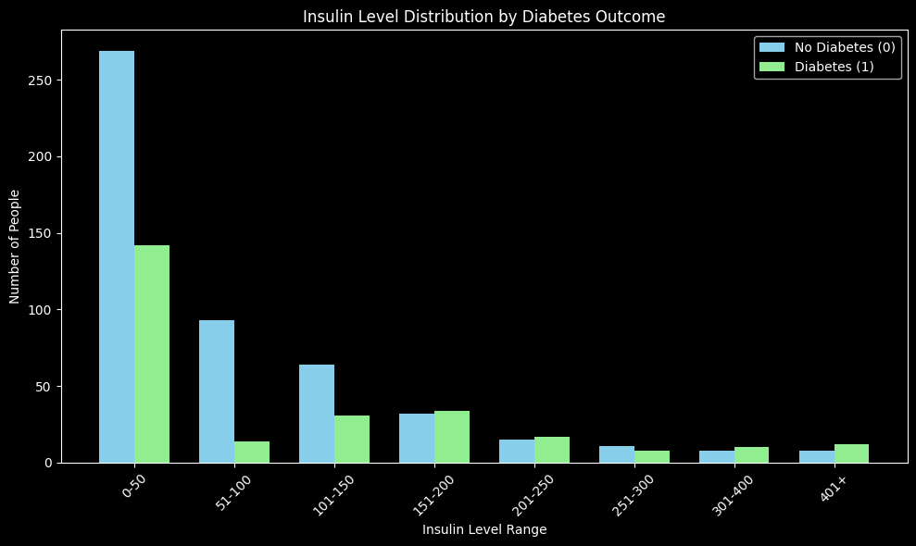
Second insight:
When insulin level increase , the diabetes existence decrease

Slide 8
conclusion:
1 You should follow your insulin level
2 Follow a good diet to ensure that your age won’t affect on diabetes existence

Slide 9
Thanks for your time
👋

