Slide 1
HR Analytics: Job Change of Data Scientists
Predicting Candidate Job-Change Likelihood

Slide 2
1. The Problem
A company offers free data-science training. Some trainees stay; others use it as a stepping stone.
Training every candidate is costly. The company needs to identify — in advance — who is likely to leave, so retention and hiring efforts focus on the right people.
Framed as binary classification: Target = 1 → Looking for a new job Target = 0 → Not looking

Slide 3
2. Dataset Overview
Source: HR Analytics — Job Change of Data Scientists (Kaggle)
19,158
Training Rows
14
Columns (13 features + target)
2,129
Test Rows (unlabeled)
75.1% / 24.9%
Class Balance (imbalanced)
Key Data Quality Issues & Handling:
• Missing values up to 32% — kept as own category (carries signal)
• Disguised numeric text ('<1', '>20', 'never') — mapped to integers
• High-cardinality city (123 values) — dropped, used city_development_index
• Engineered feature: missing company info flag → 2× higher job-hunt rate

Slide 4
3. Methodology & Approach
1
Preprocessing
Cleaned, encoded, stratified 80/20 split
2
5 Models
Logistic Regression, KNN, SVM, Random Forest, XGBoost
3
Class Imbalance
class_weight='balanced' / scale_pos_weight applied
4
Threshold Tuning
19 thresholds (0.05–0.95), F1-maximizing chosen per model
5
Evaluation
F1-score as primary metric (balances precision & recall)

Slide 5
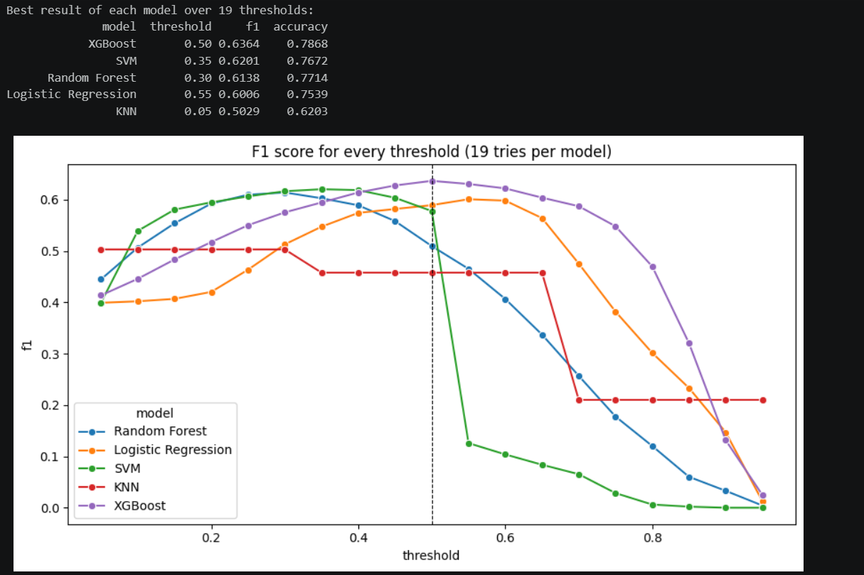
4. Results — Model Comparison
Best F1 per Model
XGBoost: F1 = 0.6364 (thresh 0.50)
SVM: F1 = 0.6201 (thresh 0.35)
Random Forest: F1 = 0.6138 (thresh 0.30)
Logistic Regression: F1 = 0.6006 (thresh 0.55)
KNN: F1 = 0.5029 (thresh 0.05)

Slide 6
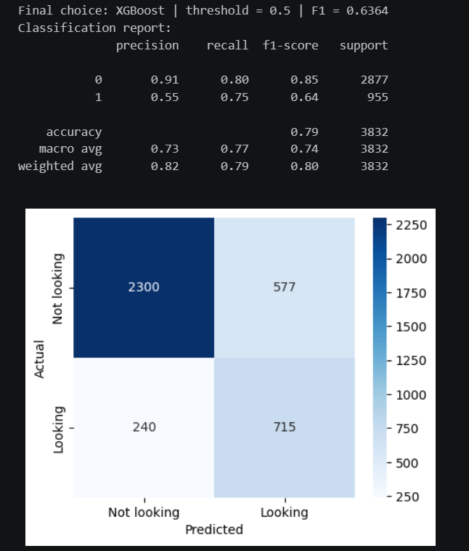
4. Results — Final Model: XGBoost
Performance Metrics
Precision (class 1): 0.55
Recall (class 1): 0.75
F1-Score (class 1): 0.64
Overall Accuracy: 0.79
5-Fold Cross-Validation
Mean F1 = 0.613 ± 0.005 (stable across folds)

Slide 7
5. Business Impact & Candidate Ranking
HR teams need a prioritized shortlist, not a flat flag list.
Precision@k (Validation Set)
k = 10: Precision = 0.60 (6 / 10 correct)
k = 20: Precision = 0.60 (12 / 20 correct)
k = 50: Precision = 0.66 (33 / 50 correct)
k = 100: Precision = 0.61 (61 / 100 correct)
Business Value
✓ 2.4–2.6× better than random guessing
✓ Focus retention budget on high-risk candidates
✓ Reduce wasted outreach to stable trainees
✓ Actionable Top-10 list for limited HR capacity
Key Insight: Missing company info is a strong predictor — candidates without it are 2× more likely to job-hunt.

Slide 8
Thank You

