Slide 1


Slide 2

NeuroScan: Advanced Brain Tumor Detection System

Slide 3
Group Id:- S2402CCFFE
Ahmed Kamal BC220422733

Slide 4

INTRODUCTION OF PROJECT
Overview:-
NeuroScan is an innovative AI-powered system designed to aid in the early detection and diagnosis of brain tumors.
Utilizes advanced deep learning algorithms and neural networks to analyze medical imaging data.
Aimed at enhancing diagnostic accuracy, reducing human error, and supporting medical professionals in clinical decision-making.
Key Features:-
Automated Detection: Quickly identifies and classifies brain tumors from MRI scans, streamlining the diagnostic process.
User-Friendly Interface: Easy-to-navigate application with an intuitive GUI, accessible to both medical professionals and researchers.
Real-time Processing: Offers rapid analysis and results, providing immediate feedback to healthcare providers.

Slide 5
INTRODUCTION OF PROJECT
Technical Specifications:-
Deep Learning Model: Implements convolutional neural networks (CNNs) trained on extensive datasets for precise image recognition.
Preprocessing and Augmentation: Includes steps like normalization, noise reduction, and data augmentation techniques (rotation, scaling, etc.) to improve model performance.
Integration with Medical Systems: Compatible with existing hospital information systems and supports multiple imaging formats.
Benefits:-
Enhanced Diagnostic Accuracy: Reduces the likelihood of misdiagnosis through consistent and reliable analysis.
•Time Efficiency: Accelerates the diagnostic workflow, allowing more patients to be evaluated in less time.
•Support for Medical Professionals: Acts as a decision-support tool, providing second opinions and augmenting radiologists’ capabilities.
Project Goals:-
•Improving Patient Outcomes: By providing early and accurate tumor detection, NeuroScan aims to improve treatment planning and patient prognosis.
•Reducing Healthcare Costs: Streamlining the diagnostic process can lead to reduced costs by minimizing the need for redundant tests and procedures.
•Advancing Medical AI Research: Contributes to the field of medical AI, setting a benchmark for future advancements in automated disease detection systems.

Slide 6
INTRODUCTION OF PROJECT
Benefits
Enhanced Diagnostic Accuracy: Reduces the likelihood of misdiagnosis through consistent and reliable analysis.
Time Efficiency: Accelerates the diagnostic workflow, allowing more patients to be evaluated in less time.
Support for Medical Professionals: Acts as a decision-support tool, providing second opinions and augmenting radiologists’ capabilities.
Project Goals
Improving Patient Outcomes: By providing early and accurate tumor detection, NeuroScan aims to improve treatment planning and patient prognosis.
Reducing Healthcare Costs: Streamlining the diagnostic process can lead to reduced costs by minimizing the need for redundant tests and procedures.
Advancing Medical AI Research: Contributes to the field of medical AI, setting a benchmark for future advancements in automated disease detection systems.

Slide 7
INTRODUCTION OF PROJECT
Target Audience
•Healthcare Providers: Radiologists, neurologists, and oncologists who require reliable diagnostic tools.
•Medical Researchers: Individuals exploring the intersection of AI and medical imaging for further development and innovation.
•Hospitals and Clinics: Institutions looking to integrate advanced technology into their diagnostic services.

Slide 8
Provide Here the Model. You can make the diagram of process model according to your choice but it should be correct.

Slide 9
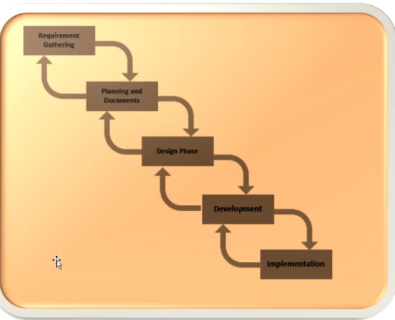
Diagram of VU Process

Slide 10
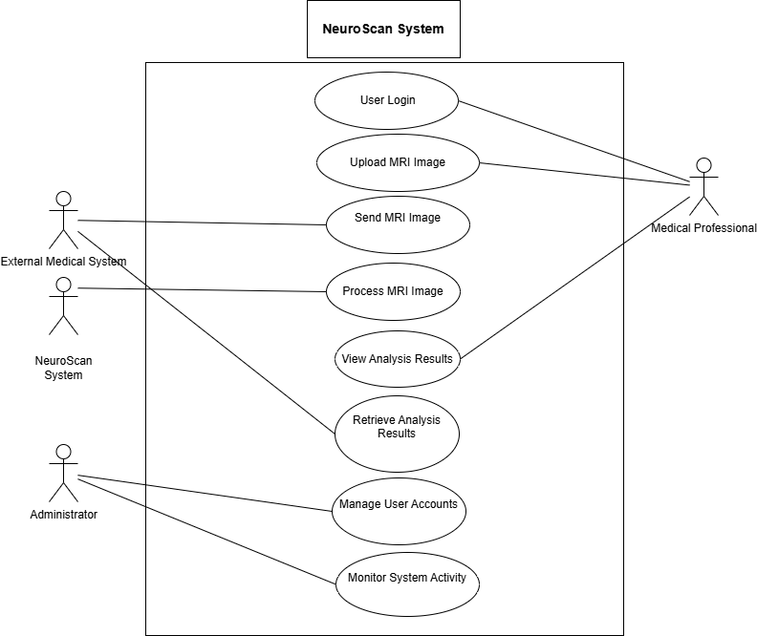
Use Case Diagram

Slide 11
Business Rules Catalog/Core Business Rules
Data Privacy and Security
All patient data must be handled in compliance with HIPAA regulations and other relevant data protection laws.
Access to patient information should be restricted to authorized users only, with robust authentication mechanisms in place.
Accuracy and Reliability
The system must achieve a diagnostic accuracy rate of at least 95% for brain tumor detection.
The deep learning model must undergo continuous training and validation with updated datasets to maintain high accuracy levels.

Slide 12
Business Rules Catalog/Core Business Rules
Integration with Existing Systems
NeuroScan must be compatible with standard medical imaging formats (e.g., DICOM) and should integrate seamlessly with existing hospital information systems (HIS).
The system must support both local and cloud-based deployments to cater to different healthcare facility needs.
User Accessibility and Usability
The user interface must be intuitive and accessible, requiring minimal training for healthcare professionals.
The system must provide multilingual support to cater to a global audience of medical professionals.
Compliance with Medical Standards
All diagnostic processes and outputs must align with the latest medical standards and guidelines for brain tumor detection.

Slide 13
Functional Requirements
1. Image Upload and Preprocessing
The system must allow users to upload MRI scans for analysis.
It should perform preprocessing steps like normalization, noise reduction, and artifact removal automatically.
2. Automated Tumor Detection
NeuroScan should analyze uploaded images using AI algorithms to detect the presence, size, and location of brain tumors.
Results should be presented in a clear, visual format, highlighting tumor areas on the scan.
3. Data Augmentation for Improved Accuracy
The system must include data augmentation functionalities such as rotation, scaling, and flipping to enhance model training and performance.
4. Real-time Analysis and Reporting
The system should process and provide diagnostic results in real-time or within a clinically acceptable time frame.
A detailed report should be generated automatically, summarizing the findings and suggesting potential next steps.

Slide 14
Functional Requirements
5. User Management and Role-Based Access
NeuroScan should include a user management module with role-based access control to manage different types of users (e.g., radiologists, admin staff).
Users should have access only to the functionalities relevant to their roles.
6. Results Storage and Retrieval
The system must store diagnostic results securely and provide an easy retrieval mechanism for future reference or further analysis.
Historical data should be accessible for tracking patient progress over time.
7. Alerts and Notifications
The system should be able to send alerts and notifications to healthcare providers for critical findings or when further action is required.
8. Continuous Learning and Model Updates
The AI model should support continuous learning, allowing for updates based on new data inputs and evolving medical knowledge.

Slide 15
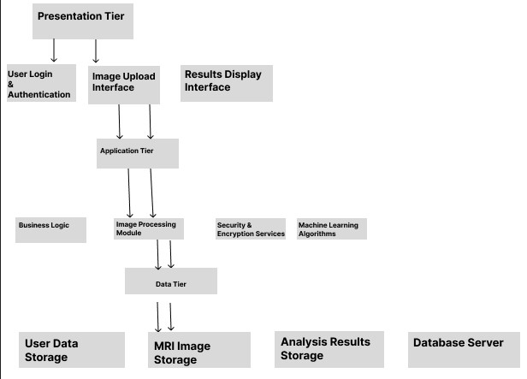
Architectural Design
Provide Architecture Diagram Here

Slide 16
Team Structure
VU - Supervisor - Umair Ali
VU - Student Ahmed Kamal
External - Supervisor : AT SPOT

Slide 17
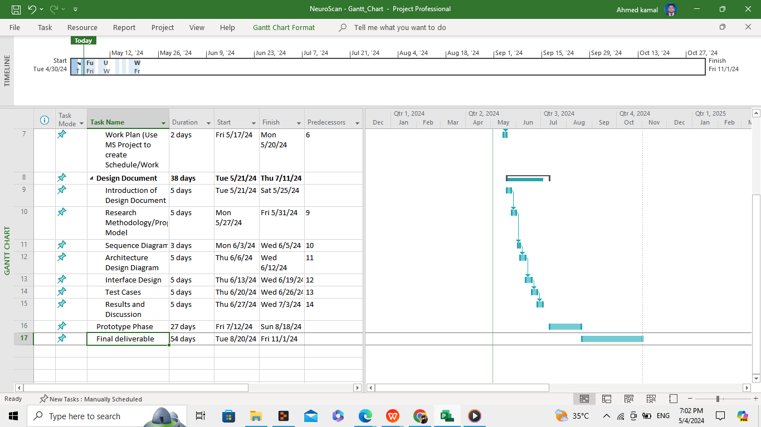
Project Schedule

Slide 18
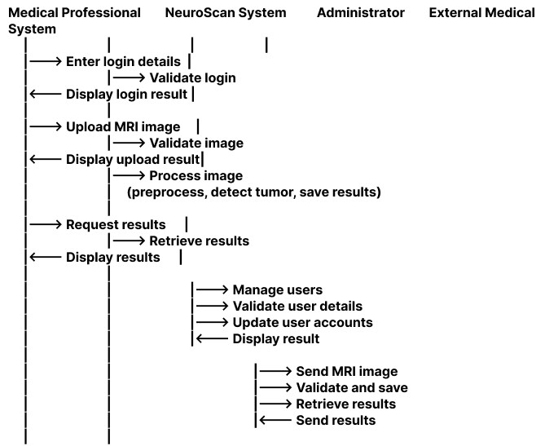
Sequence Diagrams

Slide 19
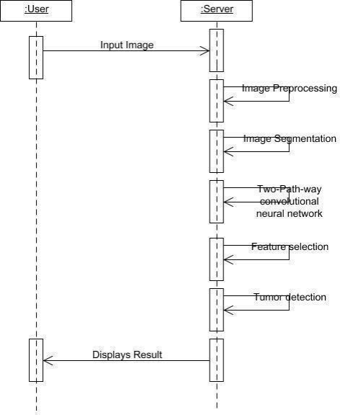
Sequence Diagram (Simplified)

Slide 20
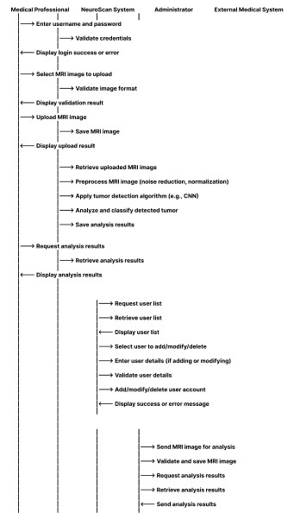
Sequence Diagram (Comprehensive)

Slide 21
Research Methodology/ Proposed Model
Provide Research Methodology/ Proposed Model diagrams here.

Slide 22
Results and Discussion
Provide Results in Tabular form.

Slide 23
User Interfaces
Provide screen shots of GUI in different slides of your application here

Slide 24
Tools
Write the various tools you have used
during the development of this application

