Slide 1
Sure Global technology
Introduction To Graph QL Ahmed Samir Abd El Aal Tutorial github: https://github.com/ahmedsure/sure_tut_gql.git

Slide 2
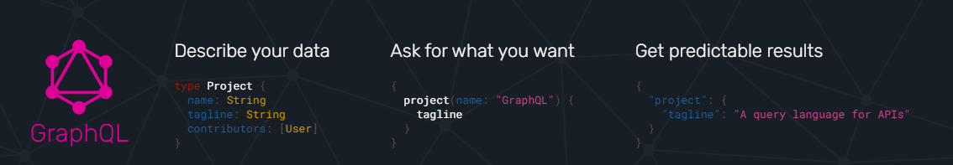
What is GraphQL ?
A query language for your API
GraphQL is a query language and server-side runtime for application programming interfaces (APIs) that prioritizes giving clients exactly the data they request and no more.
GraphQL is designed to make APIs fast, flexible, and developer-friendly. It can even be deployed within an integrated development environment (IDE) known as GraphiQL. As an alternative to REST, GraphQL lets developers construct requests that pull data from multiple data sources in a single API call.
Additionally, GraphQL gives API maintainers the flexibility to add or deprecate fields without impacting existing queries. Developers can build APIs with whatever methods they prefer, and the GraphQL specification will ensure they function in predictable ways to clients.

Slide 3
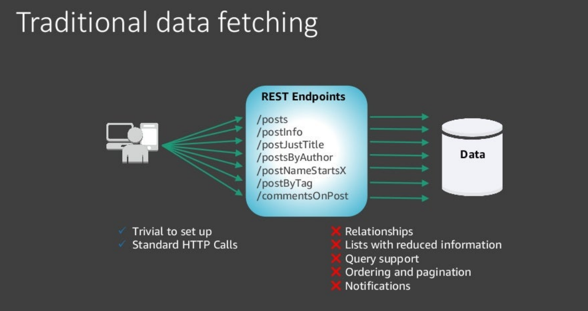
Traditional API Data Fetching
While using normal APIs : we should have multiple end points with multiple verbs to query : * All , * One , * one with some relations , * some with sorting / ordering / pagination . * you will never be able to get only the data that you need
With Graph QL
We can get one end point for all the above !
And with extra powerful queries

Slide 4
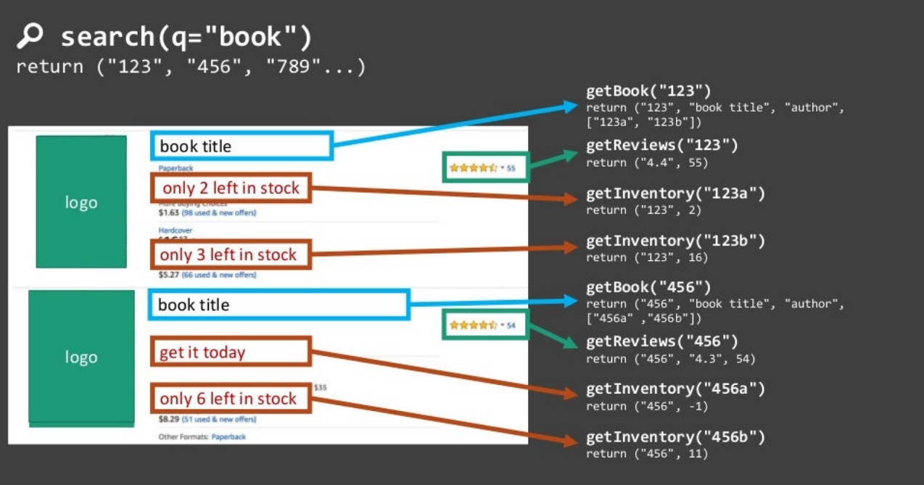
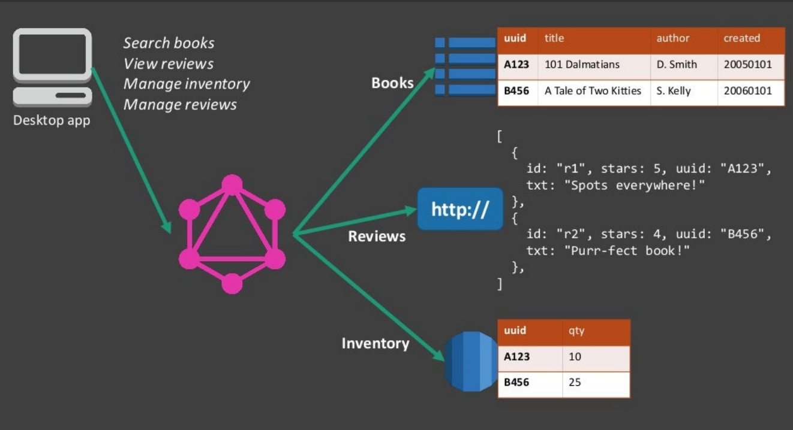
API Example for books sales web site :
* In GRAPHQL it’s just one call : Even if the inventory is on other system or other micro service ! WOW .
In REST :

Slide 5
Advantages and disadvantages of GraphQL
Advantages
A GraphQL schema sets a single source of truth in a GraphQL application. It offers an organization a way to federate its entire API.
GraphQL calls are handled in a single round trip. Clients get what they request with no overfetching.
Strongly defined data types reduce miscommunication between the client and the server.
GraphQL is introspective. A client can request a list of data types available. This is ideal for auto-generating documentation.
GraphQL allows an application API to evolve without breaking existing queries.
Many open source GraphQL extensions are available to offer features not available with REST APIs.
GraphQL does not dictate a specific application architecture. It can be introduced on top of an existing REST API and can work with existing API management tools.
Disadvantages
GraphQL presents a learning curve for developers familiar with REST APIs.
GraphQL shifts much of the work of a data query to the server side, which adds complexity for server developers.
Depending on how it is implemented, GraphQL might require different API management strategies than REST APIs, particularly when considering rate limits and pricing.
Caching is more complex than with REST.
API maintainers have the additional task of writing maintainable GraphQL schema.

Slide 6
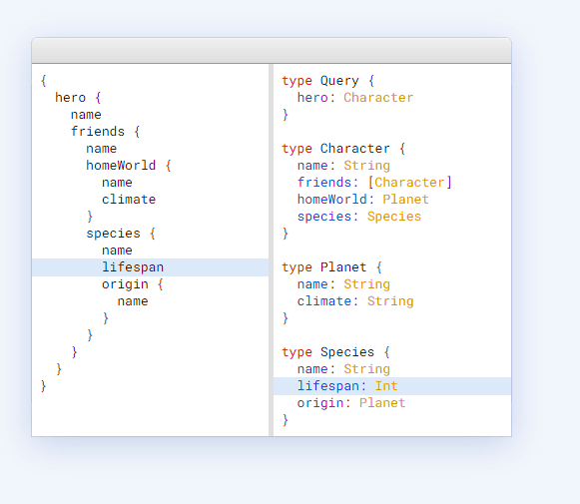

Describe what’s possible with a type system
Query :
Schema definition :
Users :

Slide 7
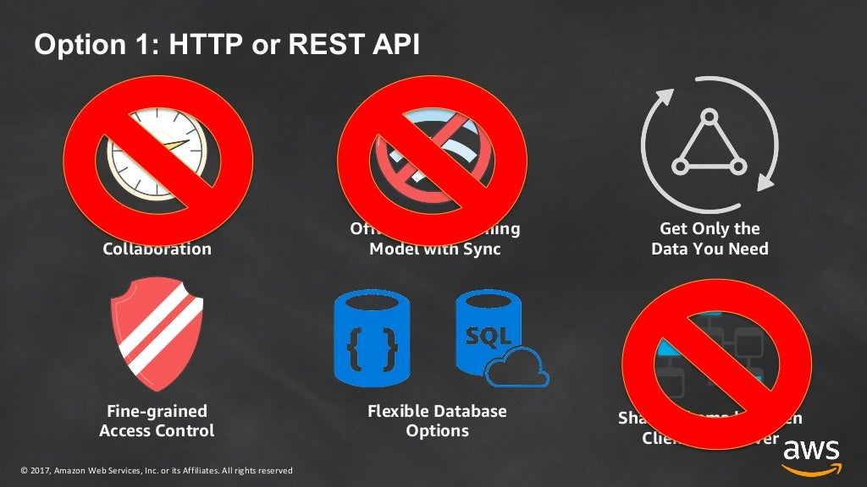

Slide 8
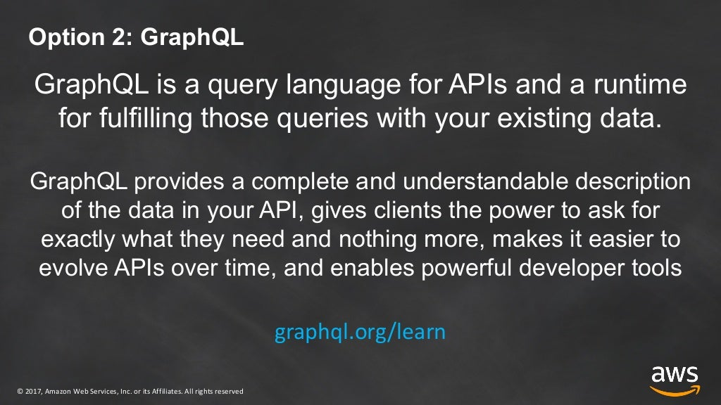

Slide 9
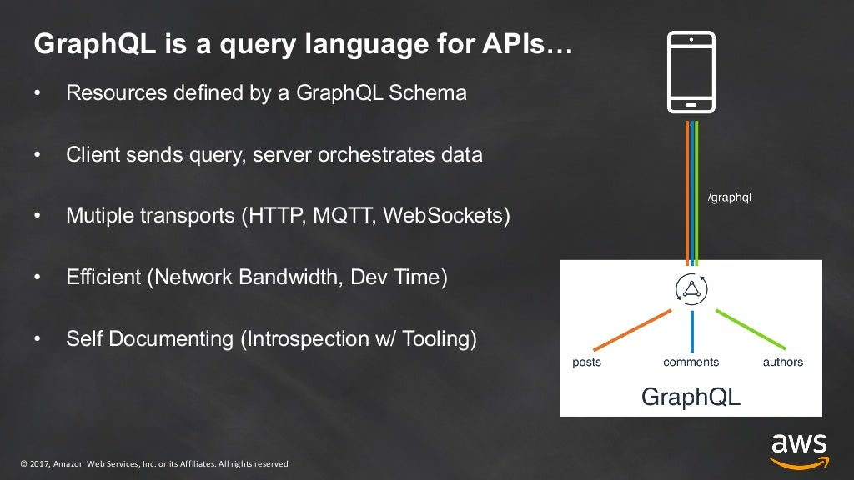

Slide 10
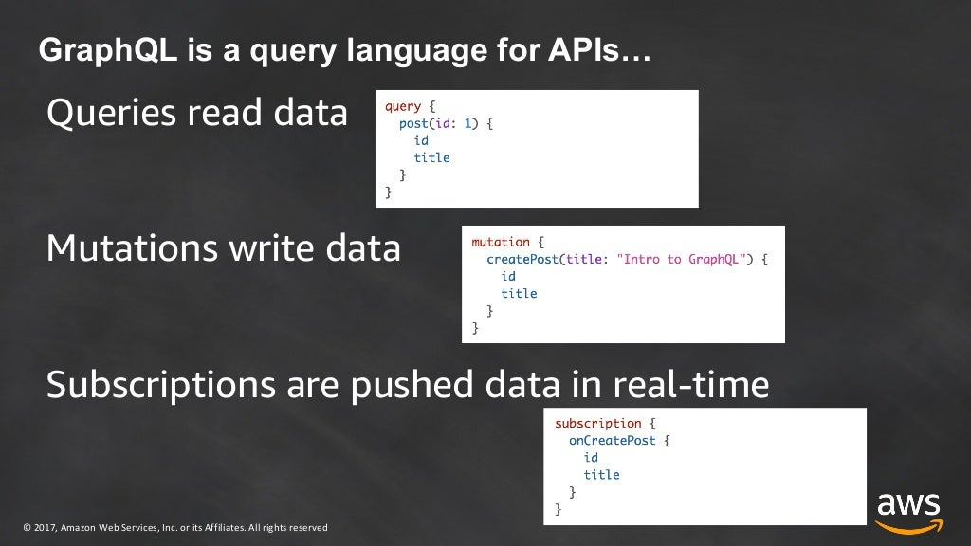

Slide 11
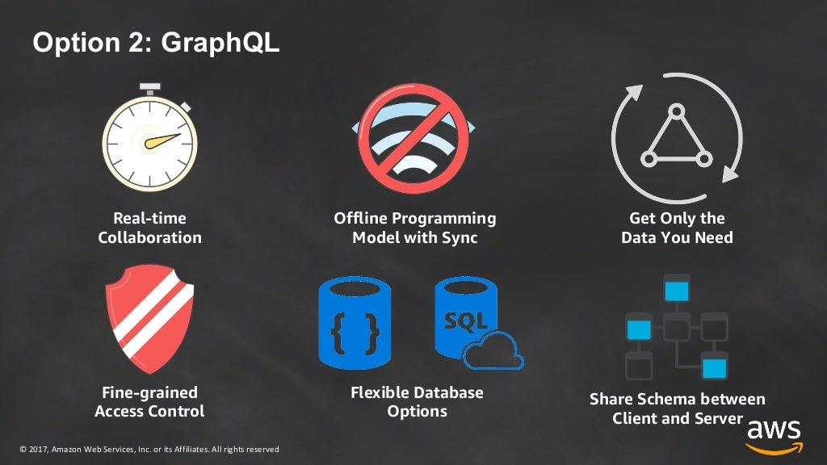

Slide 12
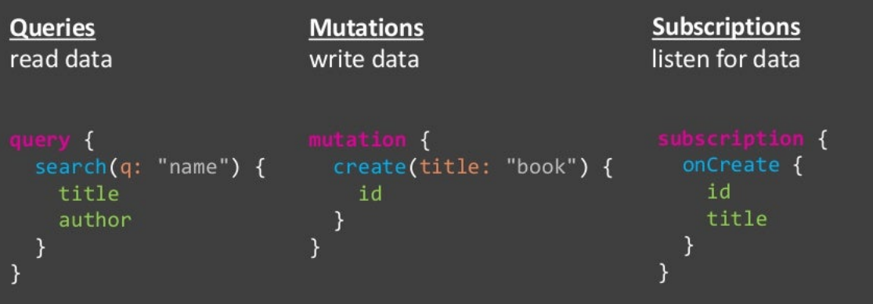
Graph QL Main Concepts:
Schema : * System Types , Scalar types , Inputs * Enumerations , Lists , Nullabellity , Interfaces , types and inheritance
Queries :
Sub concepts and components :
Fields
Arguments
Aliases
Fragments
Operation name .
Variables
Directives
Mutations :
Is For Posting / Writing Data
Sub concepts and components :
Inputs (Input types)
Payloads
Subscriptions :
are for life communications and pushing real-time notifications
Data Listeners
Resolvers and data loaders :
Are custom implementation of how to get or process data

Slide 13
Graph QL Server Libs and .Net Integrity
graphql-dotnet
Hot Chocolate <= our tutorial focus Lib.
graphql-net
Entity GraphQL
NGraphQL
Strawberry Shake
Graph QL Client Libs - Apollo:
Is available for almost all client types and Invironmets
( angular , react , js , blazor , native mobiles , almost all Client side types)

Slide 14
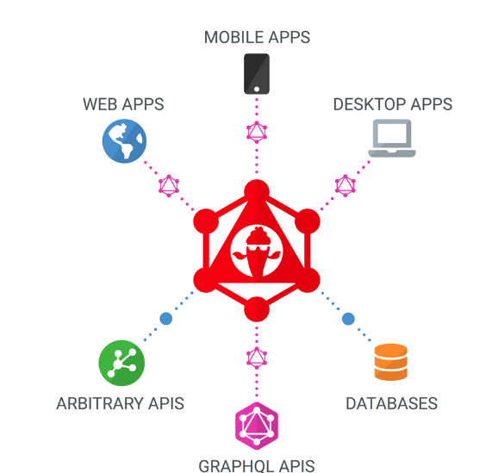
Hot Chocolate
You can use Hot Chocolate Server as:
Stand-alone ASP.NET Core GraphQL Server.
Serverless Azure Function or Amazon Lambda that serves up a GraphQL server.
GraphQL Gateway for a federated data graph that pulls all your data sources together to create the one source of truth.
And the very powerful tool Panana Cake to test , and view your schema and executing queries as GQL Client

Slide 15
1. Setup Environment demo:
public void ConfigureServices(IServiceCollection services)
{
services
.AddGraphQLServer()
.AddQueryType<GQLQuery>();
}
app.UseEndpoints(endpoints =>
{
endpoints.MapGet("/", async context =>
{
await context.Response.WriteAsync("Hello World!");
});
// Add GQL End Points
endpoints.MapGraphQL();
});

Slide 16
2. First Query 💪
user1St_Thread: users{
userName,
userProfilePath,
userPosts{
postContent
postOwner {
userName
}
postComments{
commentContent
}
}
}
userSec_Thread: users{
userName,
userProfilePath,
userPosts{
postContent
postOwner {
userName
}
postComments{
commentContent
}
}
}
Making GQL Query is starting with query { }
Calling the end point then selecting your models :
You can allies the queries Alias:
And the queries will executed in parallel and independently like
And also the power of graph QL queries the nested graph selections
And only select what you need as follow :

Slide 17
Session 2 Queries
Operation Type
Type ** from Convention IEmunerable<Type>
Query Filters
query{
userThird_Thread: users( order: { userName:ASC }, where: { or: [ { userName: { contains: "User" } }, { userPosts: { any : true }} ] } )
{
userName, userProfilePath,
userPosts{
postContent
postOwner {
userName
}
postComments{
commentContent,
commentComments{
commentOnPostID,
commentContent,
commentBy
}
}
}
}
}
Operation Alias
Selection Set ** UnderFetching Data

Slide 18
Hot Chocolate DI and Middlewares
[UseDbContext(typeof(AppDbContext))]
// allow to query a child object
[UseProjection]
[UseFiltering]
[UseSorting]
GetUsers([ScopedService] AppDbContext _ctox)

Slide 19

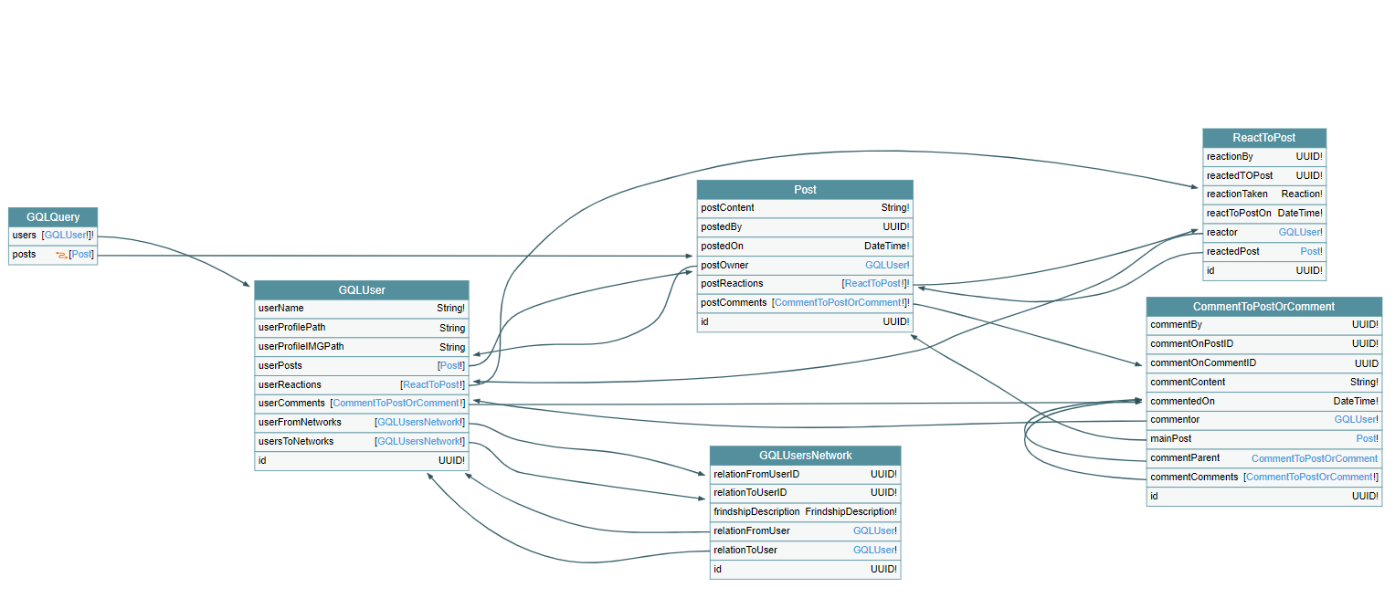
Reading Generated Schema
User Generated Types
Graph QL Auto Generated Schema Types
1- Inputs , sorting Enum
View Schema On voyager https://localhost:7163/ui/voyager

Slide 20
Adding Pagination
[UsePaging] attribute
Pagination Query Example : query{ posts{ totalCount,
pageInfo {
hasNextPage, hasPreviousPage
},
edges{
node { }
}
}
}

Slide 21
Intro For Adding Descriptors
UsersDescriptor: ObjectType<GQLUser> protected override void Configure(IObjectTypeDescriptor<GQLUser> descriptor)
{
descriptor.Description(“………… ");
descriptor
.Field(x => fieldname )
.Description(“field Description ");
descriptor.Field(x =>willbeignored).Ignore();
}

Slide 22
Mutation Time and types extention
.AddMutationType<Mutations>()
* Note Type Extentions
We can extending types (Query Type Or Mutation Type By )
[ExtendObjectType(typeof(GQLQuery))] attribute
But partial classes is doing the job

Slide 23
The Power Of Resolvers and DataLoaders
Modifying the User Model with custom Field resolver Nationality.
Modifying the User Model With Data From external source Weather
Adding second web api project as microservice simulation example ,
Extending the users with a property that has an async data loader
A powerful LoadBatchAsync implantation is that well reduce the calls as much as possible in our case GQL will make only one async call to resolve the property for all queries .
not in GQL Cloud we can mark a property directly as @Lambda to fetch a property directly from API .

Slide 24
Subscriptions : An other very powerful feature of Graph QL
Subscriptions are long-lasting operations that can change their result over time. They can maintain an active connection to your GraphQL server (most commonly via WebSocket), enabling the server to push updates to the subscription's result.
Subscriptions are useful for notifying your client in real time about changes to back-end data, such as the creation of a new object or updates to an important field.
When to use subscriptions
Small, incremental changes to large objects. Repeatedly polling for a large object is expensive, especially when most of the object's fields rarely change. Instead, you can fetch the object's initial state with a query, and your server can proactively push updates to individual fields as they occur.
Low-latency, real-time updates. For example, a chat application's client wants to receive new messages as soon as they're available.
And the alternative is Pooling Technique by WatchQuery or Query with pollInterval ** we be discussed later .

Slide 25
Clients : Time For Client side cunsumers and some play * Apollo
Apllo is one of the most famos GQL Libraries for client and server side
It’s very common use in Client sides and available for angular , react , veuJS , pureJs , kotlin and swift .
https://www.apollographql.com/docs/
https://apollo-angular.com/docs/
Lets start our FE project

Slide 26
References :
https://chillicream.com/docs
https://graphql.org/learn
Repo :
https://github.com/ahmedsure/sure_tut_gql.git

