Slide 1



Sales
View in Power BI
Last data refresh:
7/3/2021 5:11:44 PM UTC
Downloaded at:
7/3/2021 5:24:24 PM UTC

Slide 2
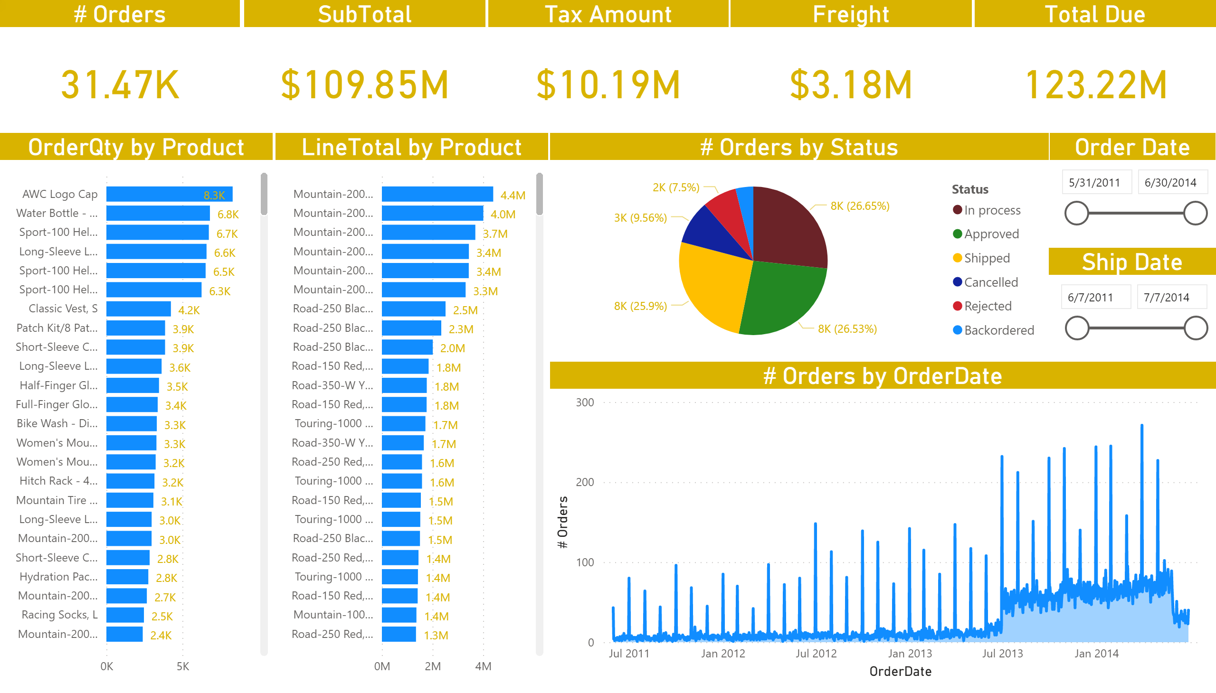
Orders
Notes:
# Orders
No alt text provided.
SubTotal
No alt text provided.
Tax Amount
No alt text provided.
Freight
No alt text provided.
Total Due
No alt text provided.
pieChart
No alt text provided.
clusteredBarChart
No alt text provided.
clusteredBarChart
No alt text provided.
areaChart
No alt text provided.
Order Date
No alt text provided.
Ship Date
No alt text provided.

Slide 3
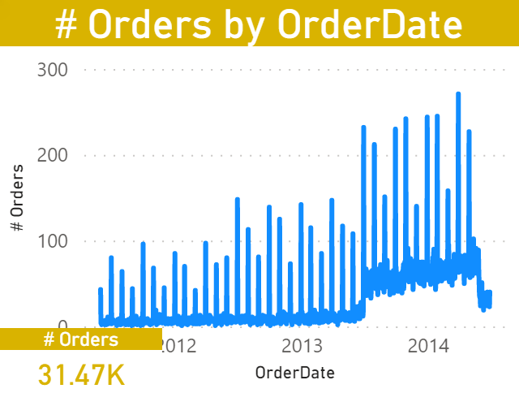
Tooltip
Notes:
lineChart
No alt text provided.
# Orders
No alt text provided.

Slide 4
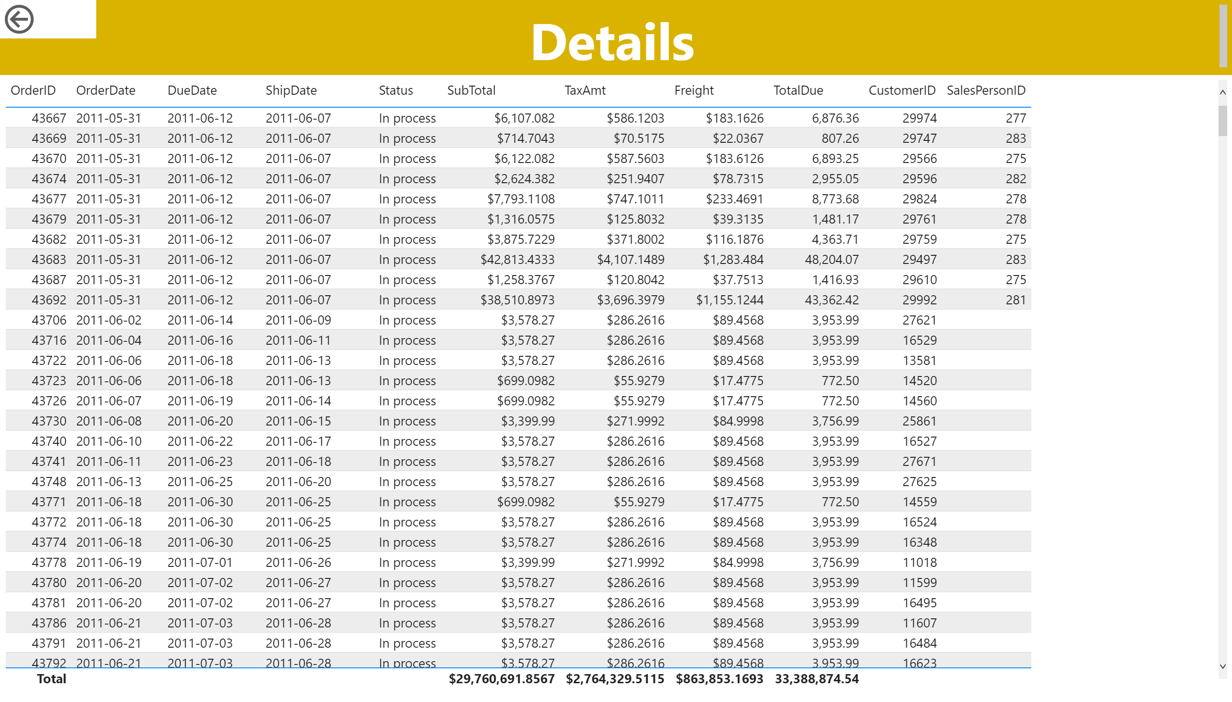
Details
Notes:
tableEx
No alt text provided.
textbox
No alt text provided.
actionButton
No alt text provided.

Slide 5
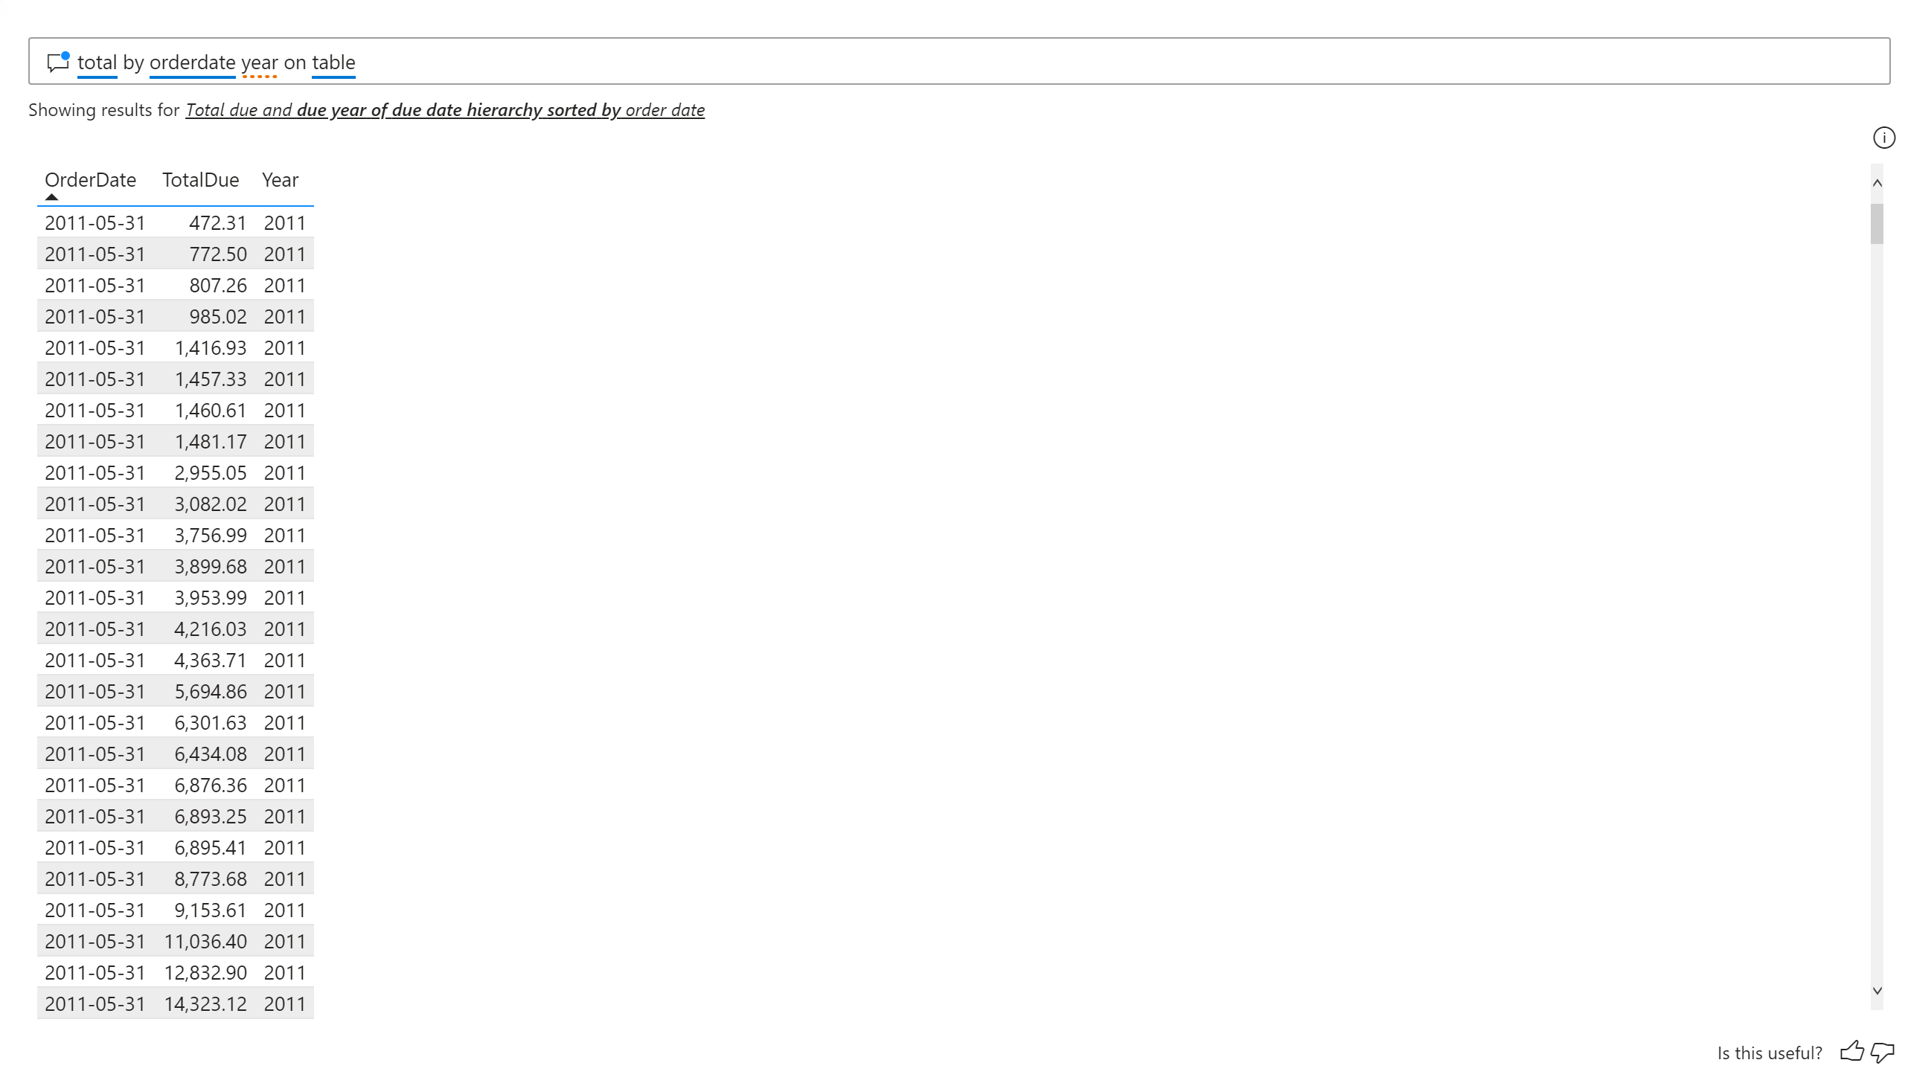
Q&A
Notes:
qnaVisual
No alt text provided.

Slide 6
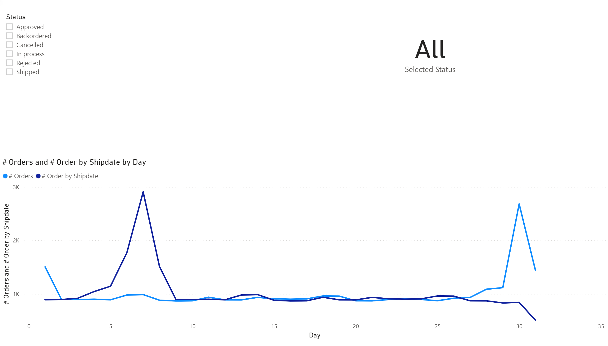
Shipdate
Notes:
card
No alt text provided.
slicer
No alt text provided.
lineChart
No alt text provided.

