Slide 1
WORDPRESS ON AZURE / WELL-ARCHITECTED REVIEW
One workspace, distinct responsibilities
Assess WordPress on Azure against the Azure Well-Architected Framework.
GITHUB COPILOT APP
INPUTS
OUTPUTS
Azure evidence
Extensions
Execute local helpers
Three reports
PowerShell + Azure CLI
Read-only capture
+ manifest
Executive summary
Detailed review
Findings CSV
Workflow canvas
Manage the review
Stages, gates, logs, artifacts
Manual input
Dashboard canvas
Review skill
Assess the evidence
Optional, dated,
run-specific answers
157 controls + evidence rules
Explore findings + priorities
Optional PowerPoint
Chat starts the request. The canvas coordinates. People validate and decide.
GitHub Copilot app | Evidence-led review, not automatic remediation
01
Notes:
The workflow and dashboard are repository-provided canvas extensions in the GitHub Copilot app. Extensions run read-only local helpers; the review skill evaluates captured evidence. Optional manual evidence is assessed, not automatically accepted. PowerPoint reuses the reports. No Azure deployment or automatic remediation is performed.

Slide 2
WORDPRESS ON AZURE / WELL-ARCHITECTED REVIEW
The canvas coordinates the end-to-end flow
Eight required stages plus two optional stages; manual validation precedes assessment.
01
Validate dependencies
02
Connect scope
03
Inventory resources
PowerShell 7 + Azure CLI
Subscription + resource group
Discover what is in scope
06
Extract evidence
05
Package data
04
Collect evidence
Find the collection manifest
Confirm the collector ZIP
Read-only configuration capture
Skip manual
6M
Manual input
07
Assess
08
Dashboard
09
PowerPoint
OPTIONAL / Persisted per run
Skill + three reports
Explore controls + findings
OPTIONAL / Reuse reports
GitHub Copilot app | Evidence-led review, not automatic remediation
02
Notes:
The numbering follows the actual canvas: 1 validate dependencies, 2 connect scope, 3 inventory, 4 collect evidence, 5 package data, 6 extract evidence, optional 6M manual validation, 7 assess with the skill, 8 display dashboard, and optional 9 PowerPoint. That is ten stages when both options are included. A ZIP upload can start at extraction. The review is complete after the eight required stages; PowerPoint never blocks the dashboard.

Slide 3
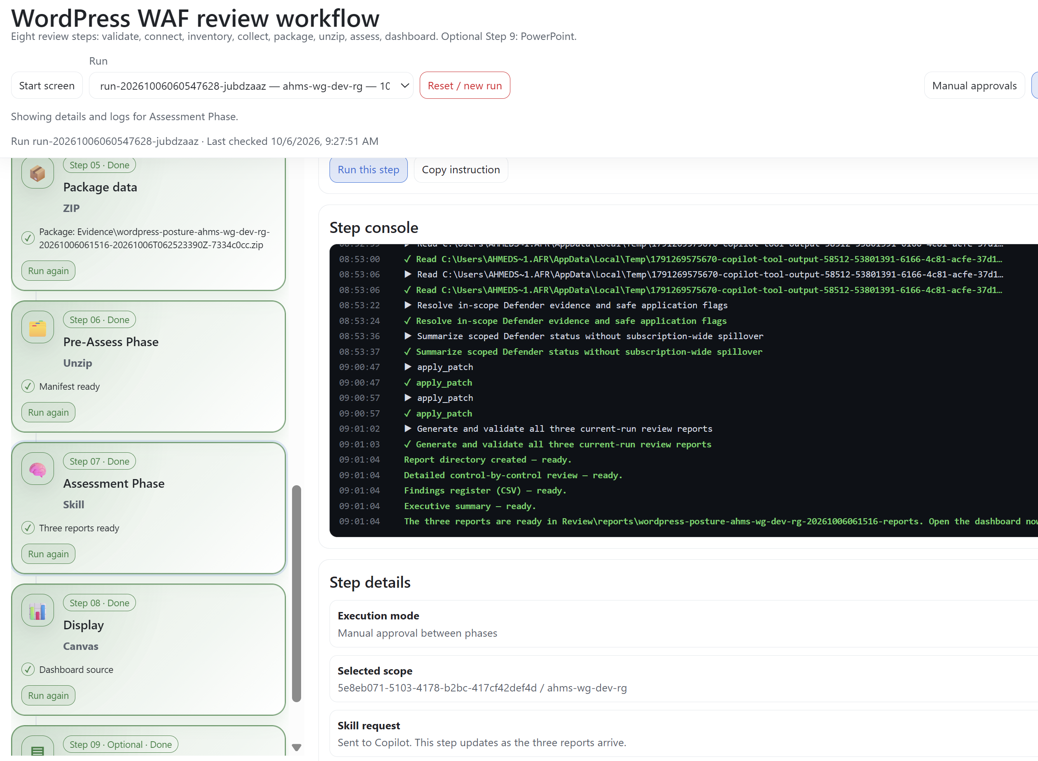
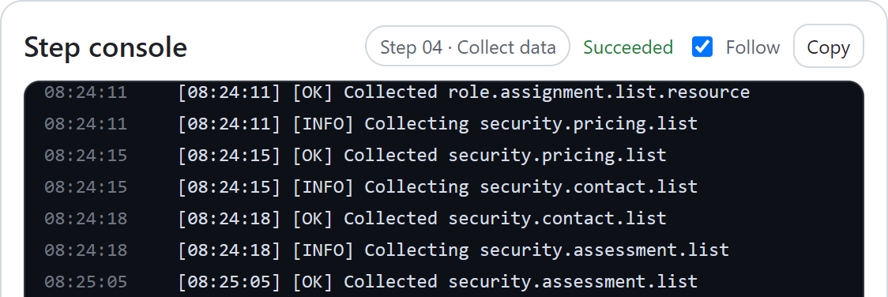
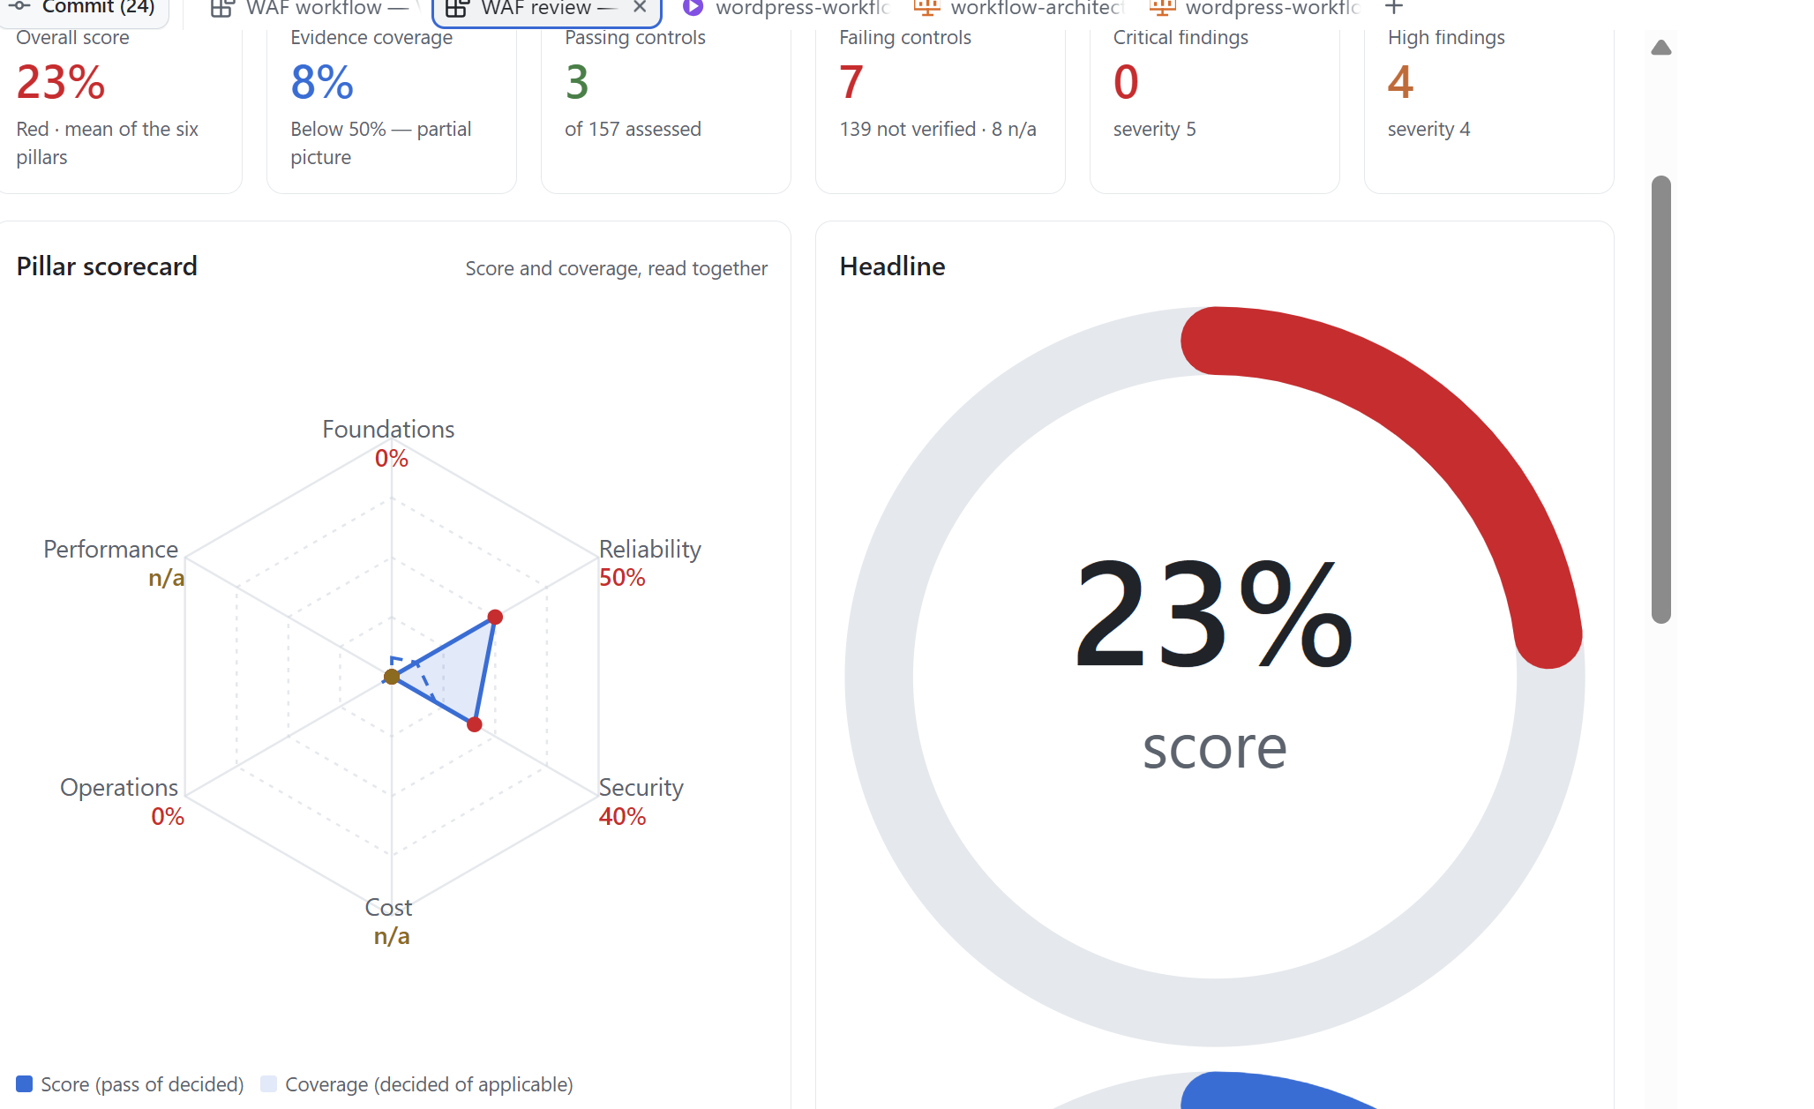
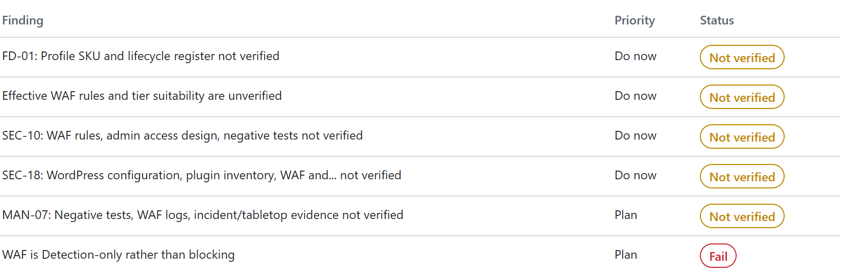
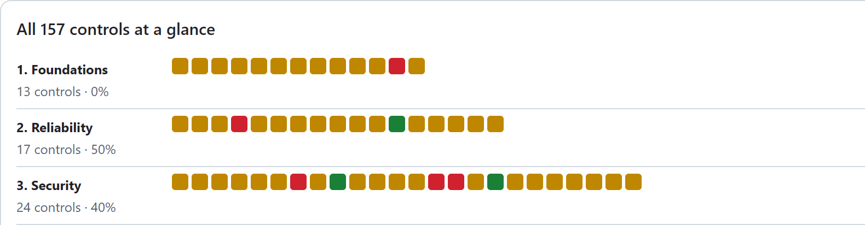
The Review Workflow
WORKFLOW / Live progress and logs
DASHBOARD / Findings and priorities
DASHBOARD / Control coverage (detail)
Notes:
Four fresh, high-resolution captures from the actual canvas web pages: the optional manual-validation choice in the new-run form; the Collect data step console from an existing completed run; a magnified detail of the first three sections of the157-control dashboard matrix; and filtered finding descriptions, priority and status. The unsubmitted create-run form demonstrates the option only: no run or manual answers were saved. No Azure collection or assessment was rerun. Crops remove unrelated interface content, and identifiers are masked. Not verified findings are verification work, not confirmed failures. The known inconsistent headline score is not included.

Slide 4
WORDPRESS ON AZURE / WELL-ARCHITECTED REVIEW
Early evidence: five days to two hours
Author-reported experience today; an opportunity for customer self-service.
PREVIOUSLY
WITH THIS WORKFLOW
CURRENT ADOPTION
5 days
2 hours
Author use only
Currently used personally by the author.
No customer adoption claimed yet.
Reported review time
Reported review time
CUSTOMER SELF-SERVICE
Customers can run the workflow themselves
Collect their evidence, follow the guided stages and explore their own findings.
Source: author's personal experience; not an independent benchmark. Time varies by scope.
GitHub Copilot app | Evidence-led review, not automatic remediation
04
Notes:
The author reports that a review which previously took five days can now be completed in two hours. This is personal experience, not an independently measured benchmark or a guaranteed customer outcome. Current usage is limited to the author; no customer adoption or customer-validated timing result is claimed. Customers can run the workflow themselves with the documented prerequisites, appropriate Azure permissions and access to GitHub Copilot. Human validation remains necessary where evidence is missing. No percentage speedup is calculated because the number of working hours represented by five days was not specified.

