Slide 1



Call_Center
View in Power BI
Last data refresh:
5/18/2023 7:41:02 PM UTC
Downloaded at:
5/18/2023 7:49:27 PM UTC

Slide 2
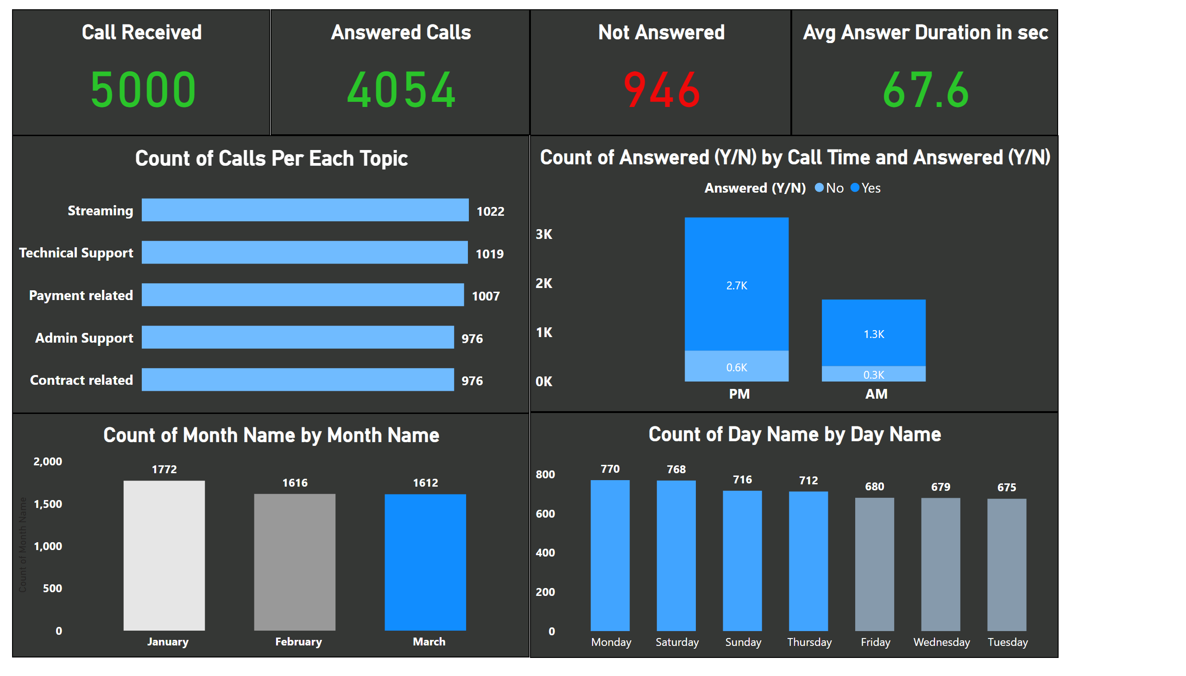
Page 1
Notes:
Call Received
No alt text provided
Answered Calls
No alt text provided
Not Answered
No alt text provided
Avg Answer Duration in sec
No alt text provided
Count of Calls Per Each Topic
No alt text provided
columnChart
No alt text provided
clusteredColumnChart
No alt text provided
clusteredColumnChart
No alt text provided

Slide 3
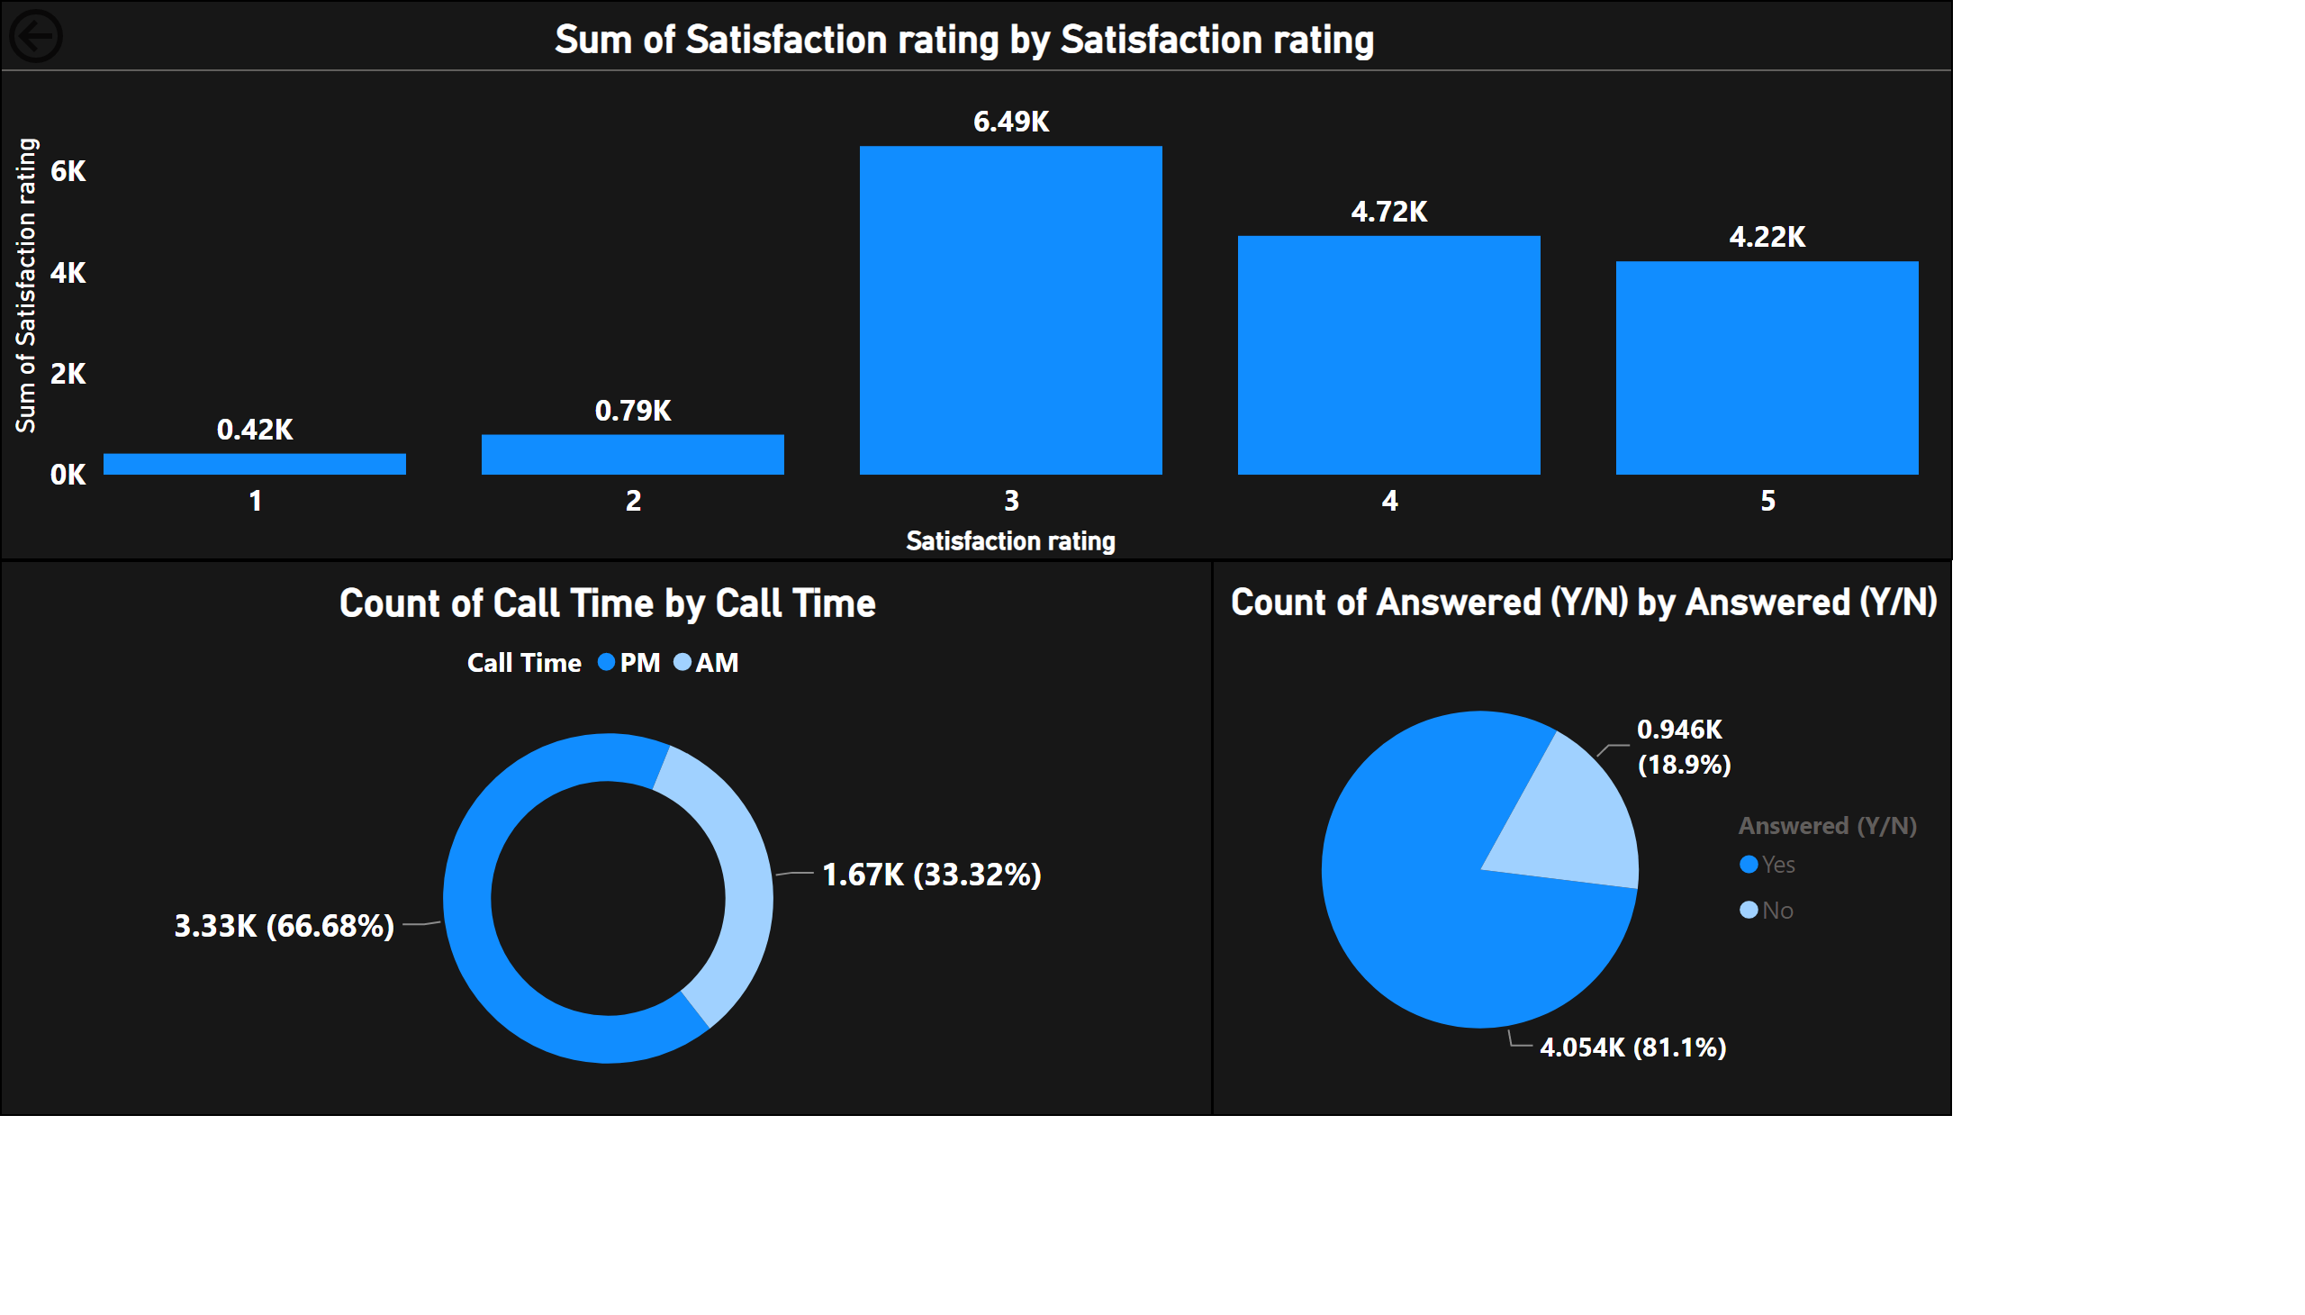
Page 2
Notes:
actionButton
No alt text provided
donutChart
No alt text provided
clusteredColumnChart
No alt text provided
pieChart
No alt text provided

Slide 4
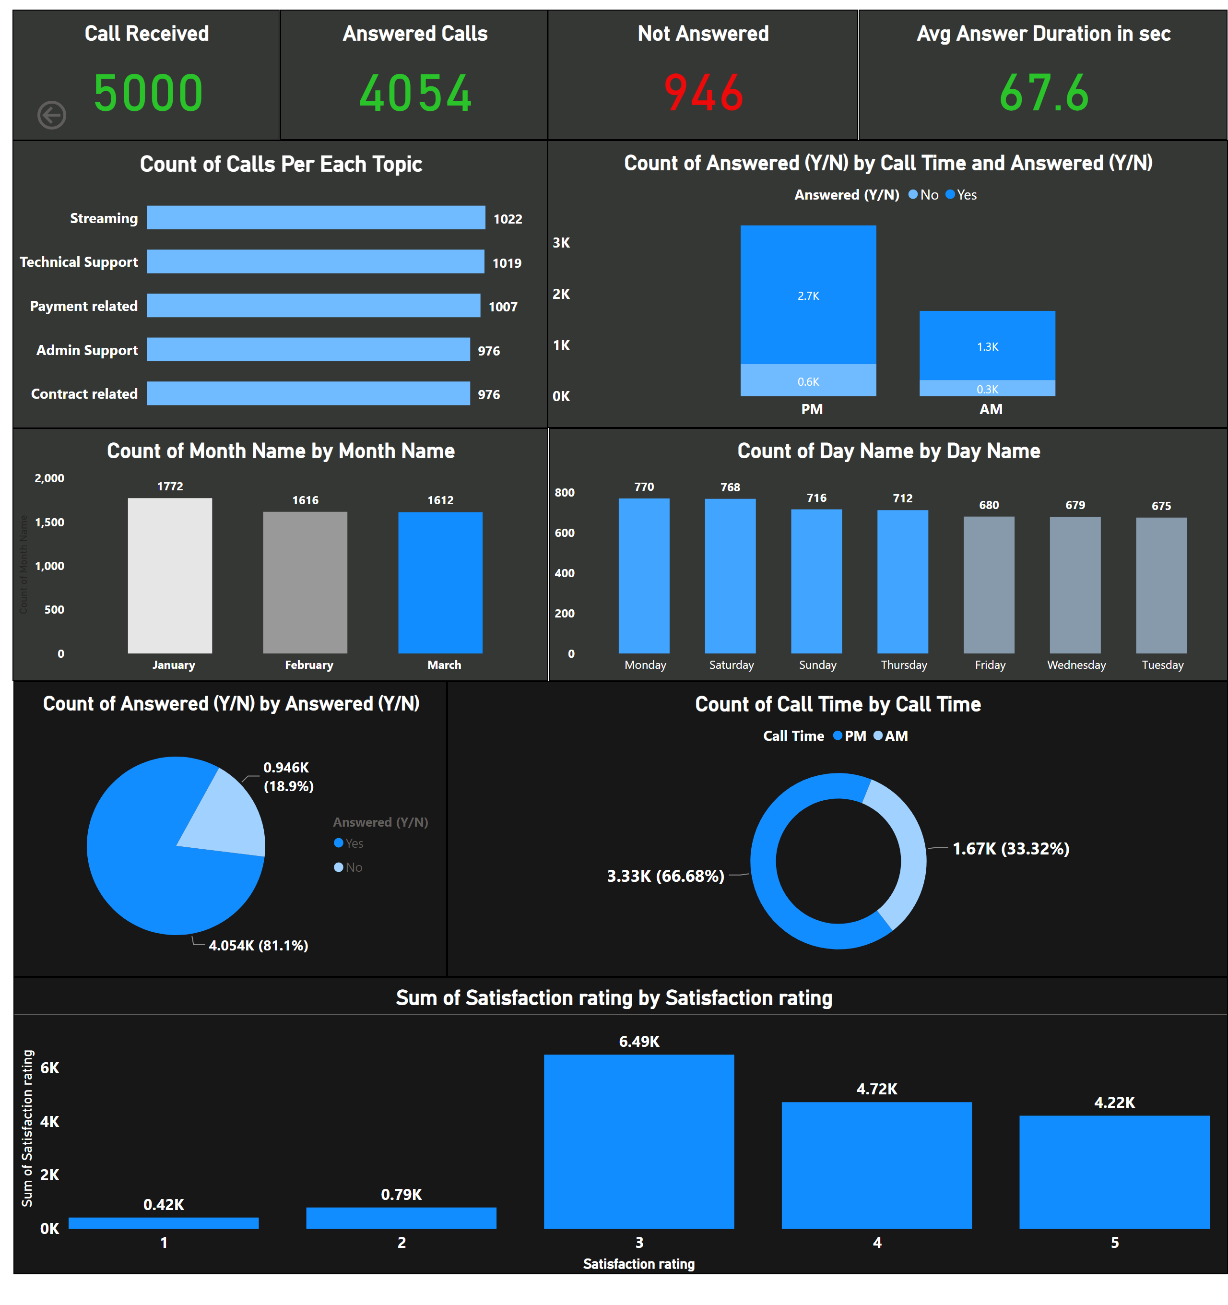
Page 3
Notes:
Call Received
No alt text provided
Answered Calls
No alt text provided
Not Answered
No alt text provided
Avg Answer Duration in sec
No alt text provided
Count of Calls Per Each Topic
No alt text provided
columnChart
No alt text provided
clusteredColumnChart
No alt text provided
clusteredColumnChart
No alt text provided
actionButton
No alt text provided
donutChart
No alt text provided
clusteredColumnChart
No alt text provided
pieChart
No alt text provided

