Slide 1
Healthcare Provider Fraud Detection Using Machine Learning

Slide 2
Problem Statement
Healthcare fraud costs millions yearly
Manual auditing is expensive and slow
Need automated risk scoring for providers

Slide 3
Data Sources
Fraud rate in providers : 0.09353049907578559
Fraud rate in inpatient claims: 0.5781983495577407
Fraud rate in outpatient claims: 0.36581121302900893

Slide 4
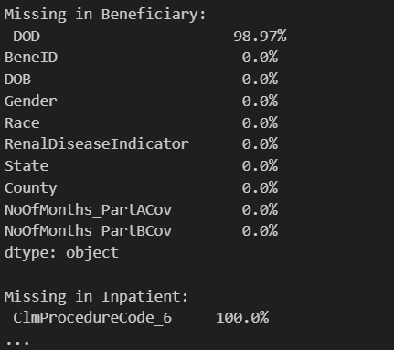
Initial Data Checks
✔ Duplicate ID checks
✔ Date validation (claim before discharge)
✔ Claims after death detection
✔ Missing data profiling

Slide 5
Creating Provider-Level Features
Total claims
Total reimbursement
Claims per patient
Inpatient vs outpatient ratio
Monthly activity features
Geographic states

Slide 6
Imbalanced Problem
Fraud is rare
Accuracy is misleading
Precision–Recall needed
Fraud rate in providers (labels): 0.09353049907578559

Slide 7
Preventing Overfitting
✔ Stratified train-test split
✔ SMOTE balancing
✔ Cross-validation
✔ Feature scaling

Slide 8
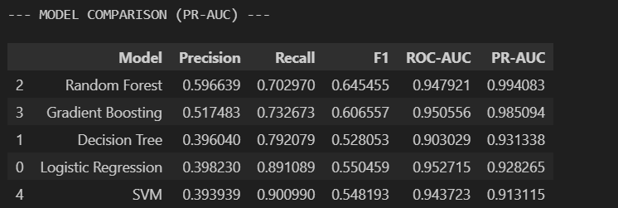
Model Selection
Logistic Regression
Random Forest
Gradient Boosting
SVM

Slide 9
Final Model: Random Forest
✔ Best performance on PR-AUC
✔ Robust to noise
✔ Handles feature interactions

Slide 10
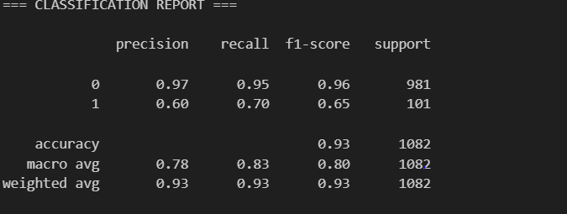
Evaluation Results

Slide 11
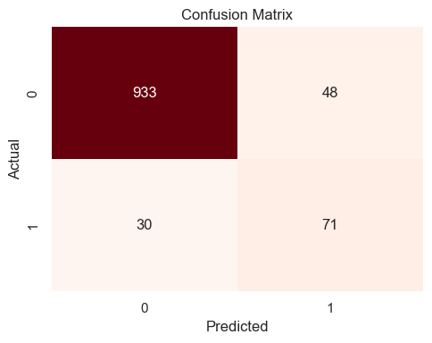
Error Breakdown
FP = investigation cost
FN = fraud escaping

Slide 12
Business Impact
=== COST ANALYSIS ===
False Positives: 48 → Admin Cost = $24,000 False Negatives: 30 → Fraud Loss = $300,000 TOTAL COST IMPACT = $324,000

Slide 13
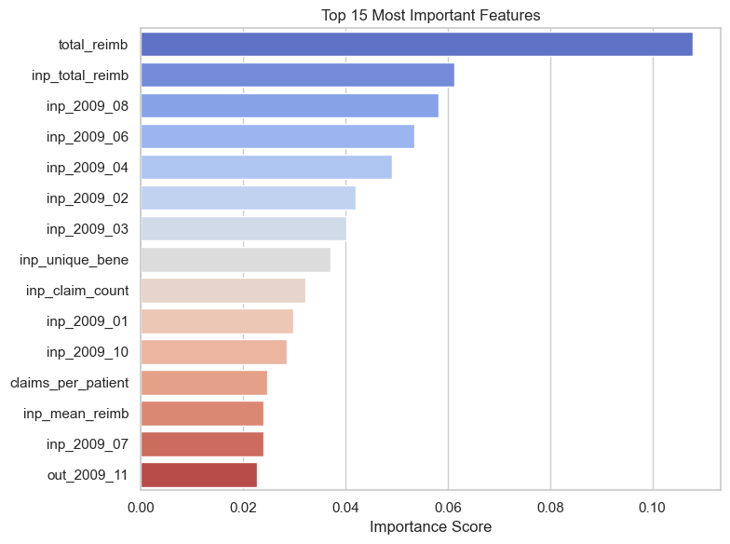
What Drives Fraud Risk?

Slide 14
Why Errors Happened
False Positives:
Large hospitals
Specialized treatments
False Negatives:
Small fraud hides inside normal activity
High volume low profile providers

Slide 15
Final Takeaways
✔ Fraud detection is feasible
✔ Model is business usable
✔ Errors are explainable
✔ Continuous improvement needed

