Slide 1
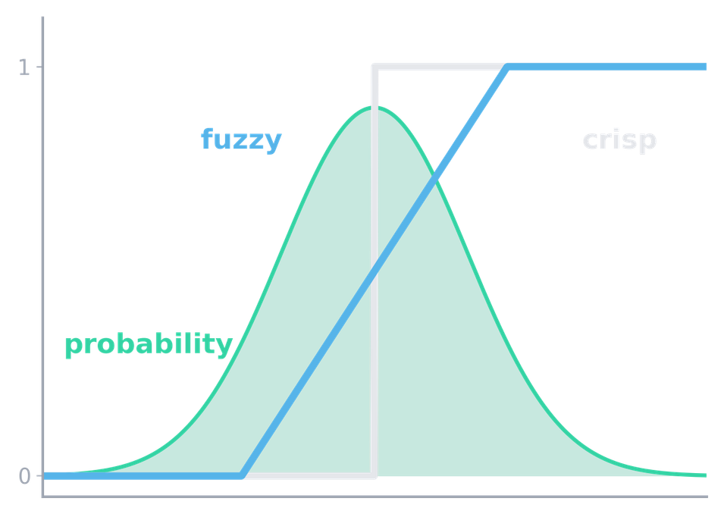

CS405 · DR.Noha El-Shoafy · WEEK 1
Advanced AI and Uncertainty
Four kinds of imperfect information, two ways to model vagueness, and probability for chance and missing data
Crisp logic, fuzzy sets and probability: three tools, three kinds of uncertainty
Ahmed Ayman Tayel
Registration ID 232611000001
College of Computers and Artificial Intelligence, Matruh University

Slide 2
AGENDA
Agenda and roles
Act | Part | Topic | Slides
Act 1 | 1 | The AI landscape today | 3–5
Act 1 | 2 | Why uncertainty matters in AI | 6–8
Act 2 | 3 | Four kinds of imperfect information | 9–10
Act 2 | 4 | Aleatoric vs epistemic uncertainty | 11–13
Act 3 | 5 | Crisp logic and its limits | 14–16
Act 3 | 6 | Fuzzy logic: the basic idea | 17–19
Act 4 | 7 | Probability and missing data | 20–23
Act 4 | 8 | Live demo and link to the course project | 24–27
Presenter : Ahmed Ayman Tayel | Registration ID: 232611000001 | Team 01
The live Google Colab demo (about 4 minutes) runs between slides 24 and 25.
2

Slide 3

PART 1 · THE AI LANDSCAPE TODAY
ACT 1 OF 4
AI is the umbrella; each ring is a narrower idea
Artificial intelligence
machines doing tasks that need intelligence
Machine learning
learns patterns from data
Deep learning
many-layer neural networks
Computational intelligence
nature-inspired, adaptive methods
Fuzzy systems
Neural networks
Evolutionary computation
Generative AI
models that create new content
Computational intelligence overlaps AI and machine learning; sources draw its boundary differently.
Diagram: own synthesis after Russell and Norvig [1], Goodfellow et al. [2], Engelbrecht [3].
3

Slide 4


PART 1 · THE AI LANDSCAPE TODAY
ACT 1 OF 4
Two ways to build AI: write the rules, or learn from data
 | Symbolic (knowledge-based) | Data-driven
Knowledge comes from | Experts write rules and facts | A model is trained on examples
It decides by | Logical inference over symbols | Numeric computation with learned parameters
Strength | Explainable; works with little data | Copes with noisy input such as images
Weakness | Brittle and costly to write | Needs much data; opaque; can be confidently wrong
Real example: MYCIN (1970s)
Real example: retinopathy AI
If-then rules with certainty factors advised on antibiotics for blood infections.
Deep learning trained on about 128,000 retinal photographs flags the disease.
MYCIN: Shortliffe [4]. Retinopathy detector: Gulshan et al. [5].
4

Slide 5




PART 1 · THE AI LANDSCAPE TODAY
ACT 1 OF 4
Four classic AI problems, each harder under uncertainty
Search
Knowledge representation
Find a sequence of actions that reaches a goal.
Encode facts so a program can use them.
Where uncertainty enters: The map, or the opponent's next move, may differ from the model.
Where uncertainty enters: Facts are incomplete or only mostly true.
Planning
Reasoning under uncertainty
Choose actions to reach goals over time.
Draw sound conclusions from partial, noisy information.
Where uncertainty enters: Actions have unpredictable effects and the world changes.
Where uncertainty enters: Needs probability or fuzzy tools: the rest of this course.
Organisation follows Russell and Norvig [1]: search (chs. 3–6), knowledge and planning (chs. 7–11), uncertain knowledge and reasoning (chs. 12–18).
5

Slide 6




PART 2 · WHY UNCERTAINTY MATTERS IN AI
ACT 1 OF 4
Uncertainty has four common sources
Noisy sensors
Human language
Incomplete knowledge
A changing world
Two thermometers give two readings for the same patient.
“High risk” means different things to different doctors.
A test was never ordered; the cause is only partly known.
Patients and hospitals change, so last year’s model drifts.
These four are different problems; Part 3 separates them because each needs a different tool.
6

Slide 7
PART 2 · WHY UNCERTAINTY MATTERS IN AI
ACT 1 OF 4
Ignoring uncertainty makes a system confident and wrong
POINT ANSWER
ANSWER WITH UNCERTAINTY
Diabetes: YES
Risk 0.62
Confidence: 99 %
0.42
plausible range
0.82
Glucose not recorded
Suggest: repeat the test
No range, no warning, no missing-data flag.
Illustrative example, not real data
1
A classifier must answer, even when the input is unlike its training data.
2
A model’s score is not automatically a calibrated probability; modern deep networks are often over-confident [6].
3
The user then trusts a number that hides what the system does not know.
Calibration finding: Guo et al. [6]. Output cards are illustrative, not real data.
7

Slide 8
PART 2 · CASE STUDY · TEMPE, ARIZONA, 18 MARCH 2018
ACT 1 OF 4
Case study: a self-driving car and an object it could not classify
1
2
3
4
5
5.6 s before impact
Repeated relabelling
Reset at each change
Never a pedestrian
1.3 s before impact
Radar and lidar first detect the pedestrian; the car is travelling at 43 mph.
Unknown object, then vehicle, then bicycle, each with a different predicted path.
After a relabel, the tracking history was no longer used to predict the path.
The system never classified her as a pedestrian; its design did not consider jaywalking.
Emergency braking judged necessary, but not enabled under computer control; operator not alerted.
[7], [8]
[8]
[7], pp. 12–13
[7], p. 16
[8]
NTSB probable cause: the operator’s failure to monitor the road (visual distraction). The report also documents how the system handled the uncertain detection.
Our reading: uncertainty was reset, not carried forward, and there was no safe fallback.
Related: a retinopathy AI in Thai clinics struggled with imperfect image quality [9].
Sources: NTSB, Highway Accident Report NTSB/HAR-19/03, adopted 19 Nov. 2019 [7]; NTSB Preliminary Report HWY18MH010, 2018 [8].
8

Slide 9




PART 3 · FOUR KINDS OF IMPERFECT INFORMATION
ACT 2 OF 4
Four kinds of imperfect information
Randomness
Vagueness
The outcome varies by chance.
The concept has no sharp boundary.
Example: A dice roll; tomorrow’s rain
Example: “Tall”, “hot”, “high risk”
Imprecision
Missing data
The value is known only within a range.
The value is not recorded at all.
Example: A sensor reading of 30 ± 2 °C
Example: An empty field in a patient record
9

Slide 10
PART 3 · FOUR KINDS OF IMPERFECT INFORMATION
ACT 2 OF 4
One patient record contains all four kinds
Patient A, diabetes screening visit (illustrative record)
Kind | Example in Patient A’s record | What is uncertain | Fixed by measuring more or better?
Randomness | Will A develop diabetes within five years? Risk estimate: 20 % | The outcome itself | No. Even with perfect data the outcome stays a matter of chance.
Vagueness | Is A “high risk”? | Where “high” begins | No. A better instrument does not define “high”; a definition or a degree of membership does.
Imprecision | A’s temperature is 37.4 ± 0.3 °C | The exact value | Partly. A better instrument narrows the range, but never to zero.
Missing data | A’s insulin field is empty | Whether a usable value exists | Yes, if the test can still be done; otherwise it must be handled (Part 7).
Illustrative record created for this talk; the empty insulin field mirrors the dataset used in the demo.
10

Slide 11


PART 4 · ALEATORIC VS EPISTEMIC UNCERTAINTY
ACT 2 OF 4
Two types of uncertainty: chance in the world, and gaps in our knowledge
Aleatoric
Epistemic
MEANING
MEANING
Variability built into the data
Lack of knowledge or data
MORE DATA?
MORE DATA?
Does not remove it
Can reduce it
MEDICAL EXAMPLE
MEDICAL EXAMPLE
Two patients with identical glucose, age and BMI respond differently to the same treatment.
The model has seen only a handful of patients over 70, so its estimate for them is shaky.
WORD ORIGIN
WORD ORIGIN
Latin alea, a die
Greek episteme, knowledge
Definitions: Hüllermeier and Waegeman [10].
11

Slide 12
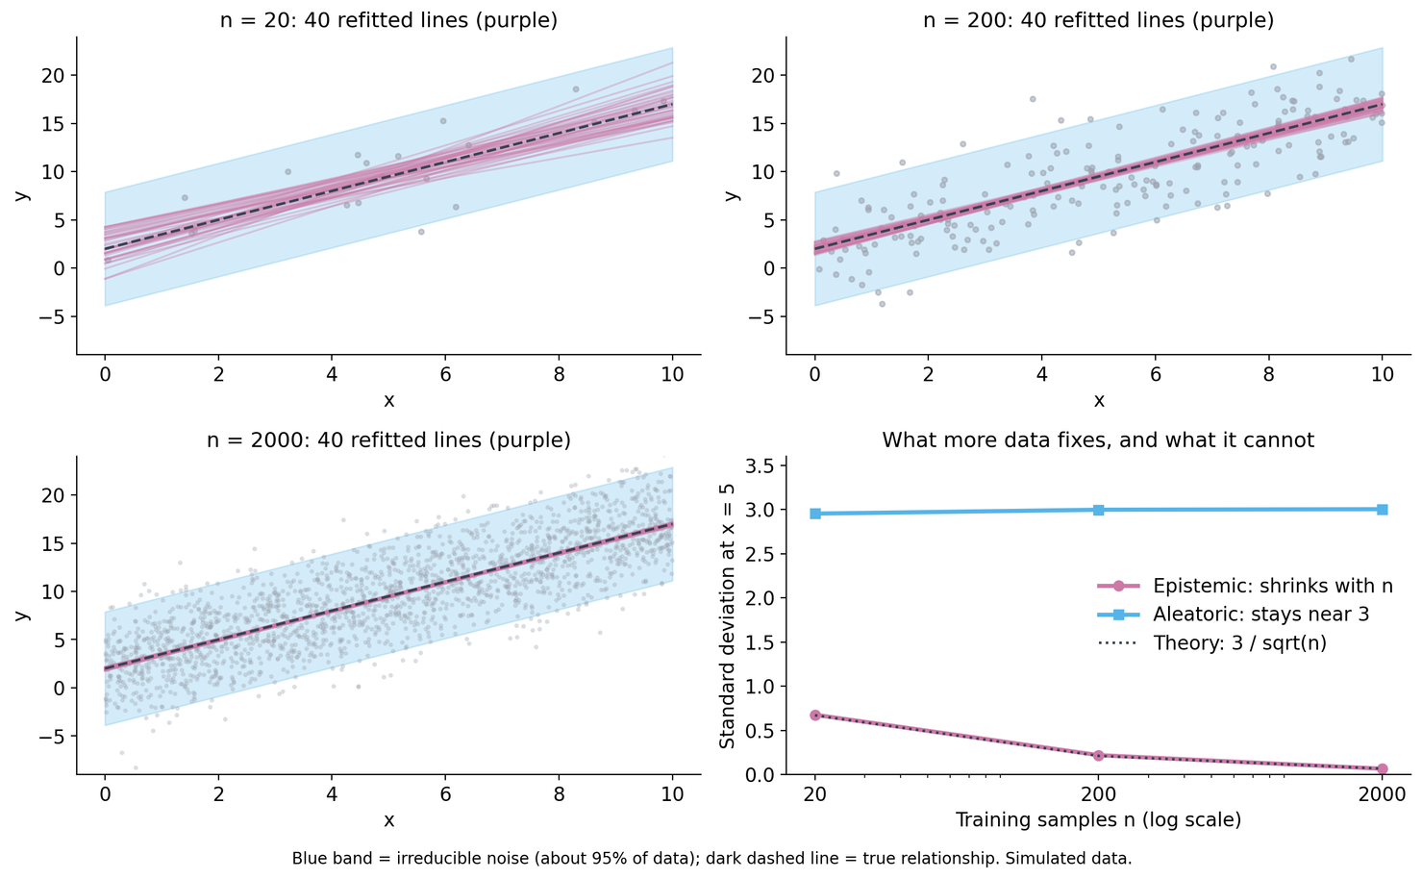
PART 4 · ALEATORIC VS EPISTEMIC UNCERTAINTY
ACT 2 OF 4
More data shrinks model doubt, but not noise
Simulated data: x = today’s fasting glucose, y = next month’s value; the same straight-line model is fitted on 20, 200 and 2,000 patients.
Blue band (aleatoric): patients with the same reading still differ by chance. Noise sd stays about 3 at n = 20, 200 and 2,000.
Purple lines (epistemic): the model’s own doubt. Spread of its prediction at x = 5: 0.68, then 0.22, then 0.07 as n grows.
More data fixes the purple part, not the blue part.
Simulated data; own computation (demo notebook, Part C, seed 405). Concepts: Hüllermeier and Waegeman [10].
12

Slide 13
PART 4 · ALEATORIC VS EPISTEMIC UNCERTAINTY
ACT 2 OF 4
Which kind of doubt it is decides what to do next
Input: patient record
Model
Two estimates: epistemic (what it does not know) and aleatoric (what is random)
MODEL STATE
WHAT IT SHOULD SAY
RIGHT RESPONSE
Epistemic high
“I have rarely seen cases like this”
“I am not sure because I lack data”
Defer to a clinician, flag the case, collect more data of this kind.
Aleatoric high
“Cases like this are inherently variable”
“The outcome is a matter of chance”
Report a range or probability; do not collect more of the same.
Both low
“I am fairly sure”
Answer, still with a range.
Wrong diagnosis of the doubt means wrong action: collecting data for pure noise is wasted effort; averaging away ignorance hides risk.
Concepts and uses: Hüllermeier and Waegeman [10].
13

Slide 14
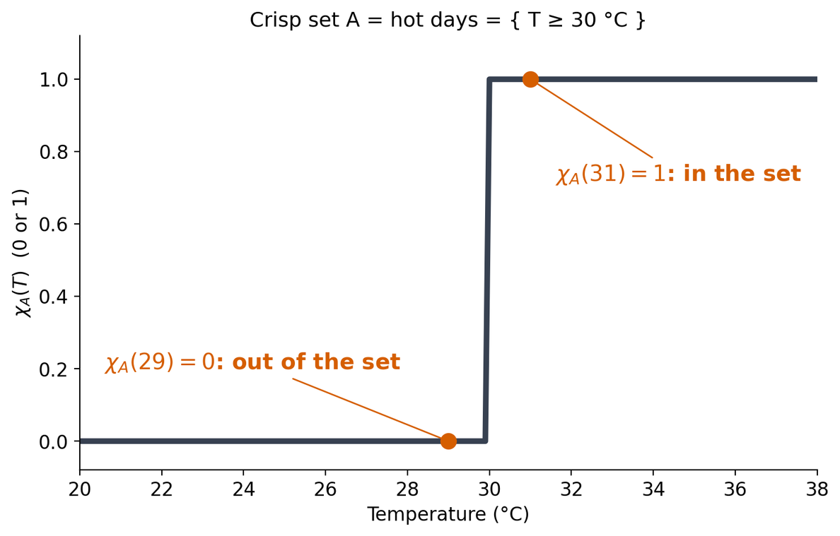
PART 5 · CRISP LOGIC AND ITS LIMITS
ACT 3 OF 4
Crisp logic: every element is in (1) or out (0)
A crisp set A has a characteristic function:
χA(x) = 1 if x ∈ A
χA(x) = 0 if x ∉ A
A = hot days = { T : T ≥ 30 °C }
χA(31) = 1, χA(29) = 0
Only two truth values: true or false. Membership is all or nothing.
Plot: own computation (demo notebook, appendix). Definition: standard set theory.
14

Slide 15
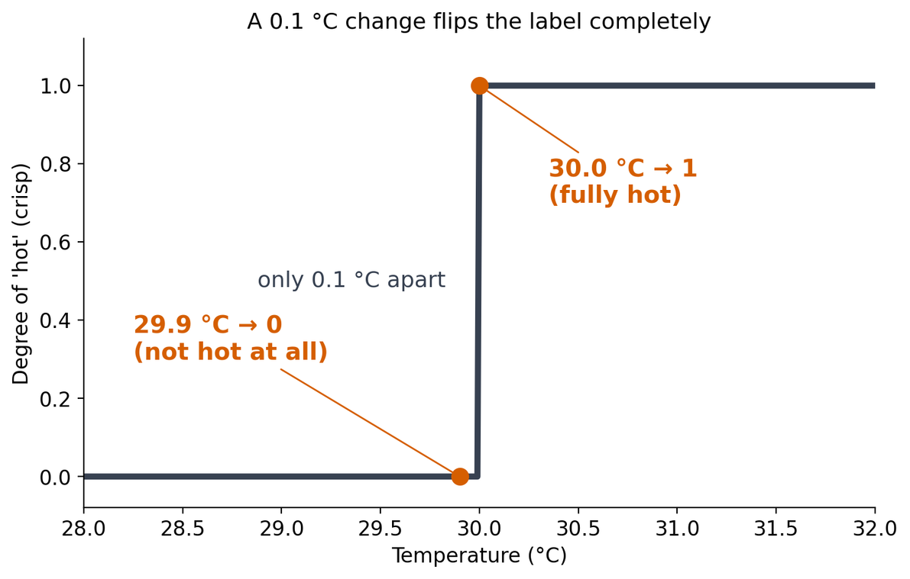


PART 5 · CRISP LOGIC AND ITS LIMITS
ACT 3 OF 4
If “hot” starts at 30 °C, then 29.9 °C is not hot at all
0.1 °C
29.9 °C
not hot (0)
30.0 °C
hot (1)
1
A change of 0.1 °C flips the label completely.
2
Thermometers are imprecise (± 0.3 °C), so noise alone can flip the label.
3
Real concepts (“tall”, “high risk”) do not change abruptly at one point.
Plot: own computation (demo notebook, appendix).
15

Slide 16

PART 5 · CRISP LOGIC AND ITS LIMITS
ACT 3 OF 4
Vague concepts break crisp logic; sharp rules still have a place
The sorites (heap) paradox
When crisp is still the right choice
Legal age: 18 is the line, by law
Pass/fail defined by regulation
1 grain
100 grains
1,000,000 grains
On/off safety interlocks
1. One grain of wheat does not make a heap.
2. If n grains do not make a heap, adding one grain does not either.
3. Therefore one million grains do not make a heap.
Exact inputs, e.g. a date of birth
Use crisp when a rule defines the boundary and a clear line is worth more than a smooth one.
Same puzzle for tall, hot, high risk.
Sorites formulation: Hyde and Raffman, Stanford Encyclopedia of Philosophy [11].
16

Slide 17
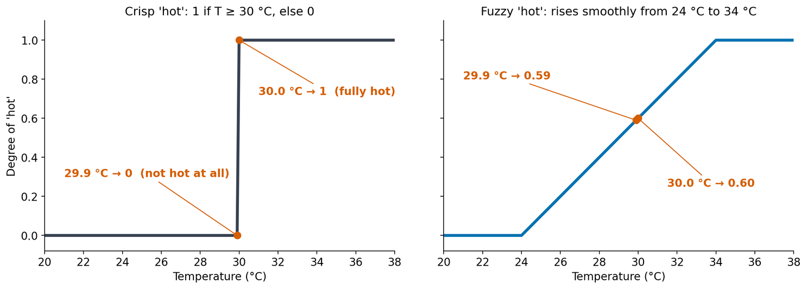
PART 6 · FUZZY LOGIC, THE BASIC IDEA
ACT 3 OF 4
Fuzzy sets soften the edge: membership is a degree from 0 to 1
A fuzzy set A has a membership function μA(x) between 0 and 1: the degree to which x belongs to A. A crisp set is the special case where only 0 and 1 occur.
Reading the plot
Left: crisp “hot” jumps from 0 to 1 at 30 °C.
Right: fuzzy “hot” rises smoothly from 24 to 34 °C; 29.9 gives 0.59 and 30.0 gives 0.60.
L. A. Zadeh, “Fuzzy sets,” Information and Control, 1965: a class of objects with “a continuum of grades of membership”.
Plot: own computation (demo notebook, appendix). Definition and quote: L. A. Zadeh [12].
17

Slide 18
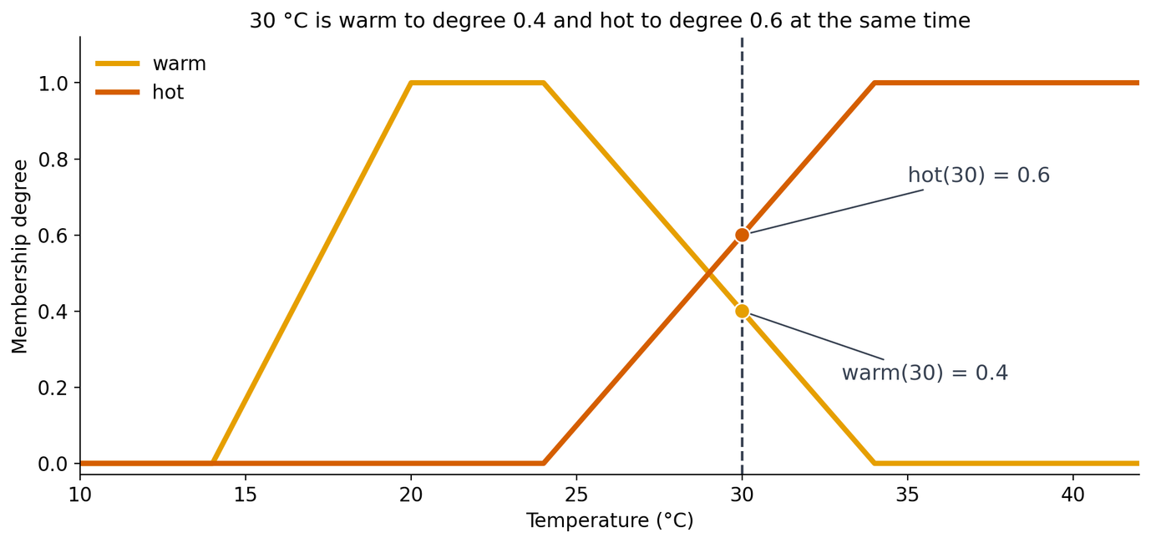
PART 6 · FUZZY LOGIC, THE BASIC IDEA
ACT 3 OF 4
30 °C is warm to degree 0.4 and hot to degree 0.6
hot(T) = (T - 24) / 10
clipped to 0 .. 1
warm(T) = trapezoid
(34 − T) / 10
hot(30) = (30-24)/10 = 0.6
warm(30) = (34-30)/10 = 0.4
One temperature, two sets, two degrees. A crisp rule would force a single label.
The shapes are design choices, usually taken from expert judgement or data.
Own membership functions; plot computed in the demo notebook (appendix).
18

Slide 19
PART 7 · PROBABILITY AND MISSING DATA
ACT 4 OF 4
A positive test does not mean 90 % sure
Illustrative numbers, not real data
test finds 90 %
9 test positive
10 sick
RESULT
≈ 8 %
1 % are sick
1 test negative
1,000 patients
Of 108 positive tests, only 9 are truly sick.
10 % false alarms
99 % healthy
99 test positive
990 healthy
P(sick | positive) = 9 / 108
891 test negative
CONDITIONAL PROBABILITY
P(A | B) = P(A and B) / P(B)
BAYES’ THEOREM, AS INTUITION
P(sick | +) = P(+ | sick) × P(sick) / P(+)
Read “|” as “given”. Full treatment of Bayes’ theorem and Bayesian networks: Week 4.
Illustrative numbers created for this talk. Concepts: Russell and Norvig [1], ch. 12.
19

Slide 20
PART 7 · PROBABILITY AND MISSING DATA
ACT 4 OF 4
Why a value is missing matters as much as how much is missing
MCAR
MAR
MNAR
missing completely at random
missing at random
missing not at random
The chance of being missing is unrelated to any value, observed or not.
The chance of being missing depends only on values that were observed.
The chance of being missing depends on the missing value itself.
Medical example
A lab tube breaks at random, so that patient’s glucose is lost.
Medical example
Older patients (age is recorded) are less often sent for a fasting glucose test.
Medical example
Patients with very high glucose feel too ill to attend the follow-up, so exactly the high values are absent.
Observed data can suggest MCAR vs MAR, but MAR vs MNAR cannot be verified from the observed data alone.
Mechanisms: D. B. Rubin [13]. Examples: own.
20

Slide 21
PART 7 · PROBABILITY AND MISSING DATA
ACT 4 OF 4
Every fix for missing data has a price
Strategy | What it does | Risk it introduces | Evidence from the demo
Deletion | Drop every row with a missing value | Loses information; biased unless data are MCAR | Keeps only 392 of 768 patients (51.0 %)
Mean or median imputation | Fill gaps with the column mean or median | Shrinks variance; treats a guess as a measurement | Insulin spread falls from sd 118.8 to 85.0
Missing-value indicator | Add a 0/1 column “was missing” | Keeps the fact of missingness, but the filled value is still invented; adds columns | 374 patients flagged for insulin
Each fix silently assumes something about why the data are missing.
Own computation on the Pima Indians Diabetes Database [14], [15] (demo notebook, Part A). Zeros recoded as missing for Glucose, BloodPressure, SkinThickness, Insulin and BMI.
21

Slide 22
PART 7 · PROBABILITY AND MISSING DATA
ACT 4 OF 4
Three tools, three different questions
 | Crisp logic | Fuzzy logic | Probability
Question it answers | Is x in the set: yes or no? | To what degree does x fit the concept? | How likely is the event, given what I know?
Type of uncertainty handled | None: assumes sharp concepts and exact facts | Vagueness | Randomness and lack of knowledge
Suitable application | Legal-age check; regulatory pass/fail | Comfort or risk labels such as “hot” or “high risk” | Diagnosis from test results; weather forecast
Limitation | Jumps at the threshold; no degrees | Degrees depend on chosen membership functions; not a measure of chance | Needs data or priors; cannot define a vague word by itself
Own synthesis after Zadeh [12] and Russell and Norvig [1].
22

Slide 23

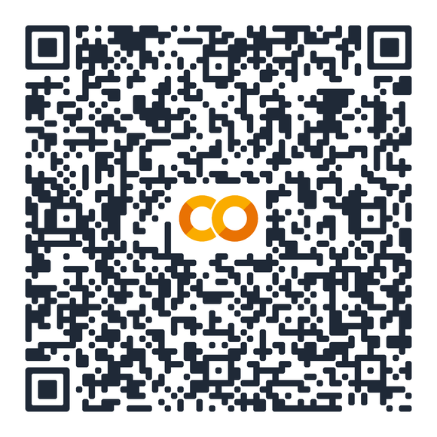
PART 8 · LIVE DEMO AND CONNECTION TO THE COURSE
ACT 4 OF 4
Live demo: real patient data, three questions
Missing values
Count them, and find the hidden zeros.
A
Pima Indians Diabetes Database
Crisp vs fuzzy
Same variable, two definitions of “obese”.
B
768 women aged 21 or older
8 measurements + diabetes outcome
NIDDK; Smith et al. (1988)
More data
What does a bigger sample fix, and what not?
C
Notebook: W01_UncertaintyDemo_Team01.ipynb
Runs top to bottom in Google Colab in about 30 seconds.
Colab share link here :
https://colab.research.google.com/github/ahmedtayel714/Advanced-AI-and-Uncertainty--W1/blob/main/W01_UncertaintyDemo_Team01.ipynb
Dataset: Smith et al. [14]; CSV copy from the plotly/datasets repository [15].
23

Slide 24
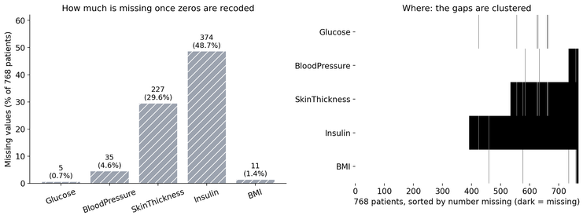
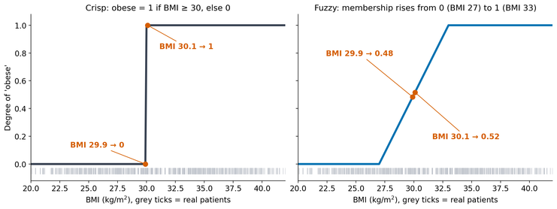
PART 8 · LIVE DEMO AND CONNECTION TO THE COURSE
ACT 4 OF 4
Three lines from the demo
From the demo notebook (context lines omitted)
374 of 768 insulin values (48.7 %) were hidden zeros
A · hidden zeros become missing values
df[cols] = df[cols].replace(0, np.nan)
df[cols].isna().sum()
BMI 29.9 gives crisp 0, fuzzy 0.48; BMI 30.1 gives crisp 1, fuzzy 0.52
B · crisp threshold vs fuzzy membership
crisp = (bmi >= 30).astype(float)
fuzzy = np.clip((bmi - 27) / 6, 0, 1)
Prediction spread 0.68, 0.22, 0.07 as n = 20, 200, 2,000; noise stays near 3
24

Slide 25
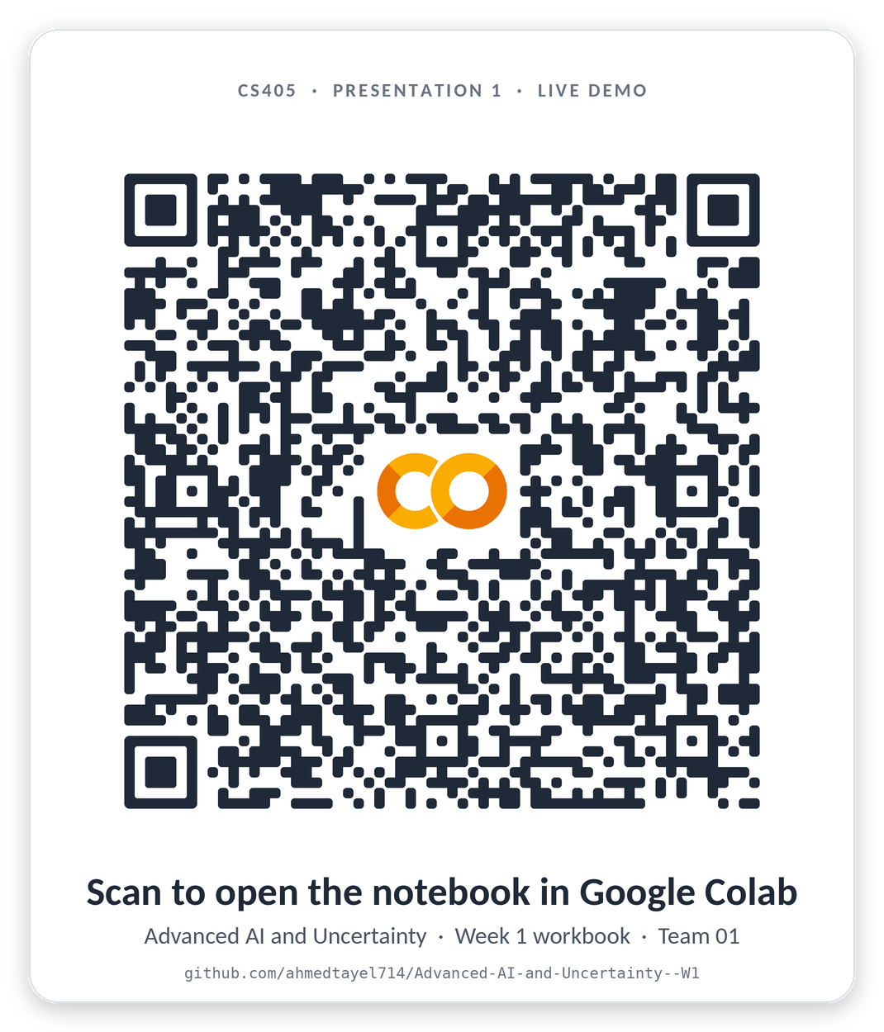
PART 8 · LIVE DEMO AND CONNECTION TO THE COURSE
ACT 4 OF 4
Live demo: real patient data, three questions
23

Slide 26
PART 8 · LIVE DEMO AND CONNECTION TO THE COURSE
ACT 4 OF 4
Final-project idea: an uncertainty-aware diabetes-risk screener
1
2
3
4
Data quality
Fuzzy layer
Risk model
Decision
Flag hidden zeros; add a missing-value indicator for every field.
Turn BMI, glucose and age into degrees, e.g. “obese 0.48”.
Predict a risk with a range; report noise and model doubt separately.
Answer, or say “I am not sure: refer to a clinician”.
REPRESENTS
REPRESENTS
REPRESENTS
REPRESENTS
Missing data
Vagueness
Aleatoric
Epistemic
All of the above
Each kind of uncertainty gets its own component.
Own design; building blocks as in Parts 3, 4, 6 and 7 of this talk.
25

Slide 27


Five things to remember
1
Uncertainty comes in four kinds: randomness, vagueness, imprecision, missing data.
2
Aleatoric noise stays; epistemic doubt shrinks with data.
3
Crisp logic jumps; fuzzy sets give degrees; a degree is not a probability.
4
Missing data has mechanisms, and every fix has a price.
5
A trustworthy model can say “I am not sure” and knows why.
27

Slide 28
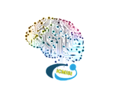

References
[1] S. Russell and P. Norvig, Artificial Intelligence: A Modern Approach, 4th ed. Hoboken, NJ, USA: Pearson, 2021.
[2] I. Goodfellow, Y. Bengio, and A. Courville, Deep Learning. Cambridge, MA, USA: MIT Press, 2016.
[3] A. P. Engelbrecht, Computational Intelligence: An Introduction, 2nd ed. Chichester, U.K.: Wiley, 2007.
[4] E. H. Shortliffe, Computer-Based Medical Consultations: MYCIN. New York, NY, USA: Elsevier, 1976.
[5] V. Gulshan et al., “Development and validation of a deep learning algorithm for detection of diabetic retinopathy in retinal fundus photographs,” JAMA, vol. 316, no. 22, pp. 2402–2410, 2016, doi: 10.1001/jama.2016.17216.
[6] C. Guo, G. Pleiss, Y. Sun, and K. Q. Weinberger, “On calibration of modern neural networks,” in Proc. 34th Int. Conf. Mach. Learn. (ICML), vol. 70, 2017, pp. 1321–1330.
[7] National Transportation Safety Board, “Collision between vehicle controlled by developmental automated driving system and pedestrian, Tempe, Arizona, March 18, 2018,” Washington, DC, USA, Highway Accident Rep. NTSB/HAR-19/03, 2019. [Online]. Available: https://www.ntsb.gov/investigations/AccidentReports/Reports/HAR1903.pdf
[8] National Transportation Safety Board, “Preliminary report: Highway HWY18MH010,” Washington, DC, USA, 2018.
[9] E. Beede et al., “A human-centered evaluation of a deep learning system deployed in clinics for the detection of diabetic retinopathy,” in Proc. CHI Conf. Human Factors Comput. Syst., 2020, doi: 10.1145/3313831.3376718.
[10] E. Hüllermeier and W. Waegeman, “Aleatoric and epistemic uncertainty in machine learning: An introduction to concepts and methods,” Mach. Learn., vol. 110, no. 3, pp. 457–506, Mar. 2021, doi: 10.1007/s10994-021-05946-3.
[11] D. Hyde and D. Raffman, “Sorites paradox,” in The Stanford Encyclopedia of Philosophy (rev. Aug. 26, 2025). Accessed: Sep. 30, 2026. [Online]. Available: https://plato.stanford.edu/entries/sorites-paradox/
[12] L. A. Zadeh, “Fuzzy sets,” Inf. Control, vol. 8, no. 3, pp. 338–353, Jun. 1965, doi: 10.1016/S0019-9958(65)90241-X.
[13] D. B. Rubin, “Inference and missing data,” Biometrika, vol. 63, no. 3, pp. 581–592, 1976, doi: 10.1093/biomet/63.3.581.
[14] J. W. Smith, J. E. Everhart, W. C. Dickson, W. C. Knowler, and R. S. Johannes, “Using the ADAP learning algorithm to forecast the onset of diabetes mellitus,” in Proc. Symp. Comput. Appl. Med. Care, 1988, pp. 261–265.
[15] Plotly, “diabetes.csv (Pima Indians Diabetes Database),” plotly/datasets repository, GitHub. Accessed: Sep. 30, 2026. [Online]. Available: https://github.com/plotly/datasets/blob/master/diabetes.csv
[16] World Health Organization, “Obesity and overweight,” fact sheet, Dec. 8, 2025. Accessed: Sep. 30, 2026. [Online]. Available: https://www.who.int/news-room/fact-sheets/detail/obesity-and-overweight

Slide 29
Thank You
Questions & Discussion
Matrouh University, Egypt
Presenter : Ahmed Ayman Tayel | Registration ID: 232611000001

