Slide 1

Information Assurance Project
Subtitle: FAST-NUCES Islamabad — Accounting & Finance Department
Prepared By: Ahmed
Course: Information Assurance
Date: 2025

Slide 2
Project Overview: ISO 27001 Alignment
This project designs and implements an ISO 27001-aligned Information Security Management System (ISMS) for the A&F Department.
1
2
3
ISMS Scope Document
Asset Inventory
Risk Assessment (24 risks)
4
5
6
Risk Control Management
Gap Analysis
Statement of Applicability (SoA)
7
Security Policies (4 policies)

Slide 3

ISMS Scope Summary
Scope Covers:
Exclusions:
Accounting & Finance Department
IT infrastructure outside A&F
LMS, HR systems
Fintech Lab
Purpose:
Financial systems (ERP, payroll)
Protect financial, academic, and personal data.
Cloud systems (OneDrive, cloud ERP)
Physical storage (exam papers)

Slide 4

Organizational Context & Key Assets
Stakeholders:
Confidential Assets:
Internal: Finance Staff, Faculty, IT Team
Payroll records
External: Auditors, Vendors, Banks, Cloud Providers
Vendor invoices
Activities Covered:
Exam papers
Student records
Teaching, exams, fee processing, procurement, reporting.
Financial reports

Slide 5

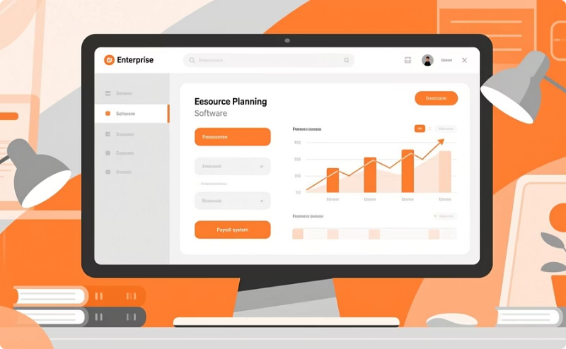


Asset Inventory Overview
Total assets documented: 45+
Hardware
Software
Cloud
Network
PCs, laptops, NAS, printers, switches
ERP, Payroll, MS Office, Antivirus
OneDrive, Cloud ERP
VLANs, Wi-Fi APs, Firewall rules

Slide 6
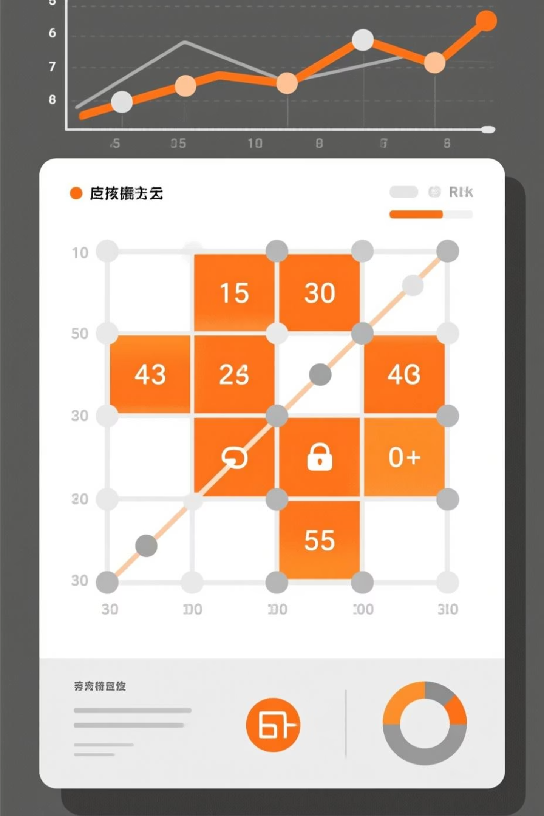

Risk Assessment Summary
Using a 5 × 5 Likelihood × Impact matrix, 24 risks were identified.
Critical Risks
High Risks
7 identified
10 identified
Medium Risks
7 identified

Slide 7
Top Critical Risks Identified
No MFA on ERP & Email
Phishing attacks
Ransomware
USB data exfiltration
Exam paper leakage
Student misuse of Lab PCs
Cloud sharing misconfiguration

Slide 8

Risk Control Management
Critical Risks Treated With:
High Risks Treated With:
DLP (Data Loss Prevention)
MFA implementation
WPA3 Wi-Fi
USB port blocking
Vendor verification SOP
BitLocker encryption
Backup restore testing
Patch management
Unlicensed software removal
Email security upgrades
Exam cabinet protection
Lab monitoring & logging

Slide 9
Gap Analysis & Solutions
Major gaps identified and addressed to strengthen security posture.
No MFA
MFA implementation
Weak Passwords
Strong password policy
USB Fully Open
Block ports + whitelist devices
Weak Wi-Fi
WPA3 + MAC filtering
Exam Papers Unprotected
Locked cabinet + digitization
Logs Not Reviewed
Monthly reviews

Slide 10






Final Outcomes & Conclusion
This project demonstrates a full ISMS lifecycle, improving data security and compliance.
Data Confidentiality
Access Control
Incident Detection
Cloud Security
Exam Integrity
Physical Protection

