Slide 1


Compressing Backoff in CSMA Networks
Mahanth Gowda
Nirupam Roy
University of Illinois (UIUC)
University of Illinois (UIUC)
Romit Roy Choudhury
Srihari Nelakuditi
University of Illinois (UIUC)
University of South Carolina
Presented by:
Mo Li
Nanyang Technological University

Slide 2
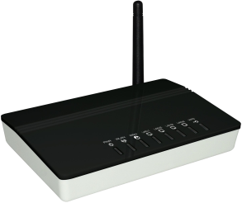

Coordination needed for medium access
AP-1
AP-2
Collision
Client-1
Client-2
Notes:
In a wireless network, we all know that coordination is necessary for medium access. Without co-ordination, multiple nodes could attempt to tramsit together resulting in a collision at the receiver

Slide 3
802.11 Contention Resolution
Backoff = 7
Backoff = 12
7
0
18
13
Transmit
Freeze and Wait
Freeze and Wait
Transmit
12
5
5
0
Notes:
So how does today’s 802.11 resolve contention .. Nodes chose random numbers and countdown in time ..One of the node reaches 0 and transmits its packet whereas the other node senses the first transmission and freezes its counter. Once the first transmission is complete, the second node will resume countdown whereas the forst own will pick a fresh counter. They repeat the process again and the cycle continues such that one node accesses the medium at a time

Slide 4
802.11 Contention Resolution
Backoff = 7
Backoff = 12
Idle time
7
0
18
13
Transmit
Freeze and Wait
Freeze and Wait
Transmit
12
5
5
0
Notes:
However, we can clearly see that the counting down time is a source of pure overhead because the channel is idle during this time .. The overhead can be as large as xx% at yy condition
# add curve lines

Slide 5
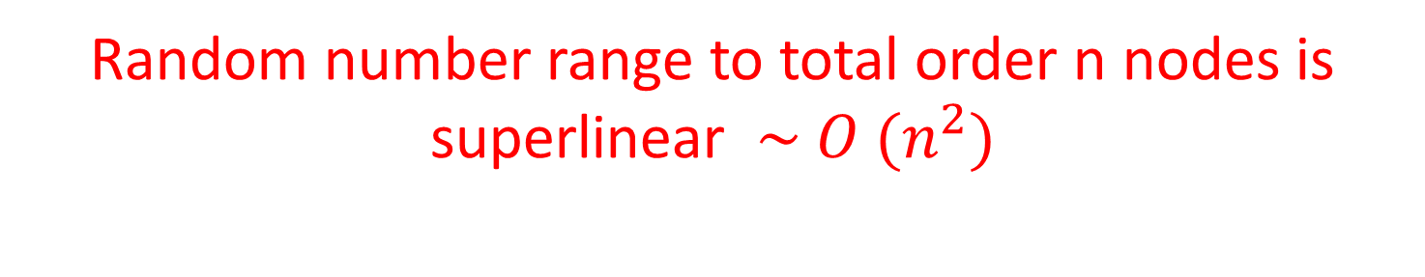
802.11 Attempts Total Ordering
C4
C3
C3
C1
C4
C2
C2
C1
15 14 13 12 11 10 9 8 7 6 5 4 3 2 1 0
Contention Window
Random number range to total order n nodes is superlinear $\sim O (n^{2})$
Notes:
Essentially 802.11 attempts to total order all the contending nodes. For example, 4 nodes can be ordered by making them choose cw form 16. .in genrel the random number range necessart totoal
Lets take a step back and analyze 802.11 contention .. It attempts to totally order contending nodes ..
For example, ordering 4 nodes may ideally require 16 slots

Slide 6
Cost of Total Ordering
Tradeoff between collision probability and channel idle time
Notes:
802.11 attempts to total order all the nodes with high probability ..
As we can see in the graph, a high total order probability needs large cw size
On the other hand, low cw size means that proability for total ordering is small, thereby increasing collisions
Clearly we have a tradeoff bw coll prob and chan idle time here

Slide 7
Can we break the tradeoff between collision probability and idle time?
Yes, we propose a hierarchical two round backoff scheme (HiBo)
First round: Partial order nodes into groups
Second round: Totally order within each group
Notes:
How can we break away from this tradeoff bw /..?
The answer is to resolve contention in 2 rounds
In the first round, we partially order nodes into groups
And then in the second round, we totally order nodes within each group

Slide 8
Two round contention example
C4
C4
C3
C3
C2
C1
C3
C1
C2
C4
C2
C1
3 2 1 0
3 2 1 0
3 2 1 0
Round1: Partial Order
(R1)
Round2: Total order each group
(R2)
4 slots
4 slots
4 slots
Two round: 12 slots
One round: 16 slots
Notes:
Here is an example for a 2 round contention scheme .. Nodes c1 to c4 choose the first round conuter from smaller cw therefore some of the nodes pick same random numbers. Consequently nodes are only partially ordered by forming two groups. IN the second round the order between nodes in each group is resolved ..

Slide 9
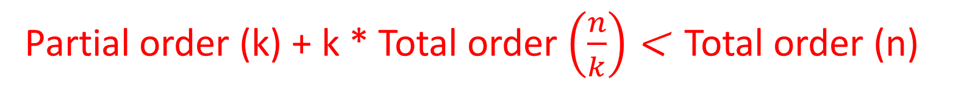
Two Round Gains via Partial Ordering
Single Round
Two Round
Higher Gain at higher densities
Partial order (k) + k * Total order $\left(\frac{n}{k}\right)$ < Total order (n)
Notes:
Here we plot the cw size necessary with a single round contention scheme like 802.11 and that required by a two round contention scheme. There is a lot of gain, particularly at higher node densities’
The key intuition is that
%Simulations indicate how this is beneficial, particularly at high node densities

Slide 10
Translating the intuition into a practical system
Entails solving many challenges
Groupwise Contention
Reliable group signaling
Multiple contention domains
Adaptivity to collisions
Notes:
However, translating the intuition into a practical system entails solution to many challenges ..

Slide 11
Basic Two Round Contention
Busy Signal
R1 contention resumes
R1 winners contend in R2
R1 contention
R1:4
0
R2:3
0
R1:6
R1:6
C4
R1:4
0
3
3
0
R1:7
C3
R2:6
R1:6
2
R1:2
R2:1
C2
R1 loosers freeze here
R1:6
2
R1:2
C1
R2:3
Notes:
We first explain a basic timeline of a multi round contention scheme ..

Slide 12




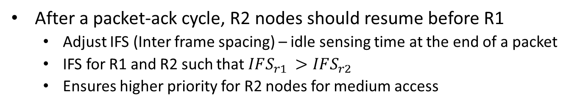

Prioritizing R2 over R1
After a packet-ack cycle, R2 nodes should resume before R1
Adjust IFS (Inter frame spacing) – idle sensing time at the end of a packet
IFS for R1 and R2 such that $IFS_{r1 }>IFS_{r2}$
Ensures higher priority for R2 nodes for medium access
R2 Nodes have higher access priority
R1 Nodes progress when R2 nodes are done
Packet & ACK
Packet & ACK
R2 Node
No R2 Nodes
R1 Node
R1 Node
$$IFS_{r1}>IFS_{r2}$$
$$IFS_{r2}$$
$$IFS_{r2}$$
$$IFS_{r1}$$
$$IFS_{r1}$$
Notes:
As we have seen in the previous slide, at the end of a packet/ack cycle, R1 nodes should continue to remain idle whereas R2 nodes should resume counting . In order to achieve these we make R1 and R2 nodes sense the channel for IFS_1 and IFS_2 resp such that IFS_1 < IFS_2
802.11 makes nodes to sense the channel for an IFS interval before beginning counting down. Similarly, in order to increase the priority of R2 nodes we assign them different IFS intervals such that IFS1 > IFS2 . The example shows ..

Slide 13
Multiple Contention Domains
C2
C3
C1
Nodes 1 and 3 do not interfere with each other
R1
R2
C1
Node 3 is needlessly kept idle, waiting on Node 2 which is blocked by node 1
C2
C3
Notes:
Here is an example where a naïve implementation causes problems in multiple contention domains. Consider topology such that C1 and C3 do not sense each other. Suppose they start 2d contention and C1 and C2 enter R2,at this point c3 will start freezing .. Suppose C1 wins .. Then C2 waits till which will result in prolonged waiting time for C3. However, this should not happen because c3 and c1 do not hear each other and should be able to transmit in parallel

Slide 14
Multiple Contention Domains
C2
C1
C3
Transmit busy tones in alternate slots during R2 contention
In the absence of busy tones, Node 3 resumes count down
R1
R2
C1
C2
Nodes 1 and 3 transmit in parallel
C3
Notes:
We introduce busy toning to resolve this problem. Nodes contending in R2 send busy tones in alternate slots while counting down.
In retrospect lets look at the timeline of C3, ..
IN our given sitation, C3 senses absesnce of busy tones and infers that C2 is blocked. So, it resumes countdown and transmits subsequently

Slide 15
Handling Overexposed Terminals
Nodes 1 and 2 do not interfere at node 3
Combined energy of their busy signals might exceed node 3’s detection threshold and block it needlessly
How to mitigate overexposed terminals?
1
3
2
Notes:
We illustrate the overexposed terminal problem with the following topology ..

Slide 16

Handling Overexposed Terminals
Add random jitter to the contending preambles
Yields multiple correlation peaks at the receiver
Distribute total received energy among the detected peaks
Resolves per collider energy, eliminates over exposed terminals
Energy
1
2
$$Δ$$
Busy Signals
Time
Notes:
To handle overexposed terminals, we introduce random jitters between busy signals .. This transmates into multiple peaks on the Correlation energy curve. By counting the number of peaks, we can resolve the number of busy signal transmitters and avoid over exposed terinanls

Slide 17
Applications beyond WiFi
oCSMA → o2CSMA
Notes:
Applies to other protocols beyond WiFi .. Like oCSMA ..
Just read

Slide 18




oCSMA
Distributed stochastic approximation algorithm
to maximize a given utility function
oCSMA prescribes channel access probabilities and mean channel access time and respectively
Theoretically optimal
Practical limitations of slot sizes make oCSMA a zero sum game between throughput and fairness
$$λ$$
$$μ$$
oCSMA
Network
$$λ (or CW)$$
$μ$ (or Packet Size)
Notes:
read

Slide 19



o2CSMA
We break the access probabilities prescribed by oCSMA into probabilities for two round contention
$$λ_{2} (or CW_{2})$$
o2CSMA
Network
$$λ_{1} (or CW_{1})$$
$$μ$$
Notes:
read

Slide 20






o2CSMA
By minimizing collisions, o2CSMA breaks the zero sum game between efficiency and fairness (more details in paper)
$$CW_{2}=\frac{CW}{2}$$
$$λ_{2} (or CW_{2})$$
oCSMA
$$λ (or CW)$$
Network
$$CW_{1}=\frac{CW}{2}$$
$$λ_{1} (or CW_{1})$$
$$μ$$
Notes:
Block diagram shows internals of o2CSMA ..

Slide 21
Evaluation
PHY micro benchmarking on USRP N210
Protocol Simulations on NS3

Slide 22
Overexposed terminal problem
Notes:
The graph shows how the combined energy of multiple colliders passes the detection threshold even though they are individual nbelow the detection threshold ..This causes over exposed terminals

Slide 23
Energy Detection is not suitable
Combined energy of colliders exceeds energy threshold

Slide 24
Peak counting based energy detection
Notes:
With our peak counting technique the qccuracy of detection of over exposed terminals is high with our scheme, whereas

Slide 25
Peak counting based energy detection
HiBo accurately detects overexposed terminals, pure energy detection fails

Slide 26
Higher gains at higher node densities
Notes:
Comapres the throughput of hibo with 802.11 and static variants of two round cw .. Consistently offers high throuput in all density regimes .. 30% gains

Slide 27
Enhancing scalability of oCSMA
Notes:
We compare o2csma with ocsma for various simulation parameters ..one parameter setting works well for high density and other for low node density .. Whereas with hibo ,, we offer consistent performance withal node densiities

Slide 28
Enhancing scalability of oCSMA
oCSMA (1000) poor performance at high density

Slide 29
Enhancing scalability of oCSMA
oCSMA (200) poor performance at low density

Slide 30
Enhancing scalability of oCSMA
o2CSMA (1000) scalable performance at all density regimes

Slide 31
Multiple Contention Domains
Notes:
Finally, the gains extend to multiple contention domans as well

Slide 32
Related Work
Unconventional backoff techniques
Back2F and WiFi Nano require more complexity
Differential queue based optimal CSMA schemes
Our proposal is complementary to oCSMA and IdleSense
Tree Splitting based protocols (in sensor networks)
They operate at the granularity of packets while we operate at slot level
MrCA
We address multi contention domains, adaptivity and phy layer signaling
Notes:
Whatever cw they prescribe can be ordered into 2 rounds and minimize collision ..
Enromous literature exist on tree splitting nased protocols .. Hgowver ..
Finally, mrca is closest to out work where theyt propose multi round contention for wigi like setting .. However .. Do not handle challenges like

Slide 33
Summary
Revisiting the classical time domain backoff scheme
Partial ordering followed by total ordering of nodes within the partially ordered groups is better than absolute total ordering
Practical scheme for two-round contention
Reliable group signal detection
Handles multiple collision domains
Promising results from simulation and micro benchmarking
Throughput gain over 30%
Enhanced scalability of oCSMA

Slide 34
Thank You
SyNRG Research Group
www.synrg.csl.illinois.edu

Slide 36
Adapting to Collisions
802.11 doubles contention window on collisions
How does two rounds of contention adapt to collisions?
Equal size contention window in both rounds desirable
Minimizes collisions for the same overhead (compared to 802.11)
Upon a collision
If R1 = R2 increase R1 so that R2 nodes do not block R1 nodes
If R2 < R1, increase R2 so as to equalize R1 and R2
Contention window in R2 is never greater than R1
Notes:
We now move to adaptivity, adapting the contention window size is necessary for protection from collisions. 802.11 adapts binary exponential backoff ..howver, the solution is not straightforward in our case, because …..two wind
.. Ensuring ..

