Slide 1
a dataset of 5,873 paired scientific documents and associated presentation slide decks is released. doc2ppt uses recurrent sequence-to-sequence architecture that "reads" the input document and “summarizes” it into structured slides. to account for the concise nature of text in slides (e. g. , bullet points), the model incorporates paraphrasing module that converts document-style full sentences to slide style phrases/clauses.
Created with a trial version of Syncfusion Essential Presentation

Slide 2
vision and language tasks have not been addressed, e. g. , multimodal document generation. our task involves summarizing a document with text and figures, but it also involves putting the summary in'structured format'.
Created with a trial version of Syncfusion Essential Presentation

Slide 3
the goal of DOC2PPT is to generate a slide deck with text and figures. the task involves encoding sentences and images and summarizing the sentences - then paraphrasing the sentence and putting it on the output slides. • A Progress Tracker (PT) maintains pointers to the input (i. e. , which section is currently being processed).
Created with a trial version of Syncfusion Essential Presentation

Slide 4
document reader (DR) extracts sentence and figure embeddings from an input document. we use a bidirectional GRU to extract contextualized sentences xini,k and v in q to shared embedded space txt (x ini k) we then concatenate them as the figure embedded V inq :V enq = [ResNet(F in Q ),RoBERTa(C )].
Created with a trial version of Syncfusion Essential Presentation

Slide 5
a learning objective captures both the structural and content similarity between the ground-truth slides and the generated slides. sentences in documents have an average of 17. 3 words, while sentences on slides have 11. 6 words; the difference is statistically significant (p = 0. 0031).
Created with a trial version of Syncfusion Essential Presentation

Slide 6
at test time, we utilize the multimodal projection head () to act as a post-processing tool. we remove figures that have relevance scores lower than 'R' and add figures with scores higher than'A.
Created with a trial version of Syncfusion Essential Presentation

Slide 7
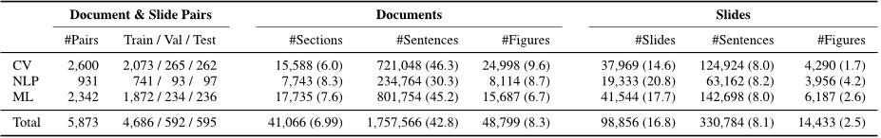
our dataset contains PDF documents and slides in the JPEG image format. to ensure that our test set is clean and reliable, we use Amazon Mechanical Turk (AMT) and have humans perform image extraction and matching for the entire set.
Created with a trial version of Syncfusion Essential Presentation

Slide 8
DOC2PPT is a new task with no established evaluation metrics and baselines. to enable large-scale evaluation we propose automatic metrics for evaluating slide generation methods. we also perform human evaluation to assess the generation quality.
Created with a trial version of Syncfusion Essential Presentation

Slide 9
to measure the quality of text in the generated slides, we adapt the ROUGE score [41] widely-used in document summarization.
Created with a trial version of Syncfusion Essential Presentation

Slide 10
we train our network end-to-end using ADAM [21] with a learning rate of 3e-4.
Created with a trial version of Syncfusion Essential Presentation

Slide 11
a “flattened” version of our Progress Tracker (flat-PT) replaces the hierarchical RNN. the flat approach learns to model the section-slide-object structure better than the 'baseline' approach achieves 64. 15% vs. 51. 72% on all metric, compared to 256 in the baseline - 512 in ours! if the model is able to learn the structure, it can bring out higher mIoU with the groundtru.
Created with a trial version of Syncfusion Essential Presentation

Slide 12
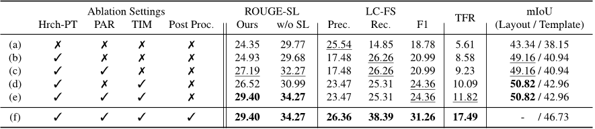
Created with a trial version of Syncfusion Essential Presentation

Slide 13
we present a novel task and approach for generating slides from documents. the task involves understanding and summarizing documents and structuring it into presentation form. we hope our work will help advance state-of-the-art in vision and language understanding.
Created with a trial version of Syncfusion Essential Presentation

Slide 14
a slide deck contains on average 2. 3 images that are excerpted from the corresponding paper. for the human-labeled testing set, an average of 2. 4 images are extracted from each slide and matched with the paper's figures using visual embedding from mobilenet (31) if the cosine similarity is larger than the threshold I, more figures will be included, which increases recall but negatively impacts accuracy.
Created with a trial version of Syncfusion Essential Presentation

Slide 15
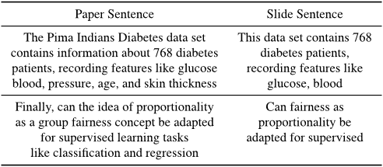
Created with a trial version of Syncfusion Essential Presentation

Slide 16
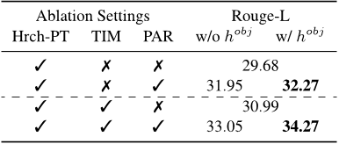
using hobj provides contextual information, which helps PAR generate a paraphrased sentence more relevant to the content in the document.
Created with a trial version of Syncfusion Essential Presentation

Slide 17
Fig. 15 shows a screenshot of the human rating task for evaluating the quality of generated slides. the annotators were asked three questions - how similar the text on slide DECK A was to that on the other slide deck b, and if there were no figures on deCK c, they could also indicate that they did not see any 'figures'.
Created with a trial version of Syncfusion Essential Presentation

Slide 18
the output of our approach can be used as a draft slide deck for humans to build upon. we apply off-the-shelf tools such as Microsoft PowerPoint Design Ideas [3].
Created with a trial version of Syncfusion Essential Presentation

