Slide 1

SourceSync: A Distributed Architecture for Sender Diversity
Hariharan Rahul
Haitham Hassanieh
Dina Katabi
Notes:
Hello everybody, I am Hariharan Rahul, and I am the diversity slot at this year’s Sigcomm.

Slide 2
Diversity is a fundamental property of wireless networks
Notes:
Diversity is a fundamental property of wireless networks.
<pause>
One aspect of diversity is receiver diversity (click)

Slide 3
Receiver Diversity
Sender
Receivers
Broadcast
Unlikely paths to all receivers are attenuated at the same time
Notes:
Which is the property that when a sender broadcasts a packet, it is unlikely that the signals to all receivers are attenuated at the same time.

Slide 4
Receiver Diversity Underlies Many Systems
All Opportunistic Routing Protocols
ExOR, MORE, MIXIT, ROMER, SOAR, …
WLAN Diversity
MRD, SOFT, Link-Alike, Vi-Fi, …
Notes:
Receiver diversity is the cornerstone of many wireless systems.
All opportunistic routing protocols exploit receiver diversity, including exor, more, mixit, romer, soar. You name it.
Not only that, wireless LAN diversity also exploits receiver diversity. Examples include MRD, soft, link-alike, vi-fi etc.

Slide 5
Opportunistic Routing Exploits Receiver Diversity
Notes:
Let’s see how opportunistic routing exploits receiver diversity.

Slide 6
Opportunistic Routing Exploits Receiver Diversity
R1
25% Loss
0% Loss
Alice
Bob
25% Loss
R2
0% Loss
src
dst
25% Loss
0% Loss
R3
25% Loss
0% Loss
R4
Best single path → Loss Probability is 25%
Receiver Diversity → Unlikely all routers see a loss
Any router can forward → Loss Prob. (0.25)⁴ < 1%
Notes:
Consider a simple topology where Alice is interested in delivering a packet to Bob. However, all links from Alice to the routers happen to be lossy.
If one picks a single path from Alice to bob, loss rate will be 25%
However receiver diversity tells us that it is unlikely that the signal from Alice to all routers is attenuated at the same time.
So, when Alice broadcasts her packet, it is unlikely that all routers will have a loss.
Opportunistic routing exploits this very basic property to allow any router that receives the packet to forward it, so the loss rate becomes the probability that no router receives the packet, which is in this case, 0.25^4, i.e, less than 1%.
[Pause]

Slide 7
WLAN Diversity Exploits Receiver Diversity
AP1
Uplink
25% Loss
Client
AP2
25% Loss
Ethernet
25% Loss
AP3
25% Loss
AP4
Best Single AP → Uplink Loss Probability is 25%
Any AP can forward → Uplink Loss Prob. (0.25)⁴ < 1%
Notes:
Similarly, wireless lans exploit receiver diversity.
Say that you have a client in a dead spot i.e. it has high loss probability to all APs.
On the uplink, if the client picks any single AP to forward its packets, it sees a loss rate of 25%.
But, receiver diversity tells us that when the client broadcasts the packet, it is unlikely that all APs will see an attenuated signal at the same time.
WLAN diversity exploits this property. It lets any AP that receives the packet on the uplink to forward it. As a result, the loss probability becomes the probability that no AP receives the packet, which is, as before, less than 1%.

Slide 8
Diversity is a fundamental property of wireless networks
Receiver
Diversity
Sender
Diversity
MRD
SOFT
Link-Alike
MORE
SOAR
Vi-Fi
ExOR
MIXIT
ROMER
Notes:
So, one aspect of wireless diversity, which is receiver diversity, has been exploited by a large number of wireless systems.
How about the second aspect of wireless diversity, which is sender diversity? <pause>

Slide 9
Sender Diversity
Senders
Receiver
Transmit simultaneously
Unlikely paths from all senders are attenuated at the same time
Notes:
Sender diversity is the dual of receiver diversity.
It is the property that when multiple senders forward a packet simultaneously, it is unlikely that the signals from all transmitters to the receivers are attenuated at the same time.
<pause>

Slide 10
Diversity is a fundamental property of wireless networks
Receiver
Diversity
Sender
Diversity
?
MRD
SOFT
Link-Alike
MORE
SOAR
Vi-Fi
ExOR
MIXIT
ROMER
Notes:
So, what have we done to exploit sender diversity?
Not much. Today, 802.11 networks cannot harness sender diversity.
<pause>
But why?

Slide 11
Is it because Sender Diversity has no benefits?
No
Sender Diversity has analogous benefits to Receiver Diversity
Notes:
Is it because sender diversity has no benefits?
<pause>
The answer to this is no. Sender diversity indeed has analogous benefits to receiver diversity.

Slide 12
Sender Diversity Improves Opportunistic Routing
Notes:
In fact, sender diversity can improve opportunistic routing protocols.

Slide 13
Sender Diversity Improves Opportunistic Routing
R1
25% Loss
0% Loss
25% Loss
Alice
Bob
25% Loss
R2
0% Loss
25% Loss
src
dst
0% Loss
25% Loss
R3
25% Loss
25% Loss
25% Loss
0% Loss
R4
Opportunistic Routing picks single router to forward
Notes:
Let’s go back to our simple topology.
It is likely that the links from the routers to Bob are lossy just like the links from Alice to the routers.
Opp routing, however, has to pick a single router to forward the packet.

Slide 14
Sender Diversity Improves Opportunistic Routing
R1
25% Loss
0% Loss
25% Loss
Alice
Bob
25% Loss
R2
0% Loss
25% Loss
src
dst
0% Loss
25% Loss
R3
25% Loss
25% Loss
25% Loss
0% Loss
R4
Opportunistic Routing → Loss to Bob is 25%
Notes:
But whichever router forwards the packet, the loss rate with opportunistic routing is going to be 25%.
But we know that with a loss rate of 25% on the first hop, 3 out of 4 routers are going to receive the packet from Alice.

Slide 15
Sender Diversity Improves Opportunistic Routing
R1
25% Loss
0% Loss
25% Loss
Alice
Bob
25% Loss
R2
25% Loss
src
dst
0% Loss
25% Loss
R3
25% Loss
25% Loss
25% Loss
0% Loss
R4
Opportunistic Routing → Loss to Bob is 25%
Sender Diversity → Unlikely paths from all routers are attenuated
Forward simultaneously → Loss to Bob is (0.25)³ < 2%
Notes:
And sender diversity tells us that if all these routers forward the packet together, it is unlikely that their signals to Bob will be attenuated at the same time.
Thus, if we can make all these routers forward simultaneously in a manner that their signals strengthen each other, then the packet is lost only when the signal from each of the routers is simultaneously attenuated , which is, in this case, 0.25^3, i.e, it reduces the loss from 25% to 2%.
<pause>

Slide 16
Sender Diversity Improves WLANs
Downlink
AP1
25% Loss
Client
AP2
25% Loss
Ethernet
25% Loss
AP3
25% Loss
AP4
WLAN Diversity→ Downlink Loss is 25%
Sender Diversity → Unlikely paths from all APs are attenuated
Forward simultaneously→ Downlink Loss (0.25)⁴ < 1%
Notes:
Similarly, sender diversity improves the performance of wireless lans.
In particular, if the downlink of a client from all APs is lossy, picking a single AP to forward will result in a downlink loss rate of 25%.
However, sender diversity tells us that if all APs transmit together, it is unlikely that the signal from all APs are attenuated at the same time.
So, if all the APs transmit together in a manner that their signals strengthen each other, the loss rate on the downlink goes from 25% to less than 1%.

Slide 17
Is it because Sender Diversity has no benefits?
No
Sender Diversity has analogous benefits to Receiver Diversity
What Has Prevented Us from Using Sender Diversity?
Notes:
So, now that we see that sender diversity has analogous benefits to receiver diversity, the natural question to ask is: what has prevented us from harnessing the benefits of sender diversity?

Slide 18
Challenge
Today, simultaneous transmissions don’t strengthen each other
Notes:
The answer is simple. Today, simultaneous transmissions do not strengthen each other.

Slide 19
Challenge
Today, simultaneous transmissions don’t strengthen each other
R1
Interference
Bob
R2
dst
R3
S_{n}
S_{n+1}
S_{n}
S_{n+1}
R4
Need Distributed Symbol-Level Synchronization
Transmissions arrive out of sync
→ Different symbols from different transmitters interfere
Notes:
Specifically, if you have all the routers forward the same packet to the receiver, since these are distributed nodes, they are not synchronized and their signals will arrive at the receiver out of sync.
As a result, adjacent symbols from different transmitters will leak energy into each other, creating interference. And as a result of this, you might be much worse off than if you had only one transmitter.
Thus, if we want to harness sender diversity, we need symbol level synchronization in a distributed manner.

Slide 20

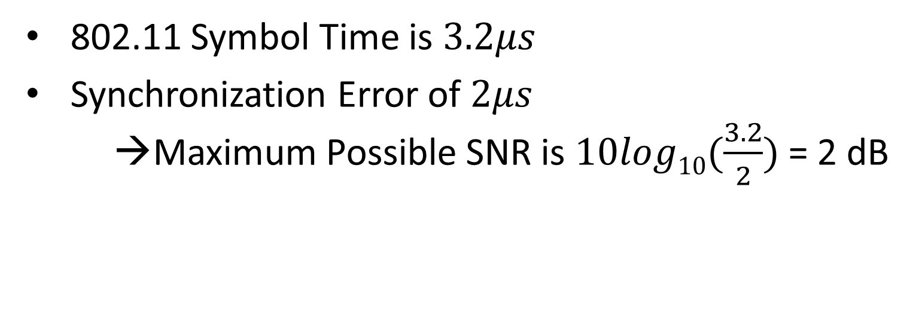

How Accurately Need We Synchronize?
$$3.2μs$$
$$2μs$$
Symbol
Misaligned Symbol
802.11 Symbol Time is $3.2μs$
Synchronization Error of $2μs$
→Maximum Possible SNR is $10log10⁡(\frac{3.2}{2})$ = 2 dB
Notes:
Just to give you a feel for how accurate the synchronization has to be, let’s do a back of the envelope calculation.
An 802.11 symbol is 3.2us.
Say two transmitters transmit simultaneously, but they have a synchronization error of 2 us. Then the misaligned symbol creates interference, which acts like noise. As a result, the maximum possible SNR for this system is 2 dB, which is much worse than if you had one transmitter.

Slide 21
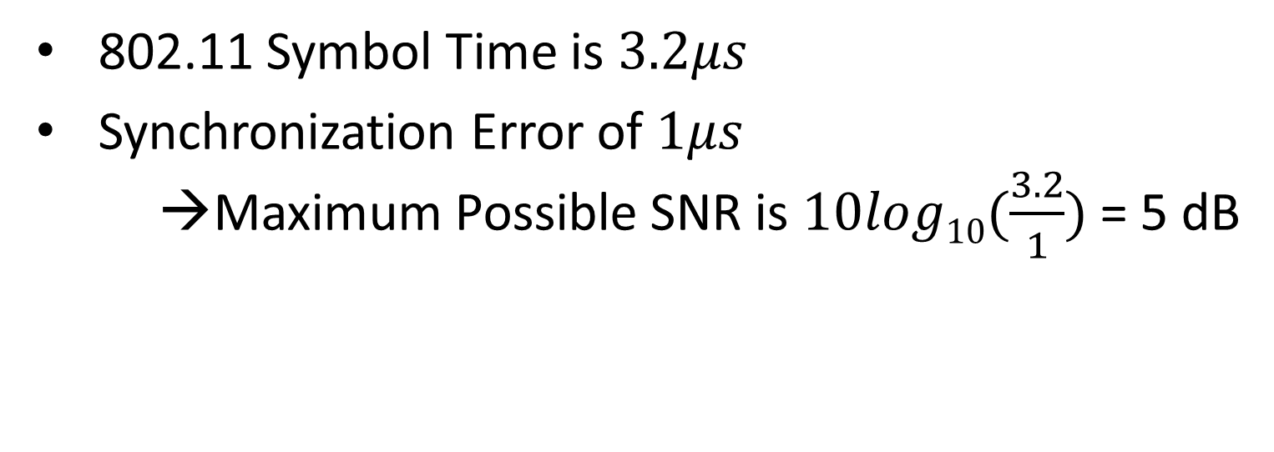

How Accurately Need We Synchronize?
$$3.2μs$$
$$1μs$$
Symbol
Misaligned Symbol
802.11 Symbol Time is $3.2μs$
Synchronization Error of $1μs$
→Maximum Possible SNR is $10log10⁡(\frac{3.2}{1})$ = 5 dB
Notes:
Now, say that the synchronization error reduces to 1us. The maximum possible snr becomes 5 dB, which is still very bad.
So, what is an acceptable maximum snr for 802.11?

Slide 22

How Accurately Need We Synchronize?
$$3.2μs$$
$$1μs$$
Symbol
Misaligned Symbol
802.11 Symbol Time is $3.2μs$
For max. bitrate, 802.11 needs an SNR of $\sim$22dB
Notes:
For 802.11 to be able to achieve the entire range of bitrates it spans, it needs to achieve a maximum snr of around 22 dB.

Slide 23


How Accurately Need We Synchronize?
$$3.2μs$$
$$20ns$$
Symbol
Misaligned Symbol
802.11 Symbol Time is $3.2μs$
For max. bitrate, 802.11 needs an SNR of $\sim$22dB
→Maximum Synchronization Error is 20 ns
Need to Synchronize Symbols to within 20 ns
Notes:
This translates into a maximum synchronization error of 20ns.
Thus, to harness the gains of sender diversity in 802.11 networks, we need to synchronize symbols to within 20 ns.
<pause>

Slide 24
SourceSync
Provides distributed and accurate symbol-level synchronization (within 20 ns)
Complements Opportunistic Routing by harnessing sender diversity gains
Complements WLAN Diversity by reducing losses on the downlink
Implemented in FPGA and evaluated in a wireless testbed
Talk is in the context of Opportunistic Routing
Results apply to both Opportunistic Routing and WLANs
Notes:
The rest of this talk, I will present our system sourceSync.
SourceSync makes the following contributions:
It provides distributed and accurate symbol level synchronization to within 20 ns or less.
We use sourcesync to enable Opportunistic routing to harness sender diversity gains, therefore achieving higher throughput.
We also use sourcesync to enable wireless lans to harness sender diversity to reduce losses on the downlink.
We have implemented sourcesync in fpga and evaluated it in a wireless testbed.
<pause>
For clarity, I will explain SourceSync within the context of opportunistic routing. However, our approach applies to both opportunistic routing and wireless lans, and I will show you results that support both.

Slide 25
How Do We Synchronize Distributed Transmitters?
Synchronize transmitters by reception
Notes:
So the first question that we have to answer is: How do we synchronize distributed transmitters?
In the absence of a global clock, the natural way to synchronize distributed transmitters is shared reception.

Slide 26
How Do We Synchronize Distributed Transmitters?
Synchronize transmitters by reception
R1
Alice
Bob
R2
src
dst
R3
R4
Routers are triggered by reception from Alice
Notes:
Let us go back to our network where Alice is transmitting to Bob.
In this case, all the routers are triggered by the reception from Alice.

Slide 27
How Do We Synchronize Distributed Transmitters?
Synchronize transmitters by reception
R1
Alice
Bob
R2
src
dst
R3
R4
Routers transmit jointly to Bob
Notes:
Triggered by Alice’s packet, the routers transmit jointly to Bob.

Slide 28
How Do We Synchronize Distributed Transmitters?
Synchronize transmitters by reception
R1
Alice
Bob
R2
src
dst
R3
R4
Paths have different delays → Signals arrive out of sync
Notes:
However, the paths through the different routers have different delays. So, still the signal will arrive at Bob out of sync.

Slide 29
How Do We Synchronize Distributed Transmitters?
Synchronize transmitters by reception
R1
Alice
Bob
R2
src
dst
R3
R4
Routers measure path delays and compensate for delay differences
How do we measure path delays?
Notes:
To address this problem, the routers have to measure the path delays and compensate for delay differences by inserting appropriate wait time
So, how do we measure path delays?

Slide 30
Components of Path Delays
A new packet?
R1
Alice
Bob
R2
src
dst
R3
R4
Propagation Delay
Packet Detection Delay
Hardware Turnaround Time from Rx → Tx
Notes:
Before we can measure the path delays and compensate for them, we need to understand where these delays come from.
First, there is the propagation delay. The time it takes the signal to travel from Alice to R1 is different from the time it takes the signal to travel to R2 because of difference in the location of the two routers. And similarly from R1 to Bob, and R2 to Bob, and so on.
Second, there is a packet detection delay. That is the router does not detect a packet upon the arrival of the first sample in that packet. It takes some time for a router to decide that this is indeed a new packet as opposed to a spike of noise.
Third, there is the hardware turn around time, that is the router needs to continue receiving the packet and then switch its hardware from reception to transmission which takes some time that depends on the HW of the router.
So our job is to measure these forms of delays and compensate for them.

Slide 31
Estimating Path Delays
Propagation Delay
Packet Detection Delay
Hardware Turnaround Time from Rx → Tx
Notes:
So, the challenge we face is to estimate the different components of path delay.
We will start with Packet detection delay because this is the most complex one, and once we get the packet detection delay right the other form of delay are easy.

Slide 32
Packet Detection Delay
Receivers detect packet using correlation
Random noise → Do not detect packet on first sample
Different receivers → different noise
→ different detection delay
Peak
Notes:
As said earlier, receivers typically do not detect a packet upon the arrival of its first signal sample.
Specifically, to detect a packet a receiver correlates the arriving signal with an expected pattern and declares a new packet when the correlation spikes.
This graph shows the correlation as a function of the sample index for a received packet.
However due to noise and practical imperfections, the correlation does not necessarily spike on the arrival of the first sample of a packet.

Slide 33
Packet Detection Delay
Receivers detect packet using correlation
Random noise → Do not detect packet on first sample
Different receivers → different noise
→ different detection delay
Peak
Notes:
Now, different receivers experience different noise and hence exhibit different correlations

Slide 34
Packet Detection Delay
Receivers detect packet using correlation
Random noise → Do not detect packet on first sample
Different receivers → different noise
→ different detection delay
Peak
Peak
Notes:
As a result, they detect the correlation peaks at different points.

Slide 35
Packet Detection Delay
Routers estimate packet detection delay
Compensate for detection delay by syncing to first sample
Notes:
So,
Routers need to estimate the packet detection delay.
And then compensate for it by syncing to the first sample in the packet.

Slide 36
Estimating Packet Detection Delay
OFDM transmits signal over multiple frequencies
f1
Notes:
To do so, we are going to exploit the fact 802.11 uses OFDM. OFDM divides the bandwidth into multiple frequencies and transmits in all of these frequencies concurrently.
Say this is the first OFDM frequency.

Slide 37
Estimating Packet Detection Delay
OFDM transmits signal over multiple frequencies
First Sample
f1
f2
Detect on first sample → Same phase
Notes:
And this is the second OFDM frequency.
The frequencies arrive sync-ed.
So, if the router detects the signal on the first sample, the two frequencies exhibit the same phase.

Slide 38
Estimating Packet Detection Delay
OFDM transmits signal over multiple frequencies
f1
f2
T
Detect after T
Frequencies rotate at different speeds
Notes:
If the router detects the packet after a delay T,
Then we know that different frequencies rotate at different speeds. For example, here the red frequency rotates faster than the blue frequency.

Slide 39
Estimating Packet Detection Delay
OFDM transmits signal over multiple frequencies
f1
f2
T
Detect after T
Different frequencies exhibit different phases
Phase = 2πfT
Notes:
As a result, different frequencies will exhibit different phases
And the resulting phase will be a linear function of the delay T and the frequency.
What is nice about this equation is the phase of the signal is something that we already compute during the OFDM packet decoding, and f is just the frequency of the ofdm subcarriers. So the only unknown is the detection delay, T.

Slide 40
Estimating Packet Detection Delay
Phase
Slope is 2πT
OFDM
Frequency f
Each router estimates packet detection delay
Estimate uses every symbol in packet → Robust to noise
Notes:
So, let’s plot the phase offset as a function of the OFDM frequency.
The slope of this line tell us the delay T that the router incurred when it detected this packet.
Each router measures the packet detection delay.
This method can use every symbol in the received packet to compute the slope and average all these estimates, and thus it is robust to channel noise.

Slide 41
Estimating Path Delays
Propagation Delay
Packet Detection Delay
Hardware Turnaround Time from Rx → Tx
Notes:
Recall that we had three types of path delays.
Now that we are done with detection delay, let’s estiamte HW turnaround time

Slide 42
Hardware Turnaround Time
Turnaround time is hardware dependent
Different hardware pipelines
Different radio frontends
Each router locally calibrates its turnaround by counting the clock ticks
Notes:
The turnaround time is hardware dependent. This is because:
different nodes will have different hardware pipelines and hence take different amounts of time to decode the packet.
Different nodes also have different radio front ends and hence will take different amounts of time for the radio to switch from receive to transmit.
The good news however is that this delay is deterministic, hence each router can measure this delay simply by counting the clock ticks since the packet detection.

Slide 43
Estimating Path Delays
Propagation Delay
Packet Detection Delay
Hardware Turnaround Time from Rx → Tx
Notes:
Last we need to estimate the propagation delay.

Slide 44
Measuring Propagation Delays
Use Probe-Response between node pairs
Probe
A
B
Response
RTT =
2 x Propagation Delay
+ Turnaround time at B
+ Packet Detection Delay at B
+ Packet Detection Delay at A
Notes:
Measuring propagation delays is now simple: We can use probe-reponse delays between pair of nodes.
A transmits a probe to B and counts the clock ticks till it gets a response from B.
The measured RTT is twice the propagation delay + turnaround time at node B + detection delay at B + detection delay at A
B measures its own turnaround time and detection delay and includes them in its response. And since A measures its own detection delay, and also measures the RTT, it can compute the propagation delay.

Slide 45
Synchronizing Distributed Transmitters
R1
Alice
Bob
R2
src
dst
R3
R4
Routers are triggered by reception from Alice
Notes:
So, let’s recap. The routers measure the different delay components.
The routers are triggered by the reception from Alice.

Slide 46
Synchronizing Distributed Transmitters
Compensate by waiting
R1
Compensate by waiting
Alice
Bob
R2
src
dst
R3
Compensate by waiting
R4
Routers are triggered by reception from Alice
Routers insert wait times to compensate for delay differences
Routers transmit after waiting
Notes:
Once they are triggered, they insert different wait times to compensate for delay differences.
And after waiting, the routers jointly transmit the packet.
So, this technique works when we have a single flow in the network. But what if there are multiple flows between different source-destination pairs in the network?

Slide 47
Synchronizing Distributed Transmitters
R1
Alice
Bob
R2
src
dst
R3
R4
Routers are triggered by reception from Alice
What about the MAC?
Routers insert wait times to compensate for delay differences
Routers transmit after waiting
Notes:
What about the MAC in such a case?

Slide 48
R1
R4
Alice
src
R2
dst
dst
R5
src
Bob
David
Charlie
R3
R6
Can We Synchronize While Using Carrier Sense?
Problem: Routers are forced to send upon reception even though the medium might be occupied
Notes:
In order to see why triggering is problematic with multiple source-destination flows, let’s say there is a second flow in the network between Charlie and David.
Now Alice has a packet destined to Bob, towards your right. And Charlie has a packet destined to David, towards your left.
Since Alice and Charlie cannot sense each other, they transmit simultaneously, and their respective routers receive them.
Now, note that the routers don’t do CSMA, and are just triggered by their reception. So they immediately transmit downstream to Bob and David, even though they are in carrier sense range of each other.
This leads to a collision and the packets are dropped.
So, the question is: Can we synchronize nodes while still retaining CSMA semantics, and avoiding such collisions? <PAUSE>

Slide 49
SourceSync MAC
Instead of triggering by reception from the previous hop, we trigger by transmission from one of the joint senders.
All nodes in the network use CSMA.
One of the nodes wins the contention and begins transmitting, just like in CSMA.
Other nodes hear the transmission; join the transmission if they have the packet after inserting wait time.
Notes:
Instead of triggering by reception from the previous hop, we trigger by transmission from one of the joint senders.
We then just let all nodes, including the routers, use carrier sense.
Let’s say one of the routers wins the contention. It begins transmitting
Other routers hear the transmission, insert a wait time to compensate for delay differences, and then join the transmission.

Slide 50
Synchronizing Multiple Transmitters
Sync Header
Gap
Data
Lead Sender
R1
dst
Co-Sender
R2
Lead sender:
Transmits Synchronization Header
Waits for known fixed gap
Transmits data
Notes:
Let us take the example of two routers transmitting to a downstream node.
Let’s say, R1, wins when contending. So it is the lead-sender.
And R2 is the co-sender.
The lead sender transmits a synchronization header used to synchronize with the co-senders.
It then waits for a known gap to allow for packet propagation to the co-sender, and hardware turnaround at the co-sender
It then transmits the data.

Slide 51
Synchronizing Multiple Transmitters
Sync Header
Gap
Data
Lead Sender
R1
dst
Co-Sender
R2
Sync Header
H/W Turnaround
Wait
Data
Co-Sender:
Listens to Synchronization Header
Turns around from receive to transmit
Waits to compensate for differences in path delays
Transmits data
Notes:
The co-sender, on its part, listens to the synchronization header from the lead sender and determines the start of the header.
It turns around from receiving the header to transmit.
But it cannot transmit immediately. It needs to wait for a little bit to fill out the gap and to compensate for differences in delays.
And after the wait, it transmits data. Since the wait time compensates for differences in delays, the data arrives synchronized at the receiver.

Slide 52
Performance
Notes:
Now that we understand how SourceSync works, let us look at its performance.

Slide 53
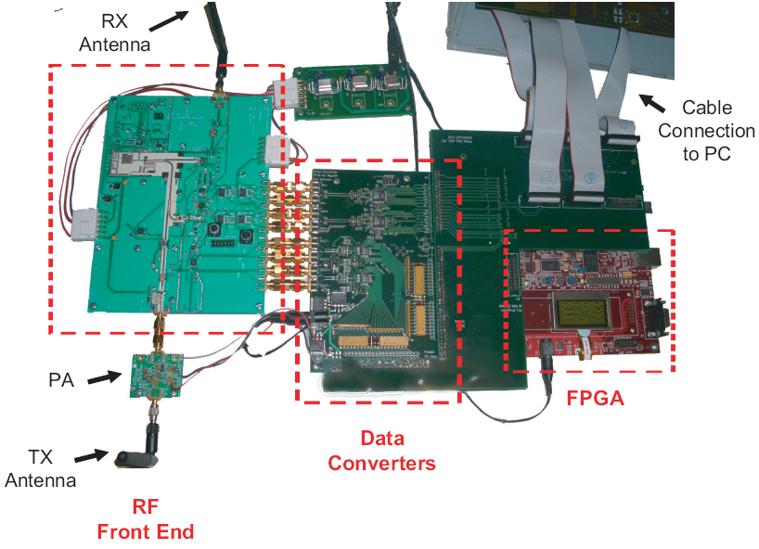
Implementation
Implemented in FPGA of WiGLAN radio
Carrier Frequency: 5.247 GHz
Bandwidth: 20 MHz
Notes:
Since SourceSync requires fine grained timing (at the granularity of nanoseconds),
we implement it on FPGA in the wiglan radio.
The carrier frequency is 5.2 GHz and the bandwidth is 20 MHz.

Slide 54
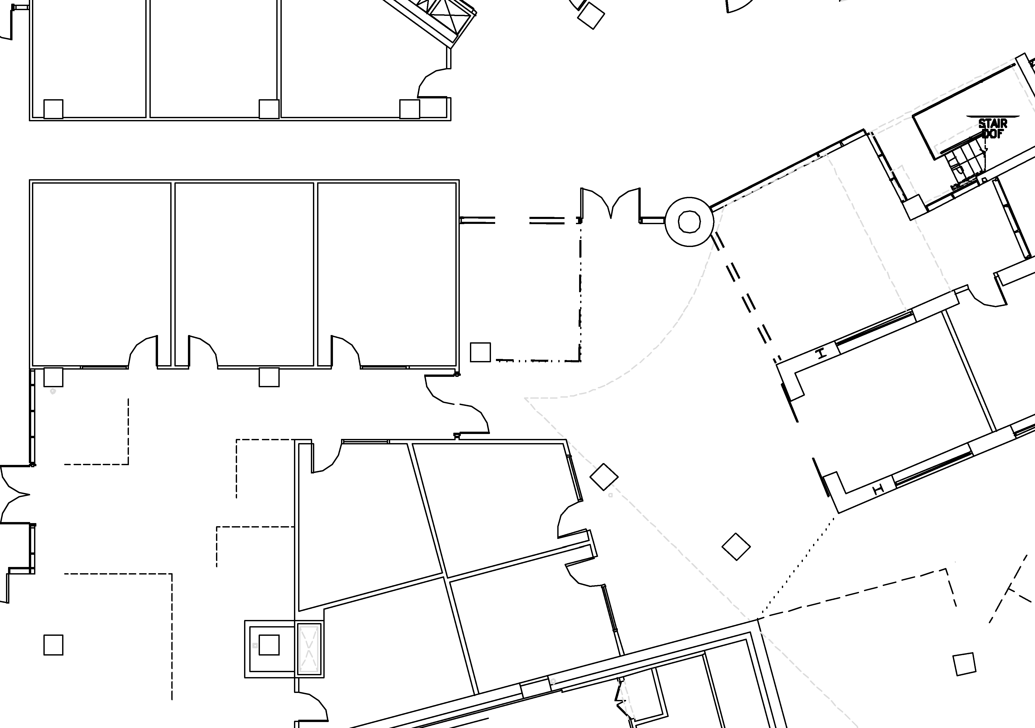
Node Locations in our Testbed
Notes:
We evaluate SourceSync in an indoor testbed with node locations in many line of sight and non line of sight configurations.

Slide 55
Can SourceSync Achieve Tight Synchronization?
Randomly pick a pair of nodes to transmit simultaneously to a receiver
Measure synchronization error
Repeat for different nodes
Notes:
The first qn we ask is: can source sync achieve tight symbol level synchronization?
To answer this question we run the following experiment,
we randomly pick 2 nodes to transmit simultaneously to a receiver
We measure the synchronization error between the 2 nodes at the receiver.
We repeat the experiment many times for different set of nodes

Slide 56
Can SourceSync Achieve Tight Synchronization?
Notes:
We then plot the synchronization error as a function of the SNR
Since we want the transmitters to be always synchronized, we do not simply look at the average synchronization error.

Slide 57
Can SourceSync Achieve Tight Synchronization?
Notes:
Instead, we look at the 95th percentile synchronization error.

Slide 58
Can SourceSync Achieve Tight Synchronization?
95th percentile
< 20 ns at all SNRs
SourceSync achieves distributed synchronization within 20 ns
Notes:
And here are the results. <pause>
Since we want nodes to be tightly synchronized, a lower synchronization error is better. As one would expect, the synchronization error decreases with high SNRs. This is because the noise is lower and the delay estimates are more accurate.
The important thing to note however, is that synchronization error is always less than 20 ns across the entire range of SNRs.
Sourcesync achieves distributed symbol level synchronization within 20 ns.

Slide 59
Can SourceSync Achieve Sender Diversity Gains?
Again, transmit simultaneously to a receiver
Check:
Two senders exhibit different channel SNRs
SourceSync is better than either sender
Notes:
The next q that we evaluate is whether sourcesync can harness sender diversity.
To answer this question, again we transmit simultaneously to a receiver.
And we check two things:
- first, we check that the two senders exhibit different channel SNR as predicted by Sender diversity
- And second we check that sourceSync’s SNR is better than transmitting from either sender alone

Slide 60
Can SourceSync Achieve Diversity Gains?
Channel SNR (dB)
Notes:
We plot the channel SNR as a function of the OFDM frequencies. Here, we show the results for one representative location. We have more results in the paper.

Slide 61
Can SourceSync Achieve Diversity Gains?
Channel SNR (dB)
Attenuation
Attenuation
Notes:
Here is the channel SNR for the first sender.
As you can see some OFDM frequencies suffer deep attenuation

Slide 62
Can SourceSync Achieve Diversity Gains?
Sender 2
Channel SNR (dB)
Attenuation
Notes:
And here is the channel SNR for the second sender. Again we see that some OFDM frequencies experience high attenuation

Slide 63
Can SourceSync Achieve Diversity Gains?
Sender 1
Sender 2
Channel SNR (dB)
Notes:
So if we plot the two channel from the two senders we can see that different senders experience bad channels on different OFDM frequencies.

Slide 64
Can SourceSync Achieve Diversity Gains?
Sender 1
Sender 2
SourceSync
Channel SNR (dB)
SourceSync Harnesses Sender Diversity
Notes:
And here is the channel SNR for SourceSync.
We see that SourceSync can achieve the best of both worlds in each frequency -- i.e. as long as one of the senders has high SNR in a frequency, the simultaneous transmissions with SourceSync have high SNR in that frequency.
Thus, SourceSync can harness Sender diversity gains.
But this is just one data point. Let me show you that across the variety of locations in our testbed, sourcesync achieves better performance than the best of the 2 senders.

Slide 65
Can SourceSync Improve WLAN Downlink Performance?
Two APs and one client
We compare
Best Single AP
SourceSync
Repeat for different nodes
Notes:
To do this, we are going to use SourceSync in the context of WLANs where two APs are transmitting to 1 client.
We are going to compare:
-- having the best AP transmit alone to a client, versus
- Having sourcesync transmit jointly with the 2 APs
We repeat for different nodes and show you the results for all the locations in our testbed.

Slide 66
Can SourceSync Improve WLAN Downlink Performance?
Notes:
We plot the CDF of the throughput of the clients.

Slide 67
Can SourceSync Improve WLAN Downlink Performance?
Single Best AP
Notes:
And here are the results. The blue line shows the throughput when transmitting from the single best AP.

Slide 68
Can SourceSync Improve WLAN Downlink Performance?
Single Best AP
SourceSync
1.57x
SourceSync improves throughput over Single Best AP by 57%
Notes:
And the green line shows the throughput of SourceSync.
As you can see, SourceSync provides a median throughput gain of 57% over picking the single best AP.

Slide 69
SourceSync With Opportunistic Routing
We compare
Single Path Routing
ExOR
SourceSync+ExOR
Notes:
Finally, we evaluate whether SourceSync can provide sender diversity gains in conjunction with opportunistic routing.
We evaluate 3 schemes:
Single best path
ExOR, as a representative of Opportunistic routing
And SourceSync+ExOR, as a representative of combining opportunistic routing with sender diversity

Slide 70
Throughput Gains of SourceSync
Notes:
We plot the cdf of the throughput across topologies, for each of the schemes.

Slide 71
Throughput Gains of SourceSync
Single Path
Notes:
Here are the results. This is the throughput of the best single path

Slide 72
Throughput Gains of SourceSync
Single Path
ExOR
Notes:
Here is ExOR

Slide 73
Throughput Gains of SourceSync
Single Path
ExOR
SourceSync+ExOR
1.45x
Median gain over ExOR is 45%
Notes:
And finally, here is SourceSync+ExOR
We see that combining sourceSync with opportunistic routing increases the median throughput of EXOR by 45%.

Slide 74
Throughput Gains of SourceSync
Single Path
ExOR
SourceSync+ExOR
2x
Median gain over ExOR is 45%
Median gain over Single Best Path is 2x
Notes:
and doubles the median throughput in comparison with single path routing.

Slide 75
Conclusion
Synchronizes distributed senders within 20ns
Adds sender diversity gains to opportunistic routing
Adds downlink diversity gains to WLANs
Brings a large body of theory closer to practice
Distributed Beamforming, Virtual MIMO, Lattice Codes …
Notes:
In conclusion, in this talk, we present our system sourcesync.
Sourcesync synchronizes distributed senders within 20ns.
It improves the throughput of opportunistic routing by adding sender diversity gains.
It also enhances the throughput of wireless lans by providing diversity gains on the downlink.
Finally, there is a large body of theoretical work that assumes tight symbol level synchronization. SourceSync’s synchronization primitive brings this body of work closer to practice. This includes such powerful ideas as distributed beamforming, virtual mimo, lattice codes, and so on.

