Slide 1
Feature Shift Detection
Localizing Which Features Have Shifted via Conditional Distribution Tests
Sean Kulinski, Saurabh Bagchi, David Inouye
- Purdue University -

Slide 2







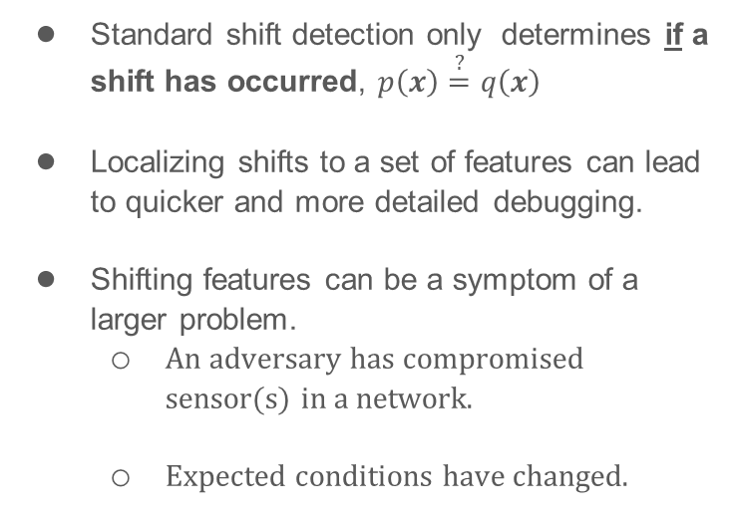
Feature shift detection can help understanding the cause of a shift
Standard shift detection only determines if a shift has occurred, $p\left(x\right)\overset{?}{=}q\left(x\right)$
Localizing shifts to a set of features can lead to quicker and more detailed debugging.
Shifting features can be a symptom of a larger problem.
  An adversary has compromised sensor(s) in a network.
  Expected conditions have changed.

Slide 3
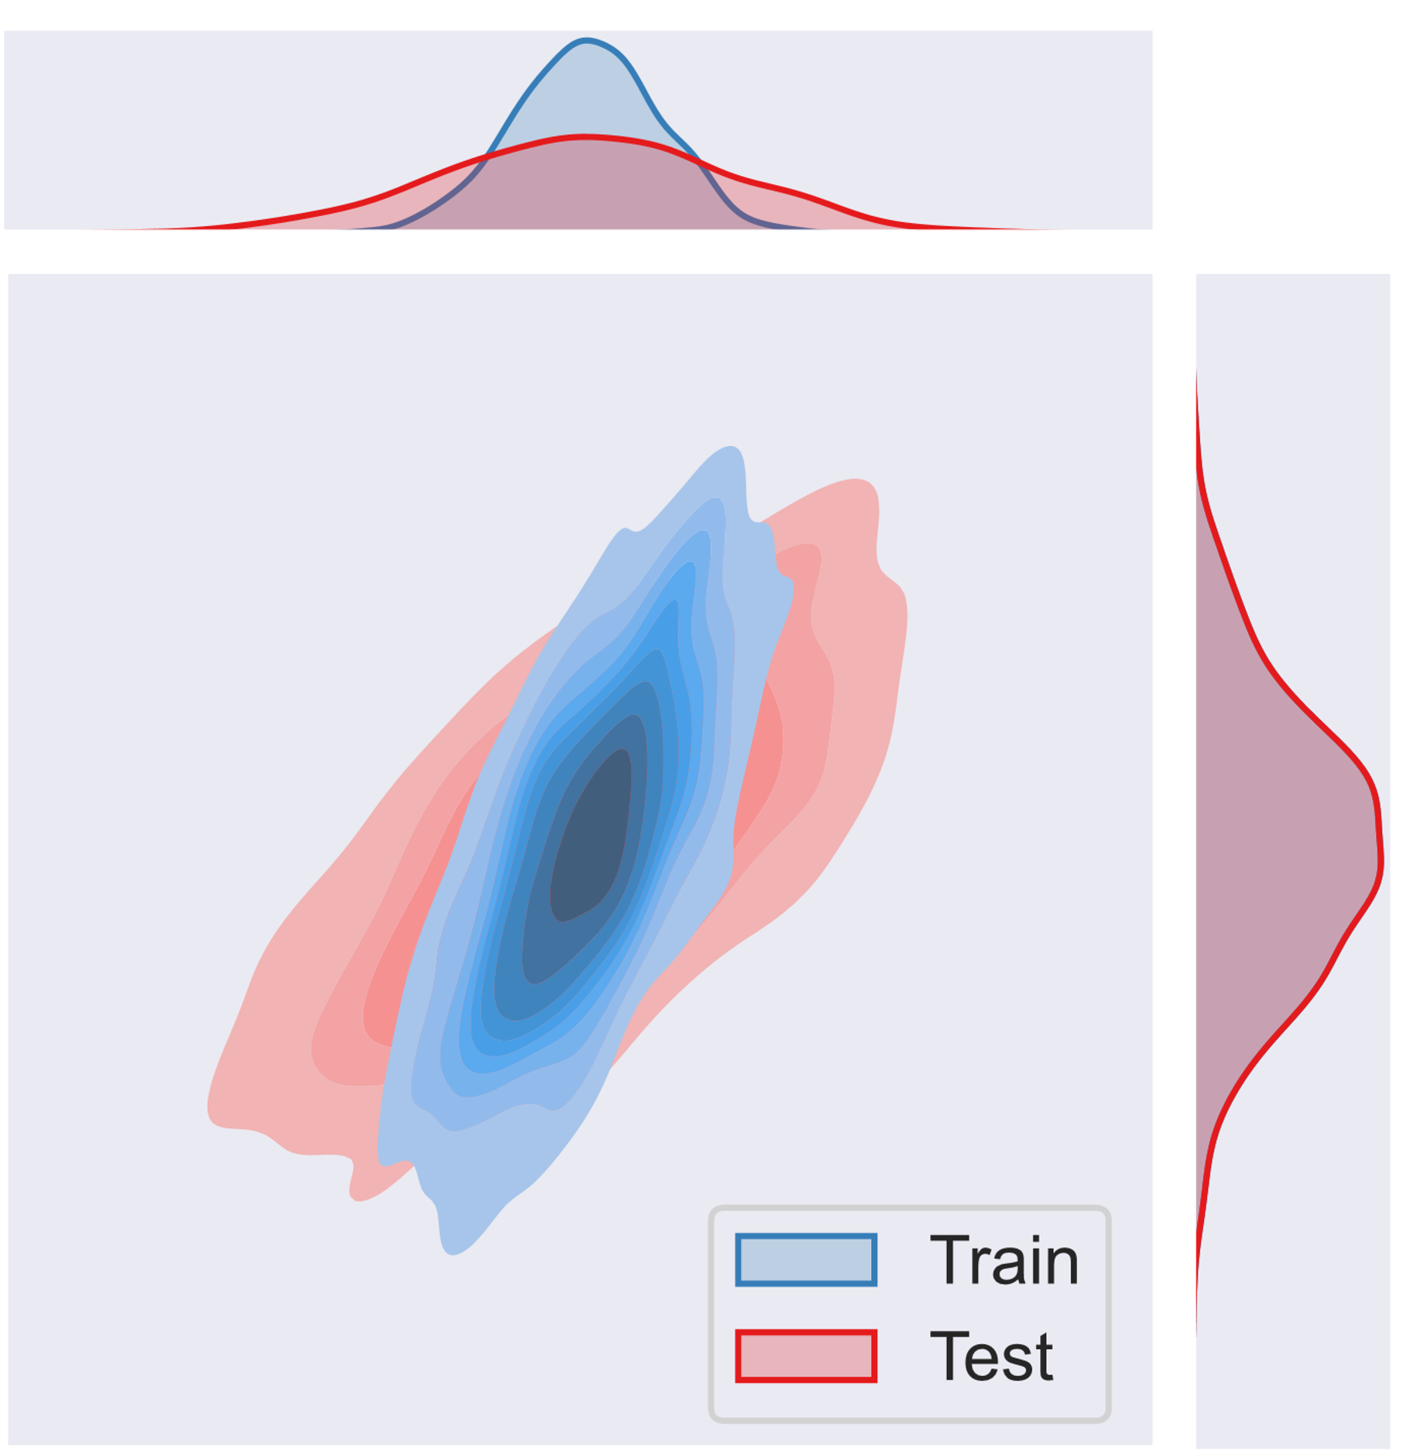
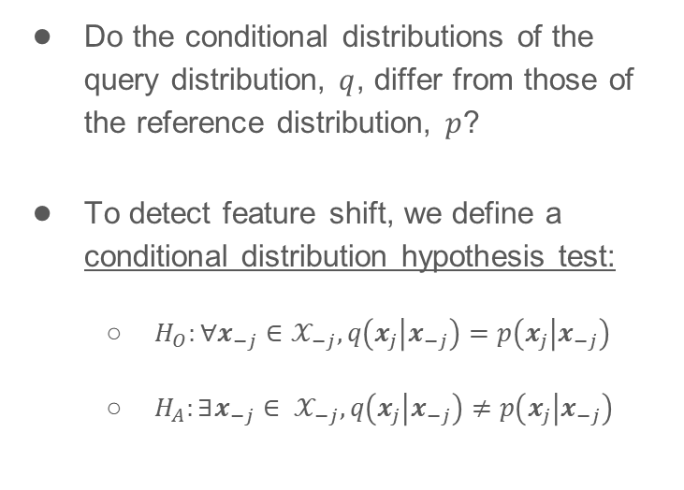
Feature shift detection localizes the problem to specific features
Do the conditional distributions of the query distribution, $q$, differ from those of the reference distribution, $p$?
To detect feature shift, we define a conditional distribution hypothesis test:
  $H_{O}:∀x_{−j}∈𝒳_{−j}, q\left(x_{j} | x_{−j}\right)=p\left(x_{j} | x_{−j}\right)$
  $H_{A}:∃x_{−j}∈ 𝒳_{−j}, q\left(x_{j} | x_{−j}\right)≠p\left(x_{j} | x_{−j}\right)$

Slide 4
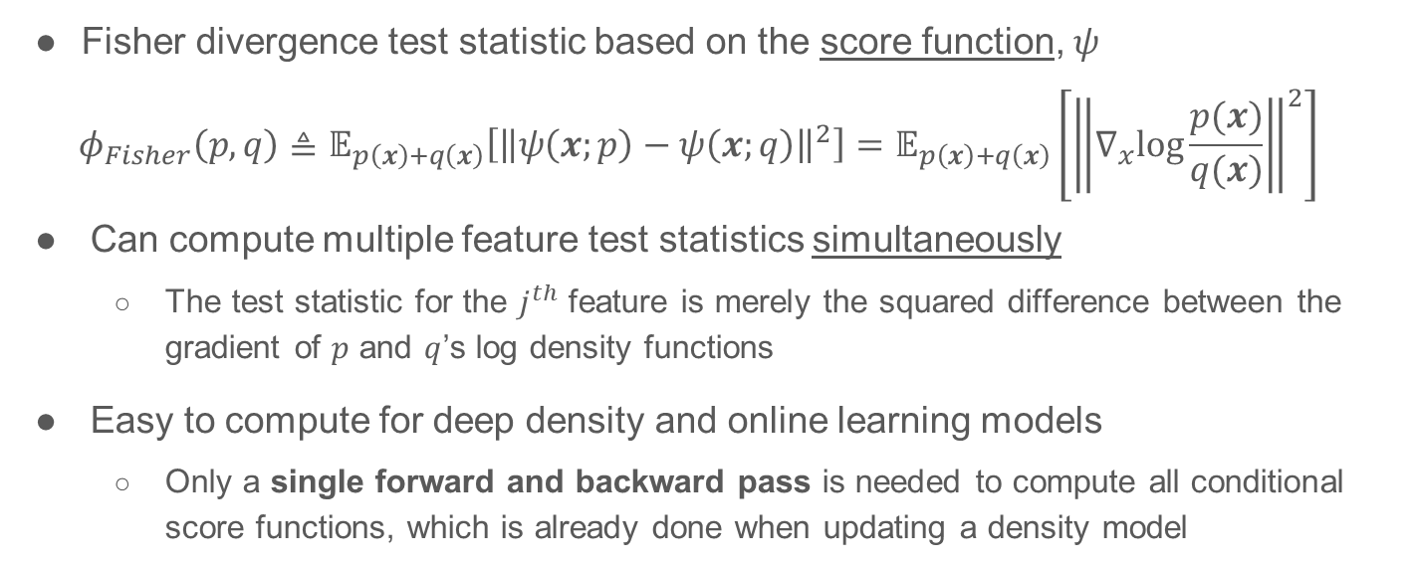
Score-based method can efficiently compute localizations
Fisher divergence test statistic based on the score function, $ψ$
$$φ_{Fisher}\left(p,q\right)≜𝔼_{p\left(x\right)+q\left(x\right)}\left[{\left\|ψ\left(x;p\right)−ψ\left(x;q\right)\right\|}^{2}\right]=𝔼_{p\left(x\right)+q\left(x\right)}\left[{\left\|∇_{x}\text{log}\frac{p(x)}{q(x)}\right\|}^{2}\right]$$
Can compute multiple feature test statistics simultaneously
  The test statistic for the $j^{th}$ feature is merely the squared difference between the gradient of $p$ and $q$’s log density functions
Easy to compute for deep density and online learning models
  Only a single forward and backward pass is needed to compute all conditional score functions, which is already done when updating a density model
Notes:
Our biggest challenge is that we much run the hypothesis test for every feature at every time point (every step)

Slide 5
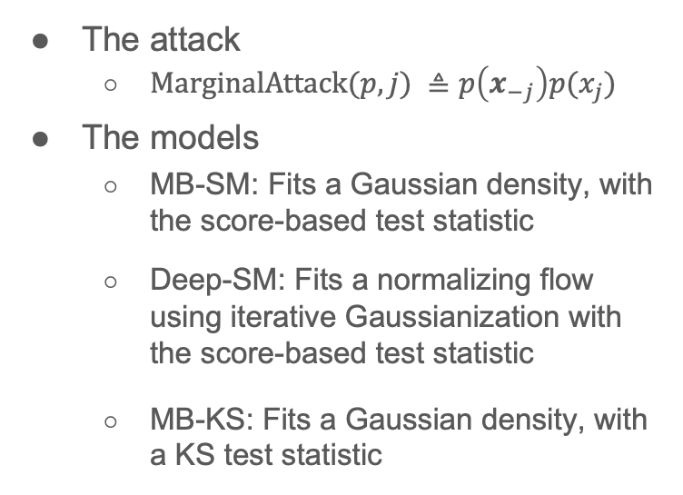
Score-based method performs better than baselines against marginal distribution attack
The attack
  $\text{MarginalAttack}\text{(}p, j) ≜p\left(x_{−j}\right)p(x_{j})$
The models
  MB-SM: Fits a Gaussian density, with the score-based test statistic
  Deep-SM: Fits a normalizing flow using iterative Gaussianization with the score-based test statistic
  MB-KS: Fits a Gaussian density, with a KS test statistic
Detection and Localization with 3 out of 25 sensors compromised
Mutual Information | MB-SM |  |  |  | MB-KS
 | Detection |  | Localization |  | Detection |  | Localization
 | Prec | Rec | Prec | Rec | Prec | Rec | Prec | Rec
0.2 | 93% | 100% | 66% | 73% | 92% | 98% | 55% | 61%
0.1 | 92% | 98% | 61% | 67% | 93% | 97% | 56% | 60%
0.05 | 92% | 94% | 54% | 51% | 90% | 76% | 49% | 43%
0.01 | 70% | 98% | 21% | 6% | 67% | 14% | 19% | 4%
Time per test | 0.044 seconds |  |  |  | 1.408 seconds

Slide 6
Conclusions
Formulated the problem of detecting and localizing distribution shift to a specific set of features
Introduced the score-based test statistic for fast computation of feature shift
It is difficult to discern between benign shifts and adversarial shifts in time-series data without further assumptions
Moving forward, in what ways can we characterize shifts beyond localization?

Slide 7



Q & A
Feature Shift Detection
Localizing Which Features Have Shifted via Conditional Distribution Tests

Slide 8
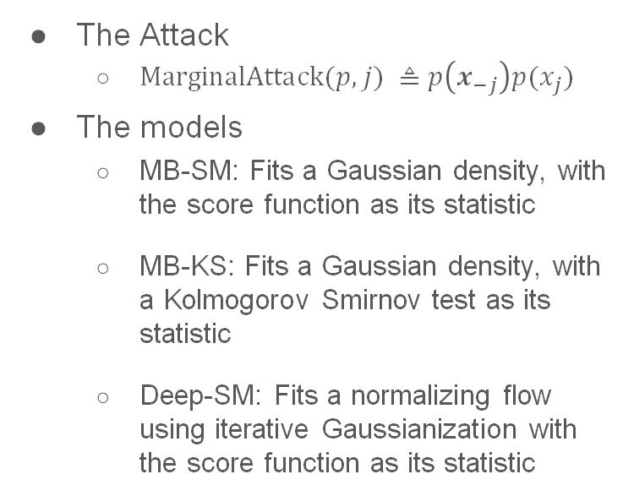
Real-world Results
The Attack
  $\text{MarginalAttack}\text{(}p, j) ≜p\left(x_{−j}\right)p(x_{j})$
The models
  MB-SM: Fits a Gaussian density, with the score function as its statistic
  MB-KS: Fits a Gaussian density, with a Kolmogorov Smirnov test as its statistic
  Deep-SM: Fits a normalizing flow using iterative Gaussianization with the score function as its statistic
UCI Gas Sensor Array Drift Dataset - Time Axis Shuffled
MB-SM |  | MB-SM-Time-Boot |  | Deep-SM-Time-Boot
Precision | Recall | Precision | Recall | Precision | Recall
Feature shift detection (1st stage)
97.3% | 100.0% | 75.9% | 100.0% | 97.8% | 100.0%
Feature shift localization (2nd stage)
51.4% | 68.4% | 56.9% | 75.0% | 68.9% | 70.5%

Slide 9
Real-world Results
Time Axis | MB-SM |  | MB-SM-Time-Boot |  | Deep-SM-Time-Boot |  | MB-SM |  | MS-SM-Time-Boot |  | Deep-SM-Time-Boot
 | Prec | Recall | Prec | Recall | Prec | Recall | Prec | Recall | Prec | Recall | Prec | Recall
 | Feature shift detection (1st stage) |  |  |  |  |  | Feature shift localization (2nd stage)
Energy
Unshuffled | 50.0% | 100.0% | 16.7% | 8.9% | 55.0% | 62.6% | 1.9% | 100.0% | 2.4% | 1.3% | 3.0% | 3.8%
Shuffled | 74.6% | 97.7% | 75.3% | 96.2% | 77.9% | 93.7% | 2.9% | 97.7% | 75.3% | 96.2% | 64.2% | 77.2%
Gas
Unshuffled | 50.0% | 100.0% | 11.1% | 2.3% | 22.2% | 4.6% | 8.9% | 100.0% | 11.1% | 2.3% | 11.1% | 2.3%
Shuffled | 97.3% | 100.0% | 75.9% | 100.0% | 97.8% | 100.0% | 51.4% | 68.4% | 56.9% | 75.0% | 68.9% | 70.5%
COVID
Unshuffled | 50.0% | 100.0% | 0.0% | 0.0% | 0.0% | 0.0% | 7.0% | 13.9% | 0.0% | 0.0% | 0.0% | 0.0%
Shuffled | 66.7% | 88.6% | 75.0% | 82.8% | 76.0% | 65.5% | 51.4% | 68.4% | 40.6% | 44.8% | 36.0% | 31.0%

Slide 10
Outline
What is feature shift, and why is it important?
Using score function to detect and localize feature shift
Results on simulated data
Results on real-world data
What comes next?

