Slide 1

MACHINE LEARNING BASED ALGORITHM SELECTION FOR
SORTING NUMERIC ARRAYS
Presented by
AHMED SALAH ABDALHI MOHAMMED
Supervised by
Assoc. Prof. Dr. Emre Özbilge
1/30
Notes:
This thesis is about a small decision that happens before sorting: which implementation should we use for this input array. I will keep coming back to three numbers: the model closes 93.1 percent of the runtime gap, reaches 76.1 percent test accuracy, and makes zero-regret decisions for 89.6 percent of the test cases.

Slide 2
Presentation Outline
01
Problem, Motivation, and Prior Work
04
Evaluation: SBS, VBS, Regret
02
Data Collection, Labels, and Features
05
Rigor, Generalisation, and Scope
03
Algorithm Selection Task and v5 Selector
06
Contributions, Limits, and Q&A
2/30
Notes:
I will first explain the task and why it matters. Then I will explain the data, the extracted features, and the model. After that I will defend the result with runtime metrics, then show the limits and what I do not claim.

Slide 3
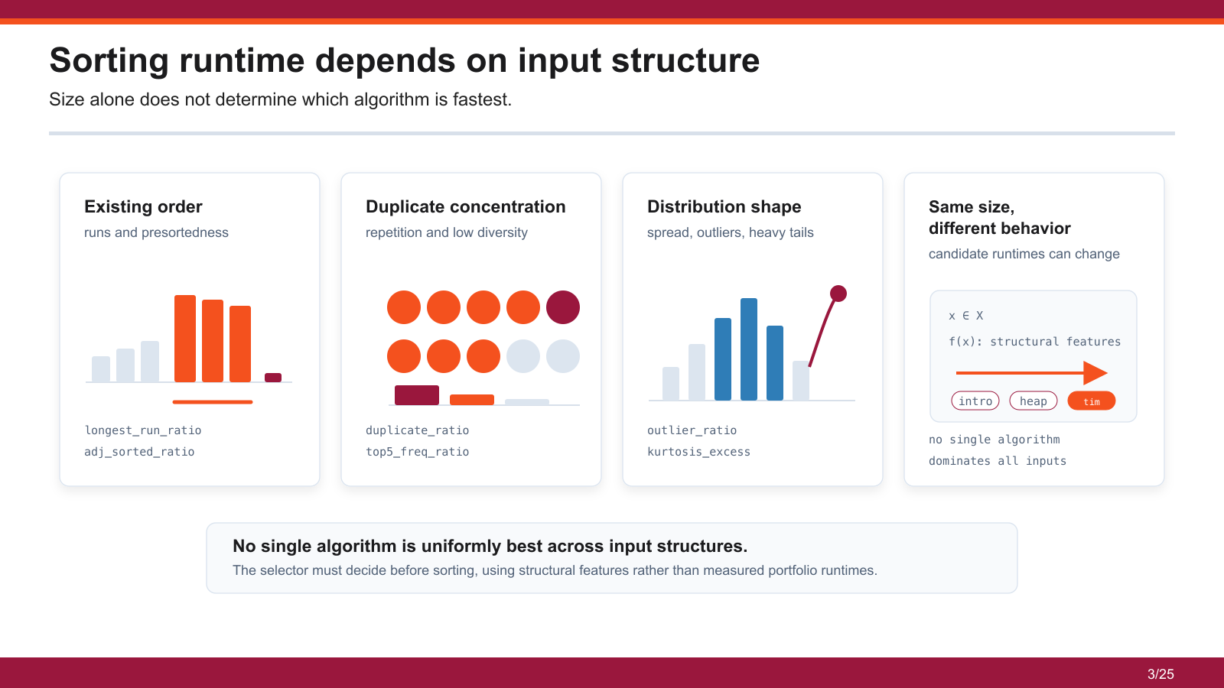
3/30

Slide 4
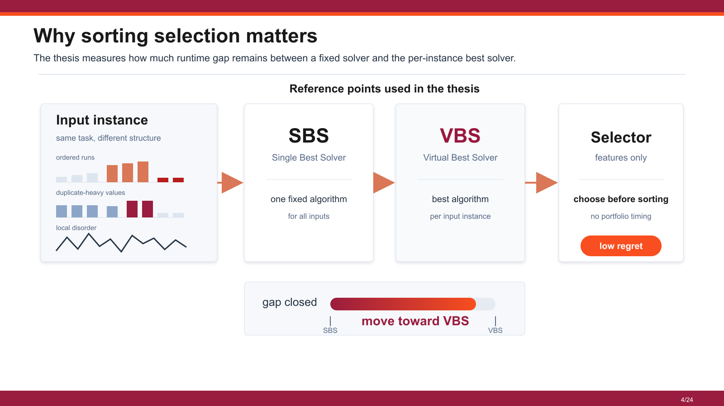
4/30
Notes:
This matters because the same input size can have different structure. A sorted-like array, random array, and duplicated array can reward different algorithms. So the useful target is not only classification accuracy; it is how much runtime loss we avoid compared with the best per-input choice.

Slide 5
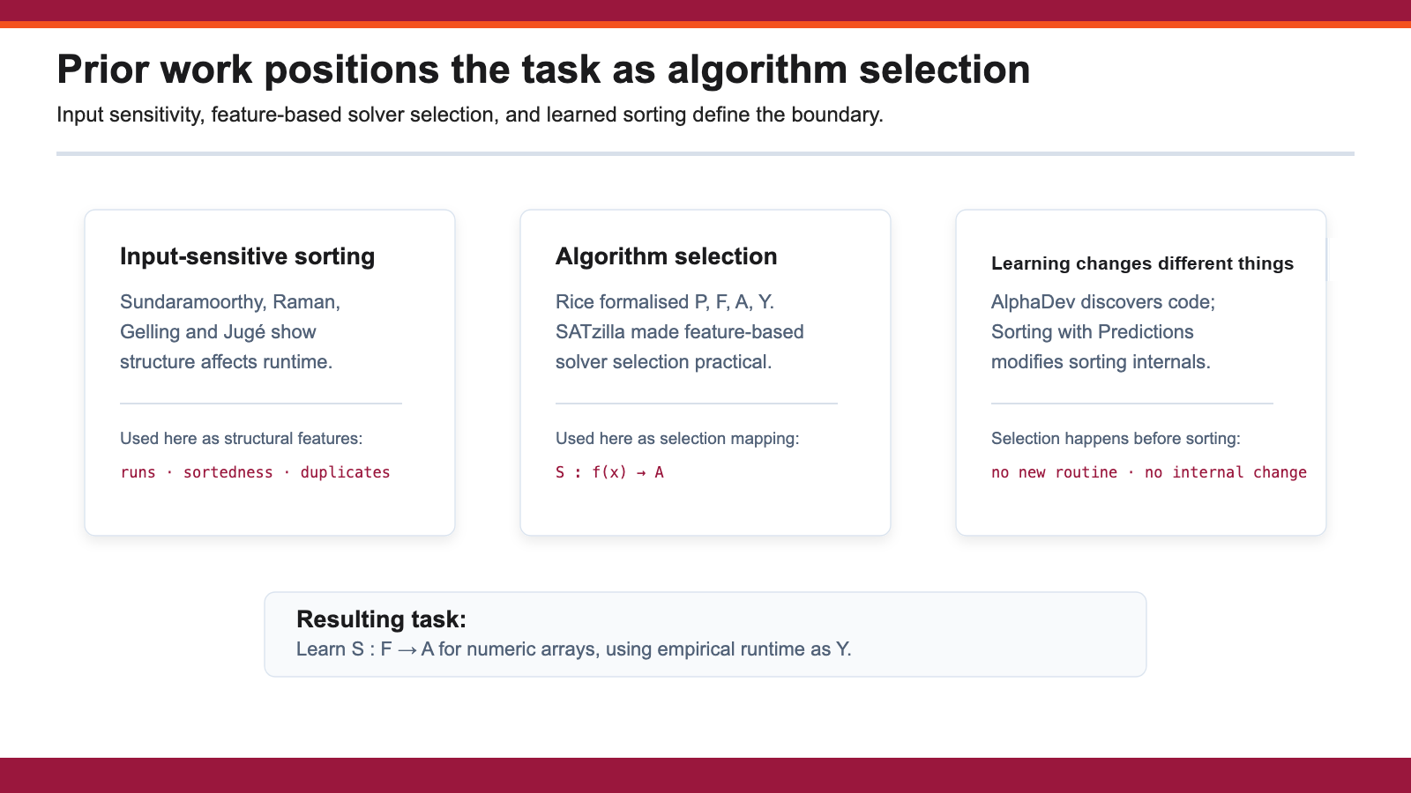
5/30
Notes:
The work connects to algorithm selection, adaptive sorting, and learned performance prediction. I am not presenting literature as a separate survey. I use it to position the task: previous work gives the idea of selecting from features, and this thesis applies that idea to measured sorting behavior.

Slide 6
The corpus uses five structurally diverse real-world domains
1,188,265 numeric arrays were extracted to maximise structural diversity.
1.18M
labeled array instances
Formula 1 telemetry
Equity prices
Cryptocurrency OHLCV
Weather
Seismic measurements
Real data was preferred because synthetic distributions failed to converge to genuine structure.
6/30
Notes:
The dataset was built from five domains: F1 telemetry, stock, crypto, earthquake, and weather. The reason for using multiple domains was to avoid building a selector that only understands one family of arrays.

Slide 7
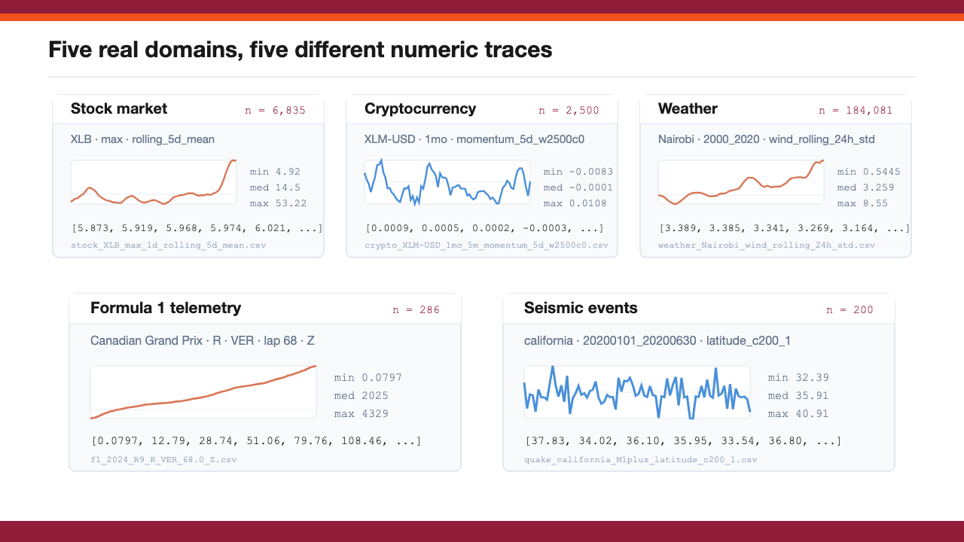

Slide 8

Labels are empirical fastest-algorithm measurements
Each candidate algorithm is timed on a fresh copy; the minimum observed runtime becomes the label.
RAW
REV
SHUF
QBIN50
PSORT10
RAW, REV, SHUF, QBIN50, and PSORT10 force a non-trivial decision boundary.
8/30
Notes:
For each domain, I generated transformed arrays and measured runtime across the three sorting algorithms. The label is not guessed; it is the fastest measured algorithm for that instance. The transformations create raw, reversed, shuffled, quantized, and partially sorted cases.

Slide 9

Sixteen O(n) structural features characterise each array
Every feature must be cheap to compute and linked to differential sorting behaviour.
Size
Ordering
length_norm
adj_sorted_ratio
size effects
runs_ratio
cache / constants
inversion_ratio
Timing features are excluded at prediction time.
A single canonical feature extractor is shared across data generation, training, and inference.
9/30
Notes:
The features are the bridge between the raw array and the model. They describe scale, order, duplicates, runs, inversions, and distribution. The important point is that these are structural features, not timing features.

Slide 10
Prediction is made before any candidate algorithm is executed
The selector extracts features once, runs one XGBoost prediction, and chooses one portfolio member.
Allowed before sorting
Not allowed at prediction time
Extract O(n) features
Sort with introsort
Measure order, runs, repetition, distribution, robust scale
Sort with heapsort
Sort with timsort
Predict introsort, heapsort, or timsort
Pick after seeing all times
The oracle is used only for evaluation; it is not available at run time.
10/30
Notes:
At prediction time, the selector cannot sort the array with all three algorithms and then choose the fastest. That would be the oracle, not a usable method. The selector must use cheaper information from the input before sorting.

Slide 11
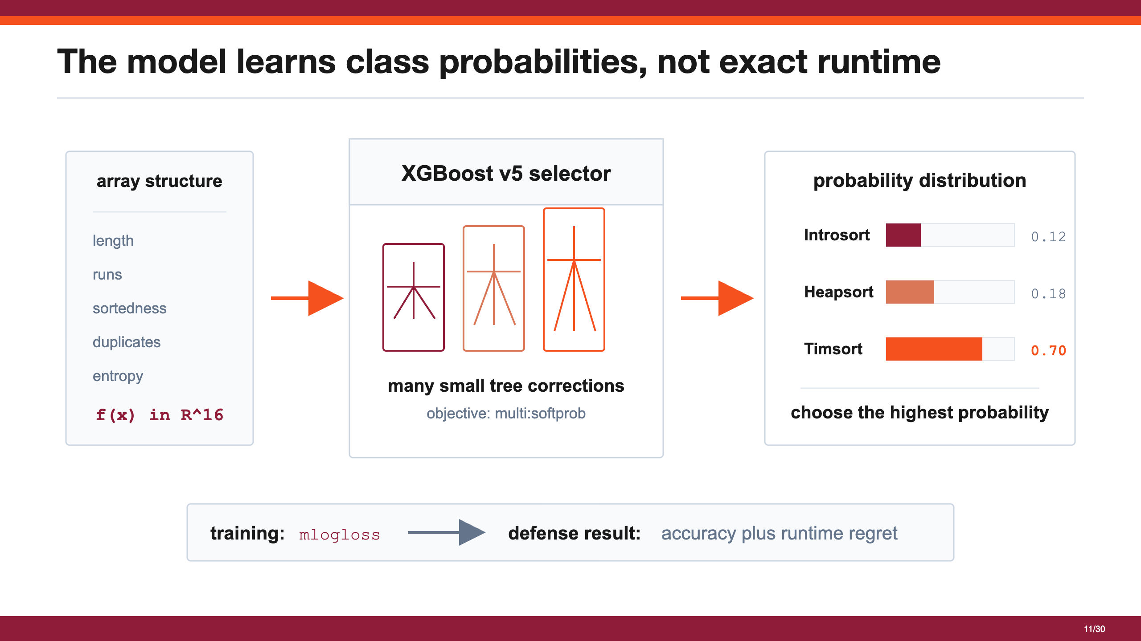

Slide 12
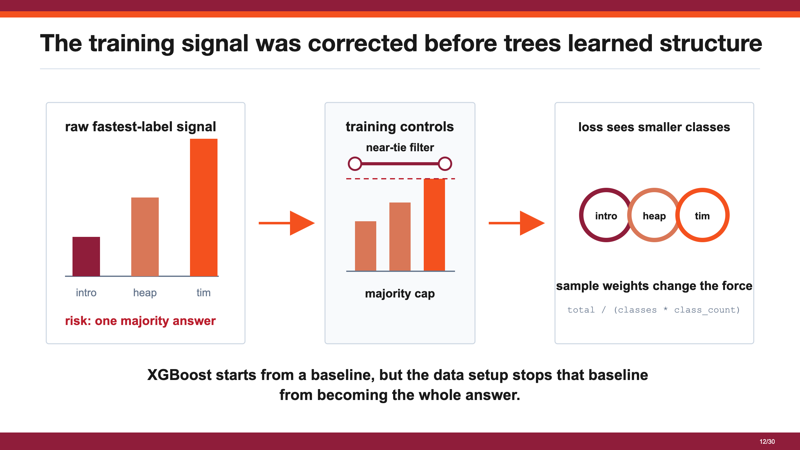

Slide 13
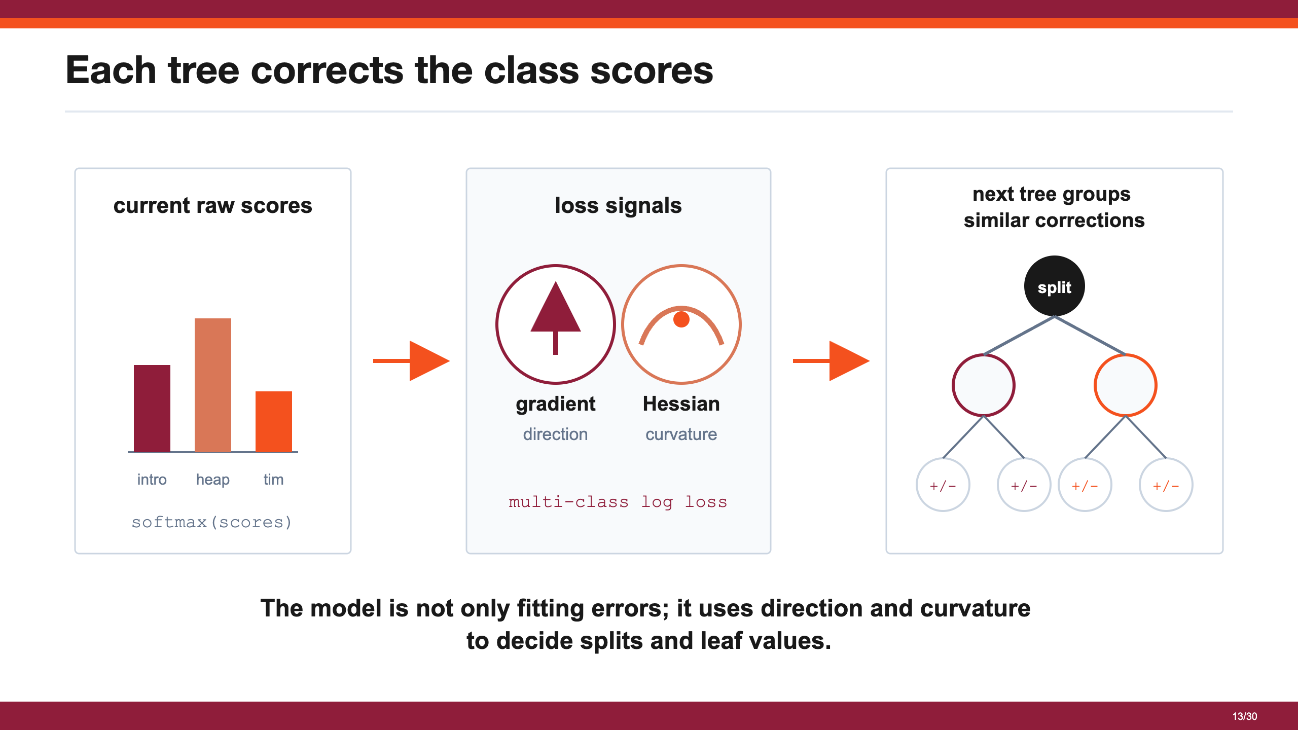

Slide 14
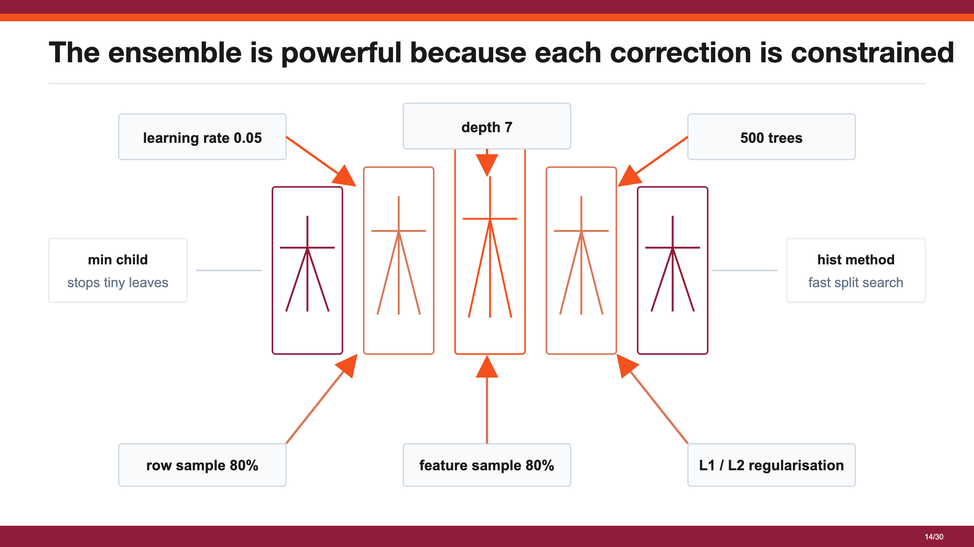

Slide 15
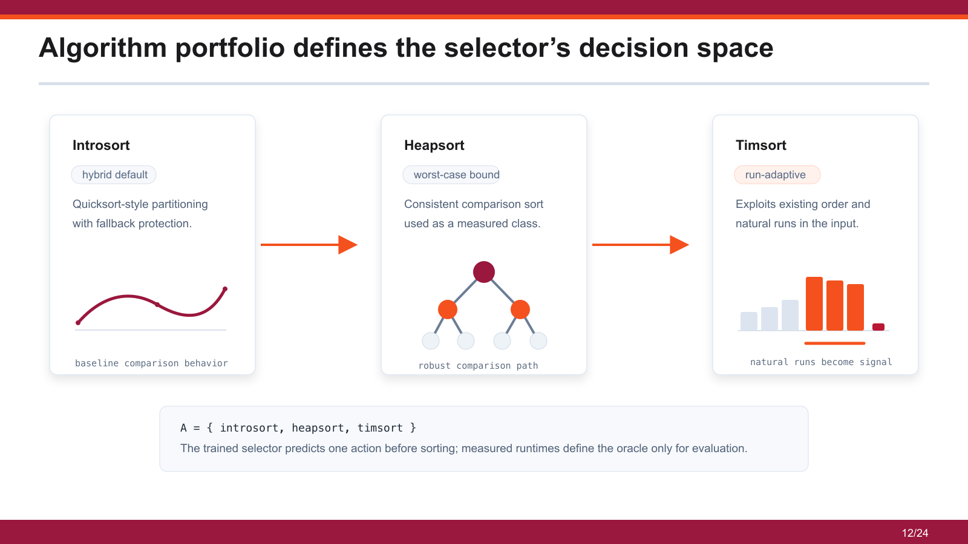
15/30
Notes:
The portfolio is deliberately limited to three real implementations: introsort, heapsort, and timsort. The model is not choosing from every sorting algorithm in theory. It is choosing from the measured implementations in this experiment.

Slide 16
Algorithm Selection Problem
Problem space P
Feature space F
Algorithm space A
numeric array
structural array features
Selector
[4, 5, 5, 6, 17, 18,
S : F → A
Introsort
19, 2, 2, 3, 31, 45]
size
sortedness / disorder
runs
XGBoost classifier
Heapsort
duplicates / entropy
predict fastest class
spread / outliers
Timsort
order, runs, duplicates, spread
x ∈ R^16
Performance space Y
Introsort
Heapsort
Timsort
label from measured runtime
18.7 μs
24.5 μs
13.2 μs
label(x) = argmin_a T(a, x)
16/30
Notes:
The task is not to invent a new sorting algorithm. The task is: given one array before sorting, choose introsort, heapsort, or timsort. The model sees cheap structural features and outputs one algorithm choice.

Slide 17
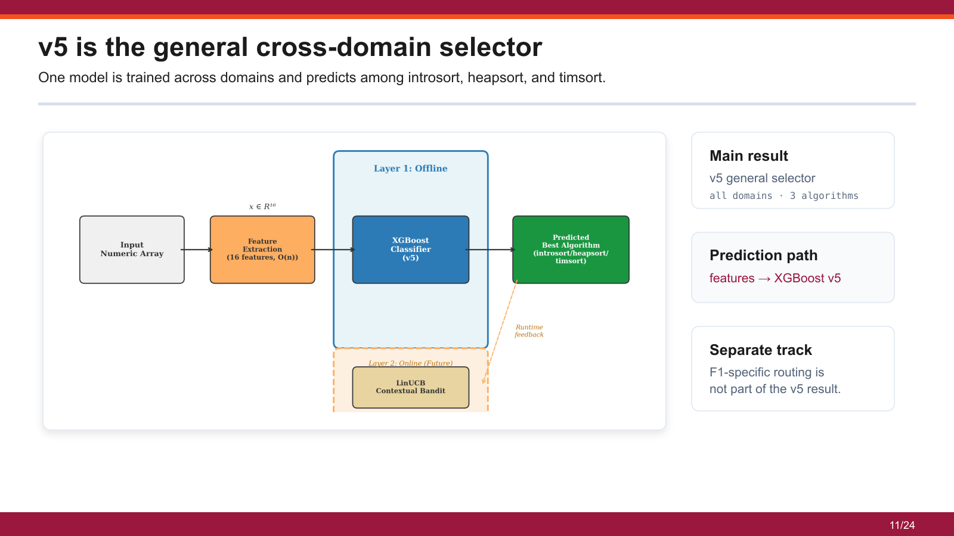
17/30
Notes:
The main system is v5. It is one general XGBoost classifier trained across all domains and choosing among the three algorithms. The F1-specific route is separate and I will only mention it as a specialization, not the main result.

Slide 18

Model evolution reduced the problem to its deployable form
Regression, timing features, source-aware checks, regret-aware loss, and cascade tests define why v5 is retained.
v1 regressor
timing-feature model
v5 XGBoost classifier
v6 / v7 / v8 checks
44.4%; size dominated
100%; non-deployable
main reported selector
leakage, objective, boundary
18/30
Notes:
The final model came after earlier paths were rejected. Regression was not strong enough, timing features were not deployable, and strict checks changed the interpretation. v5 became the main model because it gave the best practical balance under the submitted evaluation.

Slide 19


Evaluation measures distance from SBS to VBS
Accuracy is reported, but selector quality is judged by regret and gap closed.
SBS
VBS
Model
best fixed algorithm
oracle fastest algorithm
choose before execution
over the evaluation set
for each array
using structural features
Gap closed gives the fraction of the SBS-to-VBS improvement captured by the selector.
19/30
Notes:
SBS means one algorithm used for all test inputs. VBS means the fastest measured algorithm per input, which is an oracle for evaluation. The model is judged by how close it gets to VBS without having oracle information at prediction time.

Slide 20

The v5 selector closes most of the SBS-to-VBS gap
The reported result is 76.1% top-1 accuracy, 93.1% gap closed, and 89.6% zero regret.
76.1%
89.6%
93.1%
top-1 accuracy
zero-regret predictions
SBS-to-VBS gap closed
Regret, not only accuracy,
is the main evaluation signal.
20/30
Notes:
The main result is runtime value: v5 closes 93.1 percent of the gap between SBS and VBS. Accuracy is 76.1 percent, but this does not tell the whole story. The zero-regret rate is 89.6 percent, which shows many decisions are either correct or not costly.

Slide 21

Accuracy alone is insufficient for algorithm selection
A wrong label can be harmless when the selected and optimal algorithms have nearly equal runtimes.
76.1%
top-1 accuracy
93.1%
SBS-to-VBS gap closed
The result is evaluated by regret and gap closed, not accuracy alone.
21/30
Notes:
This slide explains why I do not defend the model only as a classifier. Some label mistakes happen between algorithms whose measured runtimes are very close. In those cases, the label is wrong, but the runtime regret is small.

Slide 22

Residual error is concentrated at the introsort-heapsort boundary
Timsort has a strong structural trace; introsort and heapsort often depend on lower-level effects.
94.5%
timsort recall
Interpretation
timsort is separable when runs/order are visible.
introsort and heapsort remain close in the current feature space.
Most residual boundary errors
carry low measured regret.
22/30
Notes:
The confusion matrix shows that timsort is often easier to identify when order signals are strong. The harder boundary is between introsort and heapsort because their runtime behavior is often closer. This is a limitation, but it is also why regret is necessary.

Slide 23

Feature importance follows structural sorting signals
Length, repetition, and ordering account for most of the discriminative signal.
Ordering
longest_run_ratio
runs_ratio
adj_sorted_ratio
Repetition / diversity
top5_freq_ratio
duplicate_ratio
entropy_ratio
Size / scale
length_norm
robust scale descriptors
23/30
Notes:
Feature importance shows that the model is using structural signals. This supports the method because the important features relate back to the properties that sorting algorithms react to: order, duplicates, distribution, and size.

Slide 24

Leave-one-domain-out testing supports cross-domain robustness
Each fold trains on four domains and tests on the unseen fifth domain.
>75%
gap closed in every fold
F1 sensitivity
F1 telemetry is the weakest
held-out fold because it contains
many distinct channel regimes.
24/30
Notes:
Domain holdout is stricter because the held-out domain is unseen during training. The weighted gap closed is 79.7 percent. F1 is harder than the other domains, and that is why the F1-specific route exists separately.

Slide 25
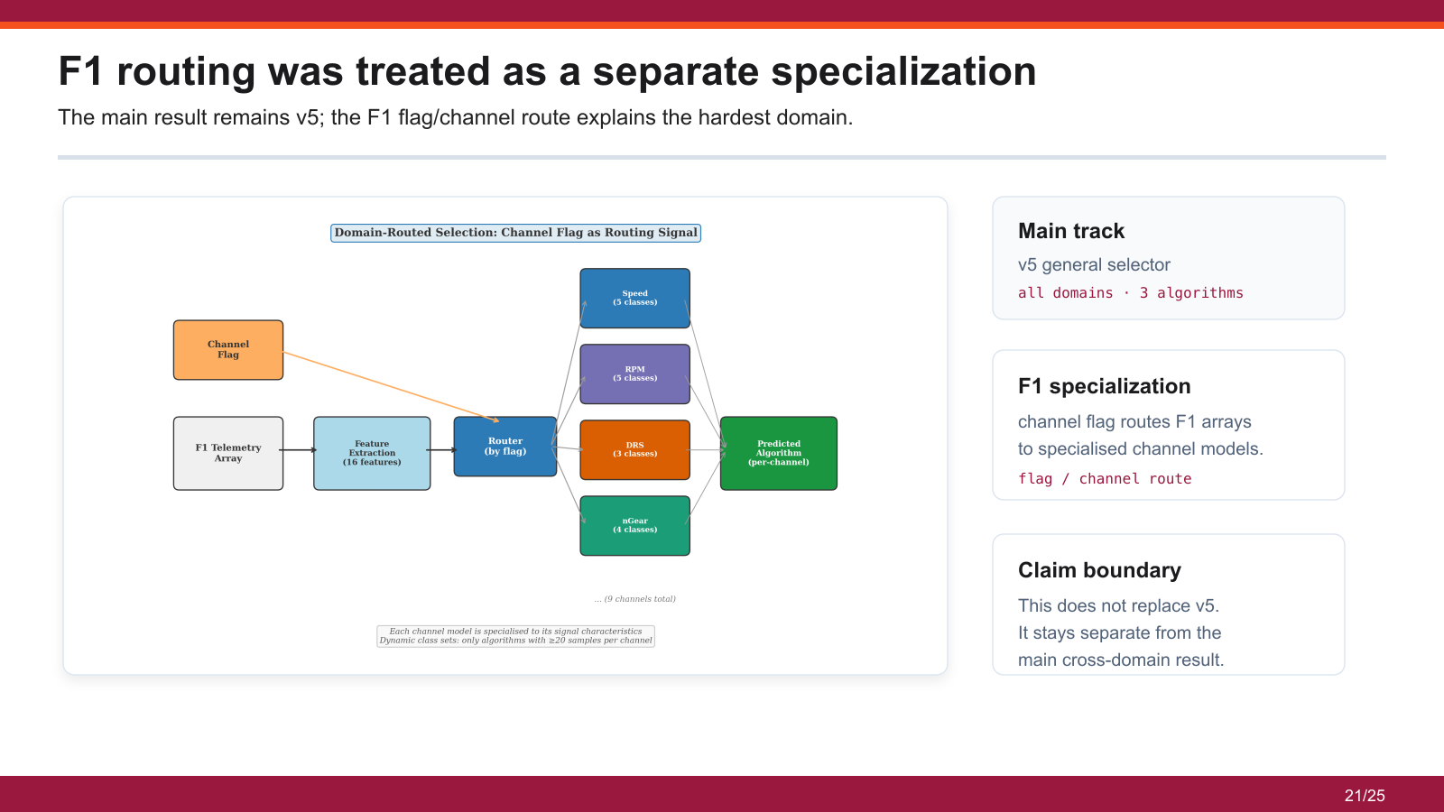
25/30

Slide 26
Strict checks define the boundary of the reported result
The reported result stays with v5; later variants explain leakage risk, objective risk, and the hard boundary.
v6 source-aware
v7 regret-aware
v8 cascade
71.2% accuracy; 45.6% gap closed.
regret-weighted loss
Stage 2 AUC = 0.603
source separation became
was less stable:
for introsort vs heapsort;
part of the evaluation protocol.
78.1% gap closed.
Stage 1 AUC = 0.982.
v5 remains the reported selector; v6, v7, and v8 are evidence for limits, not replacement results.
26/30
Notes:
The negative results are part of the rigor. v6 checked source-awareness, v7 showed that a regret-aware attempt did not improve the final result, and v8 showed that the intro-versus-heap boundary remains difficult. These results keep the claim measured.

Slide 27
Conclusion
Sixteen O(n) structural features are enough to support useful per-instance sorting decisions.
The selector improves practical runtime even when top-1 accuracy is imperfect.
76.1%
93.1%
89.6%
top-1 accuracy
SBS-to-VBS gap closed
zero-regret predictions
The strongest cases are arrays where order, runs, and repetition leave a visible structural trace.
The main residual weakness is the introsort-heapsort boundary, where current value-level features miss microarchitectural effects.
27/30
Notes:
My claim is that v5 closes most of the measured runtime gap with cheap structural features and known limitations. I do not claim a perfect classifier, I do not claim the F1 route is the main result, and I do not claim LinUCB is validated in this thesis.

Slide 28
Contributions
The contributions are the selector, the evaluation discipline, and the reproducible artefact.
01
A deployable selector
A compact pipeline combines sixteen O(n) structural features with a gradient-boosted classifier.
02
A rigorous evaluation framework
Source-level separation, near-tie filtering, LODO testing, and regret metrics give a stronger view than accuracy alone.
03
A reproducible artefact
One source-of-truth feature extractor, data pipeline, and exported XGBoost JSON / ONNX models support replication.
28/30
Notes:
The contribution is the framing, the data and feature pipeline, and the measured selector result. The future work is stronger domain adaptation, validated online selection, and deeper F1-specific evaluation.

Slide 29
Limitations and Future Work
The limits are portfolio scope, single hardware setting, unvalidated online adaptation, and small-array overhead.
Limitations
Future work
01
portfolio limited to three C-level comparison sorts
05
larger portfolios: Powersort, radix/bucket guards, SIMD/GPU sorts
02
absolute regret tied to one hardware/software environment
06
validated LinUCB under gradual and abrupt distribution shift
03
LinUCB contextual bandit designed but not validated
07
domain embeddings and stricter channel-level routing evaluation
04
feature extraction becomes unprofitable below about 1,000 elements
08
cross-platform deployment with feature-extraction overhead
Future work extends the portfolio, adaptation, and generalisation axes while preserving cost-aware evaluation.
29/30

Slide 30
Thank you
Questions?
30/30

