Slide 1
Machine Learning Based
Algorithm Selection
for Sorting Numeric Arrays
Official MSc thesis defense
93.1%
76.1%
89.6%
runtime gap closed
test accuracy
zero regret
Ahmed Salah Abdalhi Mohammed
Supervisor: Assoc. Prof. Dr. Emre Özbilge - Cyprus International University - June 2026
Notes:
Good morning. My thesis is about machine learning based algorithm selection for sorting numeric arrays. The main idea is simple: before we sort an array, can we look at its structure and choose the algorithm that is most likely to run fastest? I will focus on the general v5 selector and on runtime value, not only classification accuracy.

Slide 2
The problem is choosing the right algorithm
for each input
Selector
introsort
Numeric array
heapsort
same task, different structure
decide before sorting starts
timsort
The thesis question is not how to sort, but which sorter to trust for this array.
02
Notes:
Sorting is a familiar task, but choosing the sorting algorithm is still input-dependent. The same program may receive arrays with different sizes, repetitions, order, and distribution. My work treats this as a selection problem: given the array structure, choose introsort, heapsort, or timsort before execution.

Slide 3
Same complexity does not mean same runtime
O(n log n)
same high-level complexity class
introsort
heapsort
timsort
The practical winner depends on input structure, constants, memory behavior, and existing order.
03
Notes:
The motivation starts from a practical gap. These algorithms can sit in the same broad complexity class, but their measured runtime is not the same on every input. Complexity tells us the high-level behavior, but it does not answer which algorithm is best for this specific array.

Slide 4
This thesis selects before sorting begins
Array
16 features
one pick
not sorted yet
cheap structural summary
then execute
The selector pays a small feature cost to avoid a larger runtime mistake.
04
Notes:
The selector works before sorting begins. I do not run all algorithms and then choose the fastest, because that would already spend the runtime. Instead, I extract cheap structural features, pass them to the model, and then execute one selected algorithm.

Slide 5
The aim is a practical selector,
not a perfect oracle
93.1%
76.1%
89.6%
gap closed
accuracy
zero regret
A wrong label is only damaging when it creates meaningful runtime regret.
That is why the defense leads with runtime value, then explains accuracy and limits.
05
Notes:
The aim is not to build a perfect oracle. The aim is a practical selector. A wrong class label is not always a serious runtime mistake, because two algorithms can be very close in time. That is why I evaluate accuracy together with regret and gap closed.

Slide 6

The array is converted into structural signals
The model does not see the raw sequence.
It sees compact structure:
size
ordering
repetition
distribution
06
Notes:
This slide shows the feature extraction idea. The raw array is converted into a compact description: size, ordering, repetition, and distribution. These are the signals that sorting algorithms can react to. I will not go through every formula here; the important point is that the selector sees structure, not the full raw sequence.

Slide 7

The system makes one decision before execution
features
XGBoost
one of three algorithms
No multiple sorting runs are used at decision time.
07
Notes:
The full system is a single decision pipeline. The array enters, the structural features are computed, XGBoost predicts the algorithm, and then only that algorithm runs. This keeps the method practical and separates the decision cost from the sorting runtime.

Slide 8
The algorithms are different enough
to make selection useful
introsort
heapsort
timsort
hybrid quicksort path
stable worst-case bound
uses existing runs
strong average behavior
often the SBS baseline
structurally visible
The portfolio is small enough to defend and different enough to learn.
08
Notes:
The portfolio has three algorithms: introsort, heapsort, and timsort. I kept the portfolio focused because the defense needs a clear measured comparison. They are also different enough: timsort benefits strongly from existing runs, while introsort and heapsort are closer and harder to separate.

Slide 9

Real arrays give the selector the structures
synthetic data missed
1.18M
arrays before filtering
5
domains
F1 telemetry
stock, crypto
earthquake, weather
Source: metrics_summary.json M5_dataset_statistics
09
Notes:
The dataset is one of the main changes from the early experiments. The final v5 work uses about 1.18 million arrays from five domains: F1 telemetry, stock, crypto, earthquake, and weather. This matters because real arrays provide structures that synthetic data alone did not show.

Slide 10
The labels come from measured runtime,
not opinion
Generate array
Benchmark all three
Label fastest
real domain plus transforms
same array, measured time
with noise filtering
Transforms used:
RAW
REV
SHUF
QBIN50
PSORT10
The model learns from observed winners, not from a manual rule about algorithms.
10
Notes:
The labels were created from measured runtime. For each array, the candidate algorithms were benchmarked, and the fastest algorithm became the label after filtering noisy cases. So the model is not learning my preference. It is learning from measured winners.

Slide 11
The features describe structure, not raw values
Size
Repetition
length_norm
duplicate_ratio, top frequency ratios
Ordering
Distribution
runs, inversions, adjacent sortedness
entropy, skewness, dispersion, outliers
16 features summarize what the sorting algorithms can exploit.
11
Notes:
The 16 features are grouped by what they describe. Some describe size, some repetition, some ordering, and some distribution. This makes the model easier to defend, because the features are connected to how sorting algorithms behave.

Slide 12
The main model is the general v5 selector
XGBoost v5
Separate from F1 routing
16 structural features
v5 is the general thesis model.
3 algorithm labels
F1 channel models are a
70 / 15 / 15 split
specialized experiment.
balanced training strategy
12
Notes:
The main model in the thesis is the general v5 selector. It uses XGBoost, 16 structural features, and three labels: introsort, heapsort, and timsort. The F1 channel routing work is separate. I mention it as a specialization, but I do not mix it with the general v5 result.

Slide 13

Each failed path clarified the final design
What changed
regression was weak
timing features leaked
regret weighting hurt
cascade exposed boundary
The journey matters because it explains why v5 is the defensible center of the thesis.
13
Notes:
The research journey is important, but I keep it compact. Regression was not the right framing. Timing-based features gave a ceiling but were not deployable because they used information that would not be available before sorting. Later strict checks and alternative models helped define the limits of the final claim.

Slide 14
The model is imperfect,
but most mistakes are cheap
93.1%
of the SBS-to-VBS runtime gap closed
runtime value first
Supported by 76.1% test accuracy
and 89.6% zero-regret selections.
Source: metrics_summary.json M1_v5_evaluation and M2_v5_regret
14
Notes:
The main result is that v5 closes 93.1 percent of the runtime gap between the single best solver and the virtual best solver. Its test accuracy is 76.1 percent, and 89.6 percent of selections have zero regret. So the classifier is not perfect, but most mistakes are cheap in runtime terms.

Slide 15
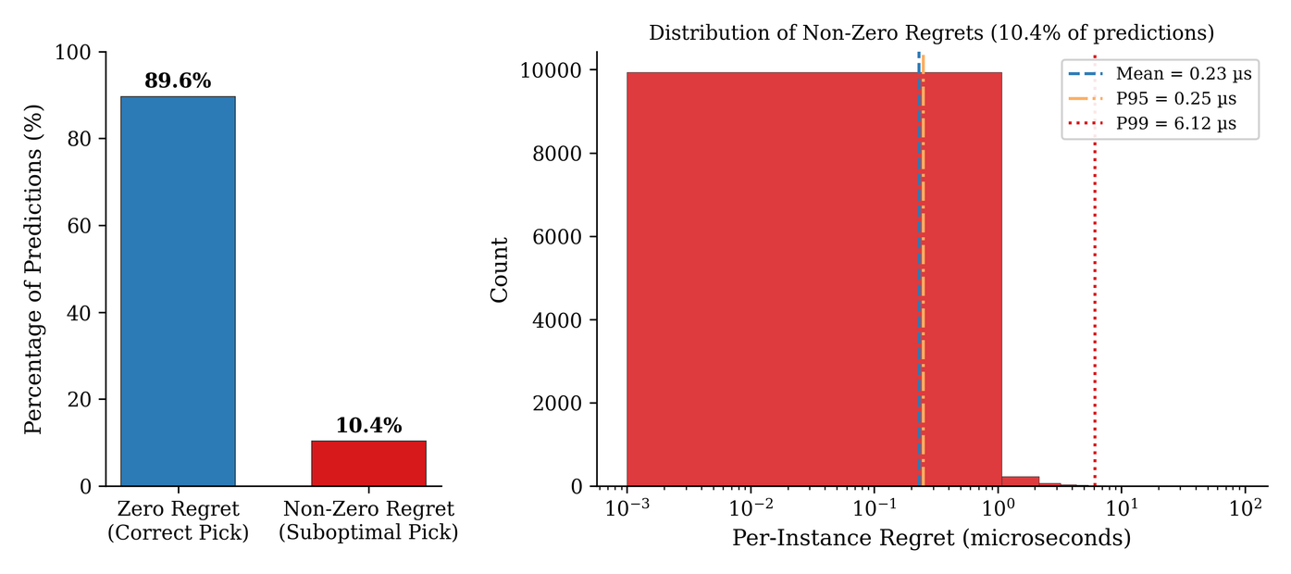
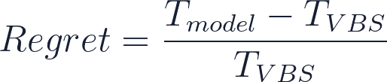
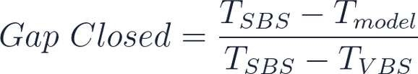
Accuracy alone does not explain the value
A selection can be wrong as a label and still almost right as a runtime decision.
15
Notes:
This is why I do not stop at accuracy. Regret measures how much slower the selected algorithm is compared with the best available algorithm for that array. Gap closed measures how much of the practical improvement over a fixed baseline is recovered. These metrics explain the real value of the selector.

Slide 16

Timsort is structurally visible;
introsort vs heapsort is not
94.5%
timsort recall
The weak boundary is
between introsort and heapsort,
where structural features are close.
16
Notes:
The confusion matrix shows the main behavior. Timsort is structurally visible, with strong recall. The hard part is separating introsort and heapsort. That weakness is important, and I do not hide it. It tells us where the current features stop being enough.

Slide 17

The model mostly uses features
that make sorting sense
Top signals
length
top frequency
longest run
duplicate ratio
This is interpretation, not causal proof.
17
Notes:
The feature importance is consistent with the story. Length, frequency features, longest runs, and duplicate ratio are among the strongest signals. I do not claim feature importance proves causality, but it supports that the model is using meaningful structural information.

Slide 18

The selector transfers when structure transfers
Holdout test
not uniform
but runtime value
survives in several
domain removals
18
Notes:
The domain holdout results show a measured generalization picture. The selector does not transfer equally to every domain, but the runtime value survives in several leave-one-domain-out tests. My interpretation is that transfer works when the held-out domain shares relevant structure.

Slide 19
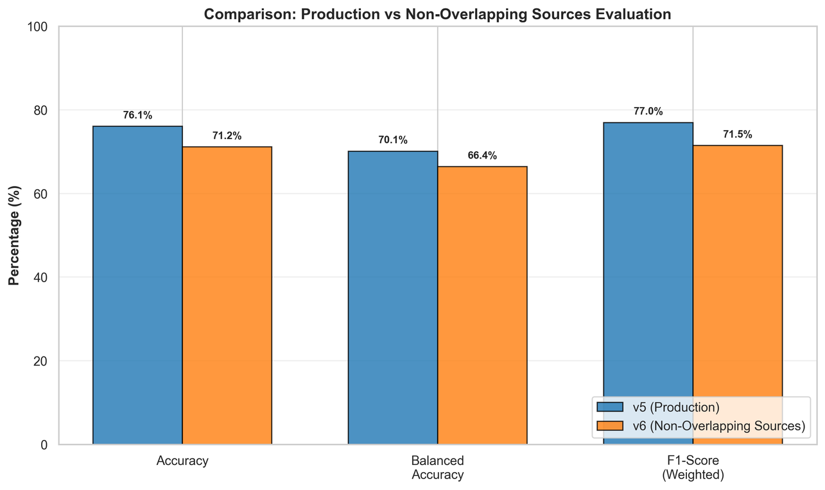
Strict checks changed the interpretation,
not the contribution
source-aware split lowered
the numbers
v7 regret-aware training
was rejected
v8 exposed the intro-heap
boundary
The stricter checks make the final claim narrower, but more defensible.
19
Notes:
Strict checks changed the interpretation. The source-aware v6 split lowers the numbers, which is expected when we reduce leakage risk. v7 regret-aware training did not improve the result and was rejected. v8 showed that the intro-heap boundary is genuinely difficult. These results make the final claim narrower, but more honest.

Slide 20
The remaining errors show where
the features stop seeing
Clear boundary
Hard boundary
timsort vs the rest
introsort vs heapsort
F1 channel routing is a separate specialization: useful to mention, not the main thesis model.
This keeps the three-label v5 selector and the F1-specific five-label experiment separated.
20
Notes:
The main limitation is clear: the current features can identify timsort-friendly structure much better than they separate introsort from heapsort. The F1 channel routing work is also separate from the general selector. It shows a specialization path, but the main contribution remains the v5 three-algorithm selector.

Slide 21
The contribution is a selector
and an evaluation discipline
1. Dataset and labeling protocol
real domains, structural transforms, measured winners
2. Structural ML selector
v5 XGBoost model using 16 cheap array features
3. Runtime-aware evaluation
accuracy, regret, SBS, VBS, and gap closed together
21
Notes:
The contribution has three parts. First, a dataset and labeling protocol based on measured runtime. Second, a structural machine learning selector for sorting algorithm choice. Third, an evaluation discipline that combines accuracy with regret, SBS, VBS, and gap closed.

Slide 22
The next step is hardware-aware
and adaptive selection
hardware context
adaptive selection
broader portfolio
cache, CPU, memory behavior
future online learning
more algorithms, stricter splits
Thank you
I am ready for your questions.
Notes:
The next step is to make the selector more hardware-aware and more adaptive. Hardware context, memory behavior, and online feedback could all affect the best algorithm choice. I also want to be clear that the bandit direction is future work, not a validated result in this thesis. Thank you, I am ready for your questions.

