Slide 1

MACHINE LEARNING BASED ALGORITHM SELECTION FOR
SORTING NUMERIC ARRAYS
Presented by
AHMED SALAH ABDALHI MOHAMMED
Supervised by
Assoc. Prof. Dr. Emre Özbilge
1/25
Notes:
This thesis is about a small decision that happens before sorting: which implementation should we use for this input array. I will keep coming back to three numbers: the model closes 93.1 percent of the runtime gap, reaches 76.1 percent test accuracy, and makes zero-regret decisions for 89.6 percent of the test cases.

Slide 2
Presentation Outline
01
Motivation and Runtime Gap
04
Evaluation and Results
02
Data, Labels, and Features
05
Rigor and Generalization
03
Task and v5 Selector
06
Conclusion and Q&A
2/25
Notes:
I will first explain the task and why it matters. Then I will explain the data, the extracted features, and the model. After that I will defend the result with runtime metrics, then show the limits and what I do not claim.

Slide 3
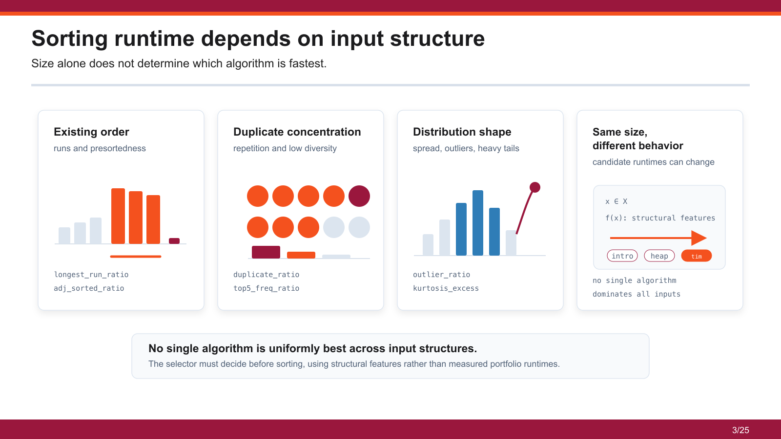
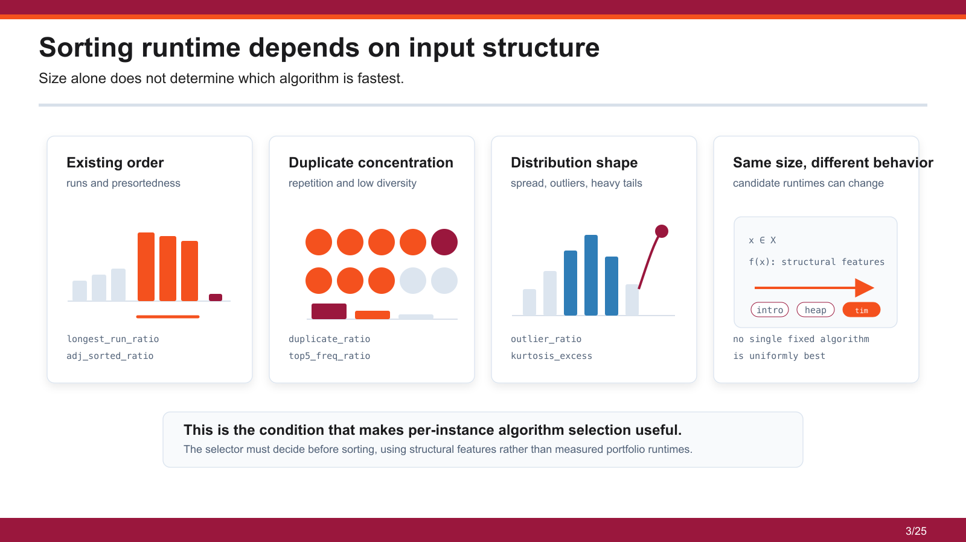
3/25

Slide 4
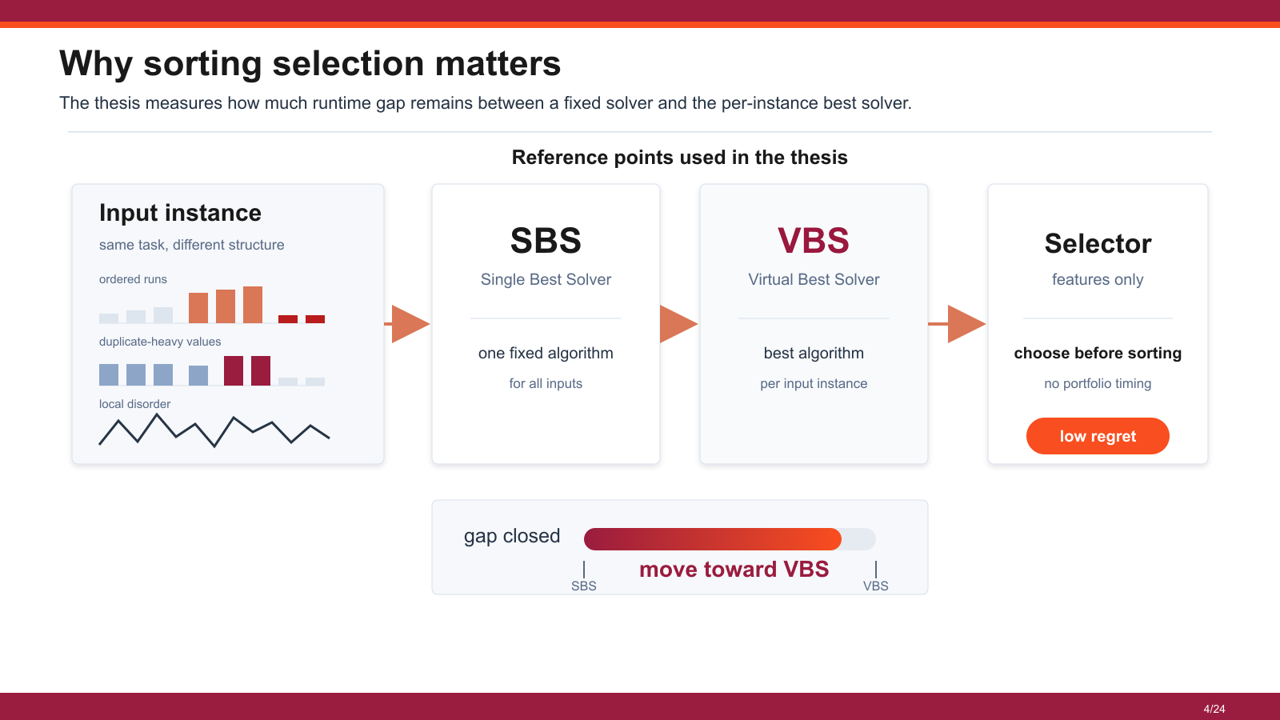
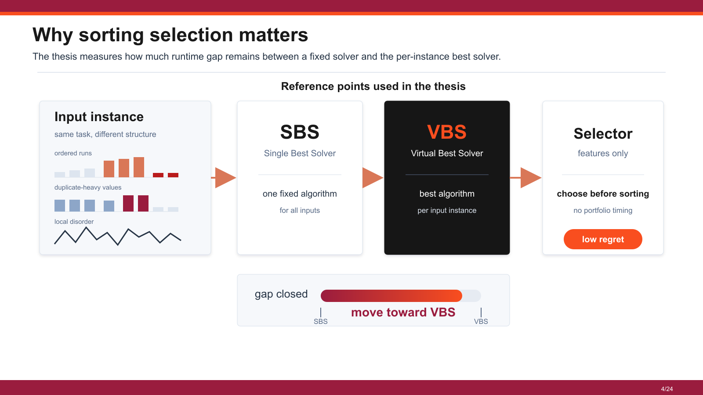
4/25
Notes:
This matters because the same input size can have different structure. A sorted-like array, random array, and duplicated array can reward different algorithms. So the useful target is not only classification accuracy; it is how much runtime loss we avoid compared with the best per-input choice.

Slide 5
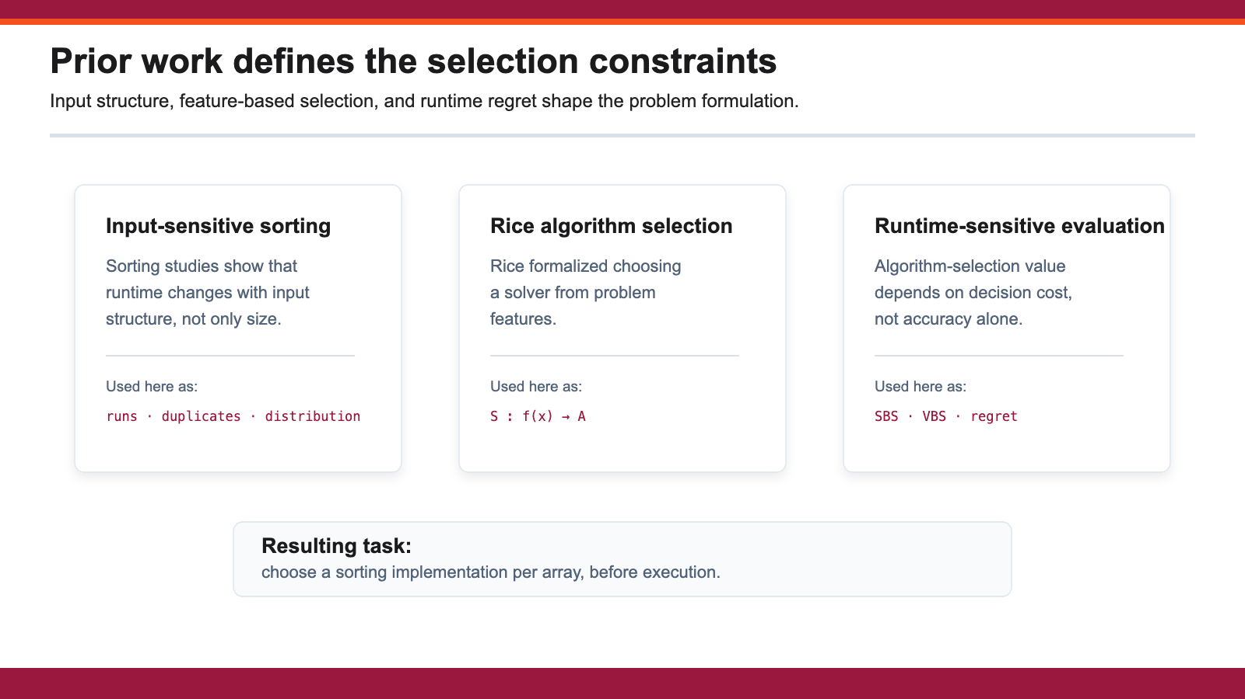
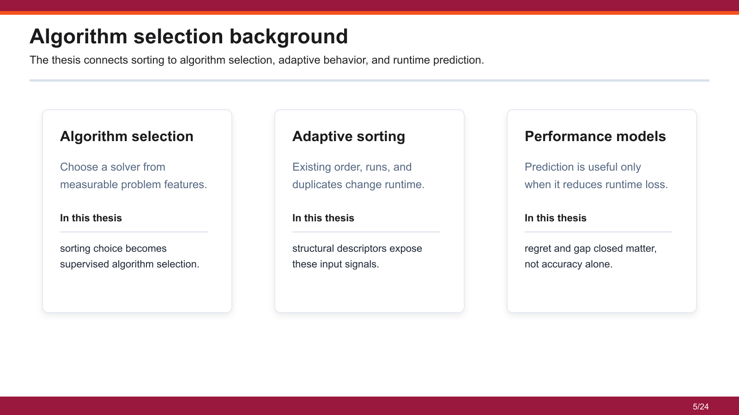
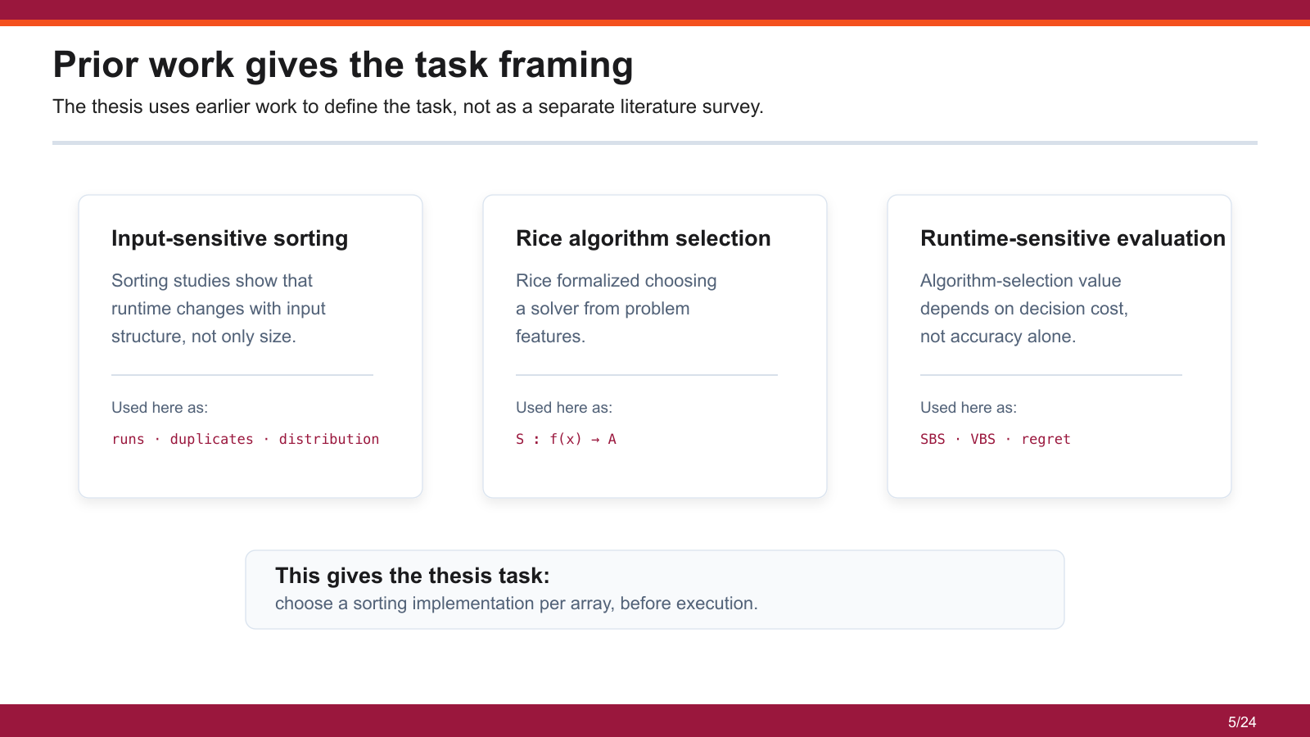
5/25
Notes:
The work connects to algorithm selection, adaptive sorting, and learned performance prediction. I am not presenting literature as a separate survey. I use it to position the task: previous work gives the idea of selecting from features, and this thesis applies that idea to measured sorting behavior.

Slide 6
The dataset spans five real-data domains
1,188,265 labeled arrays are drawn from five structurally different domains.
1.18M
labeled array instances
F1 telemetry
Stock
Crypto
Weather
Earthquake
Five domains test whether the selector generalizes beyond one workload family.
6/25
Notes:
The dataset was built from five domains: F1 telemetry, stock, crypto, earthquake, and weather. The reason for using multiple domains was to avoid building a selector that only understands one family of arrays.

Slide 7

Labels came from measured runtime
Each array is timed on the portfolio, then labeled by the fastest observed algorithm.
RAW
REV
SHUF
QBIN50
PSORT10
The transformation protocol exposes sorted, reversed, shuffled, quantized, and partially sorted structure.
7/25
Notes:
For each domain, I generated transformed arrays and measured runtime across the three sorting algorithms. The label is not guessed; it is the fastest measured algorithm for that instance. The transformations create raw, reversed, shuffled, quantized, and partially sorted cases.

Slide 8

Sixteen O(n) structural features represent each array
The selector receives sixteen O(n) structural features computed before sorting.
Size
Ordering
length
sortedness
scale
runs
spread
inversions
No timing features are used at prediction time.
The selector sees only structural descriptors.
8/25
Notes:
The features are the bridge between the raw array and the model. They describe scale, order, duplicates, runs, inversions, and distribution. The important point is that these are structural features, not timing features.

Slide 9
Prediction uses only pre-sorting structural features
Prediction is restricted to features available before sorting, then one portfolio member is selected.
Allowed before sorting
Not allowed at prediction time
Read the array once
Sort with introsort
Count order and duplicate signals
Sort with heapsort
Predict one algorithm class
Sort with timsort
Pick after seeing all times
The deployable selector never observes portfolio runtimes; VBS remains an evaluation oracle.
9/25
Notes:
At prediction time, the selector cannot sort the array with all three algorithms and then choose the fastest. That would be the oracle, not a usable method. The selector must use cheaper information from the input before sorting.

Slide 10
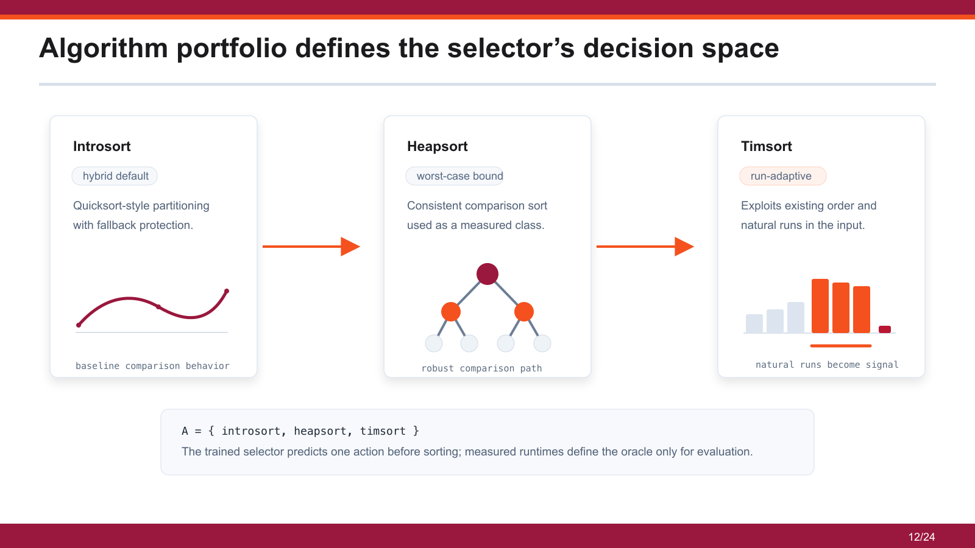
10/25
Notes:
The portfolio is deliberately limited to three real implementations: introsort, heapsort, and timsort. The model is not choosing from every sorting algorithm in theory. It is choosing from the measured implementations in this experiment.

Slide 11
Algorithm Selection Problem
Problem space P
Feature space F
Algorithm space A
numeric array
structural array features
Selector
[4, 5, 5, 6, 17, 18,
S : F → A
Introsort
19, 2, 2, 3, 31, 45]
size
sortedness / disorder
runs
XGBoost classifier
Heapsort
duplicates / entropy
predict fastest class
spread / outliers
Timsort
order, runs, duplicates, spread
x ∈ R^16
Performance space Y
Introsort
Heapsort
Timsort
label from measured runtime
18.7 μs
24.5 μs
13.2 μs
label(x) = argmin_a T(a, x)
11/25
Notes:
The task is not to invent a new sorting algorithm. The task is: given one array before sorting, choose introsort, heapsort, or timsort. The model sees cheap structural features and outputs one algorithm choice.

Slide 12
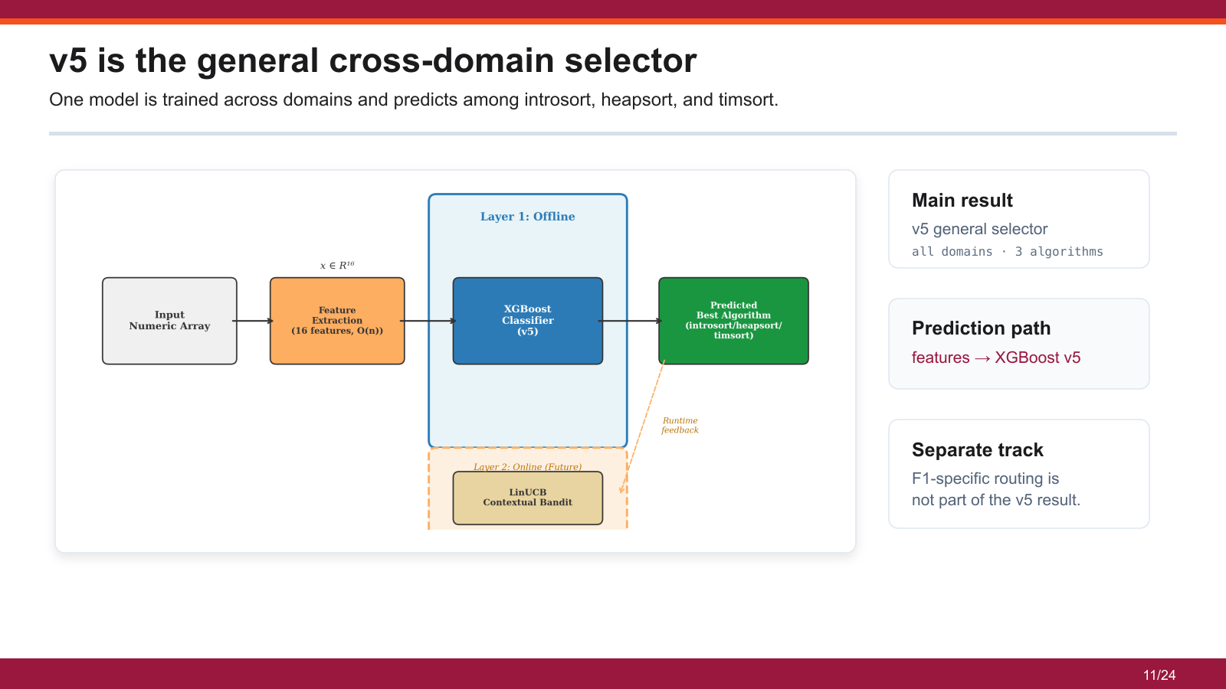

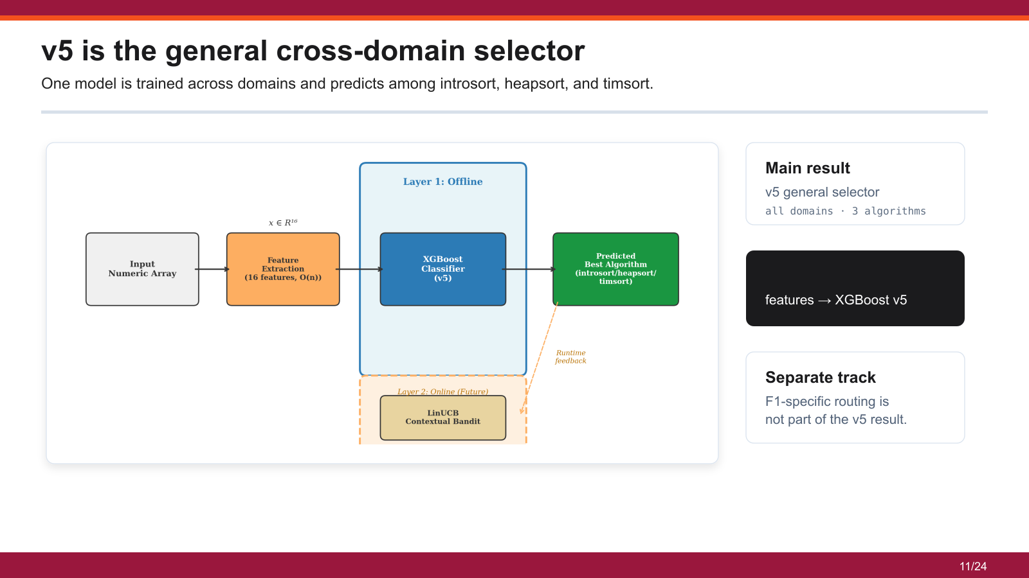
12/25
Notes:
The main system is v5. It is one general XGBoost classifier trained across all domains and choosing among the three algorithms. The F1-specific route is separate and I will only mention it as a specialization, not the main result.

Slide 13

Model evolution separated deployable and leakage-prone designs
Model evolution removed leakage-prone designs and weak objective choices before fixing v5 as the main model.
v1 regression
v3 timing features
v5 classifier
v6/v7/v8
dominated by size
ceiling proof only
final main model
final scope checks
13/25
Notes:
The final model came after earlier paths were rejected. Regression was not strong enough, timing features were not deployable, and strict checks changed the interpretation. v5 became the main model because it gave the best practical balance under the submitted evaluation.

Slide 14


Evaluation compares the model against SBS and VBS
Classification accuracy is reported, but runtime regret measures the cost of each decision.
SBS
VBS
Model
single best algorithm
fastest measured algorithm
choose before sorting
over the test set
for each input
using features only
Regret measures the runtime cost of the selected algorithm relative to VBS.
14/25
Notes:
SBS means one algorithm used for all test inputs. VBS means the fastest measured algorithm per input, which is an oracle for evaluation. The model is judged by how close it gets to VBS without having oracle information at prediction time.

Slide 15

The selector closes most of the runtime gap
The most important result is runtime value: v5 recovers 93.1% of the SBS-to-VBS gap.
76.1%
89.6%
93.1%
test accuracy
zero regret
runtime gap closed
Runtime regret is the main
evaluation signal.
15/25
Notes:
The main result is runtime value: v5 closes 93.1 percent of the gap between SBS and VBS. Accuracy is 76.1 percent, but this does not tell the whole story. The zero-regret rate is 89.6 percent, which shows many decisions are either correct or not costly.

Slide 16

Accuracy alone does not explain runtime value
Many misclassifications have low regret because candidate runtimes are nearly tied.
76.1%
label accuracy
93.1%
gap closed
The result is evaluated by runtime regret,
not accuracy alone.
16/25
Notes:
This slide explains why I do not defend the model only as a classifier. Some label mistakes happen between algorithms whose measured runtimes are very close. In those cases, the label is wrong, but the runtime regret is small.

Slide 17

The residual error is concentrated in the introsort-heapsort boundary
The confusion matrix shows strong timsort behavior and weaker separation where runtimes are close.
94.5%
timsort recall
Interpretation
timsort is easier when order signals are present.
introsort and heapsort can be much closer.
Many errors in this boundary
have low measured regret.
17/25
Notes:
The confusion matrix shows that timsort is often easier to identify when order signals are strong. The harder boundary is between introsort and heapsort because their runtime behavior is often closer. This is a limitation, but it is also why regret is necessary.

Slide 18

The model uses structural array signals
Feature importance is dominated by length, repetition, and ordering descriptors.
Ordering
longest_run_ratio
runs_ratio
adj_sorted_ratio
Repetition / distribution
top5_freq_ratio
duplicate_ratio
entropy_ratio
Size / scale
length_norm
robust scale descriptors
18/25
Notes:
Feature importance shows that the model is using structural signals. This supports the method because the important features relate back to the properties that sorting algorithms react to: order, duplicates, distribution, and size.

Slide 19

Leave-one-domain-out testing shows partial cross-domain transfer
Each fold holds out one full domain, making the test workload unseen during training.
79.7%
weighted gap closed
Domain sensitivity
F1 is the hardest held-out
domain, which motivates the
separate F1 specialization.
19/25
Notes:
Domain holdout is stricter because the held-out domain is unseen during training. The weighted gap closed is 79.7 percent. F1 is harder than the other domains, and that is why the F1-specific route exists separately.

Slide 20
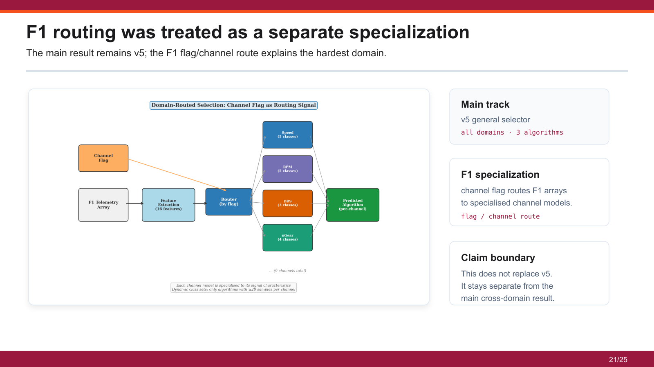
20/25

Slide 21
Source-aware and regret-aware checks narrowed the final scope
Later checks define the boundary of the reported v5 result.
v6 source-aware
v7 regret-aware
v8 cascade
Accuracy dropped to 71.2%.
Optimizing the wrong signal
Stage 2 stayed weak
This made leakage checks
reduced gap closed to
when introsort and heapsort
part of the evaluation protocol.
78.1%.
were too close.
v5 remains the reported selector; source-aware and regret-aware variants are scope checks.
21/25
Notes:
The negative results are part of the rigor. v6 checked source-awareness, v7 showed that a regret-aware attempt did not improve the final result, and v8 showed that the intro-versus-heap boundary remains difficult. These results keep the claim measured.

Slide 22
Conclusion
Structural array features support per-instance sorting decisions when evaluation is based on measured runtime.
The v5 selector recovers most of the SBS-to-VBS gap on real-world numeric arrays.
76.1%
93.1%
89.6%
top-1 accuracy
SBS-to-VBS gap closed
zero-regret predictions
The strongest cases are where array structure is visible, especially timsort-friendly inputs.
The main residual weakness is the introsort/heapsort boundary, where the current feature space often cannot see enough difference.
22/25
Notes:
My claim is that v5 closes most of the measured runtime gap with cheap structural features and known limitations. I do not claim a perfect classifier, I do not claim the F1 route is the main result, and I do not claim LinUCB is validated in this thesis.

Slide 23
Contributions
Three contributions follow from the experimental framework.
01
A deployable selector
A compact pipeline combines inexpensive structural characteristics with a gradient-boosted classifier.
02
A rigorous evaluation framework
Source-aware splitting, near-tie filtering, leave-one-domain-out testing, and regret metrics give a better view than accuracy alone.
03
A reproducible artefact
One feature extractor, one data pipeline, and exported XGBoost JSON / ONNX models support replication.
23/25
Notes:
The contribution is the framing, the data and feature pipeline, and the measured selector result. The future work is stronger domain adaptation, validated online selection, and deeper F1-specific evaluation.

Slide 24
Limitations and Future Work
Limitations come from the selected portfolio, hardware setting, and validation scope.
Limitations
Future work
portfolio limited to introsort, heapsort, and timsort
broader algorithm portfolios and hardware-aware features
timing results collected on one hardware configuration
validated online adaptation under workload drift
LinUCB was designed but not empirically validated
stricter F1-specific evaluation and channel-level routing
feature overhead is not profitable for very small arrays
deployment study including feature-extraction overhead
Future work targets broader portfolios, online adaptation, and stronger generalisation tests.
24/25

Slide 25
Thank you
Questions?
25/25

