Slide 1


Slide 2
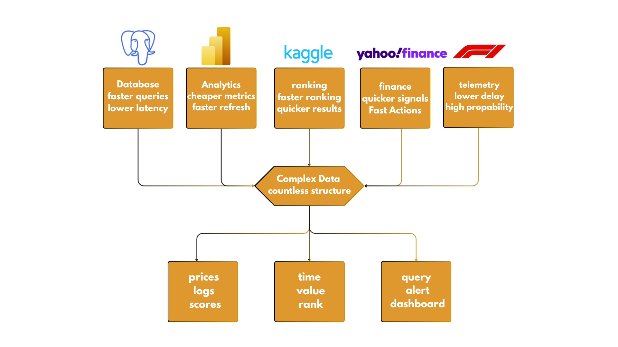
Why sorting selection matters at scale

Slide 3
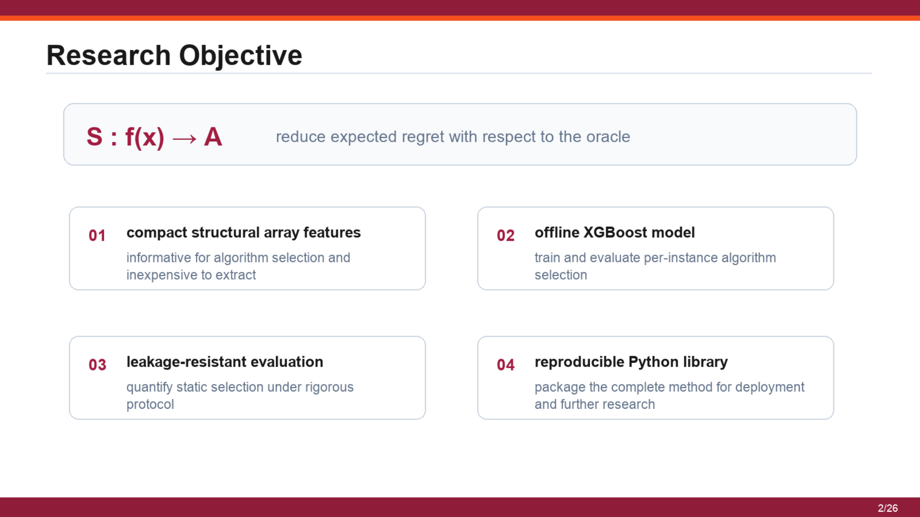
Research Objective

Slide 4
Prediction is made before any candidate algorithm is executed
Allowed before sorting
Not allowed at prediction time
Extract O(n) structural features
Run Introsort
Measure order, runs, repetition, dispersion
Run Heapsort
Use robust scale and distribution signals
Run Timsort
Predict introsort, heapsort, or timsort
Pick after seeing all measured times
Evaluation uses measured runtimes; prediction does not.

Slide 5
Candidate algorithms define the action space
Introsort
Heapsort
Timsort
hybrid quicksort + heap fallback
fixed memory comparison sort
run-aware stable sort
Output class: introsort / heapsort / timsort

Slide 6
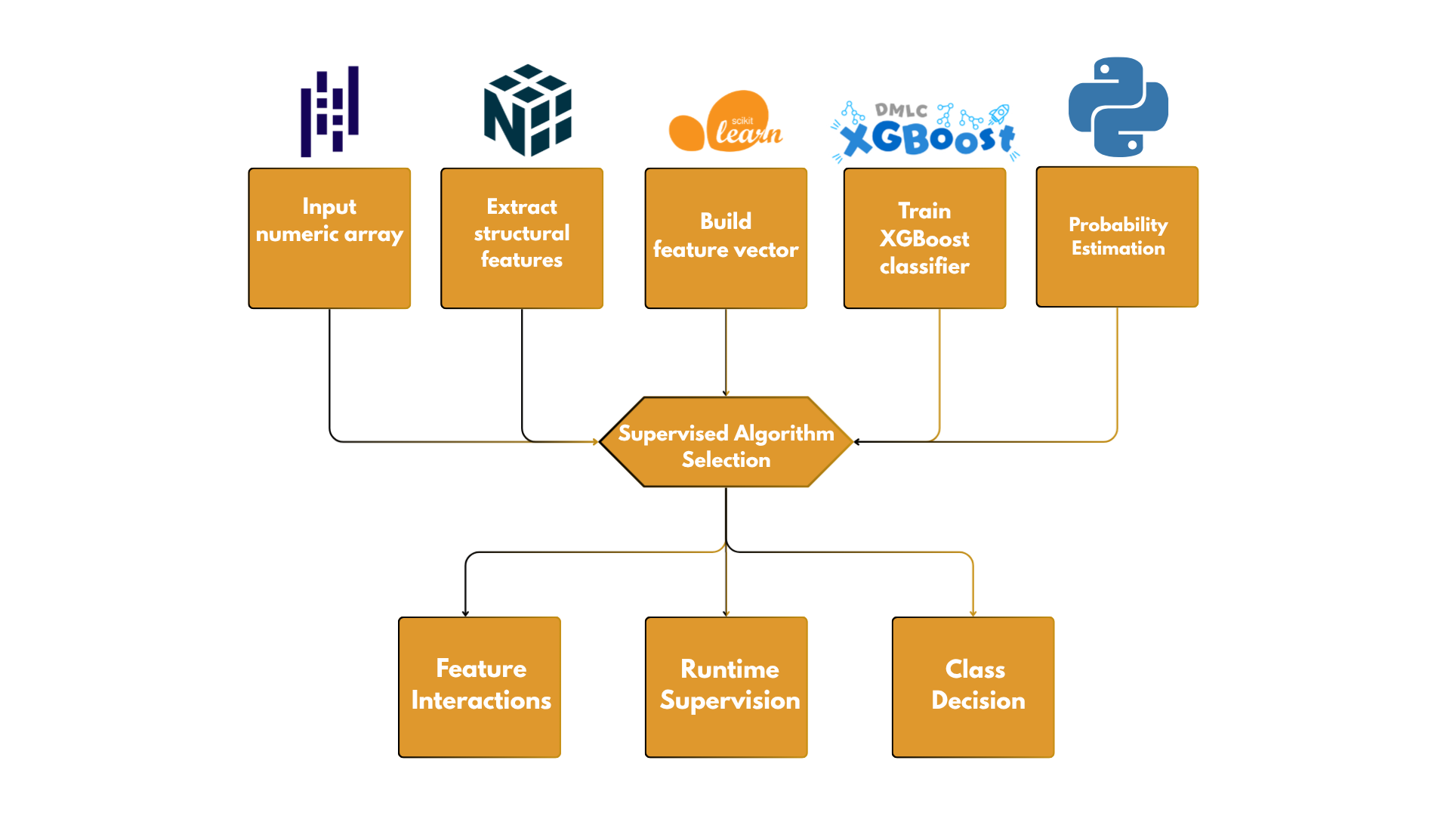
System Architecture

Slide 7
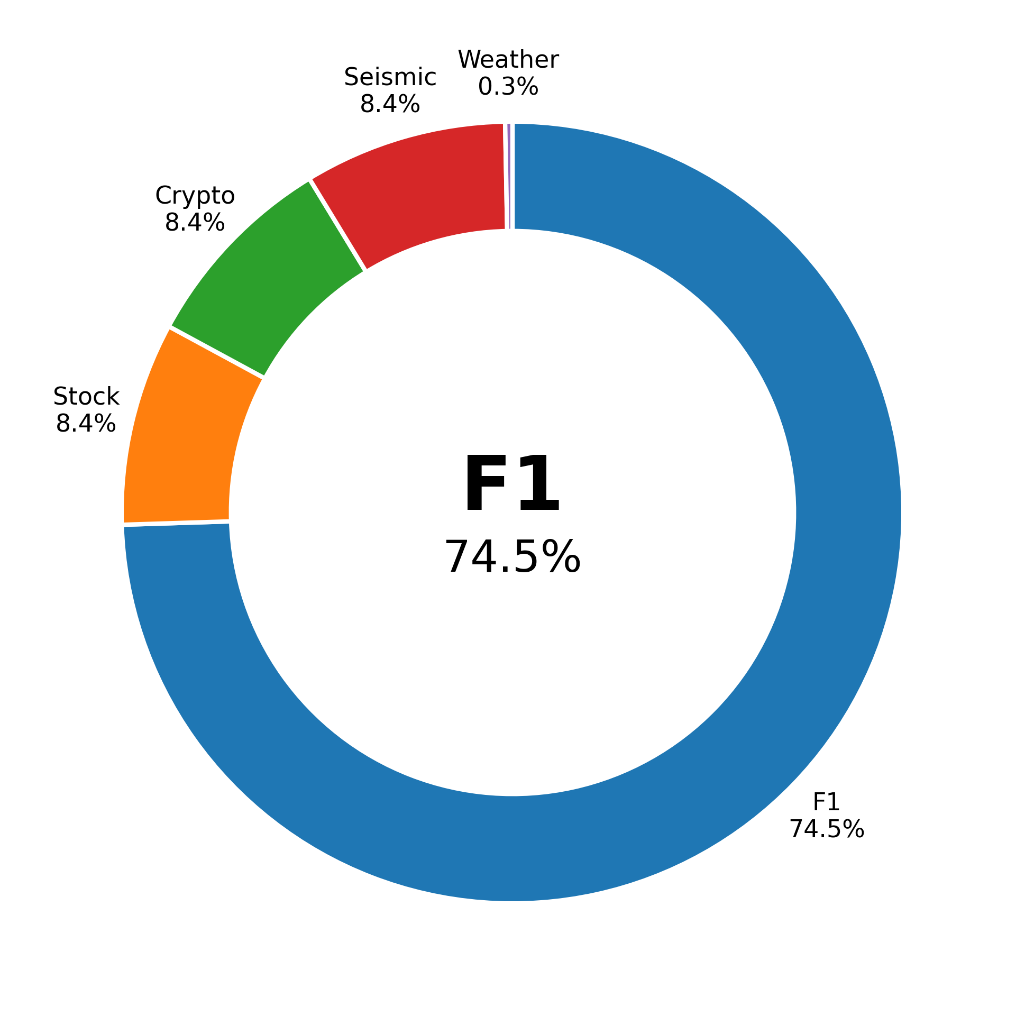
The corpus uses five structurally diverse real-world domains
1.18M

Slide 8
Five real domains, five different numeric traces
01 Weather: [3.389, 3.385, 3.341, 3.269, 3.164, 3.201, 3.244, 3.302, 3.355, 3.410]
02 Formula 1 telemetry: [0.0797, 12.79, 28.74, 51.06, 79.76, 108.46, 141.30, 172.55, 201.10, 238.42]
03 Stock market: [5.873, 5.919, 5.968, 5.974, 6.021, 6.044, 6.081, 6.114, 6.156, 6.203]
04 Cryptocurrency: [0.0009, 0.0005, 0.0002, -0.0003, 0.0001, 0.0007, -0.0002, 0.0010, 0.0004, -0.0001]
05 Seismic events: [37.83, 34.02, 36.10, 35.95, 33.54, 36.80, 38.21, 35.12, 34.88, 36.42]

Slide 9

Labels are empirical fastest-algorithm measurements

Slide 10
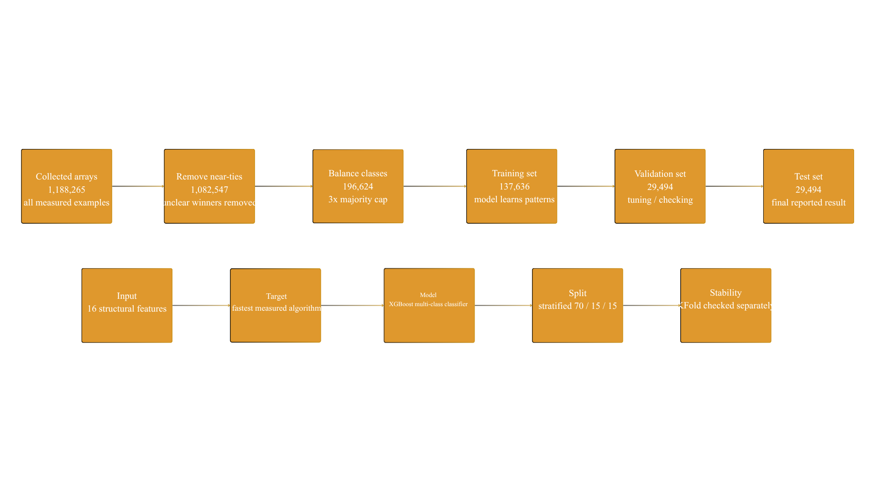
Training Dataset and Split

Slide 11
Train, validation, and test sets have separate roles
Train
Validation
Test
137,636
29,494
29,494
fit model
check tuning
final result
same features 16 structural values
same target measured fastest algorithm
same split rule stratified 70 / 15 / 15

Slide 12
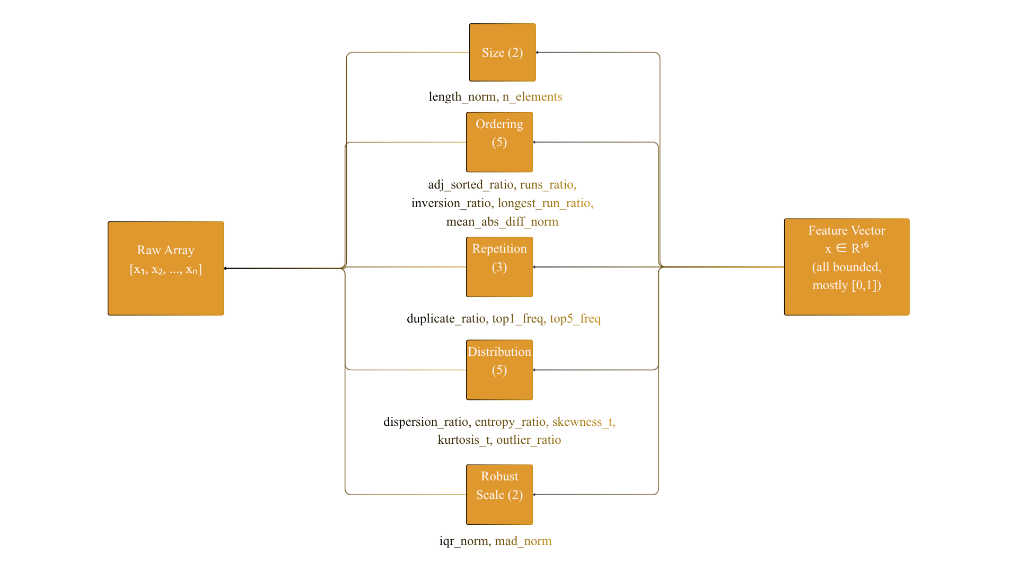
Sixteen O(n) structural features characterise each array

Slide 13

Feature importance follows structural sorting signals

Slide 14
XGBoost is decision-tree based gradient boosting
Decision trees
Gradient boosting
Multi-class output
split feature space
add trees sequentially
probability per algorithm
objective: multi:softprob
loss: mlogloss
classes: 3 algorithms

Slide 15
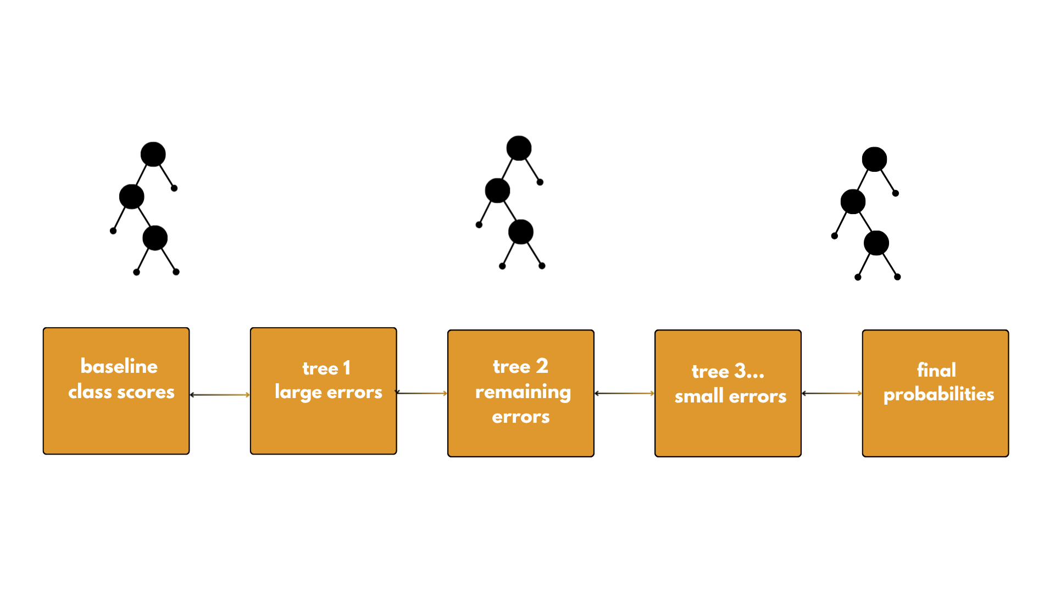
Each new tree corrects what previous trees still miss
After each tree, predictions update. Next tree learns remaining correction signal.

Slide 16
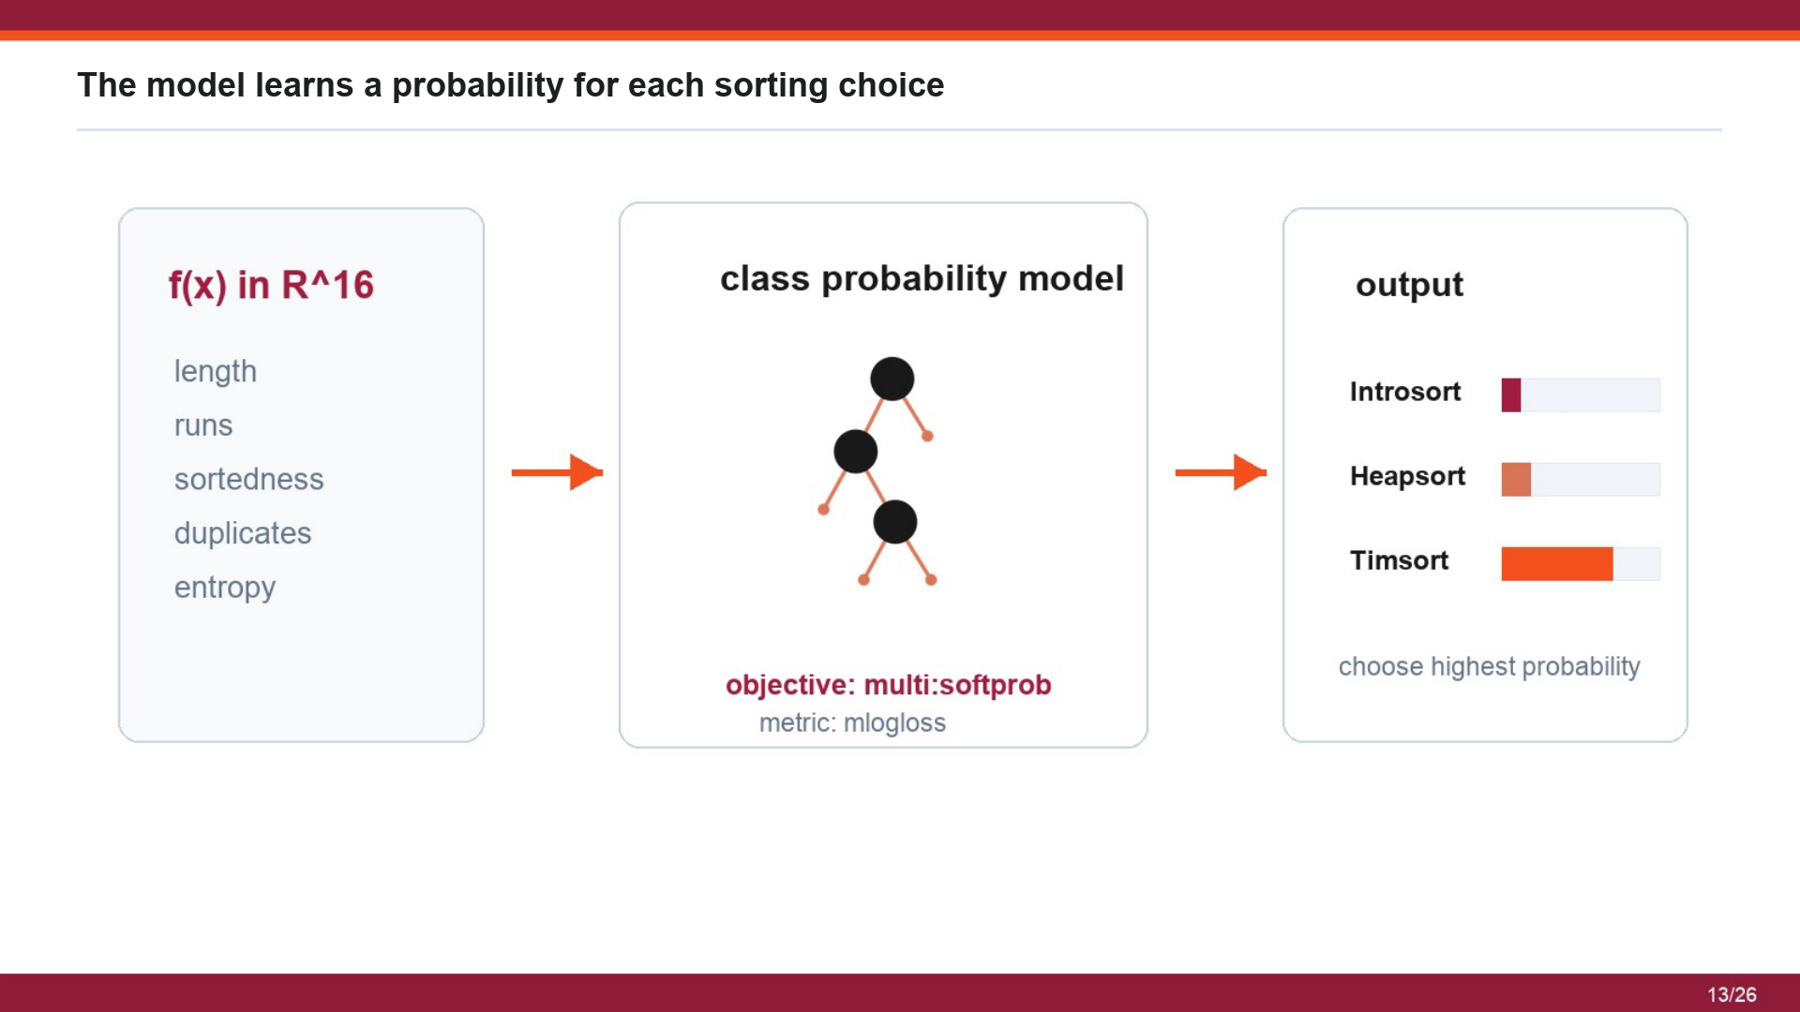
The model learns a probability for each sorting choice

Slide 17
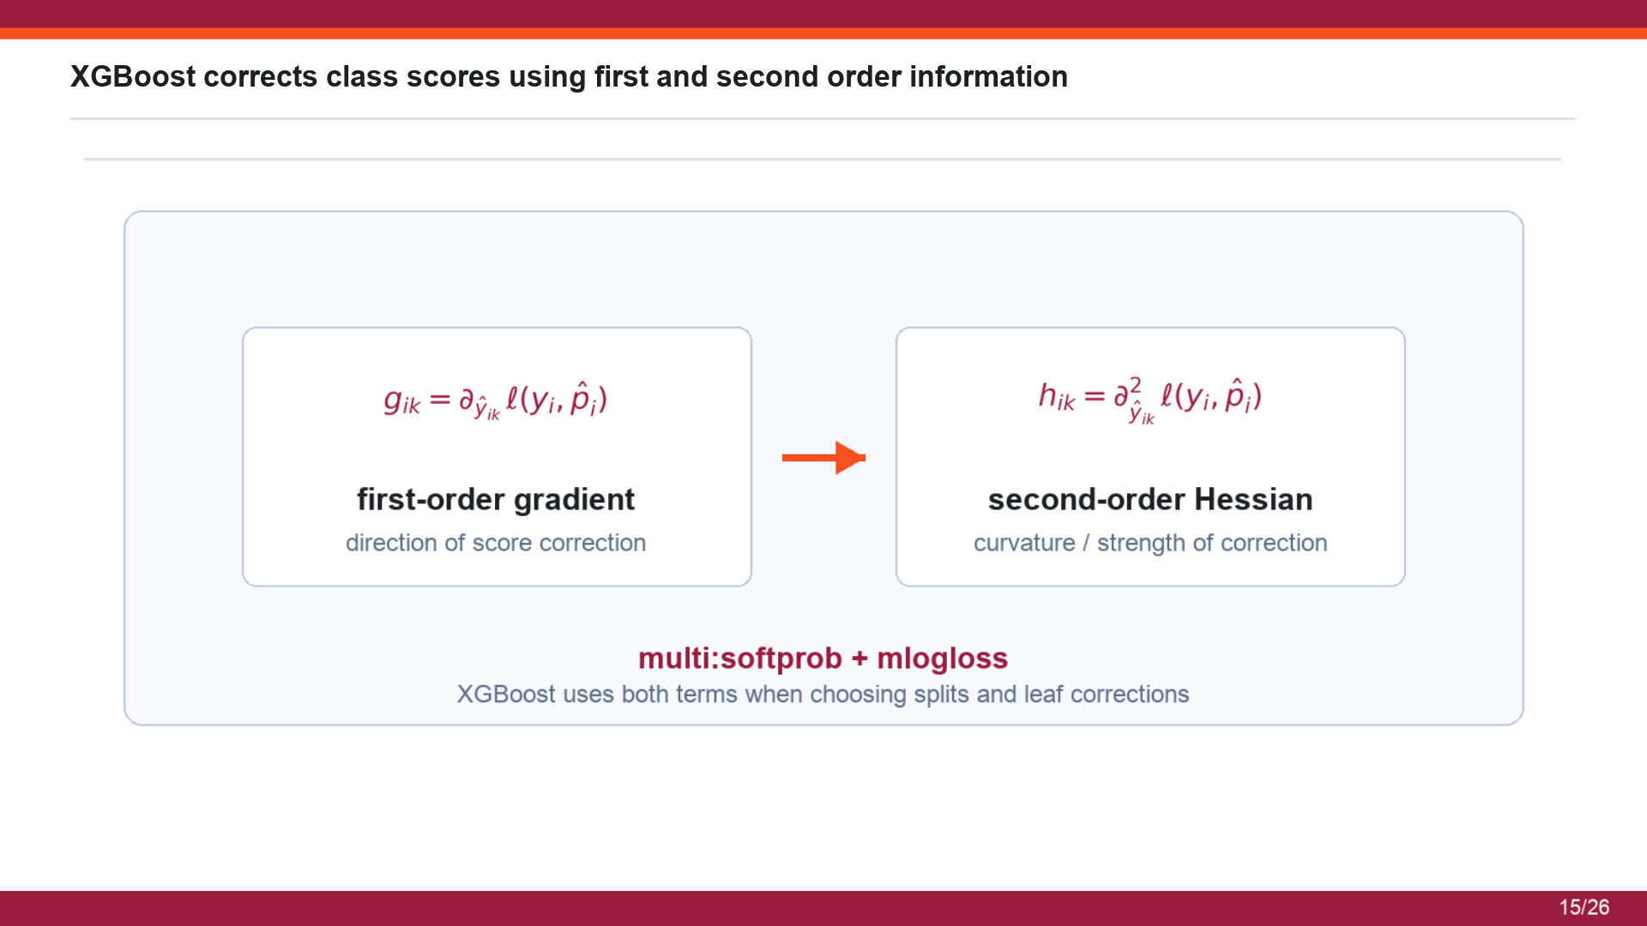
XGBoost corrects class scores using first and second order information

Slide 18
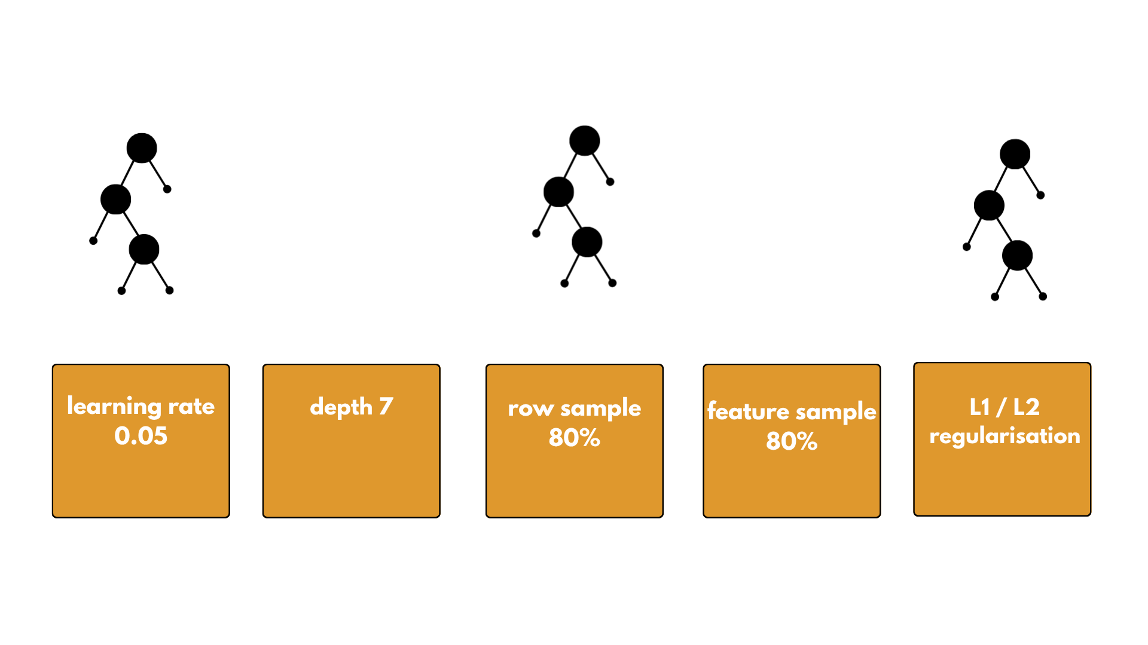
The ensemble is constrained so it does not overfit timing noise

Slide 19
Test examples show correct and failed selections
SUCCESS
SUCCESS
FAILED CASE
Earthquake n=1,000 true: timsort pred: timsort regret: 0.00 us
Weather n=52,441 true: introsort pred: introsort regret: 0.00 us
Stock n=2,513 true: introsort pred: heapsort regret: 155.21 us
intro 12.12 us heap 11.71 us tim 0.79 us
intro 1338.13 us heap 1338.46 us tim 1481.87 us
intro 43.83 us heap 199.04 us tim 131.29 us
Success and failure are both evaluated by measured runtime, not by label alone.

Slide 20
Experimental results report accuracy, F1, and runtime value
76.1%
70.1%
77.0%
93.1%
89.6%
Accuracy
Balanced accuracy
Weighted F1
Gap closed
Zero regret
Introsort
Heapsort
Timsort
P 37.1% R 52.1% F1 43.3%
P 74.2% R 63.8% F1 68.6%
P 96.0% R 94.5% F1 95.3%

Slide 21
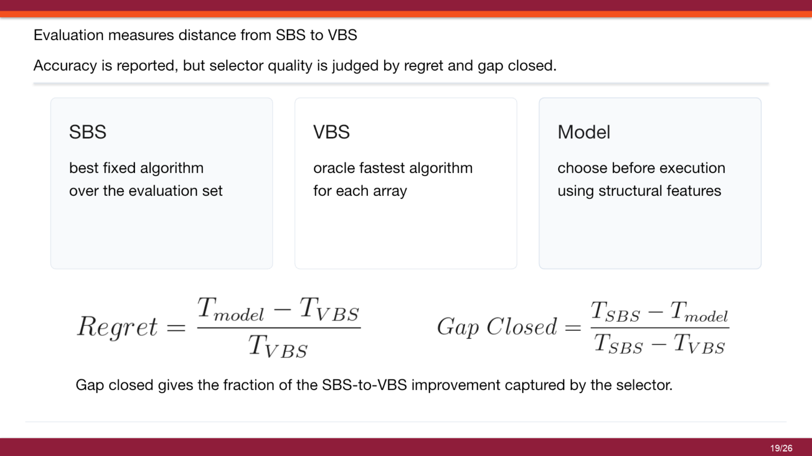
Evaluation measures distance from SBS to VBS
Evaluation measures distance from SBS to VBS

Slide 22

The v5 selector closes most of the SBS-to-VBS gap

Slide 23
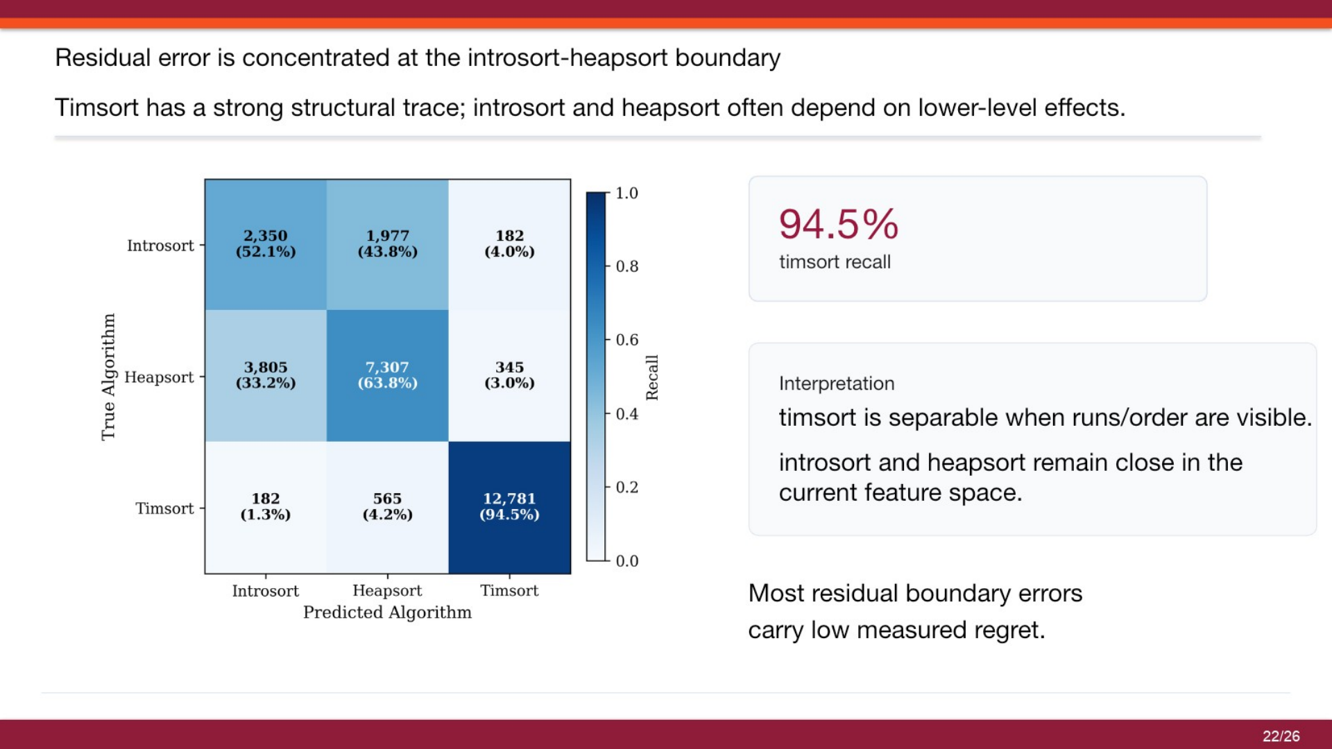
Residual error is concentrated at the introsort-heapsort boundary
Residual error is concentrated at the introsort-heapsort boundary

Slide 24
KFold checks whether the F1 model is stable across splits
How the check was run
Actual 5-fold result
mean ± standard deviation
F1
F2
F3
F4
F5
F1-only
balanced sample
Accuracy
Macro F1
one fold hidden for testing
61.61 ± 0.61%
62.00 ± 0.60%
the other four folds train a fresh XGBoost model
Gap closed
Zero regret
then the test role moves to the next fold until all five folds are tested
59.78 ± 0.64%
66.87 ± 0.73%
The folds are close, so this is a row-level stability check;
source-level generalization is still evaluated separately by domain holdout
KFold

Slide 25
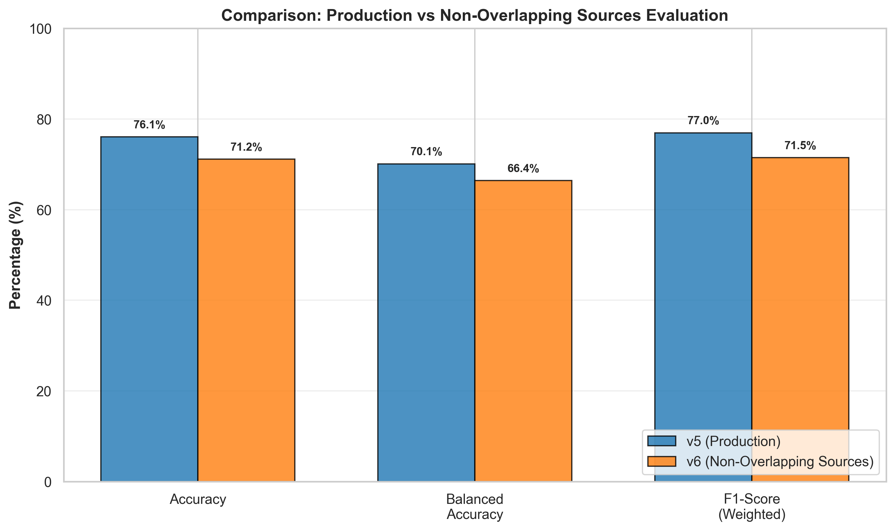
Strict checks define the boundary of the reported result

Slide 26

Model evolution reduced the problem to its deployable form

Slide 27
Leave-one-domain-out testing supports cross-domain robustness
Crypto
87.5%
90.1%
Earthquake
82.1%
95.0%
F1
88.8%
75.5%
Stock
88.0%
90.7%
Weather
60.6%
89.7%
Accuracy
Gap closed

Slide 28
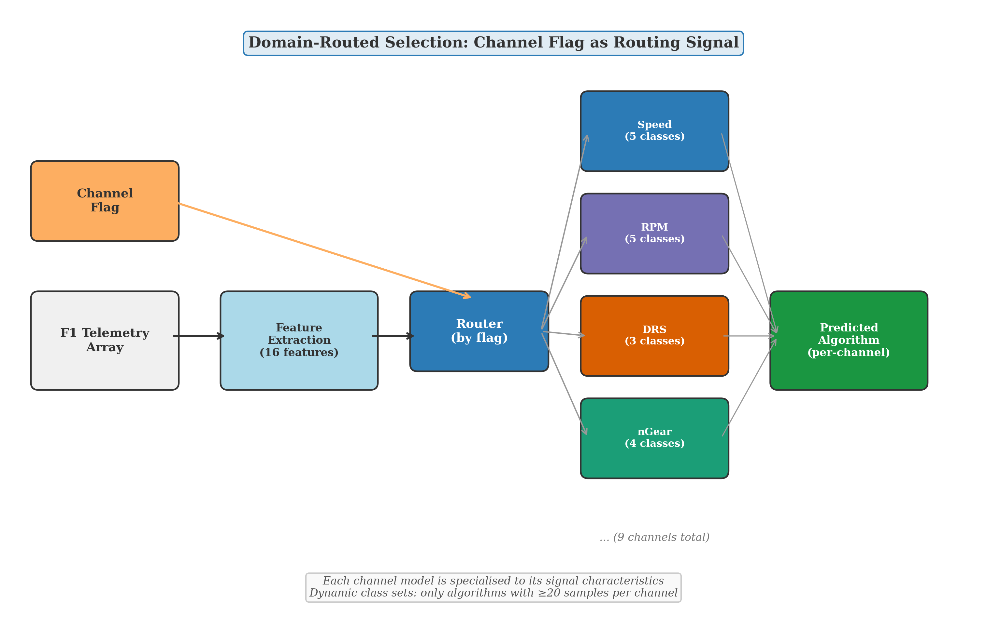
F1 routing was treated as a separate specialization

Slide 29
Optuna tuning strengthened the F1 channel models
Optuna tuning strengthened the F1 channel models
Optuna tuning strengthened the F1 channel models
Optuna searched: tree count, tree depth, learning rate, row/feature sampling, and regularisation
Metric
Before
After Optuna
Change
F1 channel average
F1 avg test accuracy
46.0%
53.6%
+7.6
test accuracy
53.6%
F1 avg balanced accuracy
48.2%
49.8%
+1.6
46.0%
DRS test accuracy
55.0%
76.4%
+21.4
Throttle balanced accuracy
24.0%
47.1%
+23.1
RPM test accuracy
32.9%
44.0%
+11.1
Before avg
After avg

Slide 30
Where this selector can be used
Where this selector can be used
Where this selector can be used
01
Database query engines: choose sorting method for ORDER BY, joins, grouping, and index builds
02
ETL and analytics pipelines: choose sorting method for IDs, timestamps, prices, partitions, and batches
03
Search and ranking systems: choose sorting method for candidate scores before top-k output
04
Financial time-series processing: choose sorting method for rolling windows, events, prices, and order-book values
05
Scientific and telemetry processing: choose sorting method for sensor traces, physics logs, weather data, and F1 telemetry
06
Selector action: extract features first, predict fastest algorithm, choose Introsort / Heapsort / Timsort

Slide 31
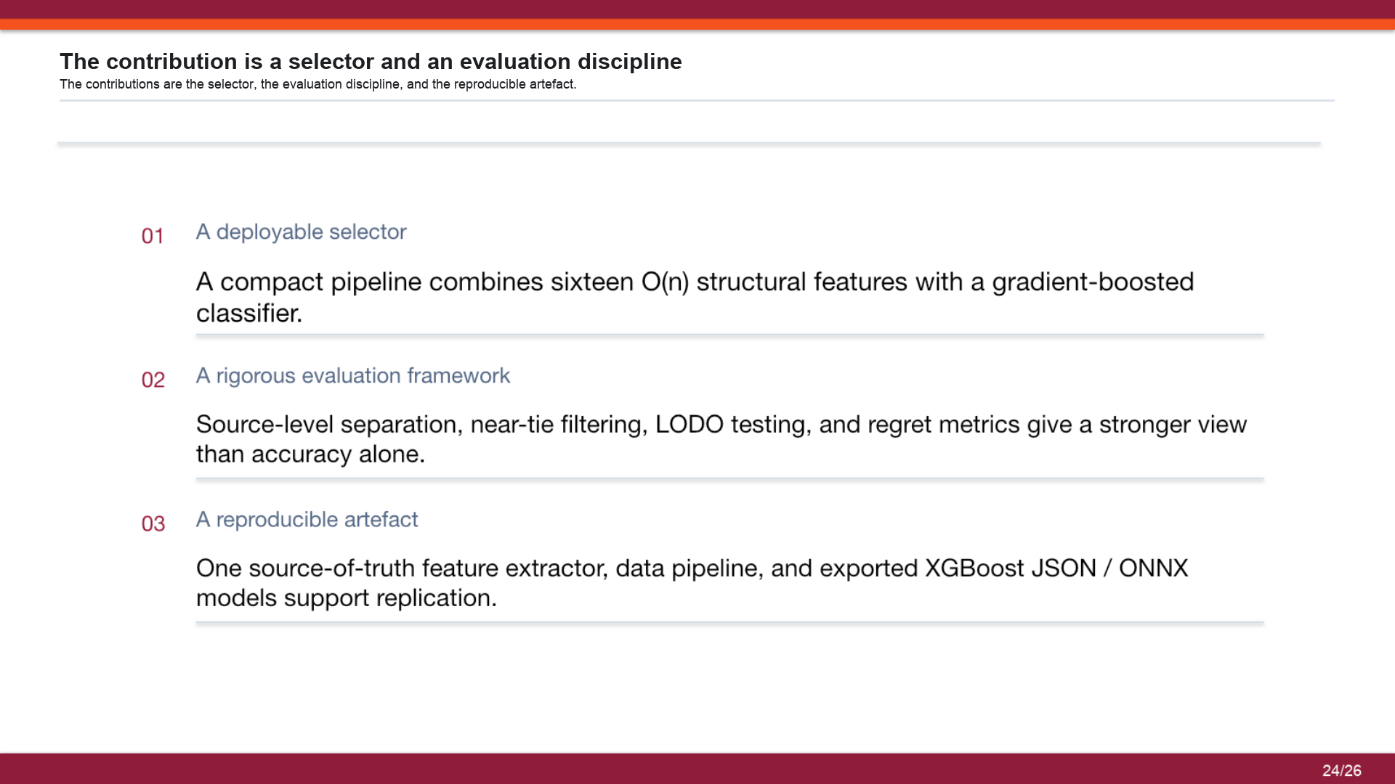
The contribution is a selector and an evaluation discipline
01
A deployable selector: compact pipeline combines sixteen O(n) structural features with a gradient-boosted classifier
02
A rigorous evaluation framework: source-level separation, near-tie filtering, LODO testing, and regret metrics give a stronger view than accuracy alone
03
A reproducible artifact: one source-of-truth feature extractor, data pipeline, and exported XGBoost JSON / ONNX models support replication

Slide 32
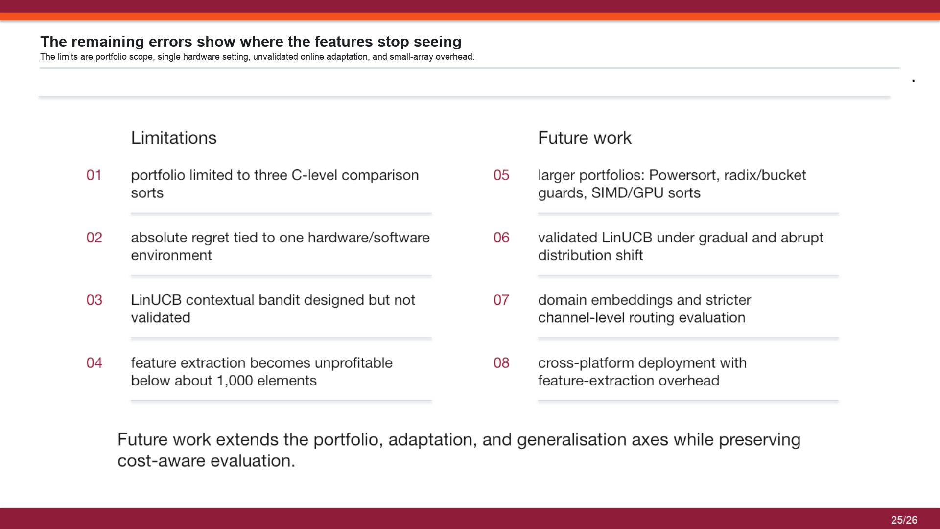
The remaining errors show where the features stop seeing
01
Portfolio: limited to three C-level comparison sorts
02
Environment: absolute regret is tied to one hardware/software environment
03
Source-aware split: stricter validation lowers performance, so deployment needs domain testing
04
Extraction cost: feature extraction becomes unprofitable below about 1,000 elements
05
Larger portfolios: Powersort, radix/bucket/quads, SIMD/GPU sorts
06
Channel validation: stricter channel-level routing evaluation
07
Domain routing: domain embeddings and stricter channel-level routing evaluation
08
Deployment: cross-platform deployment with feature-extraction overhead

Slide 33


