Slide 1
F1 New Direction Update
Method, evidence, results, decision

Slide 2
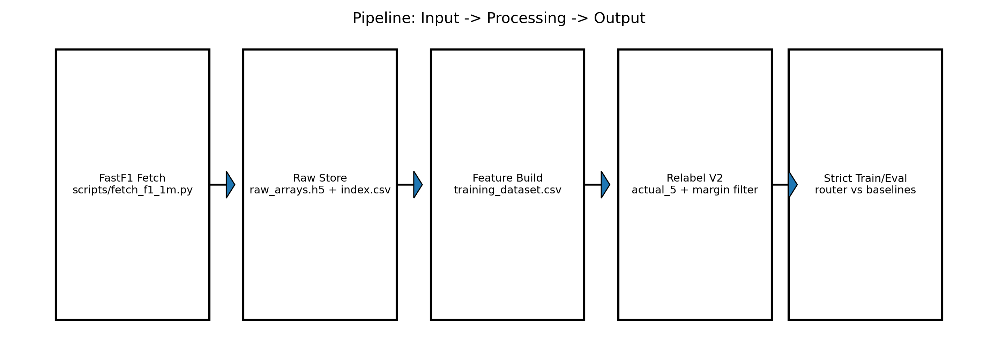
Method Flow
Input: numeric array + channel context
Output: one best sorting algorithm

Slide 3
What Was Tested
Channel-aware routing with dynamic class sets
Strict protocol: split first, train on train only, evaluate on untouched test
Comparison against two baselines: channel-majority and global-majority

Slide 4
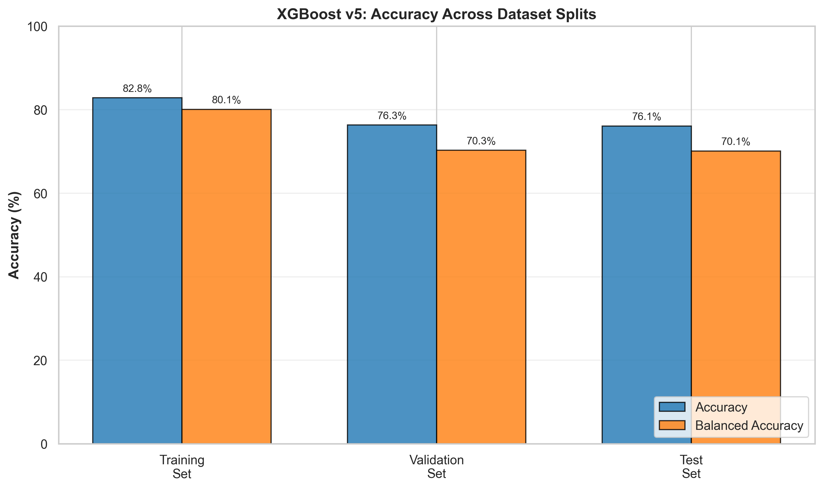
Strong Baseline Context (v5)
v5 test accuracy=0.7608
v5 test balanced accuracy=0.7012

Slide 5
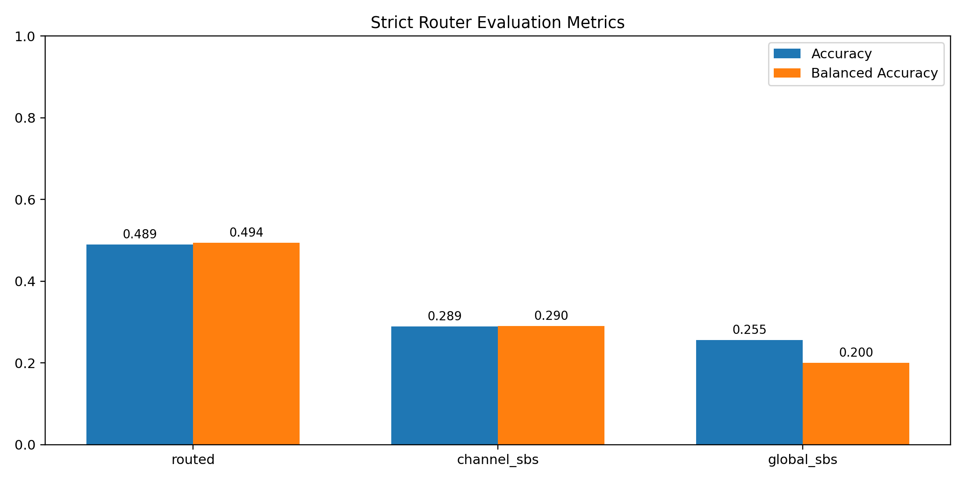
Strict New-Direction Results
Routed: acc=0.489, bal_acc=0.494
Channel baseline: acc=0.289, bal_acc=0.290
Global baseline: acc=0.255, bal_acc=0.200

Slide 6
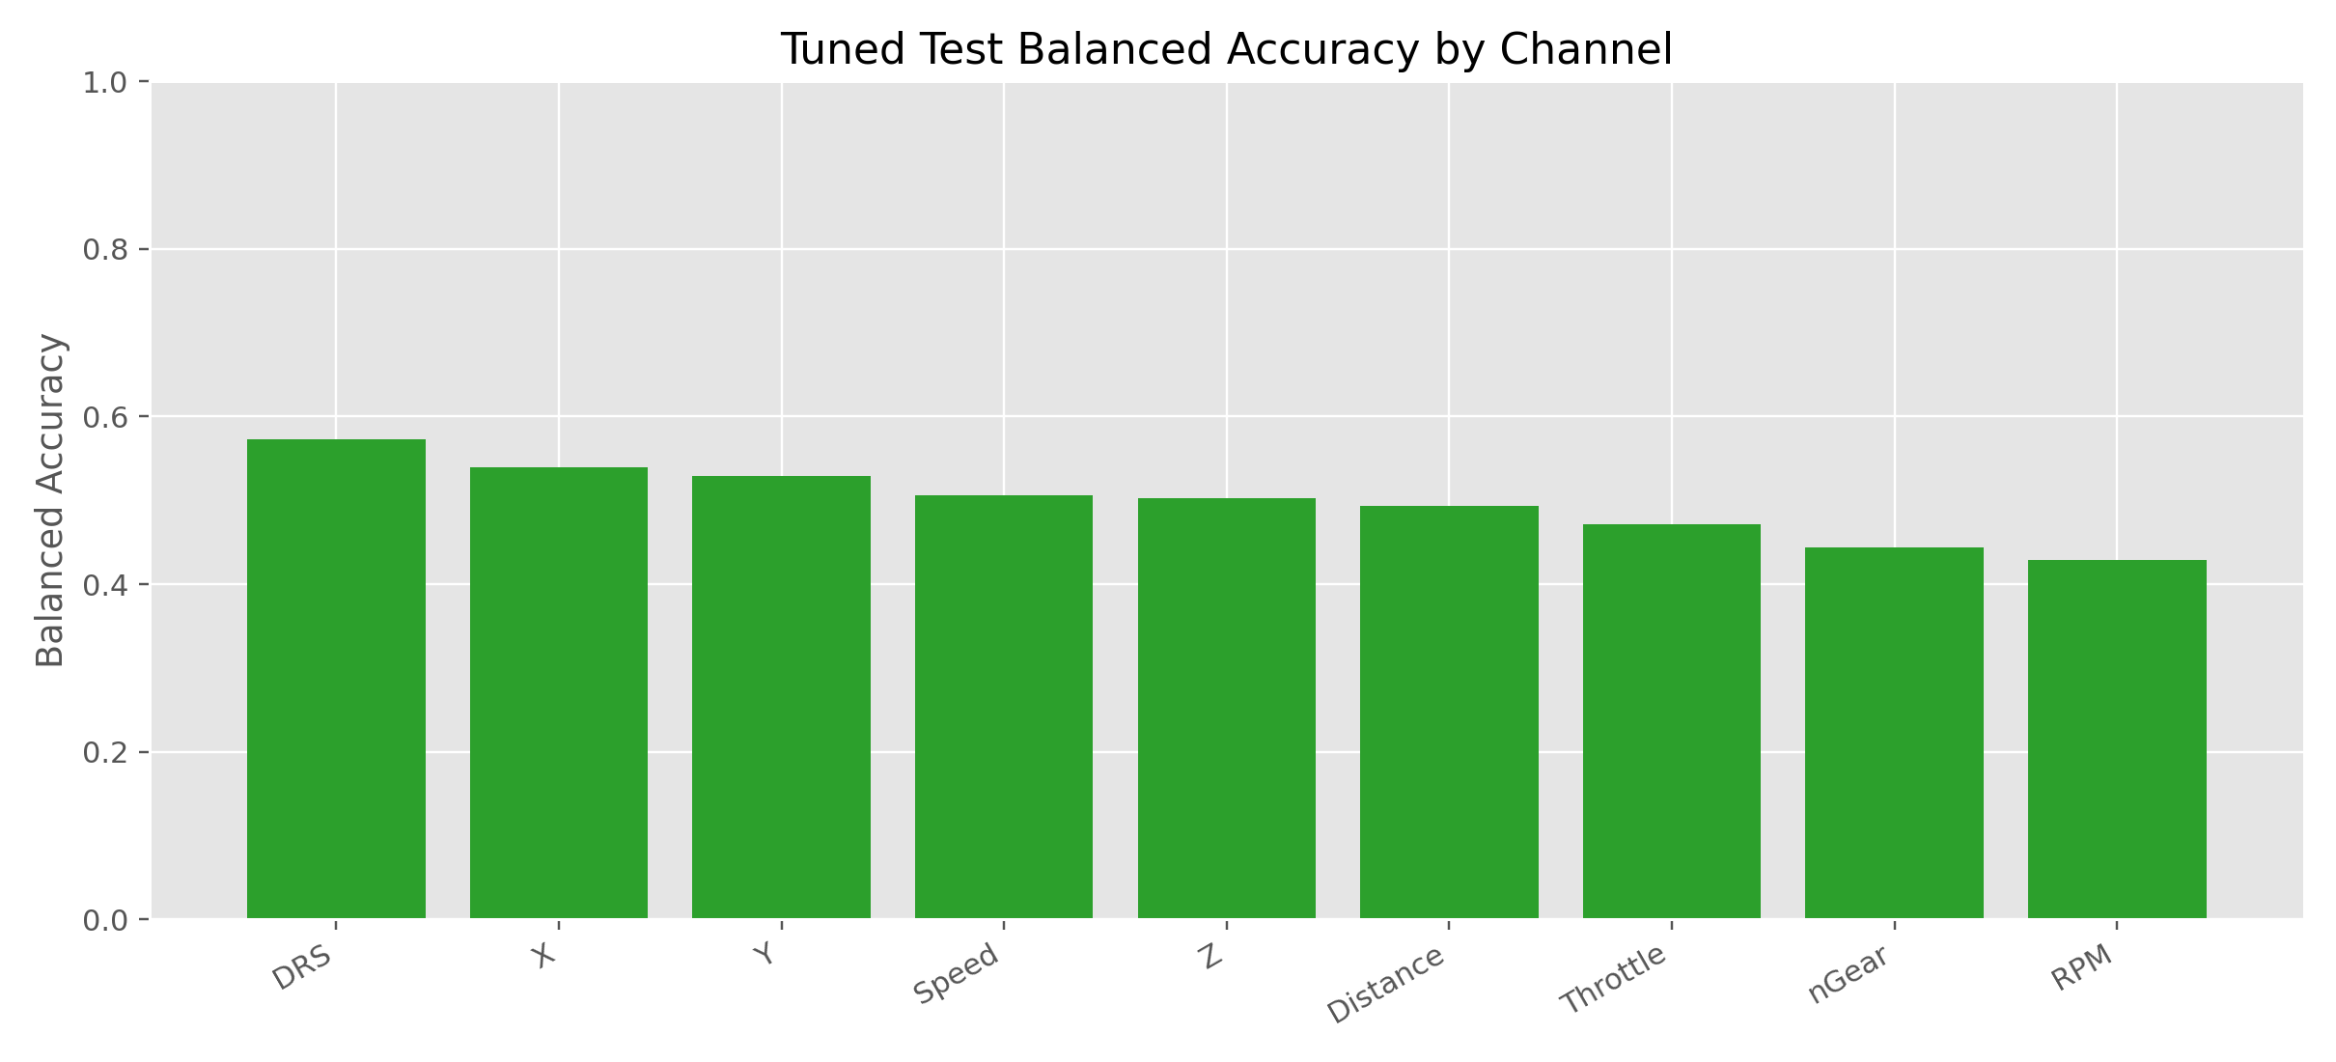
Optuna Tuning Summary
Mean tuned test accuracy across channels=0.536
Mean tuned test balanced accuracy across channels=0.498

Slide 7
Key Finding
New direction is valid: routed model beats both naive baselines
Current gain is moderate, not a v5-level breakthrough
Main bottleneck is data retention after filtering/balancing

Slide 8
Decision for Thesis
Keep v5 as main baseline/result
Keep new direction as exploratory extension with strict evidence
Scale this branch only with a stronger data-construction strategy

