Slide 1
F1 New Direction: Full Experiment Update
All numbers/figures loaded from repository artifacts

Slide 2
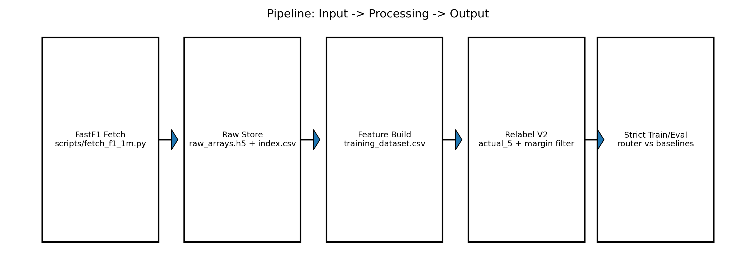
Experiment Pipeline (Implemented)
Scripts used: fetch_f1_1m.py -> build_training_dataset.py -> relabel_f1_exact_algorithms_v2.py -> train/eval strict router

Slide 3
Input/Output Artifacts (Actual Files)
Raw arrays: /Volumes/k/thesis_data/f1_only_1m_packed/raw_arrays.h5
Index: /Volumes/k/thesis_data/f1_only_1m_packed/index.csv (1,000,008 rows)
v2 balanced hard-case: training_dataset_algos_v2_hard_m0p05_balanced.csv (13,215 rows)
Strict eval JSON: results/f1_9_channel_models_dynamic_v2_strict/strict_router_eval.json

Slide 4
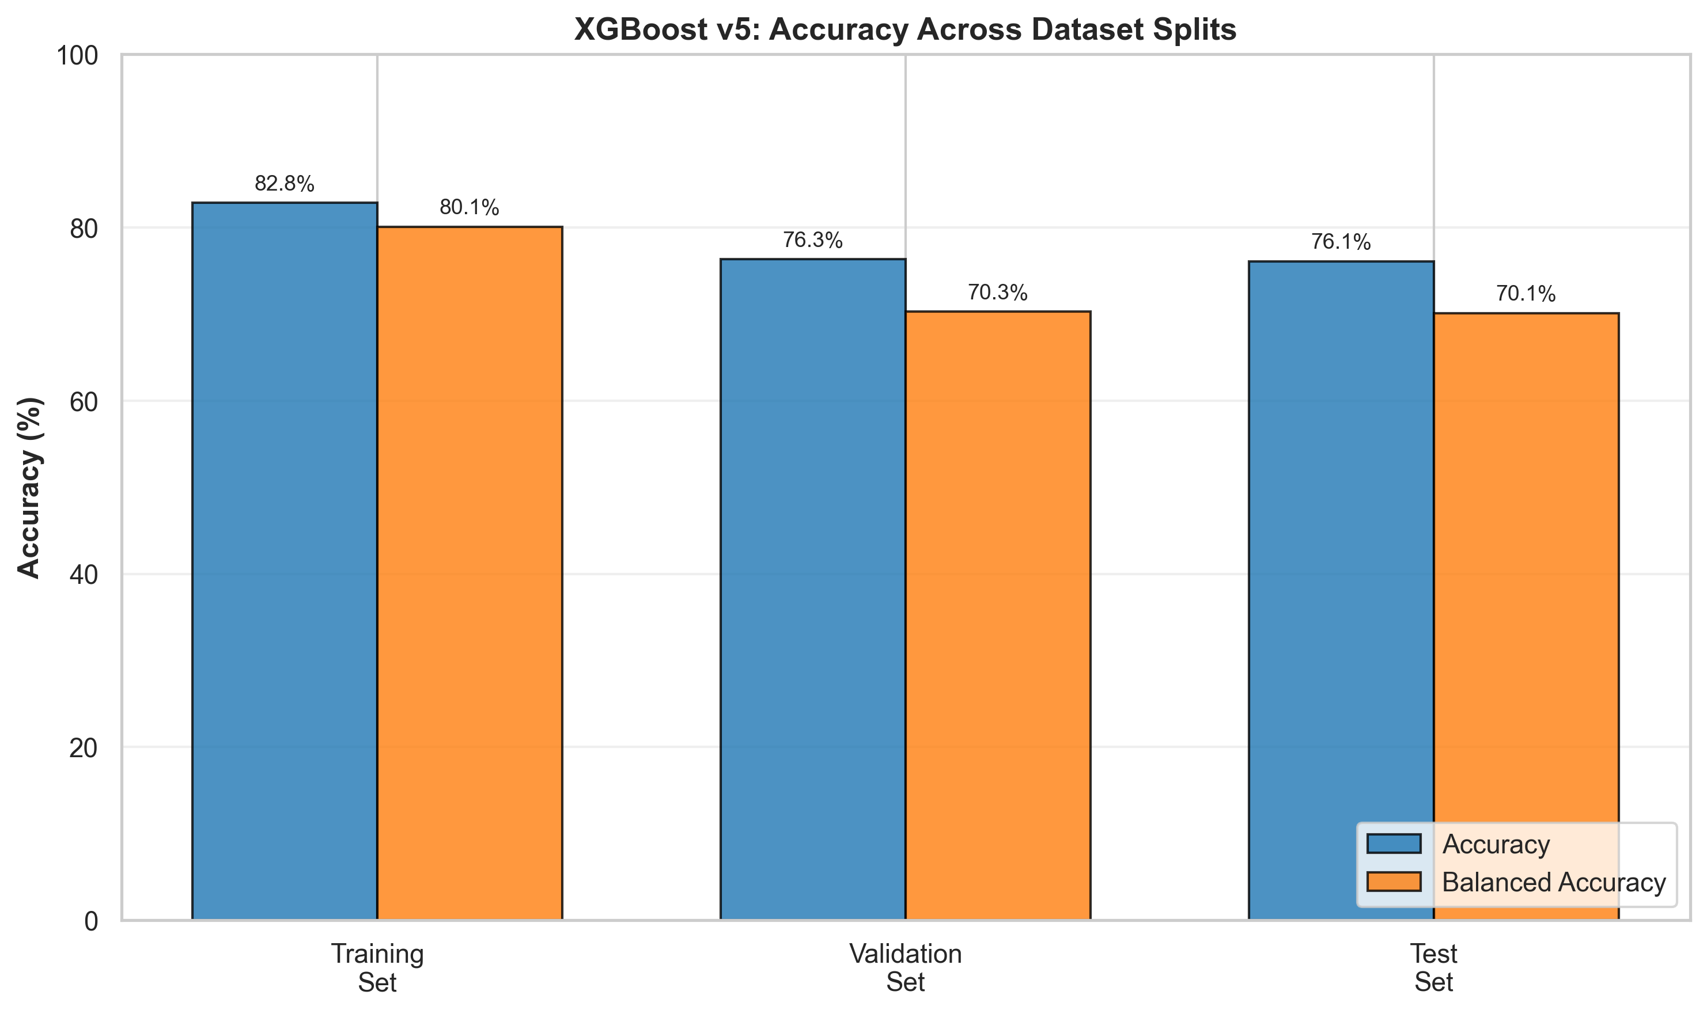
v5 Baseline Figure (Repo)
v5 test acc=0.7608, bal_acc=0.7012

Slide 5
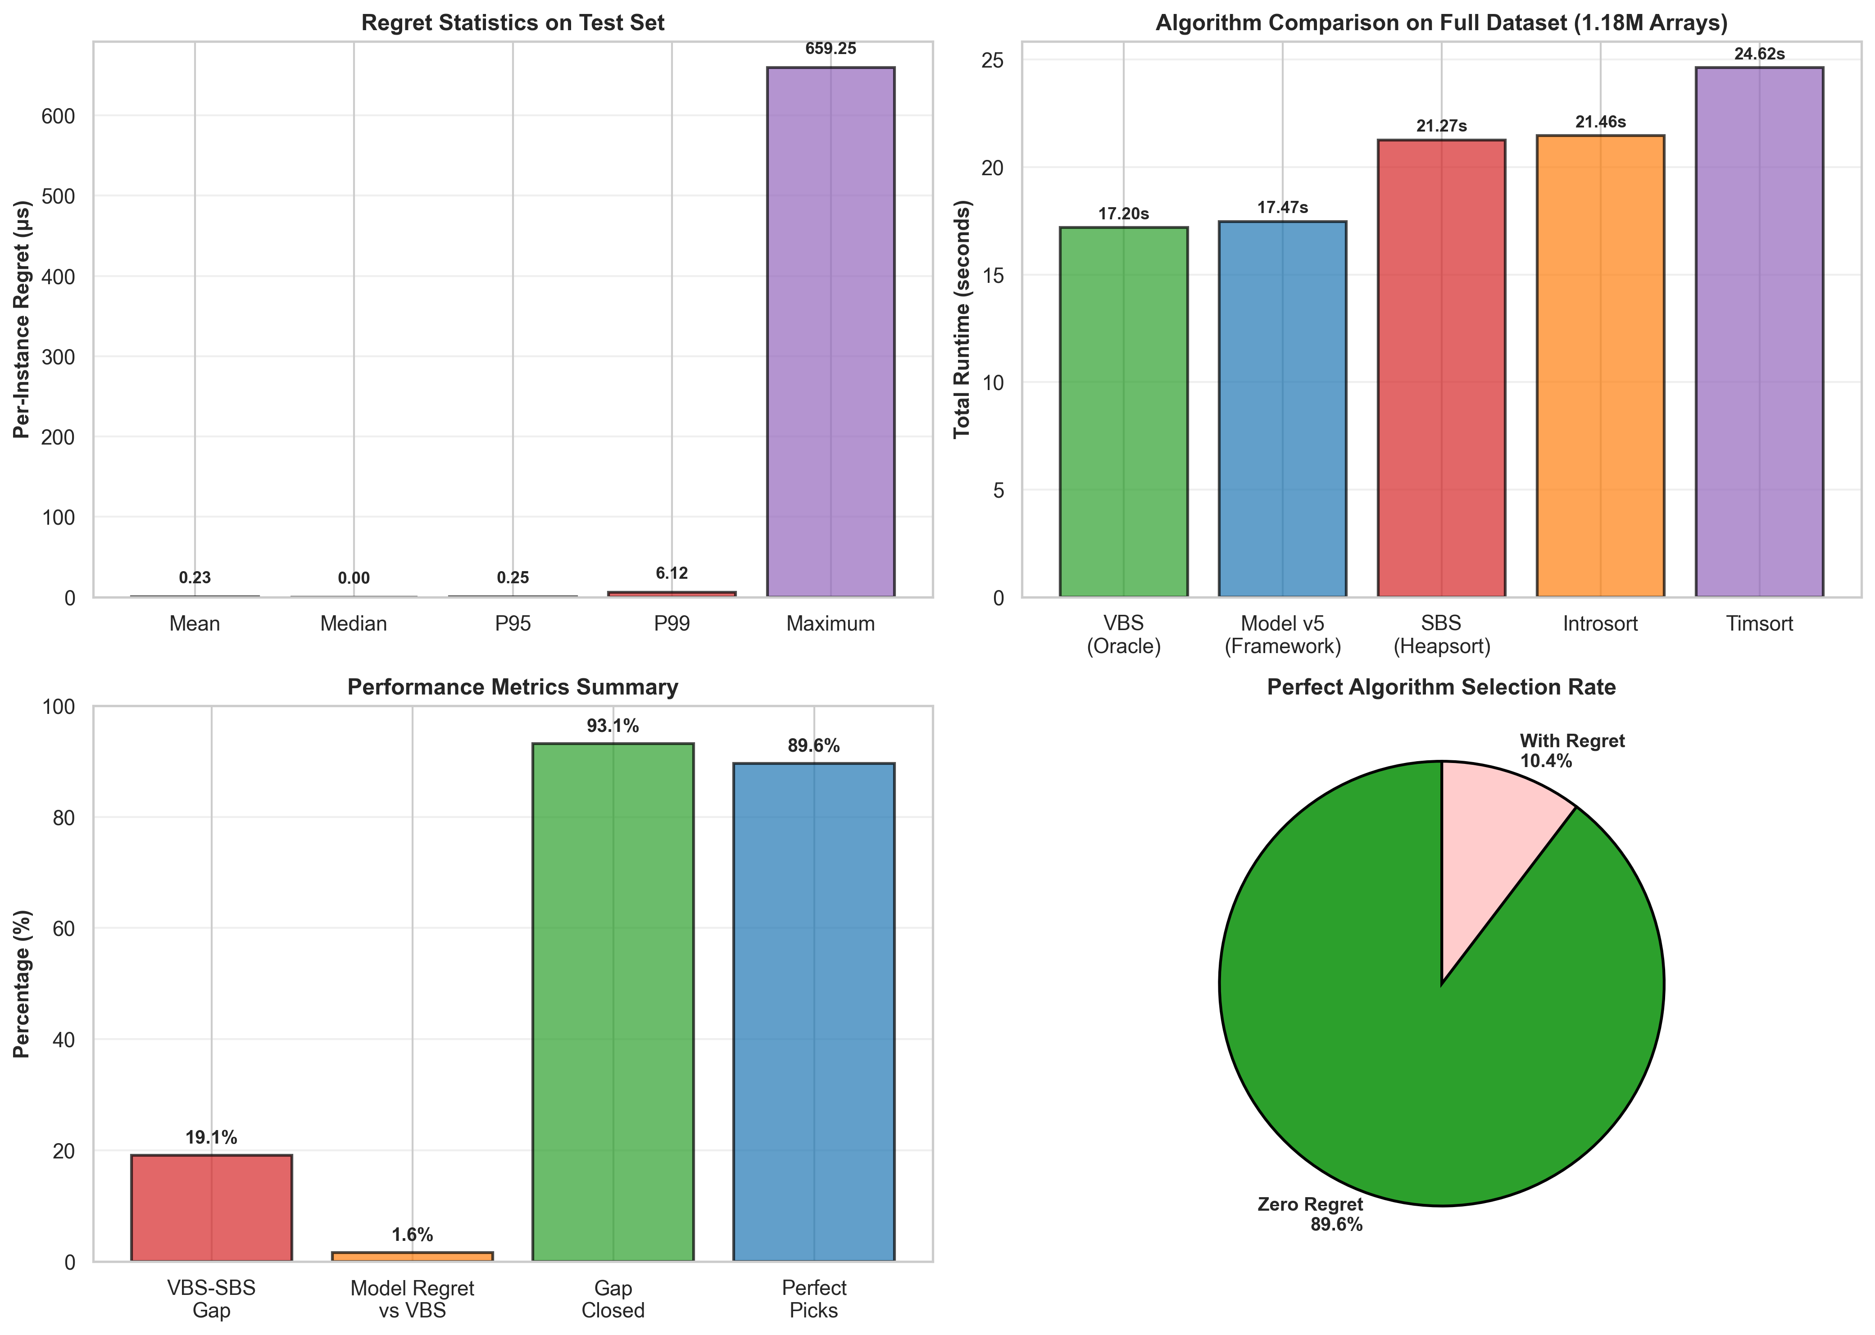
v5 Regret Figure (Repo)

Slide 6
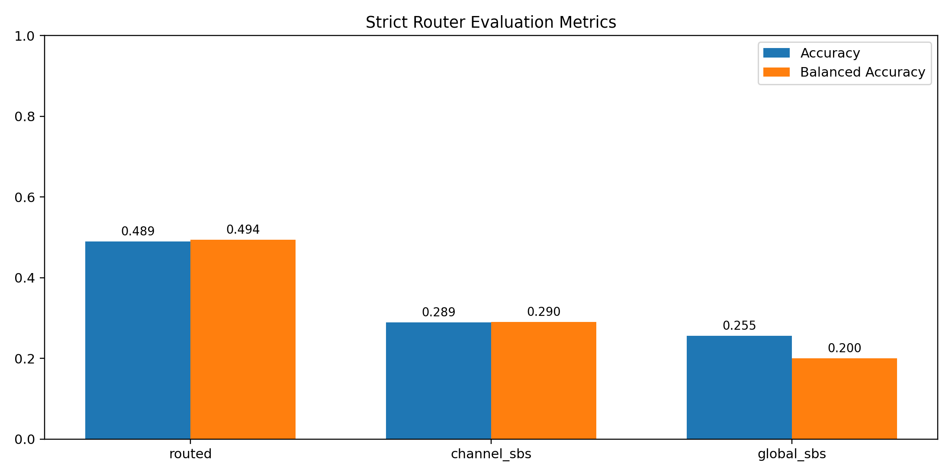
Strict Router Metrics (Generated from strict_router_eval.json)
Routed: acc=0.489, bal_acc=0.494
Channel_SBS: acc=0.289, bal_acc=0.290
Global_SBS: acc=0.255, bal_acc=0.200

Slide 7
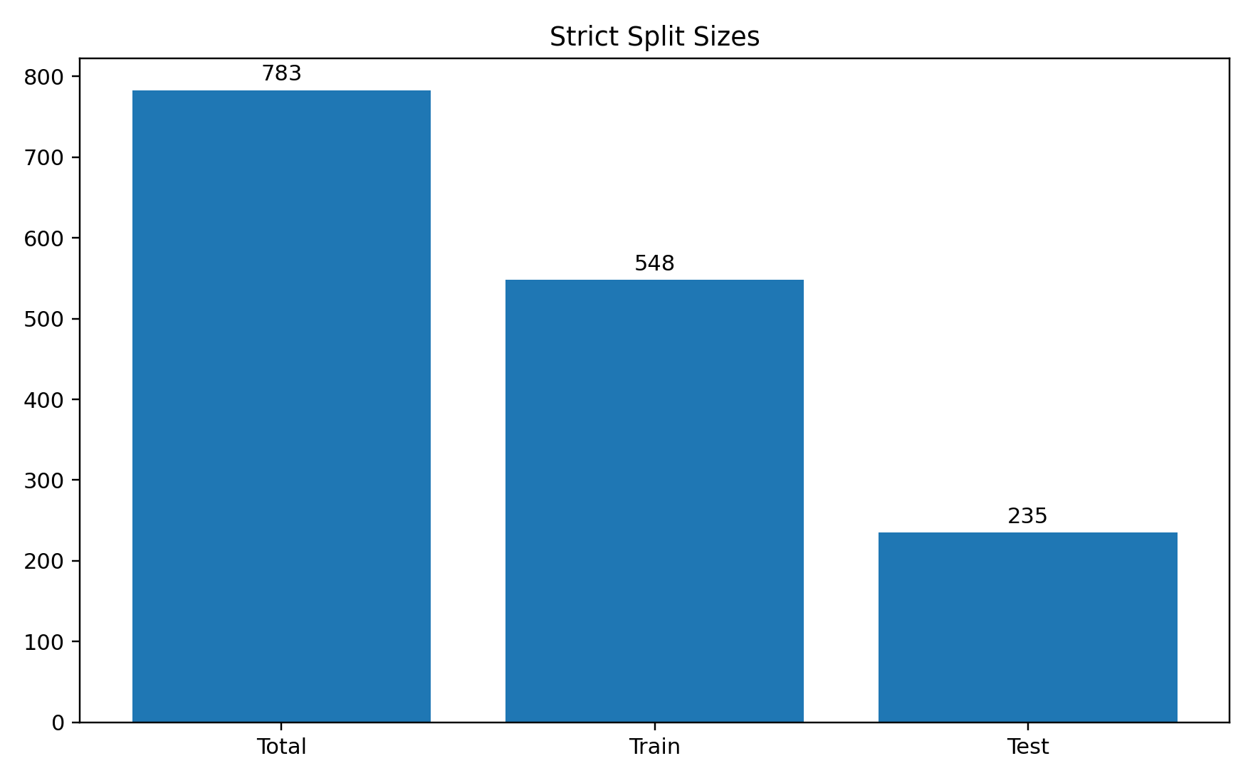
Strict Split Sizes (Generated from strict_router_eval.json)

Slide 8
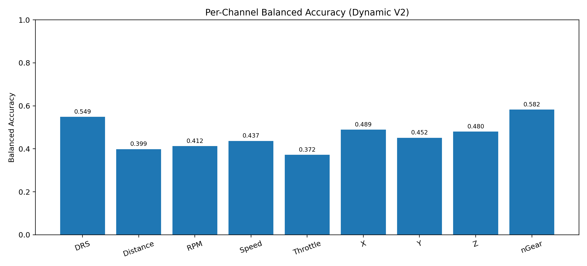
Per-Channel Balanced Accuracy (Dynamic V2 Manifest)

Slide 9
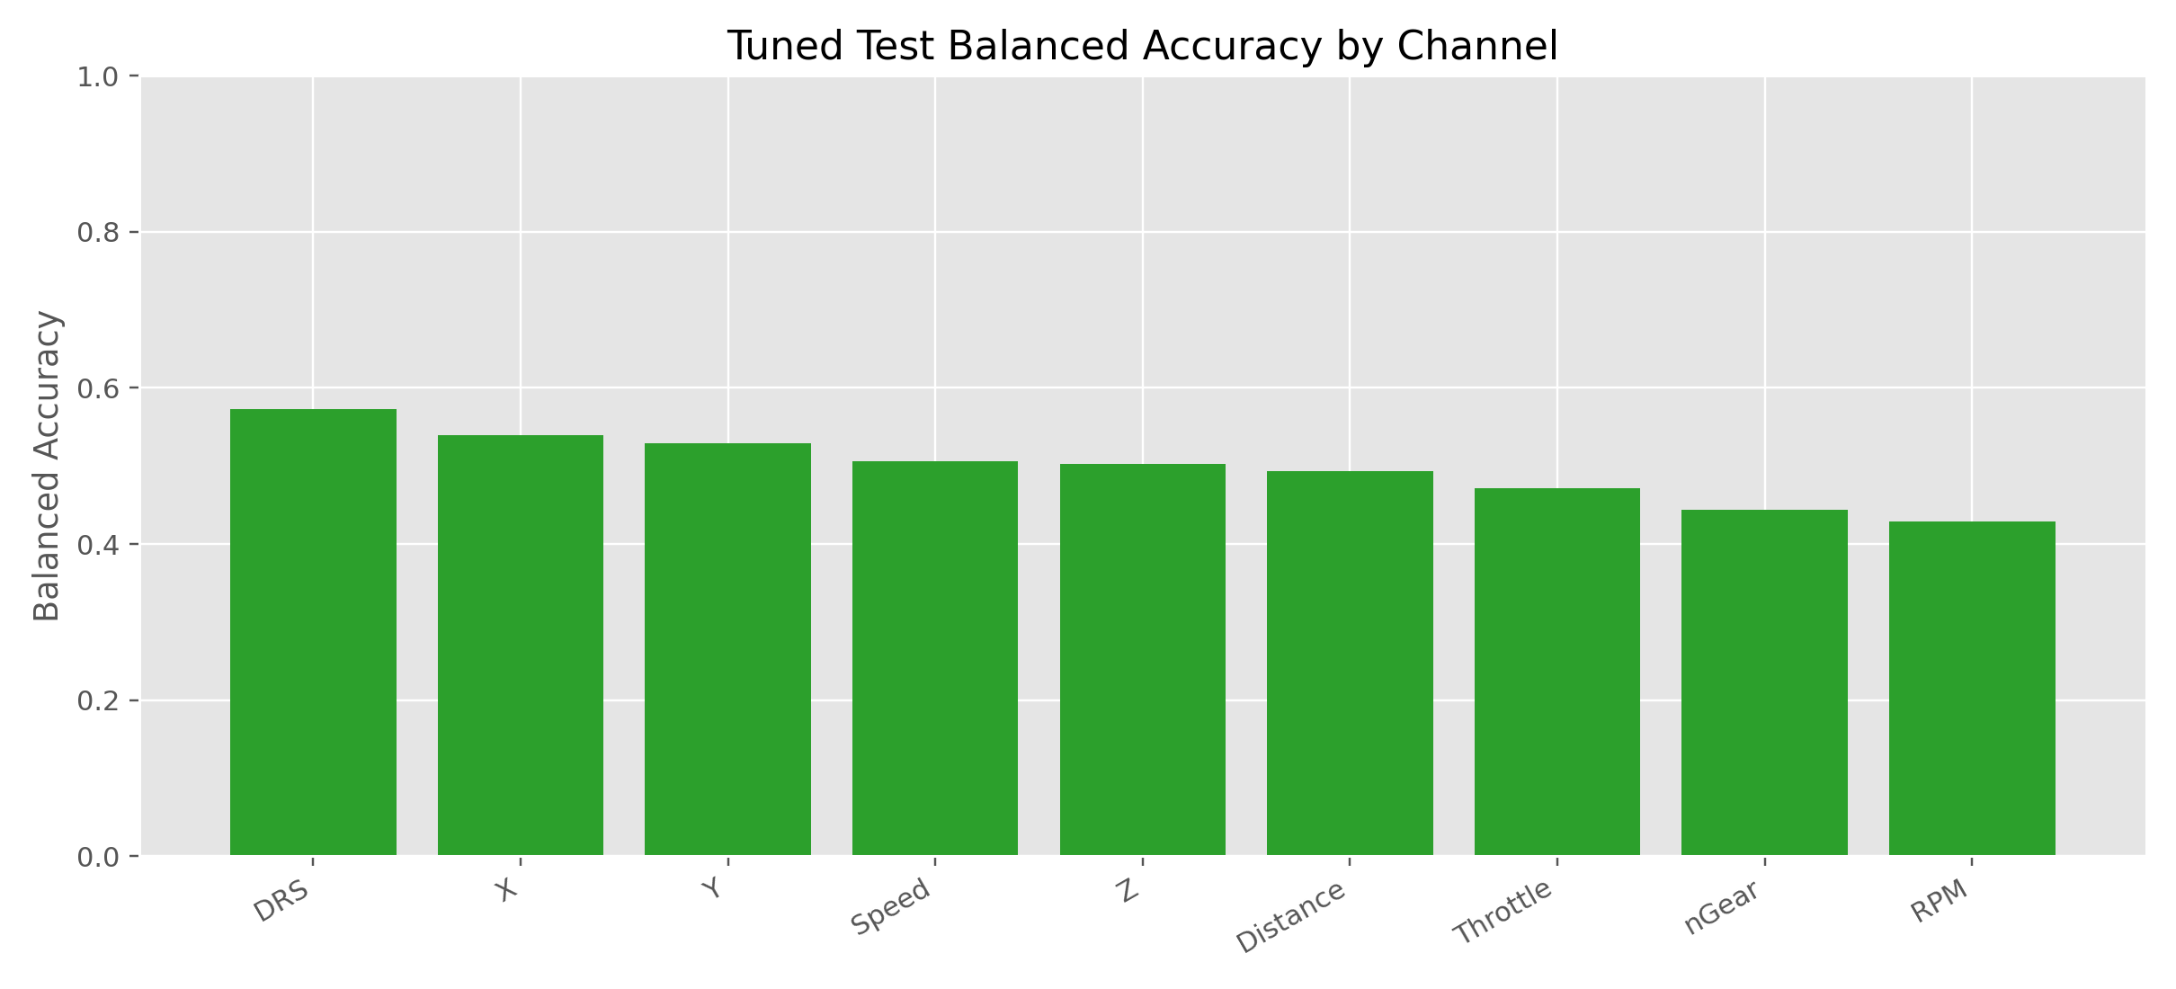
Optuna Figure (Repo)
Source: results/f1_9_channel_models_optuna/figures/00_balanced_accuracy_by_channel.png

Slide 10
Pilot Method Test (100k Relabel)
Relabel 100k completed; hard-case rows=6,970; hard-case balanced rows=1,865
Per-channel balancing on pilot reduced usable rows to 783
Strict pilot eval: routed acc=0.489, bal_acc=0.494 (still > baselines)

Slide 11
What Worked / What Did Not
Worked: dynamic routing beats both naive baselines under strict protocol
Did not work: gains remain modest vs strong v5 baseline level
Bottleneck confirmed: data retention after filtering/balancing, not hyperparameter tuning

Slide 12
Decision for Next Step
Main thesis baseline remains v5
New direction kept as exploratory extension with strict evidence
No large-scale reruns unless data-construction strategy changes

Slide 13
Optuna: Applied Exactly Where
Script: scripts/tune_f1_9_channel_models_optuna.py
Dataset: /Volumes/k/thesis_data/f1_only_1m_packed/training_dataset_algos_v2_hard_m0p05_balanced.csv
Channel source: /Volumes/k/thesis_data/f1_only_1m_packed/index.csv (join by file)
Scope: 9 separate channel models (DRS, Distance, RPM, Speed, Throttle, X, Y, Z, nGear)
Objective tuned: validation balanced accuracy (not plain accuracy)
Search backend: results/f1_9_channel_models_optuna/optuna_studies.db

Slide 14
Optuna: Exact Results from Repo
Trained channels: 9
Mean test accuracy: 0.536
Mean test balanced accuracy: 0.498
Best channel (bal_acc): DRS = 0.572
Worst channel (bal_acc): RPM = 0.429
Per-channel test_bal_acc:
DRS: test_bal_acc=0.572, test_acc=0.764, best_val_bal_acc=0.788
Distance: test_bal_acc=0.493, test_acc=0.541, best_val_bal_acc=0.544
RPM: test_bal_acc=0.429, test_acc=0.440, best_val_bal_acc=0.432
Speed: test_bal_acc=0.506, test_acc=0.426, best_val_bal_acc=0.527
Throttle: test_bal_acc=0.471, test_acc=0.438, best_val_bal_acc=0.570
X: test_bal_acc=0.539, test_acc=0.533, best_val_bal_acc=0.532
Y: test_bal_acc=0.530, test_acc=0.513, best_val_bal_acc=0.504
Z: test_bal_acc=0.502, test_acc=0.507, best_val_bal_acc=0.526
nGear: test_bal_acc=0.443, test_acc=0.662, best_val_bal_acc=0.693

Slide 15
Optuna Figure (Exact Repo Output)
Source: /Users/ahmed/Desktop/thesis/My-Master-thesis/results/f1_9_channel_models_optuna/figures/00_balanced_accuracy_by_channel.png

