Slide 1
F1 New Direction Update
All numbers and figures loaded from repository results files

Slide 2
What We Tested
Flag-aware routing: one model per channel
Dynamic class sets per channel (no impossible forced classes)
Strict protocol: split first, train on train only, test on untouched split

Slide 3
Strict Input / Output
Input dataset rows: total=783, train=548, test=235
Input features: array-structure features from training CSV
Output: one predicted best algorithm per test row

Slide 4
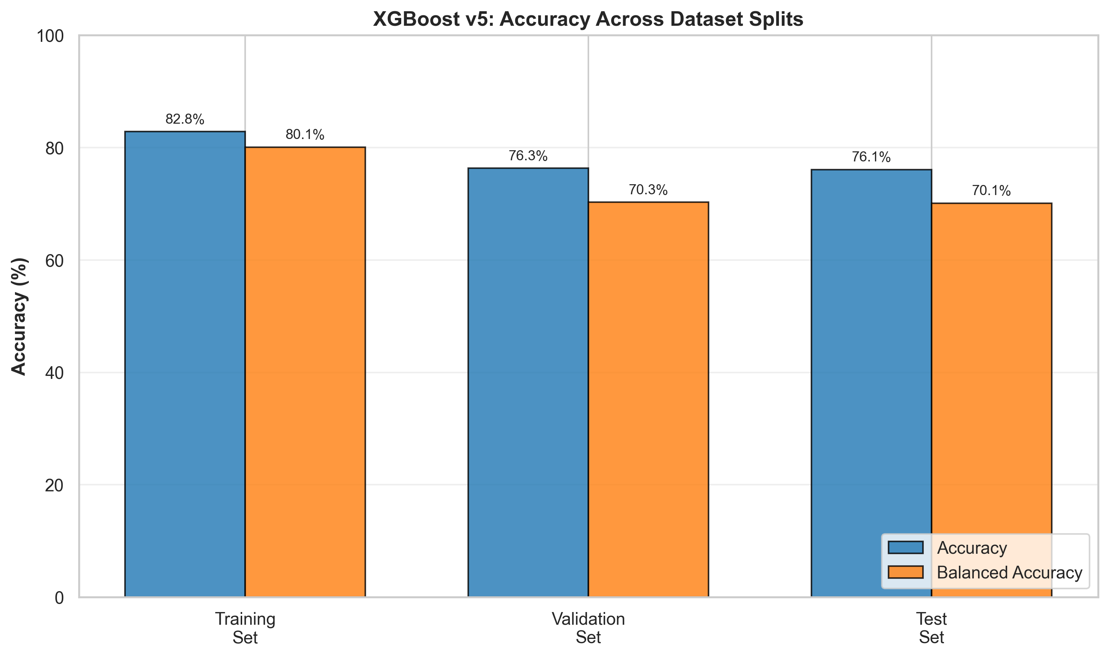
Baseline v5 Metrics (Repo Figure)
v5 test accuracy=0.7608
v5 test balanced_accuracy=0.7012

Slide 5
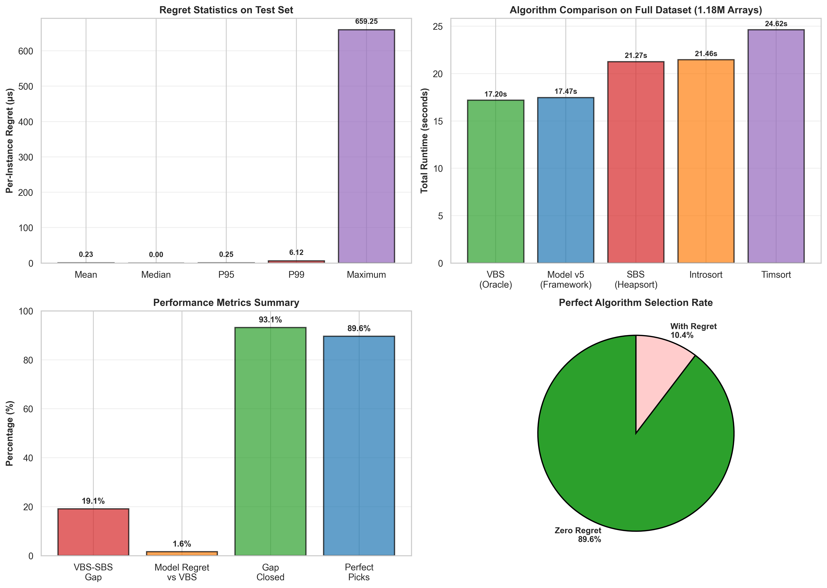
v5 Regret Figure (Repo Figure)
Figure source: results/thesis_figures/05_regret_analysis.png

Slide 6
New Direction Metrics (Strict)
Routed: acc=0.489, bal_acc=0.494
Channel_SBS: acc=0.289, bal_acc=0.290
Global_SBS: acc=0.255, bal_acc=0.200

Slide 7
Other Recorded Run (Non-Strict)
Router eval file: results/f1_9_channel_models_dynamic_v2/router_eval.json
Routed: acc=0.860, bal_acc=0.860
Used as reference only; strict score is decision metric

Slide 8
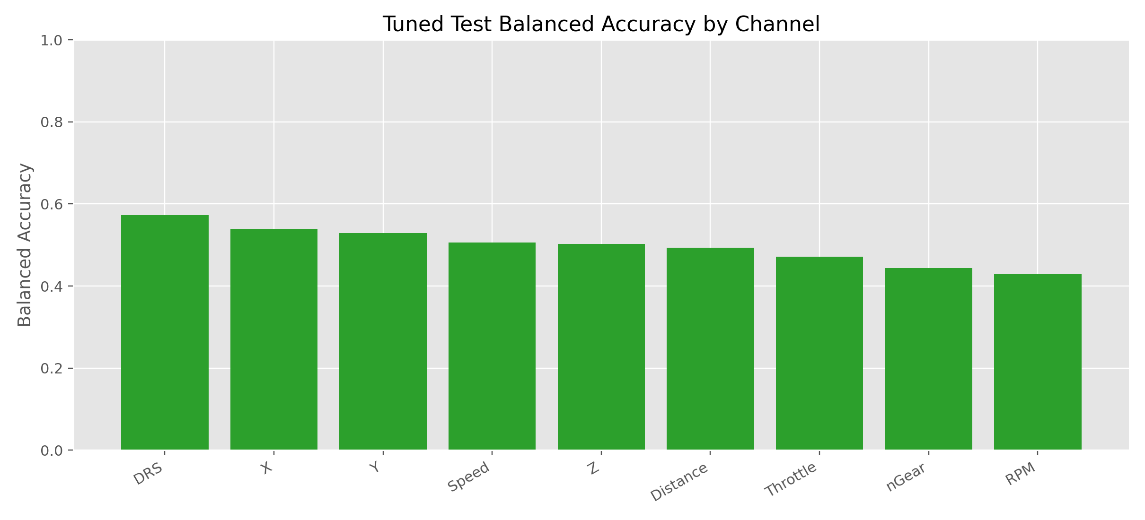
Optuna By-Channel Figure (Repo Figure)
Figure source: results/f1_9_channel_models_optuna/figures/00_balanced_accuracy_by_channel.png

Slide 9
Conclusion From Experiments
Dynamic routing beats naive baselines in strict setup
Current strict score remains moderate; data retention is bottleneck
Recommendation: keep v5 as main baseline, keep new direction as extension

