Slide 1

Enterprise Network
Infrastructure Project - Network Design and Implementation
by Ahmed Mahmoud & Hatem Said

Slide 2
Project Overview and Objectives
Project Scope
Design and implement a multi-layer enterprise network using Cisco devices covering user access, voice, server access, and internet connectivity.
Main Goals
Create a scalable and robust network supporting data, voice, and servers
Ensure high availability and redundancy at Layer 2 and Layer 3
Segment network with VLANs for security and performance
Provide secure and efficient internet access

Slide 3






Network Overview
Core
Routing & high-speed traffic
Distribution
Aggregation and control
Access
End device connection
This network uses a hierarchical design with three layers. Helps scalability, performance, and manageability.

Slide 4
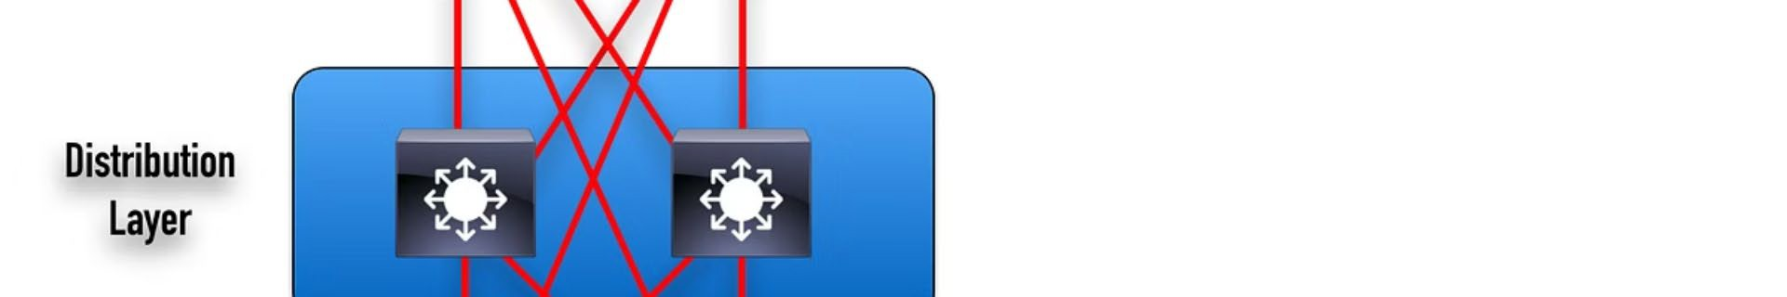

Network Topology - High Level
Access Layer
Connects end devices like PCs, printers, and IP phones using switches Switch0 to Switch15.
Distribution Layer
Aggregates access switches and provides inter-VLAN routing via multilayer switches MLS-1 and MLS-2.
Core Layer & Edge
Core switches CORE-SW-1 and CORE-SW-2 form the backbone; edge routers connect to external networks and internet.

Slide 5
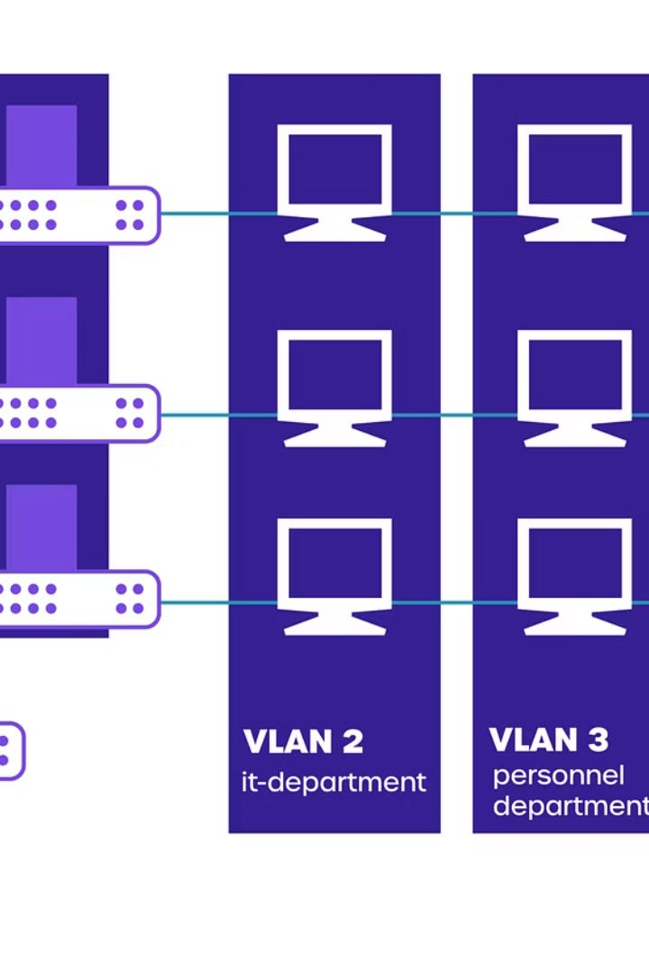



Network Segmentation with VLANs
Purpose of VLANs
Improve performance by reducing broadcast domains, enhance security by isolating traffic, and simplify management.
Key VLANs
VLAN 5: Printer
VLANs 10, 15, 25, 35, 50, 55: General Data
VLAN 20: Group A
VLAN 30, 40: Group B
VLAN 70: Voice
VLAN 80: Server
VLAN 100: General Purpose
VLAN Configuration
Defined VLANs isolate departments. Configuration Examples:
vlan 20 name HR vlan 30 name Finance

Slide 6



Switching Infrastructure
Access Layer Role
Provides network access to end devices with access ports assigned to VLANs and trunk ports
connecting to distribution switches.
Key Configurations:
2
Distribution Layer Role
Aggregates access traffic, performs inter-VLAN routing, and connects to core switches using multilayer switches MLS-1 and MLS-2.
Access ports assigned to specific VLANs
PortFast and BPDUGuard on access ports for fast and secure connections
Port security configurations to limit MAC addresses (if applied)
Configuration Examples:
interface f0/1 switchport access vlan 30 interface f0/2 switchport access vlan 20 Switch(config-if- range)#spanning-tree portfast Switch(config-if-range)#spanning-tree bpduguard enable
Key Configurations:
802.1Q trunking between access and distribution layers
Layer 3 interfaces (SVI) for inter-VLAN routing
Redundancy protocols like HSRP (discussed later)
Configuration Examples:
Switch(config)#interface range f0/4-7 Switch(config-if-range)#switchport mode trunk
Core Layer Role
Provides a high-speed, low-latency backbone interconnecting distribution layers for efficient traffic
flow. Manages routing and inter-VLAN traffic.
Devices Used:
Core switches CORE-SW-1 and CORE-SW-2 handle backbone connectivity and routing.
Key Configurations:
High-bandwidth links such as GigabitEthernet or EtherChannel
STP Root Bridge placement on core switches for critical VLANs to optimize traffic paths
Services and Management: Uses VLAN interfaces for routing and management.
Configuration Examples:
interface vlan 30 ip address 192.168.30.2 255.255.255.0 interface range f0/1-8 switchport trunk encapsulation dot1q switchport mode trunk interface range f0/1-2 channel-protocol pagp channel- group 1 mode desirable spanning-tree vlan 20,30,40,50 root primary interface vlan 20 ip address
192.168.20.2 255.255.255.0 standby 20 ip 192.168.20.1

Slide 7



Redundancy and High Availability
Spanning Tree Protocol (STP)
Prevents loops by allowing only one active path between devices, blocking redundant links to avoid broadcast storms. Uses PVST+ or Rapid PVST+ mode with root bridges strategically placed on core switches for traffic control.
EtherChannel
Bundles multiple physical links into one logical link, increasing bandwidth and providing link redundancy. Protocols used: PAgP (Cisco proprietary) and LACP (IEEE standard).
HSRP (High Availability)
Ensures a virtual gateway IP remains up. One router is active handling traffic; others are standby ready to take over if active fails.
Configuration Examples:
interface range f0/4-5 channel-group 1 mode desirable interface f0/3 switchport mode trunk spanning-tree portfast spanning-tree bpduguard enable HSRP configured on VLAN interfaces of MLS-1, MLS-2, MYGETWAY-ROUTER-1, and MYGETWAY-ROUTER-2 with priorities to determine active devices. Configuration Examples:
standby 20 ip 192.168.20.1 standby 20 priority 150 standby 20 preempt

Slide 8




Network Services and Routing
DHCP Relay Agent
In a switched network, DHCP clients cannot reach a DHCP server if it resides on a different subnet. To resolve this, a DHCP relay agent is configured on the Layer 3 interface of the VLAN. This forwards DHCP requests to the server across different subnets.
Benefits:
OSPF
Interior gateway protocol used for dynamic routing within the network using link-state advertisements.
Configured in Area 0 (backbone) on multiple routers, sharing routing info to build topology and calculate best paths.
Configuration Examples:
ip ospf 1 area 0 ip route 0.0.0.0 0.0.0.0
192.168.100.1 ip route 192.168.0.0
255.255.0.0 192.168.100.4 default-
information originate
Edge and Internet Connectivity
Edge Routers: Router0, Router1, MYGETWAY-ROUTER-1, and MYGETWAY-
ROUTER-2 connect internal network to external networks and internet.
NAT: NAT Overload (PAT) allows multiple private IPs to share public IPs for internet access.
Security Features: Access port protection and STP tuning.
Configuration Examples:
interface range f0/1-2 spanning-tree portfast spanning-tree bpduguard enable ip nat pool hatem 19.19.19.5 19.19.19.10 netmask 255.255.255.0 access-
list 10 permit 192.168.0.0 0.0.255.255 ip nat inside source list 10 pool hatem overload
interface g0/0 ip nat inside interface s0/3/0 ip nat outside
Centralized DHCP management
Reduces need for multiple DHCP servers
Ensures efficient IP distribution across VLANs
Configuration Examples:
interface vlan 20 ip address 192.168.20.2
255.255.255.0 ip helper-address 192.168.1.1

Slide 9




Network Security - Access Layer Protection
BPDUGuard
Protects the Spanning Tree Protocol (STP) topology. When enabled on a PortFast-configured interface, it shuts down the port if it receives a Bridge Protocol Data Unit (BPDU), preventing rogue switches from interfering with STP.
Port Security
Restricts input to an interface based on MAC addresses. It can limit the number of MAC addresses learned on a port or allow only specific MAC addresses.
NAT
Primarily used for IP address conservation and allowing multiple devices to share a public IP address for internet access. It also adds a layer of security by hiding the internal IP address scheme from the external network.
DHCP Snooping
(Not explicitly shown but common): Filters untrusted DHCP messages to prevent rogue DHCP servers.
Configuration Examples:
interface f0/1 switchport mode access switchport access vlan 20 switchport port-security switchport port-security maximum 5 switchport port-security violation shutdown switchport port-security mac-address sticky spanning-tree portfast spanning-tree bpduguard enable
NAT Overload (PAT): Allows many internal private IP addresses to be translated to a single public IP address using different port numbers. Configuration Examples:
ip nat pool hatem 19.19.19.5 19.19.19.10 netmask 255.255.255.0 access-list 10 permit 192.168.0.0 0.0.255.255 ip nat inside source list 10 pool hatem overload interface g0/0 ip nat inside interface s0/3/0 ip nat outside

Slide 10



Network Security - Access Control Lists (ACLs)
Traffic Filtering
Filtering specific types of traffic between networks.
Access Control
Controlling access to specific services.
Traffic Identification
Identifying traffic for various network services (e.g., QoS).
Extended ACLs are used to filter network traffic based on a wider range of criteria compared to standard ACLs, including source and destination IP addresses, protocols, and port numbers. They are essential for implementing granular security policies and controlling traffic flow.
Configuration Examples:
access-list 110 permit tcp 192.168.1.0 0.0.0.255 192.168.2.0 0.0.0.255 eq www access-list 110 deny ip any any
(Note: This example permits HTTP traffic from the 192.168.1.0/24 network to the 192.168.2.0/24 network and denies all other IP traffic.)

