Slide 1

EMG Team
Ahmed Yahya
Ayman Shaapan
Rawan Ali
Reham Abdelqader
Alaa Thabet
Mariam Muhammed

Slide 2
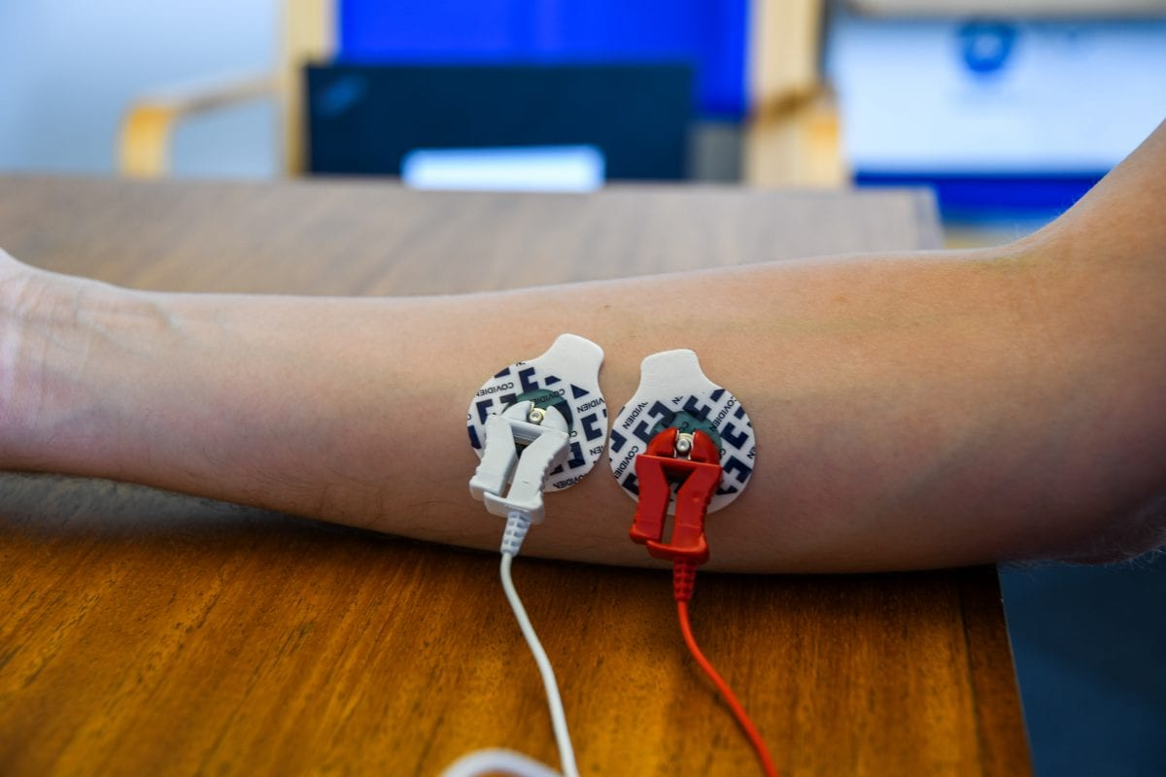
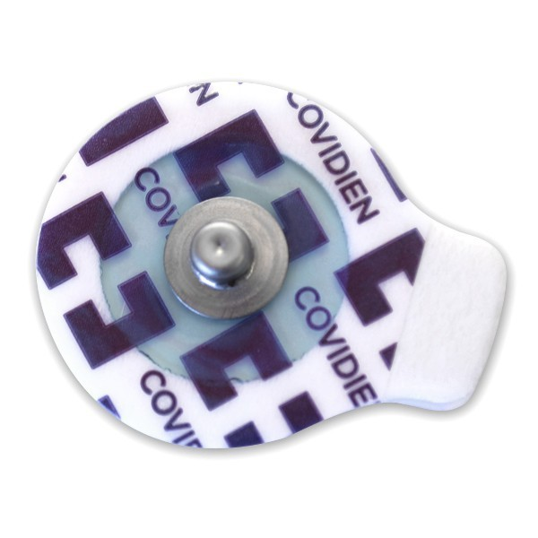
EMG Electrodes:
Electromyography (EMG) measures muscle response or electrical activity in response to a nerve's stimulation of the muscle. The test is used to help detect neuromuscular abnormalities.

Slide 3
Stages
Instrumentation (Signal Acquisition).
High-Pass Filter.
Low-Pass Filter.
Notch Filter(Fliege Filter).
Rectification Circuit.
Amplification Circuit.
Smoothing Stage.

Slide 4
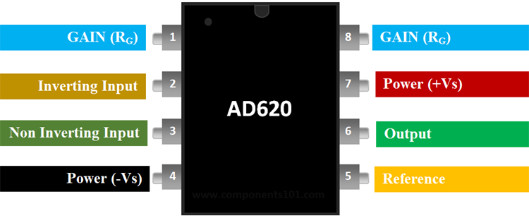
Data Sheet(AD620)
Product Details
The AD620 is a low cost, high accuracy instrumentation amplifier that requires only one external resistor to set gains of 1 to 10,000. Furthermore, the AD620 features 8-lead SOIC and DIP packaging that is smaller than discrete designs and offers lower power (only 1.3 mA max supply current), making it a good fit for battery powered, portable (or remote) applications.

Slide 5
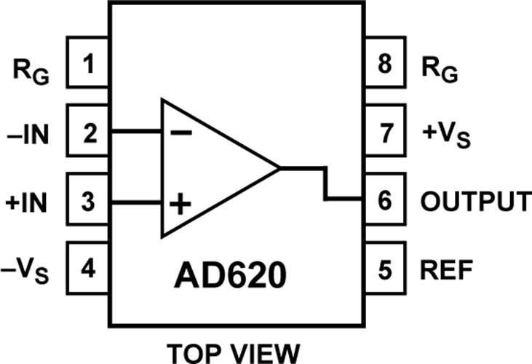
Where to use the AD620 Instrumentation Amplifier?
The AD620, with its high accuracy of 40 ppm maximum nonlinearity, low offset voltage of 50 μV max, and offset drift of 0.6 μV/°C max, is ideal for use in precision data acquisition systems, such as weigh scales and transducer interfaces. Furthermore, the low noise, low input bias current, and low power of the AD620 make it well suited for medical applications, such as ECG and non-invasive blood pressure monitors.
D620 Features & Specifications:
Power Supply Range: ±2.3 V to ±18 V
Max Supply Current: 1.3 mA
Input Offset Voltage: 50 μV
Bandwidth:120 kHz
Input Offset Drift: 0.6 μV/°C
Input Bias Current: 1.0 nA max
Available in 8-Pin PDIP,SOIC packages

Slide 6
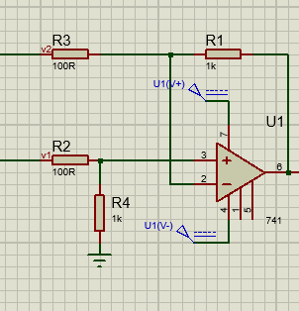
Applications of AD620
Weigh scales
ECG and medical instrumentation
Transducer interface
Data acquisition systems
Industrial process controls
Battery-powered and portable equipment
The formulae to calculate the value of gain from R is
G = (49.4 kΏ / RG) + 1
G = (49.4 kΏ / 50) + 1 ≌ 1000
Vin
Vout

Slide 7
Second order filters
Second Order or two-pole Filters consist of two RC filter sections connected together.
The Sallen-Key filter design is one of the most widely known and popular 2nd order filter designs.
Most active filters consist of only op-amps, resistors, and capacitors with the cut-off point being achieved using feedback eliminating the need for inductors as used in passive 1st-order filter circuits.

Slide 8
Second Order Low-Pass Filter
Second order low pass filters are easy to design and are used extensively in many applications
The filter design is based around a non-inverting op-amp configuration so the filters gain, a will always be greater than1,also the op-amp has a high input impedance which means that it can be easily cascaded with other active filter circuits to give more complex filter designs
This second order low pass filter circuit has two RC networks.

Slide 9
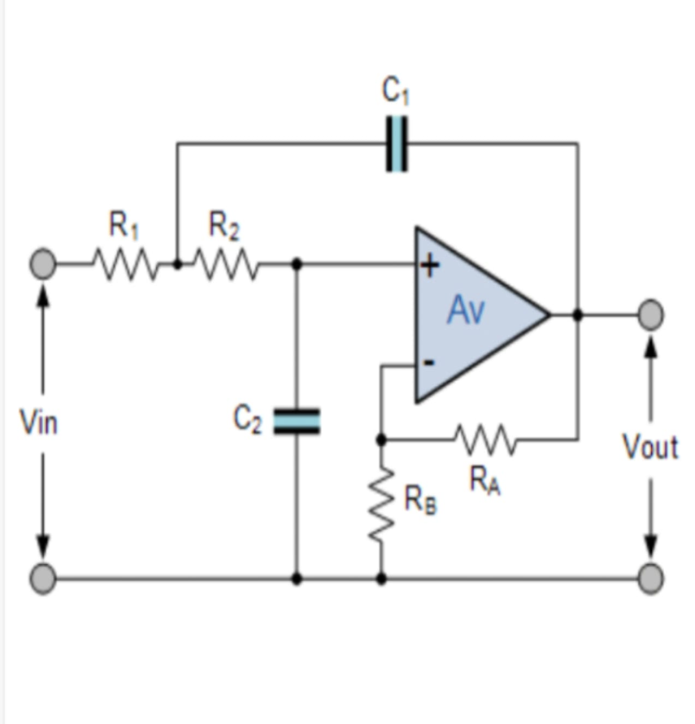
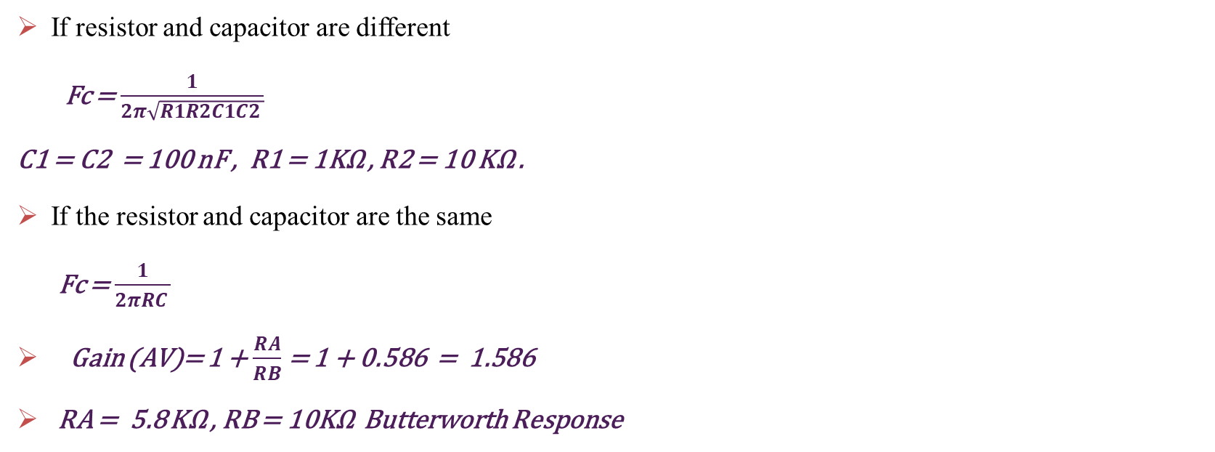
Low-Pass Circuit
If resistor and capacitor are different
Fc = $\frac{1}{2π\sqrt{R1R2C1C2 }}$
C1 = C2 = 100 nF , R1 = 1KΩ , R2 = 10 KΩ .
If the resistor and capacitor are the same
Fc = $\frac{1}{2πRC }$
Gain (AV)= 1 + $\frac{RA}{RB}$ = 1 + 0.586 = 1.586
RA = 5.8 KΩ , RB = 10KΩ Butterworth Response

Slide 10
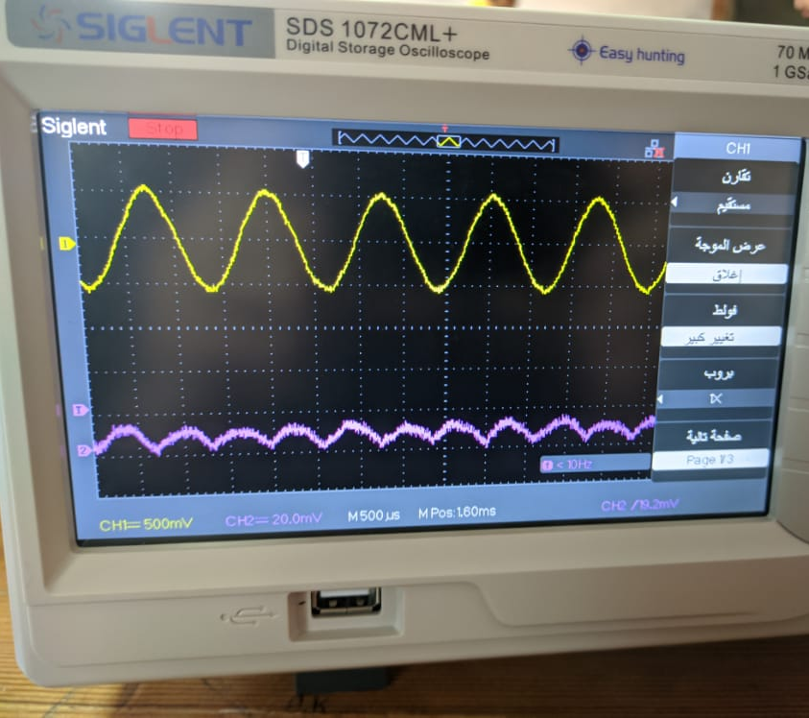
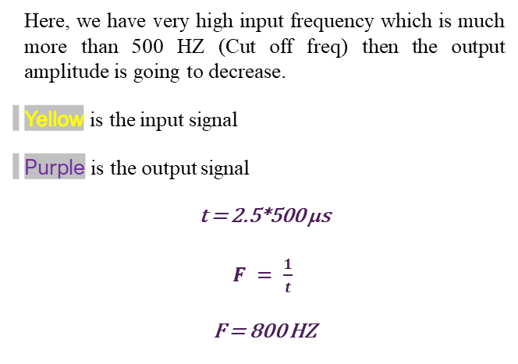
Low-pass filer
Here, we have very high input frequency which is much more than 500 HZ (Cut off freq) then the output amplitude is going to decrease.
Yellow is the input signal
Purple is the output signal
t = 2.5*500 μs
$F = \frac{1}{t}$
F = 800 HZ

Slide 11
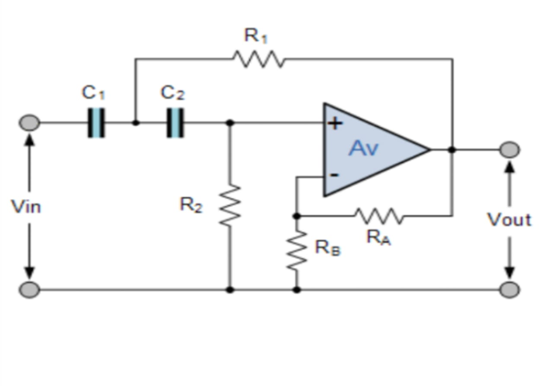
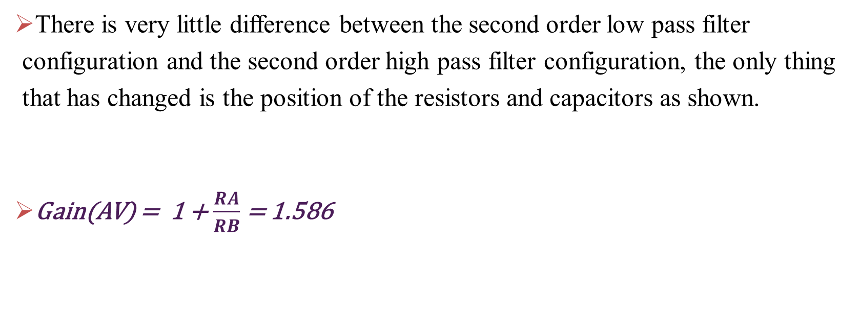
Second Order High-Pass Filter
There is very little difference between the second order low pass filter configuration and the second order high pass filter configuration, the only thing that has changed is the position of the resistors and capacitors as shown.
Gain(AV) = 1 + $\frac{RA}{RB}$ = 1.586

Slide 12

Second Order High-Pass Filter
If resistor and capacitor are different
Fc = $\frac{1}{2π\sqrt{R1R2C1C2 }}$
C1 = C2 = 100 nF , R1 = R2 = 80 KΩ .
If the resistor and capacitor are the same
Fc = $\frac{1}{2πRC }$
Gain (AV)= 1 + $\frac{RA}{RB}$

Slide 13
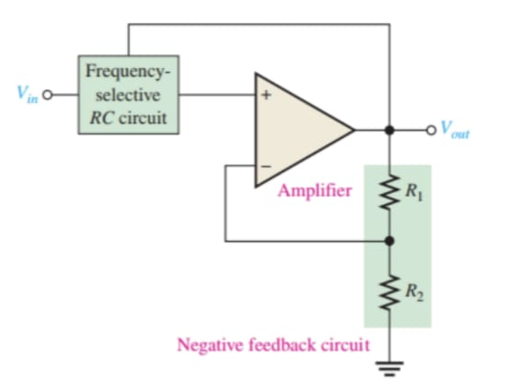
Damping factor
The damping factor (DF) of an active filter circuit determines which response characteristic the filter exhibits. It includes an amplifier, a negative feedback circuit, and a filter section. The amplifier and feedback are connected in a noninverting configuration.
The damping factor is determined by the negative feedback circuit.
DF = 2 - (R1/R2) = 2 - 0.586 = 1.414

Slide 14
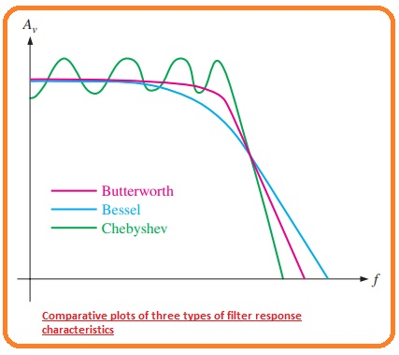
Butterworth Response
The values for the damping factor have been derived for various orders of filters to achieve the maximally flat response of the Butterworth characteristics.
The value of the damping factor required to produce a desired response characteristic depends on the order (number of poles) of the filter. A pole, for our purposes, is simply a circuit with one resistor and one capacitor.
The more poles a filter has, the faster its roll-off rate is , To achieve a second-order Butterworth response, for example, the damping factor must be 1.414.To implement this damping factor.
the feedback resistor ratio must be
R₁/ R₂ = 2 - DF = 2 - 1.414 = 0.586
This ratio gives the closed-loop gain of the noninverting amplifier portion of the filter, Acl(NI), a value of 1.586
Acl(NI)= 1 /B = 1 /(R₂(R₁ + R₂))
= ( R₁ + R₂)/ R₂ = R₁/ R₂ + 1 = 0.586 + 1 = 1.586

Slide 15
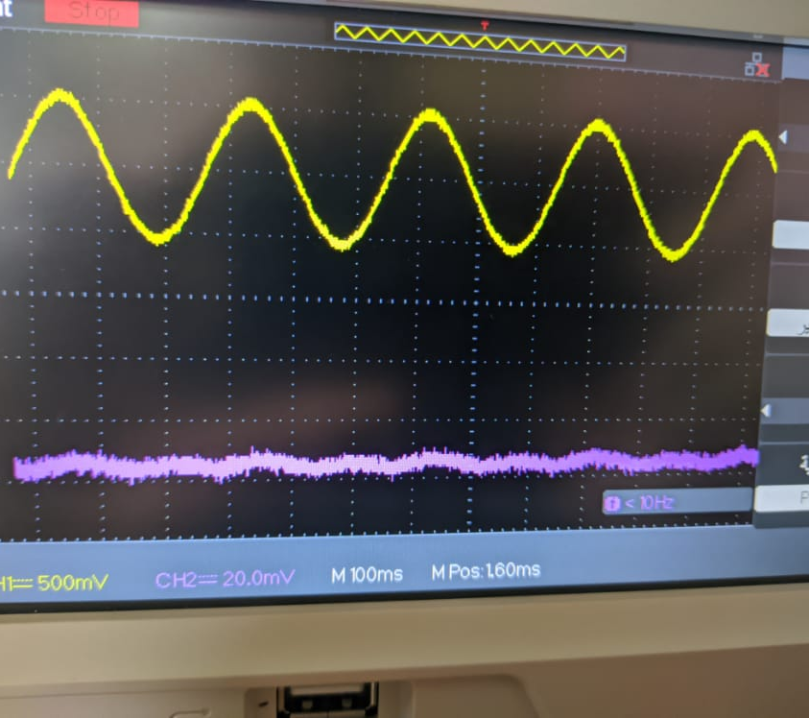
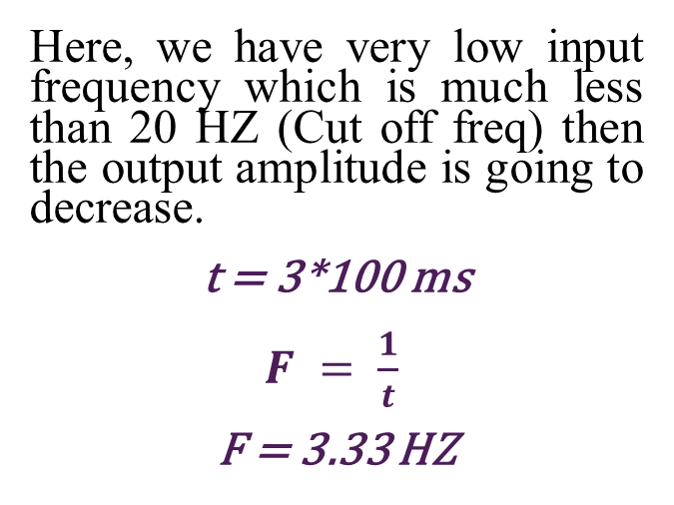
High-pass filer
Here, we have very low input frequency which is much less than 20 HZ (Cut off freq) then the output amplitude is going to decrease.
t = 3*100 ms
$F = \frac{1}{t}$
F = 3.33 HZ

Slide 16
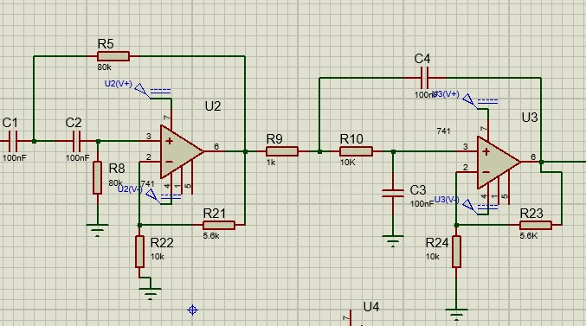
High & low pass filters
Simulation on Proteus
Vin
Vout

Slide 17
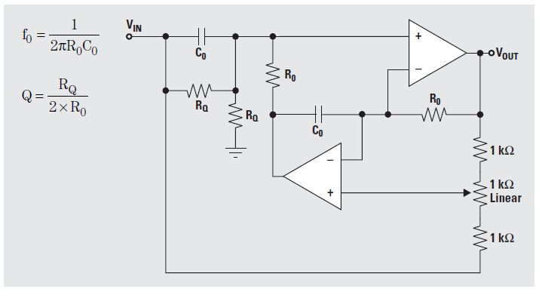


The Fliege Notch Filter
Figure(4) indicates the Fliege Notch filter design, which identifies a few distinct advantages when compared with the Twin-T counterpart, as narrated below:
F= 1/ 2πRC
$$f_{0}=\frac{1}{2πR_{0}c_{0}}$$
$$Q=\frac{R_{Q}}{2×R_{0}}$$
Figure(4)

Slide 18
It incorporates just a couple of precision components in the form of Rs and Cs in order to fulfill an accurate center frequency tuning.
One appreciable aspect about this design is that it allows slight inaccuracies within the components and the settings without affecting the depth of the notch point, although the center frequency could change a bit accordingly.
You'll find a couple of resistors responsible for determining the center frequency discretely whose values may not be extremely critical
The configuration enables the setting up of the center frequency with a reasonably narrow range without influencing the notch depth to a significant level.
However, the negative thing about this topology is its use of two op amps, and yet still it does not become usable with differential amplifiers.

Slide 19
The Fliege notch topology is shown in Figure 4. The advantages of this circuit over the twin-T are as follows:
Only four precision components—two Rs and two Cs—are required for tuning the center frequency. One nice feature of this circuit is that slight mismatches of components are okay—the center frequency will be affected, but not the notch depth.
The Q of the filter can be adjusted independently from the center frequency by using two noncritical resistors of the same value.
The center frequency of the filter can be adjusted over a narrow range without seriously eroding the depth of the notch.
Unfortunately, this circuit uses two op amps instead of one, and it cannot be implemented with a fully differential amplifier.

Slide 20
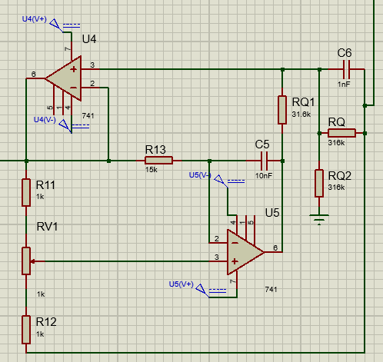
Fliege Filter
Vin
Simulation on Proteus
Vout

Slide 21
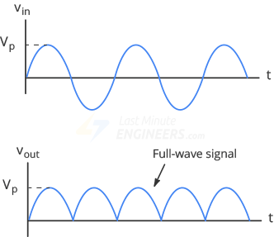
Rectification circuit
Since an EMG signal is not rhythmic in nature, typical signal processing involves rectification.
A full wave rectifier is used due to the muscle movement that has generated both the negative and positive value of the EMG signal.
If the half wave rectifier is used some information of the signal might be removed.

Slide 22
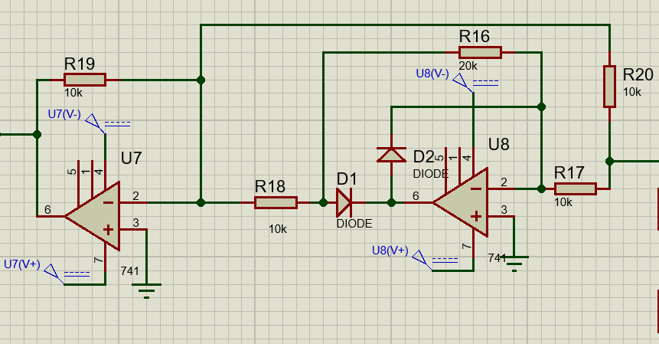
Rectification circuit
Simulation on Proteus
Vout
Vin

Slide 23
Amplification
The EMG signal, is very weak (1-10 mV). For certain muscles, for which the signal response is very strong, a gain of 500-1000 can be enough. But for muscles, whose EMG response is weak Flexor Palmaris Longus (ring finger muscle), the gain settings should be very high 10000.
The proper gain setting solely depends upon the signal response observed from the subject’s target muscle. It is to be noted that every subject gives a separate signal response. Some subjects will give weak responses as compared to others. So, in that case, appropriate gain value should be set once the subject’s EMG signal response is properly observed.

Slide 24
Non-inverting Amplifier
After the signal has been filtered properly and a suitable band of EMG frequency is obtained, the next stage is amplification. The EMG signal obtained must be powered up to a suitable level. The amplification of the EMG signal can be easily carried out with the help of a non-inverting amplifier.
The non-inverting amplifier is only used when the signal is being received from a single wire referenced to ground. Amplification can be done in stages in order to cater for chip requirements, by cascading them in series.

Slide 25
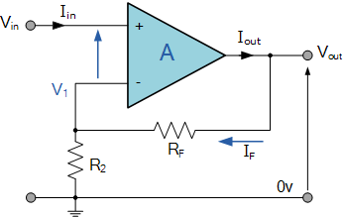

Non-inverting Op Amp
In this configuration, the input voltage signal(Filtered EMG), ( V_{IN} ) is applied directly to the non-inverting ( + ) input terminal which means that the output gain of the amplifier becomes “Positive” in value in contrast to the “Inverting Amplifier” circuit whose output gain is negative in value. The result of this is that the output signal is “in-phase” with the input signal.
The more Rf increase and R2 decrease, the more gain (Av) increase.

Slide 26
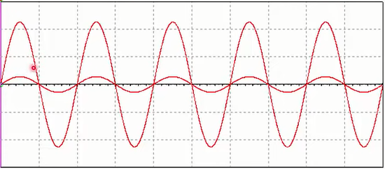
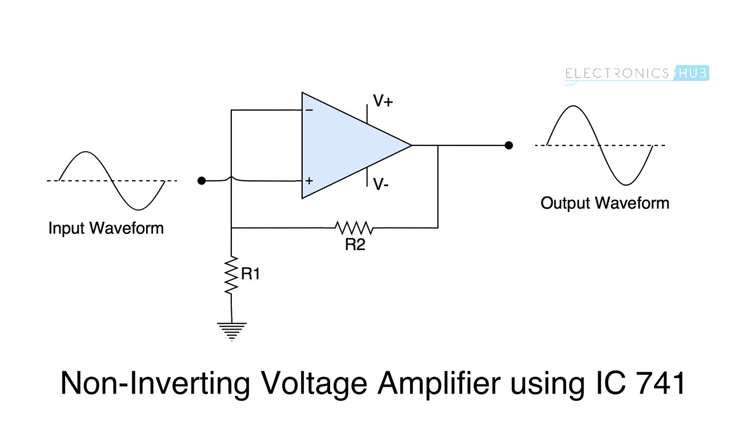
Before and after Gain
The figures show the difference between the input signal (signal before amplification), and the output signal (signal after amplification)

Slide 27
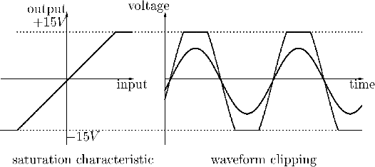
Saturation
It is happened when the gain is greater than the limit of OP Amp.
The limit of OP Amp is the difference between (+) and (-) of the power supply, so if the op amp is powered by (+15v) and (-15v), the gain should not increase than 30 times

Slide 28
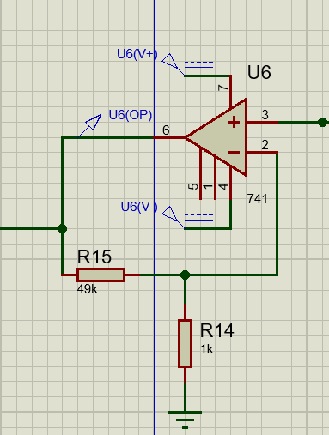
Proteus Simulation of the Amplification Circuit:
Rf = R15 = 49K
R2 = R14 = 1K
So, Gain A(v) = 1+ $\frac{RF}{R2}$
So, Gain A(v) = 1+ 𝑹𝑭/𝑹𝟐
A(v) = 1 + $\frac{49}{1}$= 50
A(v) = 1 + 𝟒𝟗/𝟏= 50
The input signal will be amplified by 50 times.
Vin
Vout

Slide 29
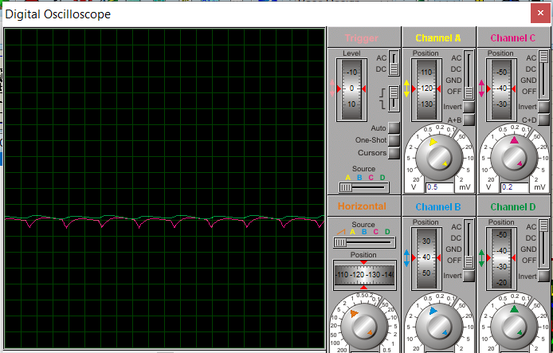
Smoothing Stage
For the smoothing process it is necessary to select a window to be used during the signal processing .This selection can influence the results in a biological phenomenon like electromechanical delay (EMD)? This study aims to analyze the influence of the smoothing processing on the quantification of an EMD.

Slide 30
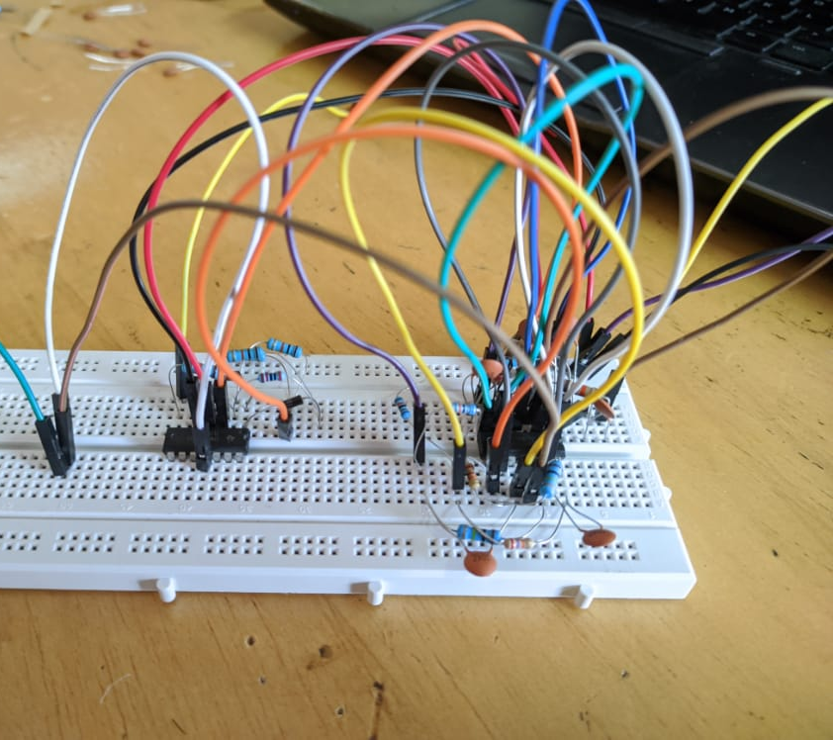
Circuit
These are our stages that we have been tested (Filters, Notch_Filter, Rectification Stages) using TL084.

Slide 31
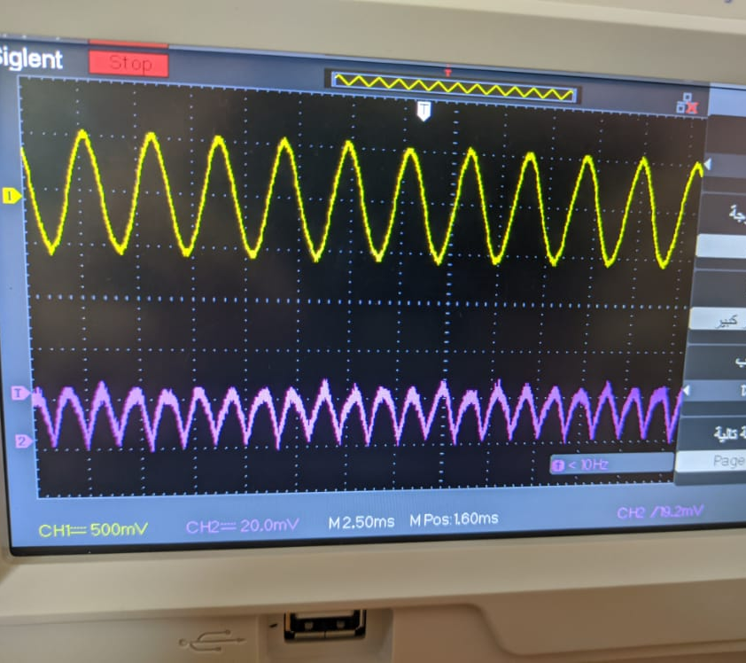
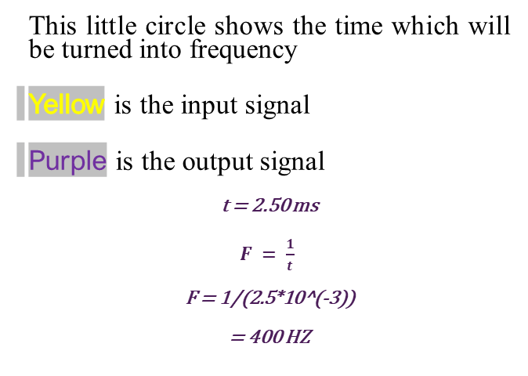
Test signal
This little circle shows the time which will be turned into frequency
Yellow is the input signal
Purple is the output signal
t = 2.50 ms
$F = \frac{1}{t}$
F = 1/(2.5*10^(-3))
= 400 HZ

Slide 32
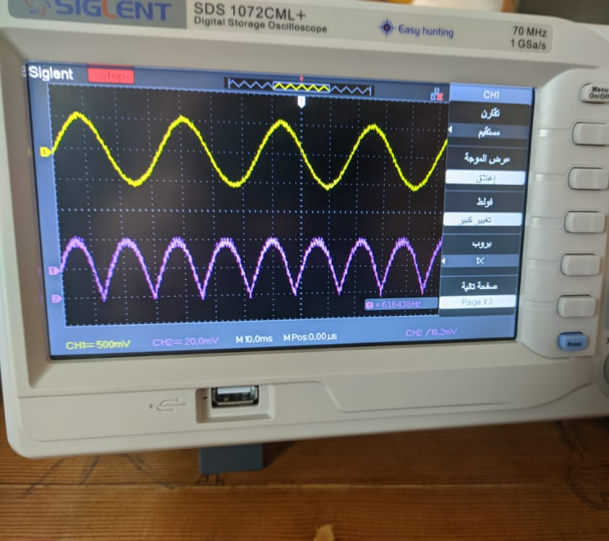
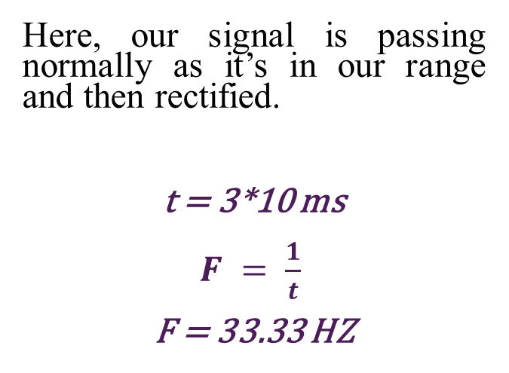
Test signal
Here, our signal is passing normally as it’s in our range and then rectified.
t = 3*10 ms
$F = \frac{1}{t}$
F = 33.33 HZ

Slide 33
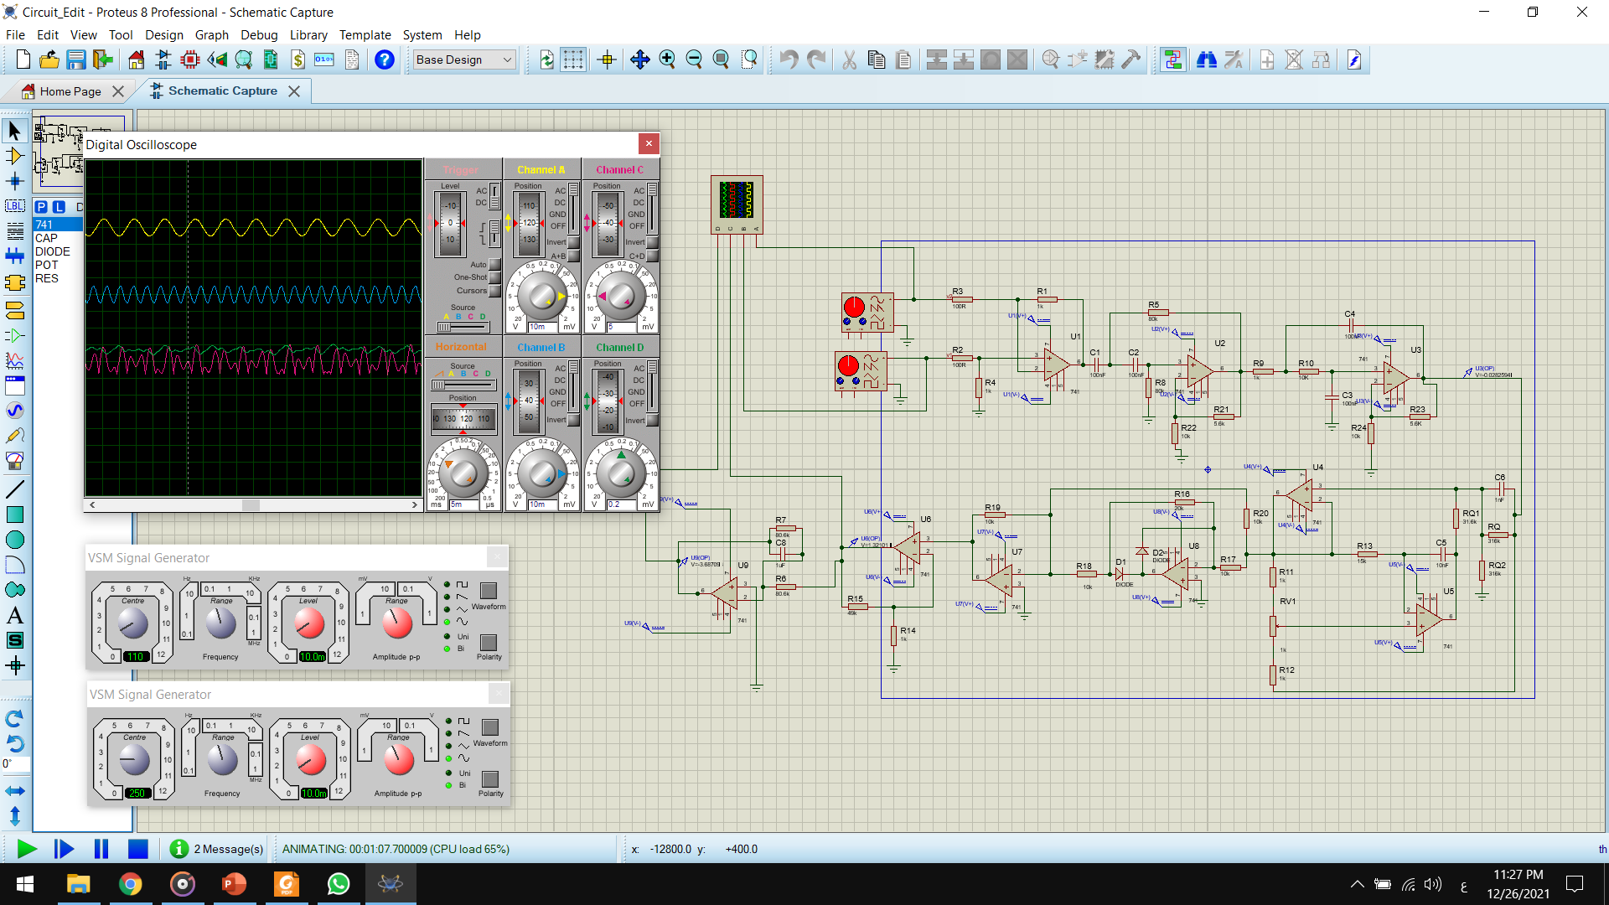

Slide 34
The End

