Slide 1
Department of Computer Science National University of Sciences & Technology (NUST)
Course Code: CS-315 – Cloud Computing
Autoscaling Stream ETL & Window Aggregation with Spark Structured Streaming
Ahmed Yar, Humayun Junaid, Muhammad Asjad Kashif

Slide 2


The Big Data Dilemma: Static Infrastructure Challenges
Resource Wastage
Performance Bottlenecks
Static infrastructure leads to over-provisioning during low traffic, resulting in significant cloud costs.
Under-provisioning causes high latency and potential data loss during traffic spikes, impacting real-time insights.
Traditional batch processing systems struggle with real-time demands, while static streaming systems face a financial and performance trade-off. Our project addresses these critical issues.

Slide 3

Our Solution: Dynamic Allocation for Stream ETL
We implemented a robust, real-time streaming pipeline using Apache Spark Structured Streaming and Apache Kafka to demonstrate infrastructure elasticity.
Stream ETL Job
Designed an Extract, Transform, Load (ETL) job for efficient data processing.
Spark Dynamic Allocation
Leveraged Spark's dynamic allocation to automatically provision or release executors based on task backlog.
Optimal Resource Utilization
Ensured resources are scaled up during load spikes and scaled down during idle periods, maximizing efficiency and cost savings.

Slide 4
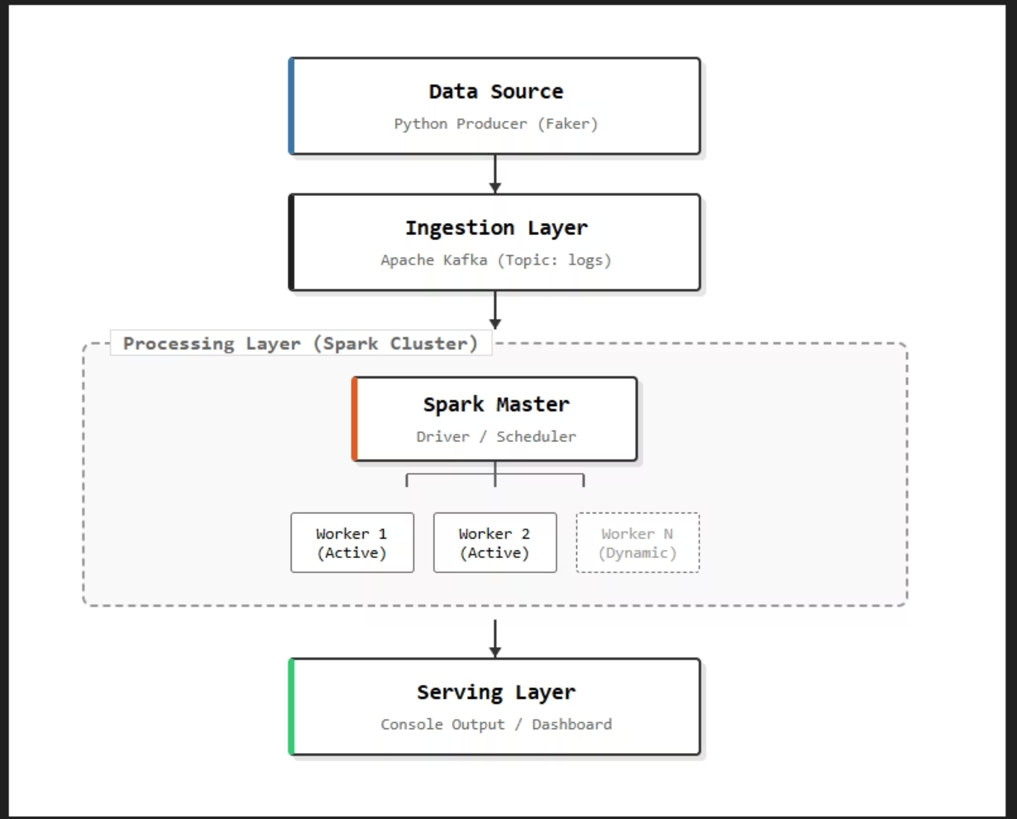
System Architecture Overview
Our pipeline is structured into three distinct stages: Data Ingestion, Real-time Processing, and eventual Visualization (not covered in detail here).
This modular design allows for clear separation of concerns and efficient handling of streaming data at each step.

Slide 5

Data Ingestion: Apache Kafka
The ingestion layer serves as the critical entry point for our streaming data, providing a high-throughput and fault-tolerant buffer.
Message Broker: Apache Kafka acts as a central nervous system for our data, decoupling data generation from subsequent processing stages.
High Throughput Buffer: It efficiently handles large volumes of incoming data, ensuring no data is lost even during peak loads.
Topic: Simulated real-time logs from Computer Science students are pushed to a dedicated Kafka topic named cs_student_logs.
Decoupling: Kafka effectively separates the data producers from consumers, providing flexibility and resilience to the overall system.

Slide 6

Processing Layer: Spark Structured Streaming
Apache Spark Structured Streaming forms the core of our real-time data processing engine, enabling sophisticated analytics on continuous data streams.
Engine: Apache Spark 3.5.0 (PySpark) is utilized for its powerful streaming capabilities.
Read: Continuously consumes data from the Kafka cs_student_logs topic.
Parse: Converts incoming JSON strings into a structured schema, preparing data for analysis.
Watermarking: Implemented with a 1-minute threshold to gracefully handle late-arriving data and ensure data consistency.
Aggregation: Performs a 10-second tumbling window aggregation, calculating metrics like "Total Lines of Code" and "Average CPU Usage" grouped by Course.

Slide 7
Autoscaling Mechanism: Spark Dynamic Allocation
The project's highlight is the implementation of Spark Dynamic Allocation, ensuring resource efficiency and cost optimization.
1
2
Enable Dynamic Allocation
Minimum Executors
spark.dynamicAllocation.enabled: True — Activates the autoscaling feature.
spark.dynamicAllocation.minExecutors: 0 — Allows scaling down to zero executors when the cluster is idle, saving costs.
3
4
Maximum Executors
Rapid Scaling Trigger
spark.dynamicAllocation.maxExecutors: 4 — Sets an upper limit to prevent infinite resource consumption during extreme load.
spark.dynamicAllocation.schedulerBacklogTimeout: 1s — Ensures quick scaling up in response to increased task backlog.
These parameters enable the system to automatically adjust computing resources based on real-time demand.

Slide 8
Experimental Results: Autoscaling Demonstration
To validate the system's elasticity, a load test was conducted, simulating varying traffic conditions.
Baseline
Load Spike
System runs with 1 producer, steady input rate (~10 ev/sec), utilizing 1 Spark Executor. Stable processing observed.
3 additional producers launched, increasing input rate by 300% (~40 ev/sec). Backlog grows, triggering executor scaling.
Scaling Up
Cooldown
Dynamic Allocation adds 3 new executors, reaching a total of 4. System adapts to increased load.
Additional producers stopped, input rate returns to baseline. Executors scale down to 1 after a timeout.

Slide 9
Cost Analysis: Autoscaling vs. Static Cluster
A comparison of estimated costs on AWS EMR highlights the significant financial benefits of dynamic allocation.
Static Cluster Strategy
Autoscaling Strategy
Running 4 m5.xlarge instances for 24 hours daily, regardless of load:
Running 1 instance for 20 hours (low traffic) and scaling to 4 instances for 4 hours (peak traffic):
24 hrs × 4 instances = 96 instance-hours/day
(1 × 20) + (4 × 4) = 36 instance-hours/day
This represents a constant, high cost even during periods of low activity.
This dynamic approach aligns resource usage with actual demand.
Result: 62.5% Cost Reduction
In this specific scenario, autoscaling dramatically reduces operational costs by optimizing resource allocation.

Slide 10



Conclusion & Outlook
Our project successfully demonstrated the power of Spark Structured Streaming combined with Dynamic Allocation for efficient and cost-effective real-time ETL.
Real-time ETL Success
Spark Structured Streaming efficiently handled continuous data streams and complex aggregations.
Achieved Elasticity
Dynamic Allocation maintained low latency during high traffic while minimizing resource usage during low traffic periods.
Cost-Effective Approach
This architecture offers a modern and economical solution for Big Data processing in cloud environments.
This approach paves the way for scalable, resilient, and budget-friendly data pipelines in the cloud era.

