Slide 1
REAL ESTATE Rental Company
Your key to comfortable living

Slide 2
OUR COMPANY
Finding the perfect rental real estate can be a complicated task, if you have to do it yourself. Our real estate software application helps real estate owners and renters mange their properties
efficiently.
MYHOME
REAL ESTATE

Slide 3
Definition
The “Real estate rental Company” is being developed for tenants and owners to buy, sell, or find anything in their community.
In this community, goods are redistributed to fill new needs and become wanted another time, where these products are offered, sell, rented and all process within ways don’t require centralized institutions or middlemen.
This is what this application does, it provides more good opportunities for the owner and the tenant, replacing the lack of visual advertising on the streets and main roads and the tenants in ability to reach what he desired, and the owner’s failure to sell or rent more properties, which leads to some losses to the owners.
This application is considered a good intermediary and advertiser between the owner and the tenant.

Slide 4
Problem definition:
Difficulty reaching a buyer or tenant
Difficulty finding a location, price, space, and features that are suitable for the buyer or tenant, which leads to the tenant or buyer not reaching what they want
Lack of trust and non-compliance with the laws and conditions agreed upon between the contracting parties

Slide 5
System objective
Build an integrated system that meets the needs of owners and tenants.
Provide good and frequent opportunities for owners to reach tenants and vice versa.
Make it easy for tenants to find what they want by specifying all the features they want.
Guarantee compliance with the laws and agreed conditions and prevent the loss of the rights of owners and tenants.

Slide 6
Abstract
This project focuses on providing management to real estate
agencies, commercial construction companies or property
management company. This helps customer to save time & get
Right business solution for problems.

Slide 7
GUIDING GUI
Hello page
Manage the unit info
Search for real estate
rent real estate
Login

Slide 8
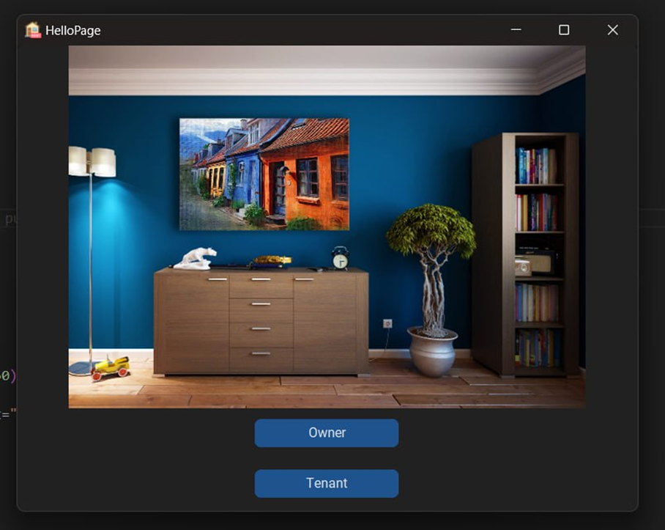
First, our application starts by
Choosing who will deal with this
software application by selecting
between two choices which are Owner
or tenant.

Slide 9
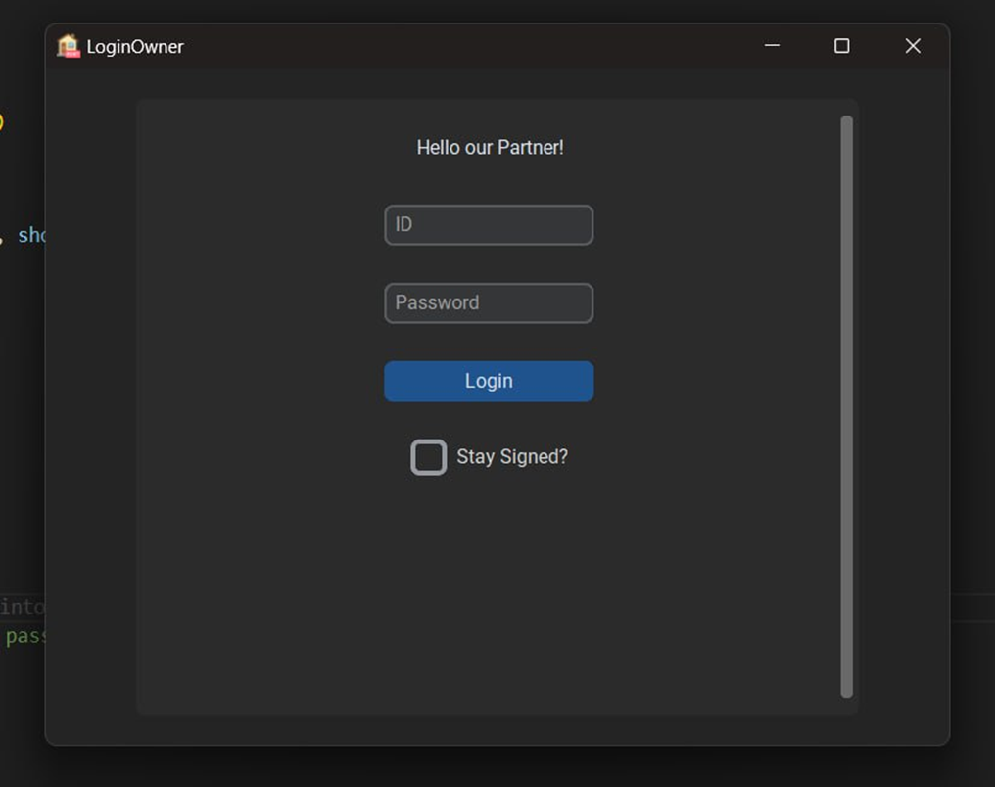
For Owner
The owner starts login by entering his ID and password which is saved in the database.
If the entered data is not valid an error message appears, and the owner should re-enter his valid data again.

Slide 10
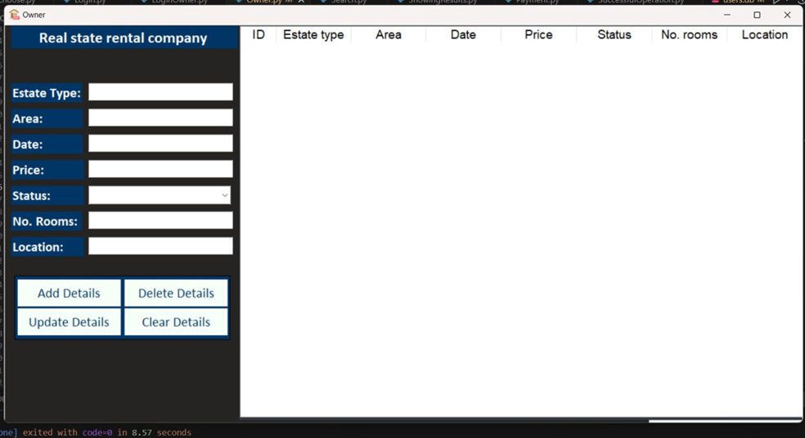

After login, the owner can access his real estate data by add, update, delete from database.
All data will appear in the database table.

Slide 11
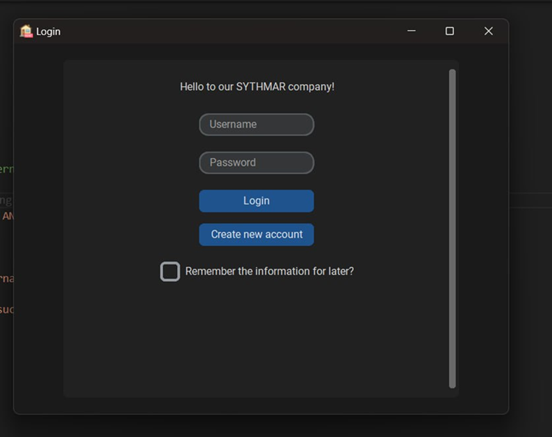
For Customer
For customer:
The customer starts login by entering his personal information into the system if he has an existing account and if not, he can create a new account.

Slide 12
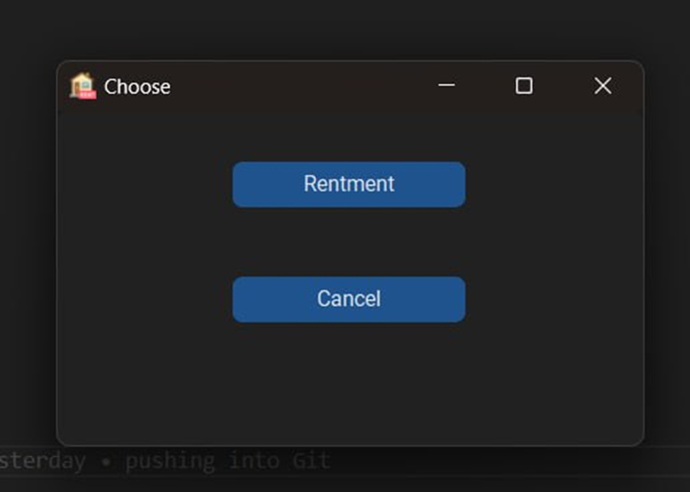
Through this page the customer can
choose his process if it is rent or
cancelation process.

Slide 13
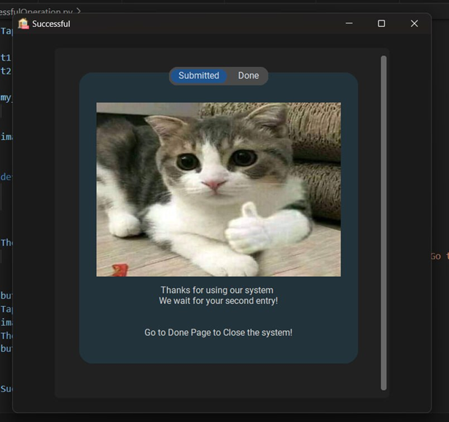
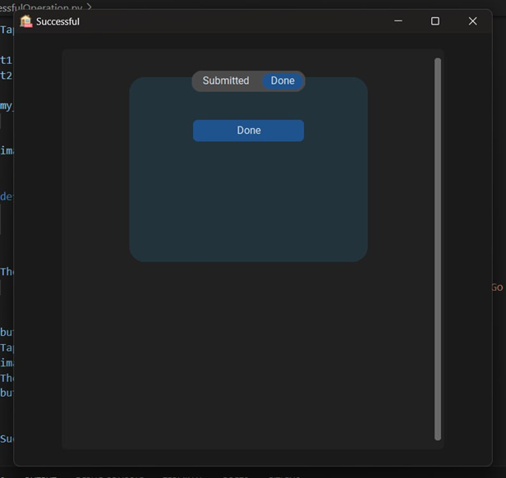
Cancel:
The process is done successfully, and a confirmation message appears.

Slide 14

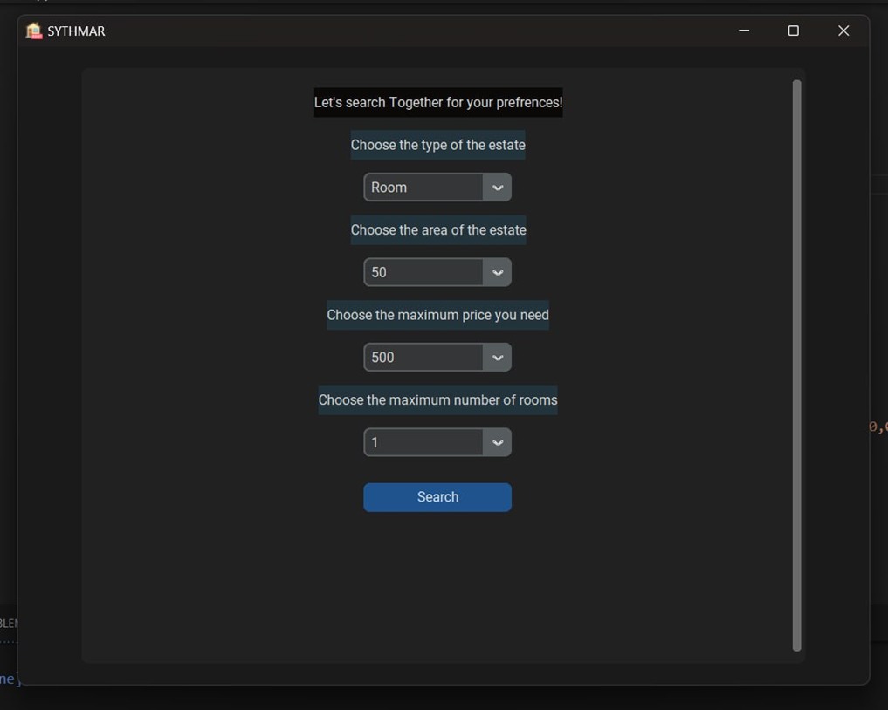
Rent:
The customer enters the data about the needed real estate that he searches for (type of the real estate, area of the real estate, price of the real estate, number of rooms)

Slide 15
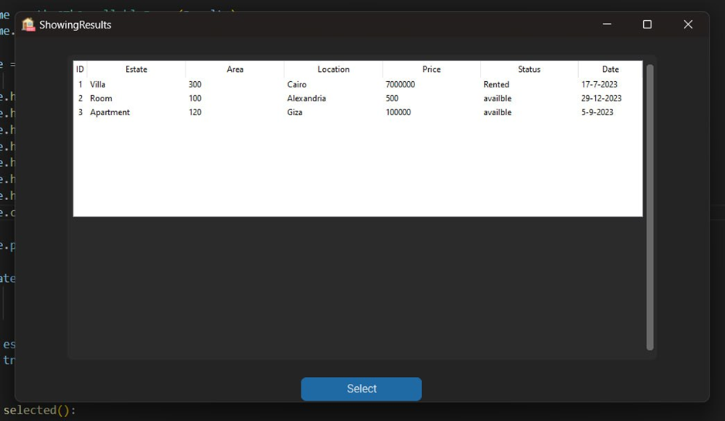

After searching, the available real estate that matches
the customer search appears to the customer, then he
selects what he wants.

Slide 16
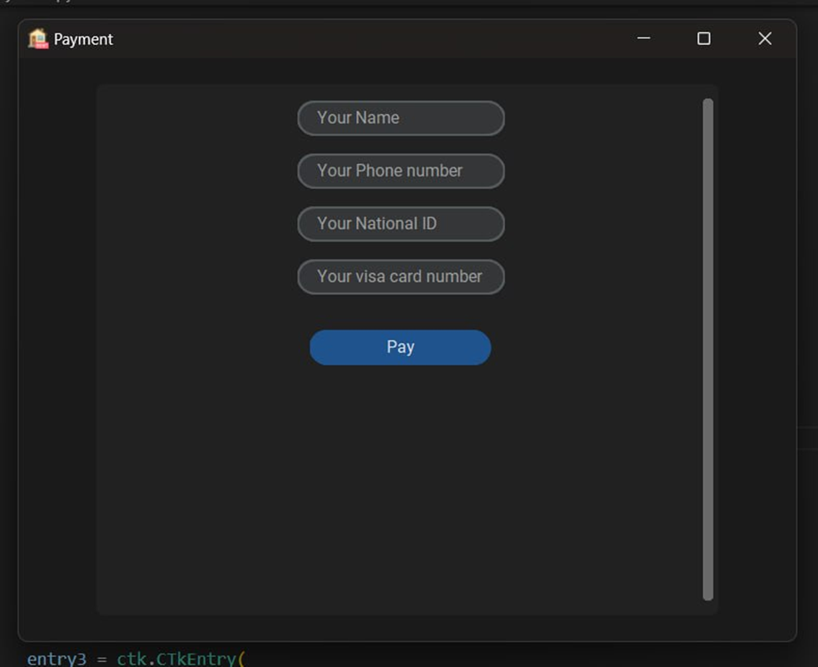

Customer enters his personal data and
Credit card data to verify the payment.

Slide 17

The process is done successfully, and a confirmation message appears.

Slide 18
OUR TEAM
Maram Nasser Farid
Ahmed Yasser Taha
Amira Fawzy Salem
Esraa Adel Ahmed

Slide 19
THANKS

Slide 20


