Slide 1

Abstract about Genius Clinic
Eslam Hamdina

Slide 2
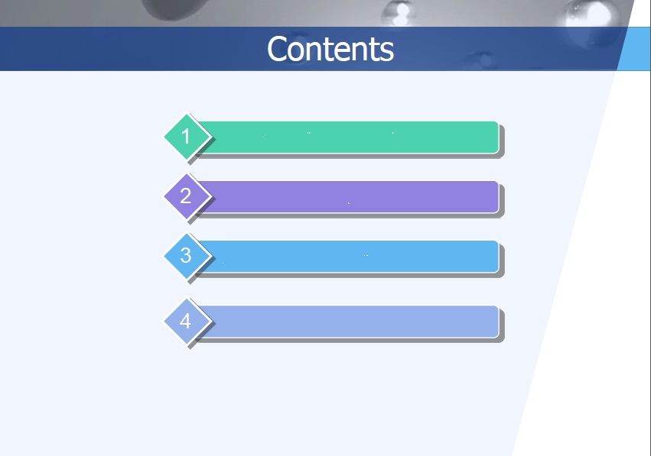

Slide 3

Forms

Slide 4

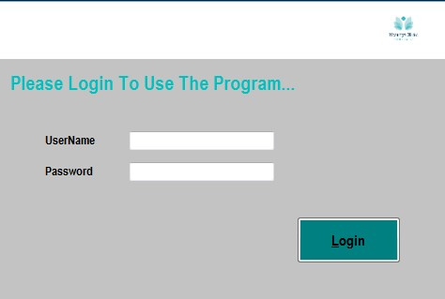
Login Form
The user should be enter username and password to Use the program and press Login….

Slide 5
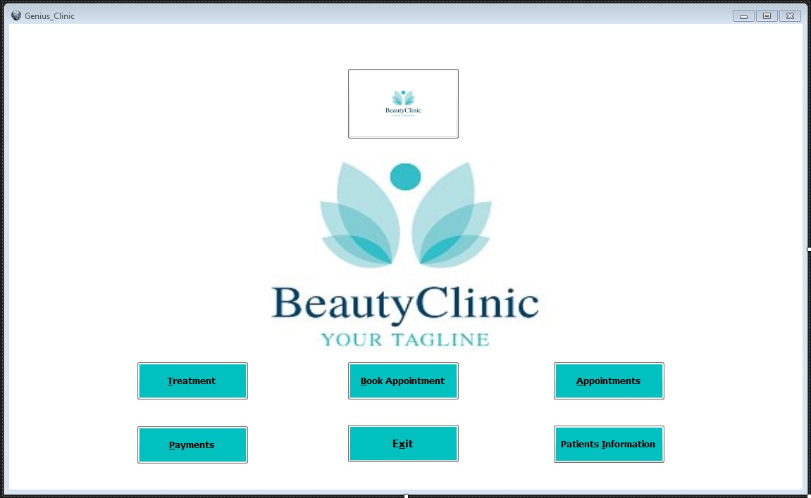
Homepage Form
When the user logs on, this screen will be appeared. In this main screen there are seven buttons. Such as treatment, Book appointment, appointments, Payments, patient information, button in above and exit.

Slide 6
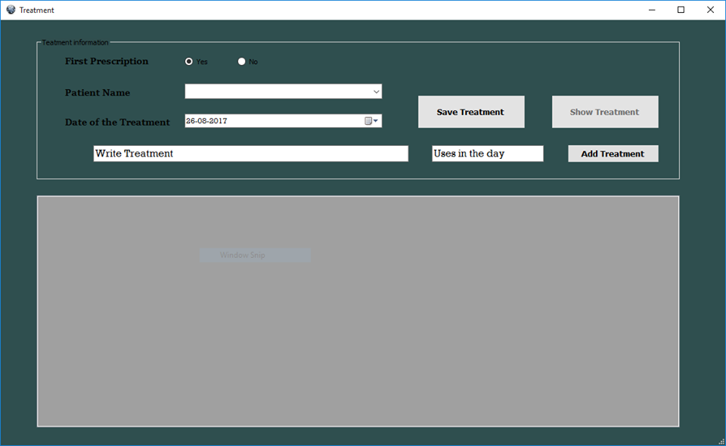
Treatment Form
Patient must enter his name and answer if this the first time or no. if this is first time, patient must enter his name. Else the program will be give registered names. Security write treatment and uses in the day. When she click save treatment, the program will be saved treatment in file.

Slide 7
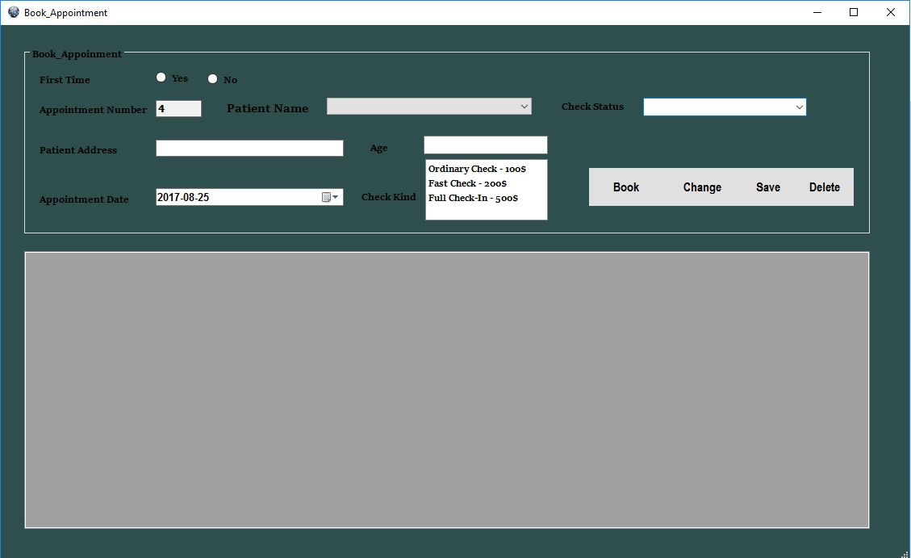
Book Appointment Form
There are four buttons. Such as book, change, save and delete. User should enter that number of patient, name, age, check status, patient address, appointment date and sort of check. If this is the first time, patient will be enter his name. If this is not the first time the program will show his name .

Slide 8
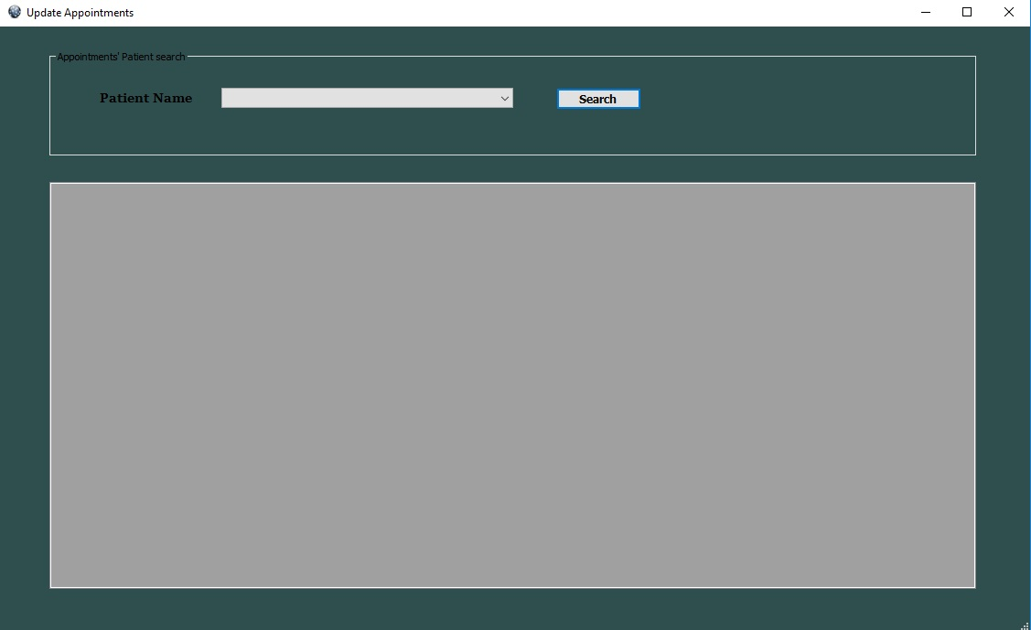
Update Appointment Form
User should enter patient name and press search. Patient’s information will show in this textbox.

Slide 9
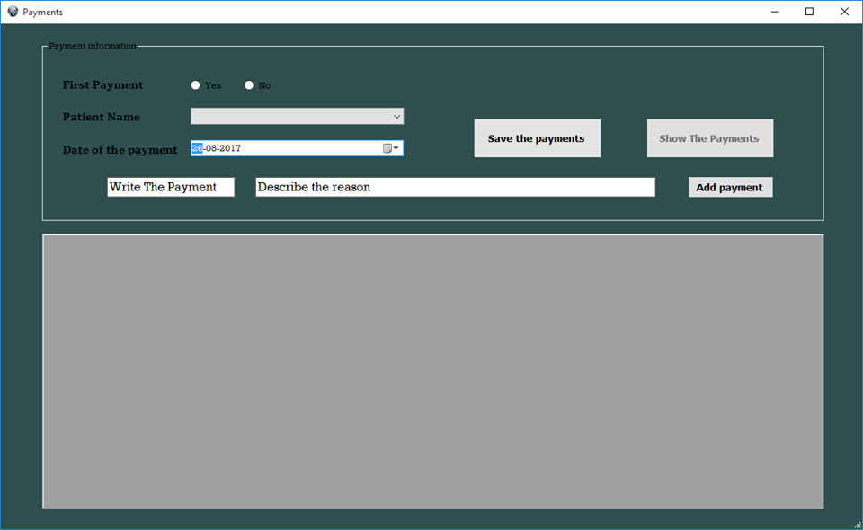
Payments Form
User should enter that patient name,payment,reason and press Add payment . Patient’s payment will show in this textbox.

Slide 10
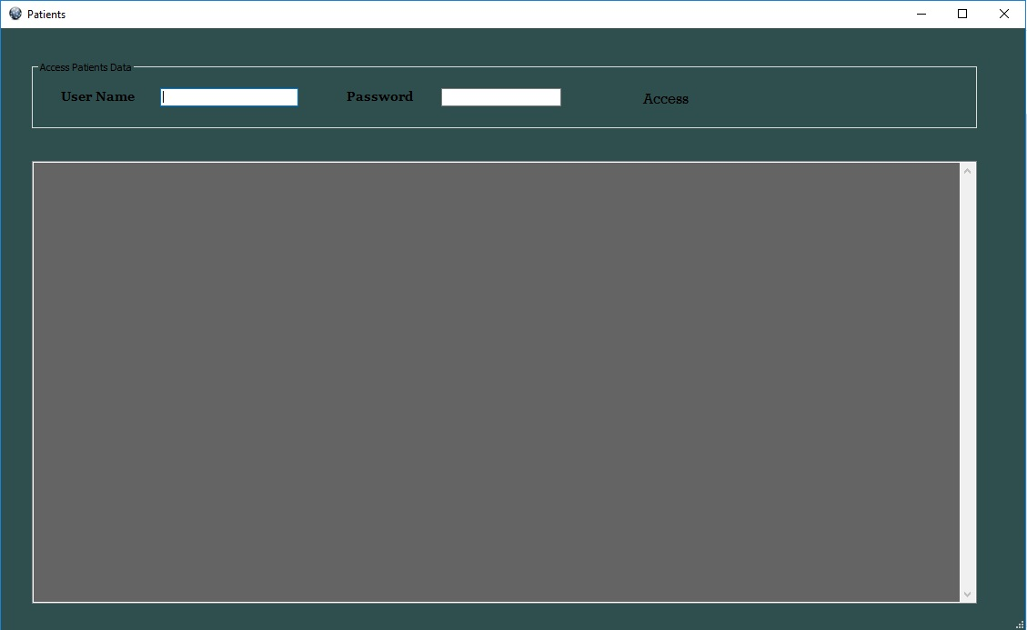
Patients Form
When user enter username, password and access, the program will be shown information about all patients in this day.

Slide 11
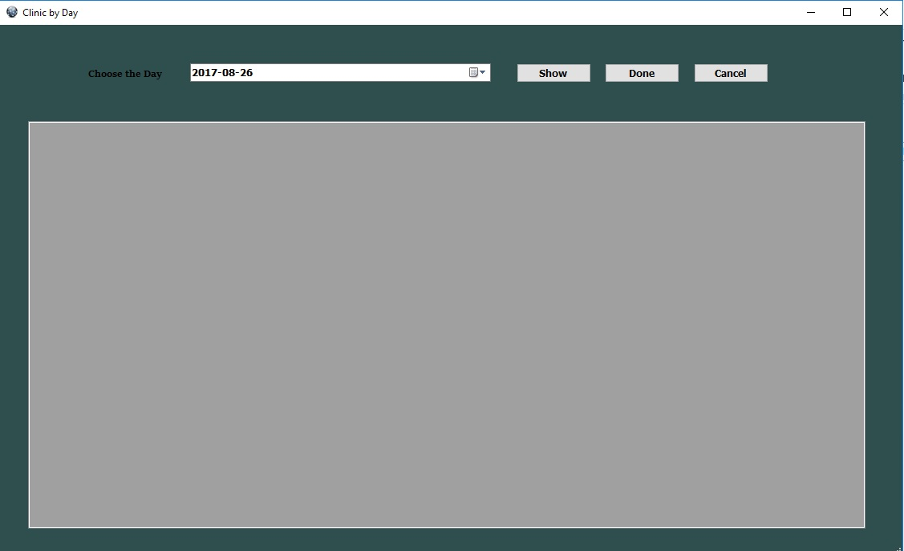
Clinic By Day Form
In this form ,user can get up the appointments in any day.

Slide 12
Team

Slide 13
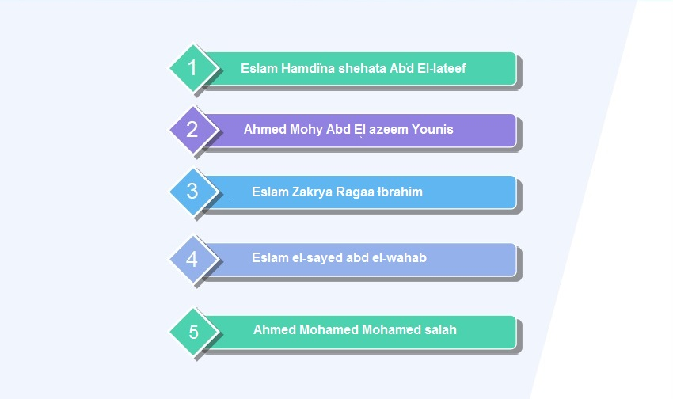
Team

Slide 14


