Slide 1
Genius Pharmacy
BY Ahmed Mohey Younis
SECTION 3

Slide 2
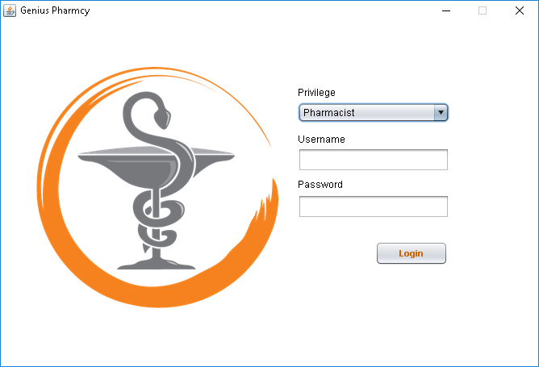
This is the home screen in the system here you can log in as Pharmacist, admin, gust.

Slide 3
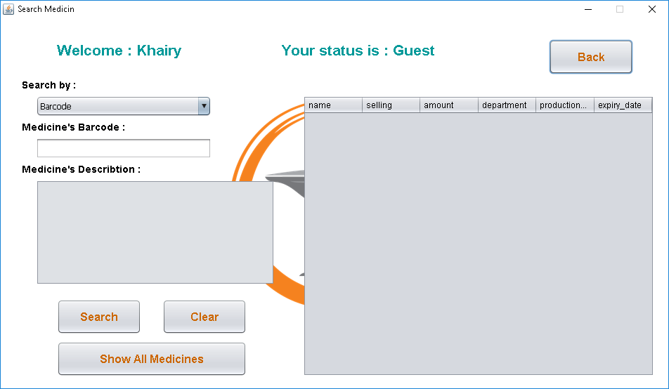
If you logged in as a guest you can search for any medicine you want.

Slide 4
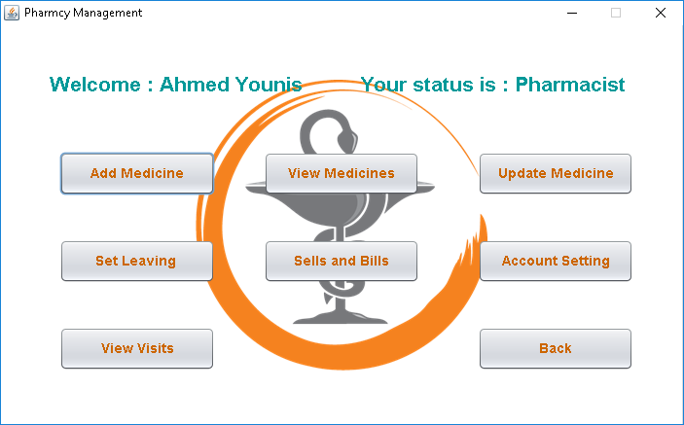
If you logged in as a Pharmacist this screen will appear with this features.

Slide 5
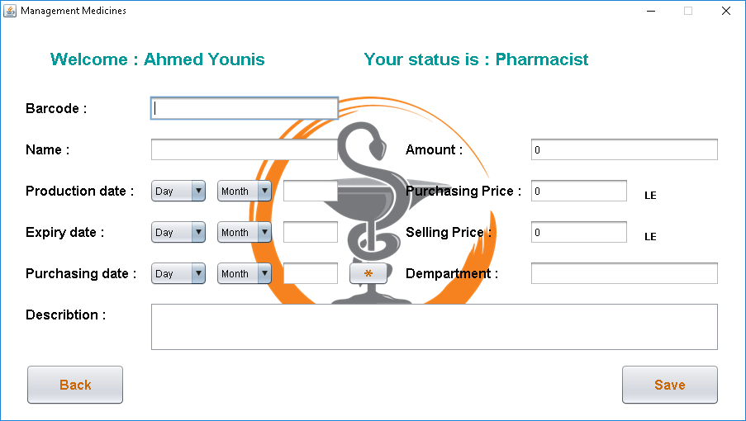
Here you can add any medicine with it’s details.

Slide 6
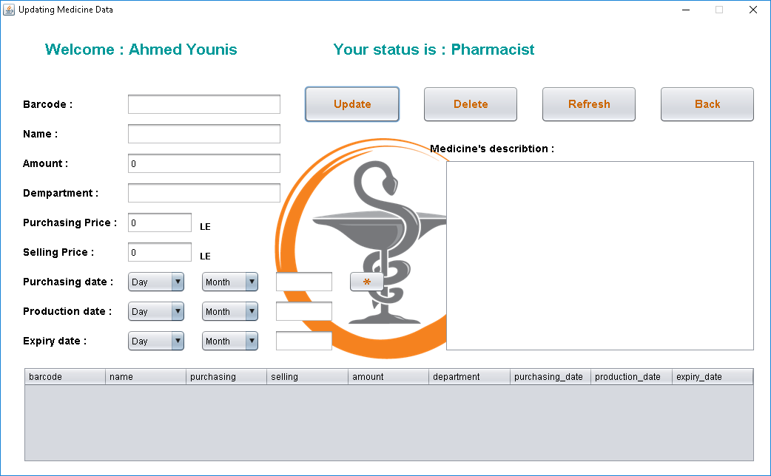
Here you can update medicine if you typed it’s details wrong.

Slide 7
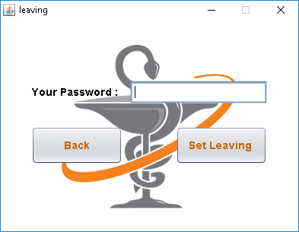
Here all the employees must set their leaving time after they finished.

Slide 8
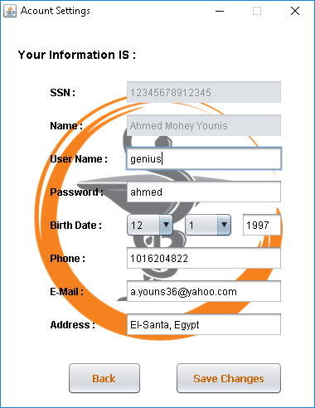
Here you can edit your account settings if you logged in.

Slide 9
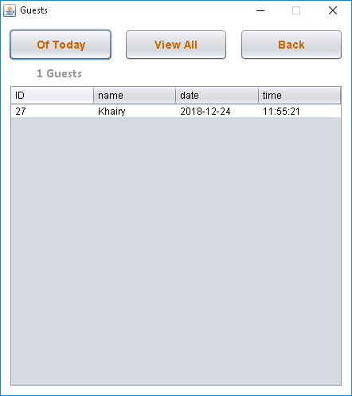
Here the list of all guests.

Slide 10
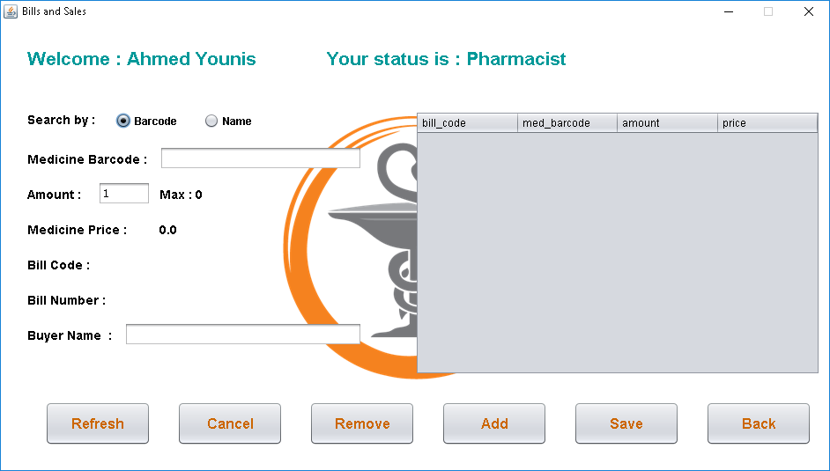
Here the pharmacist can create a bill with the medicine that the customer want to buy.

Slide 11
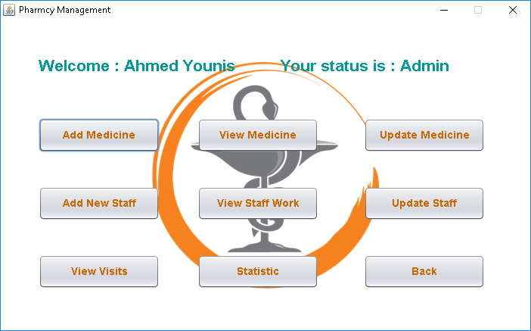
If you logged as an admin this screen will appear with this features.

Slide 12
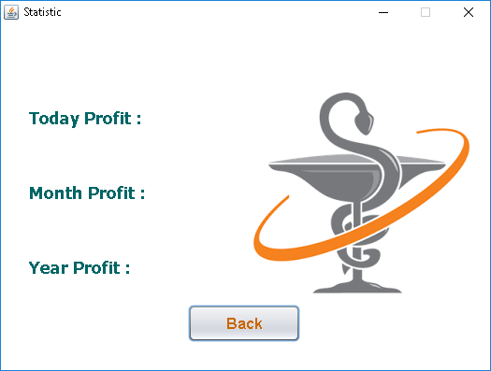
Here you will find all the statistics about the pharmacy’s profit.

Slide 13
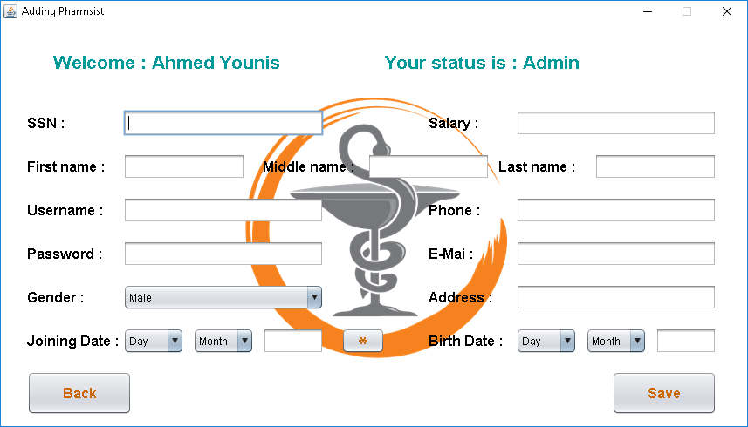
Here you can add a pharmacist to be able to work in the pharmacy and create his/her account .

Slide 14
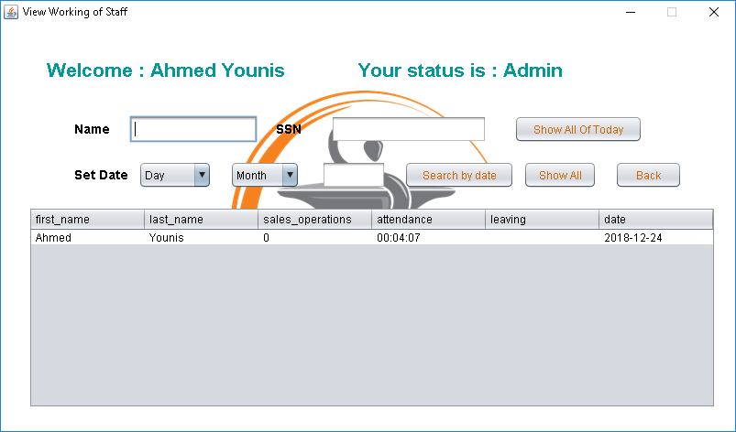
Here you can view the stuff’s stats and know everything about them.

Slide 15
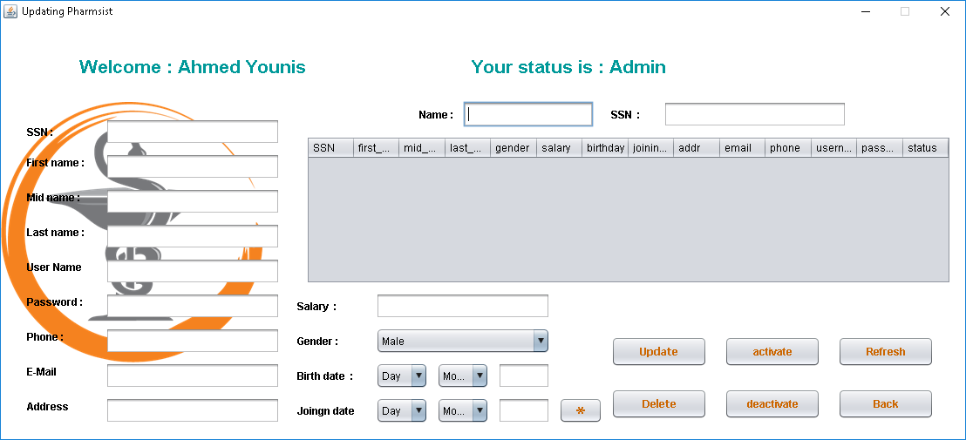
Here you can update the info of any pharmacist.

Slide 16
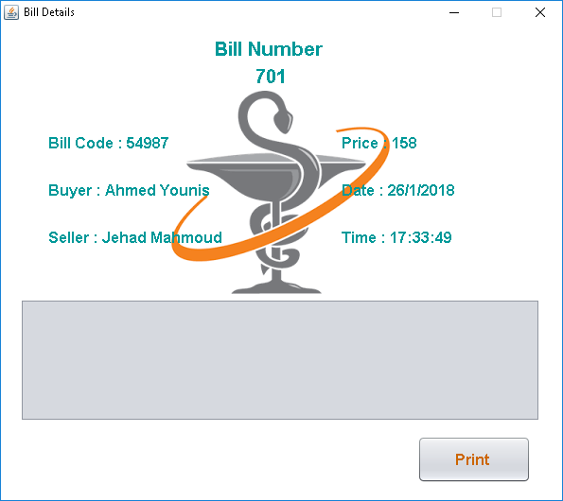
And finally, you can print the bill here after clicking the “Print” button.

