Slide 1



Predicting A Disease Based on The Diagnosis of Another Disease Using Machine Learning

Slide 2
:Prepared By
1-Yasmine Emad El-Sayed Hemisa
4-Ahmed Mohamed Mohamed Salah Mohamed
7-Ahmed Mohie Abd El-Azem Younis
2-Doaa Maher Shahat Ahmed
3-Fadia Alazab Muhammad Elgendi
6-Mahmoud Saeed Mustafa Lashin
5-Ahmed Mahmoud Ahmed Labib

Slide 3

:Supervised By
Dr\ Ahmed Hagag .
Eng\ ElShaima Abdel Fattah.
Eng\ Doaa Lotfy.

Slide 4
Content
Project idea
Medical Review
Machine Learning Review
Project Interface
Connection between Web & Machine model (Flask).
Dataset Overview
Machine learning model – Preprocessing
Machine learning model – Model analysis
Future Work

Slide 5
Project Idea
Our project is about predicting a disease based on the diagnosis of another disease using machine learning , to help in early diagnosis of disease by supporting the pathologists and doctors in their decision , our idea is to diagnosis of chronic kidney disease (CKD) as well as predicting other diseases, such as Coronary artery disease (CAD).
The motivation that drove us to do this project is in order to estimate whether patients with moderate CKD already show signs and symptoms of HF found in its early stages.

Slide 6
Medical Review
Why does the medical field need our project?
Is there any relations between diseases?
Chronic kidney disease medical examinations
Coronary artery disease medical examinations
Why we choose Chronic kidney and Coronary artery diseases?

Slide 7

Machine Learning Review
What is machine learning?
Machine learning advantages vs disadvantages
Machine learning applications
Types of machine learning
Why we choose classification to build our model?
Tools used to build our machine learning model

Slide 8
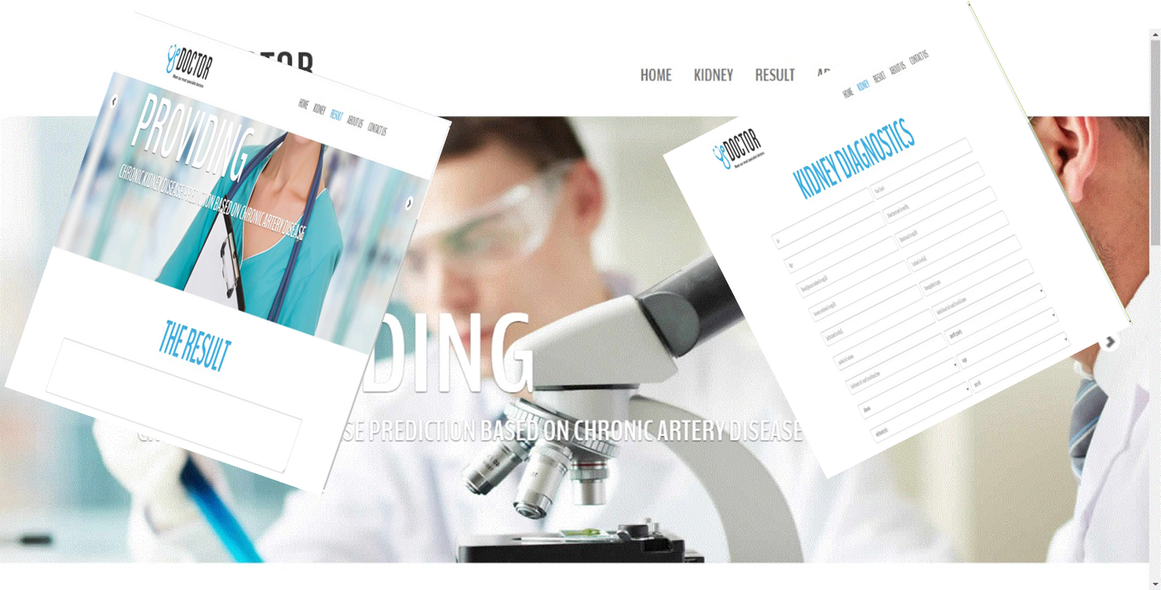
Project Interface

Slide 9
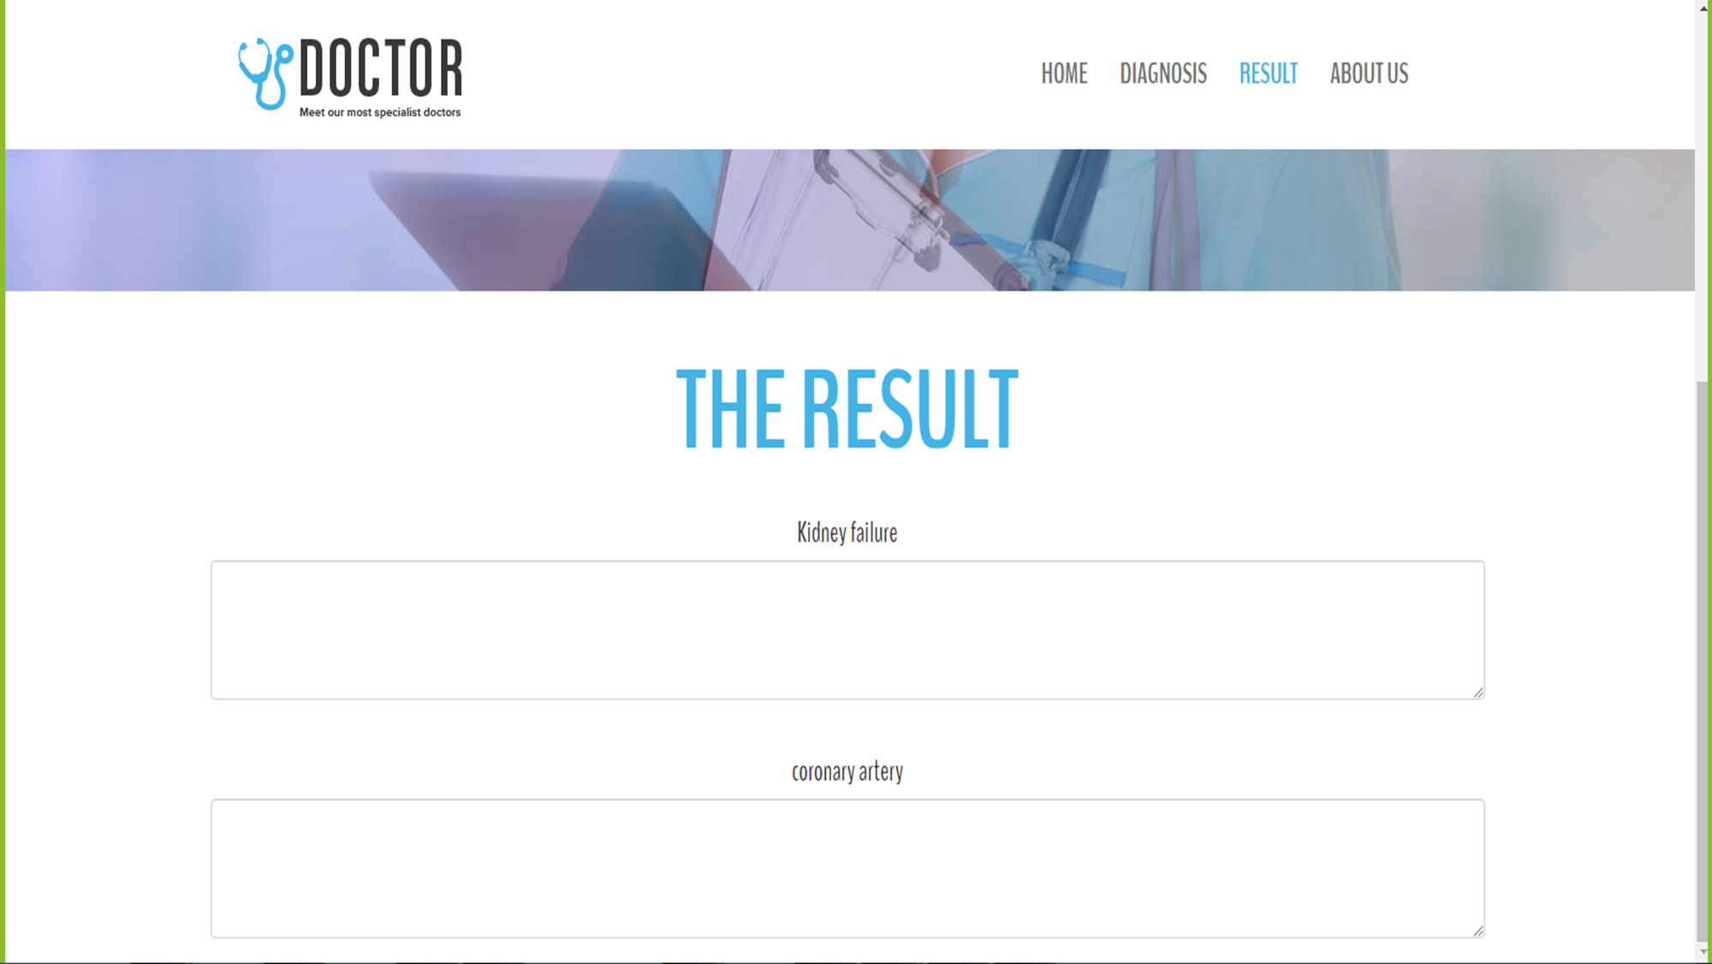
Project Interface

Slide 10
Project Interface
The advantage of using website for our project interface
Project interface structure
Home Page – Diagnosis Page – Result Page explanation
Tools used to build our project interface

Slide 11
Connection between Web & Machine model (Flask).
What is Flask? And Why?
Flask connection structure
Connection steps
Used tools to build the connection

Slide 12
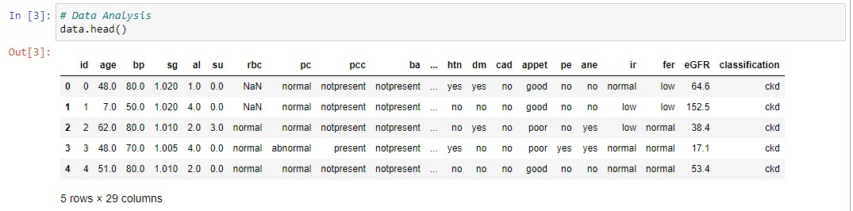
Dataset Overview

Slide 13
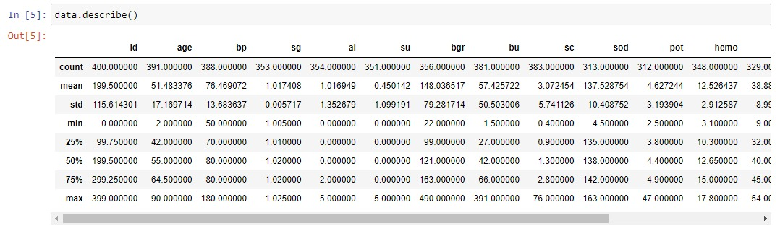
Dataset Overview

Slide 14
Dataset Overview
The difficulties we faced in finding the dataset
Type of our dataset
Dataset Features (attributes)
Advantages and disadvantages of our dataset
Dataset Modifications
Data analysis

Slide 15
Machine learning model – Preprocessing
Features selection
Missing values in categorical features
Missing values in numerical features
Encoding categorical features – Label Encoder
Dataset scaling – Standard Scaler
Dataset splitting for X, y

Slide 16
Machine learning model – Preprocessing
Dataset splitting for train and test (Test Case)
Building The classification algorithms
Logistic regression
Naïve Bayes
Decision Tree
Random Forest
Support vector machine
K Neighbors Classifier

Slide 17
Machine learning model – Model analysis
Cross validation
Grid Search
Evaluating classification algorithms results
How we choose the final model?
How we apply our idea using machine learning?

Slide 18
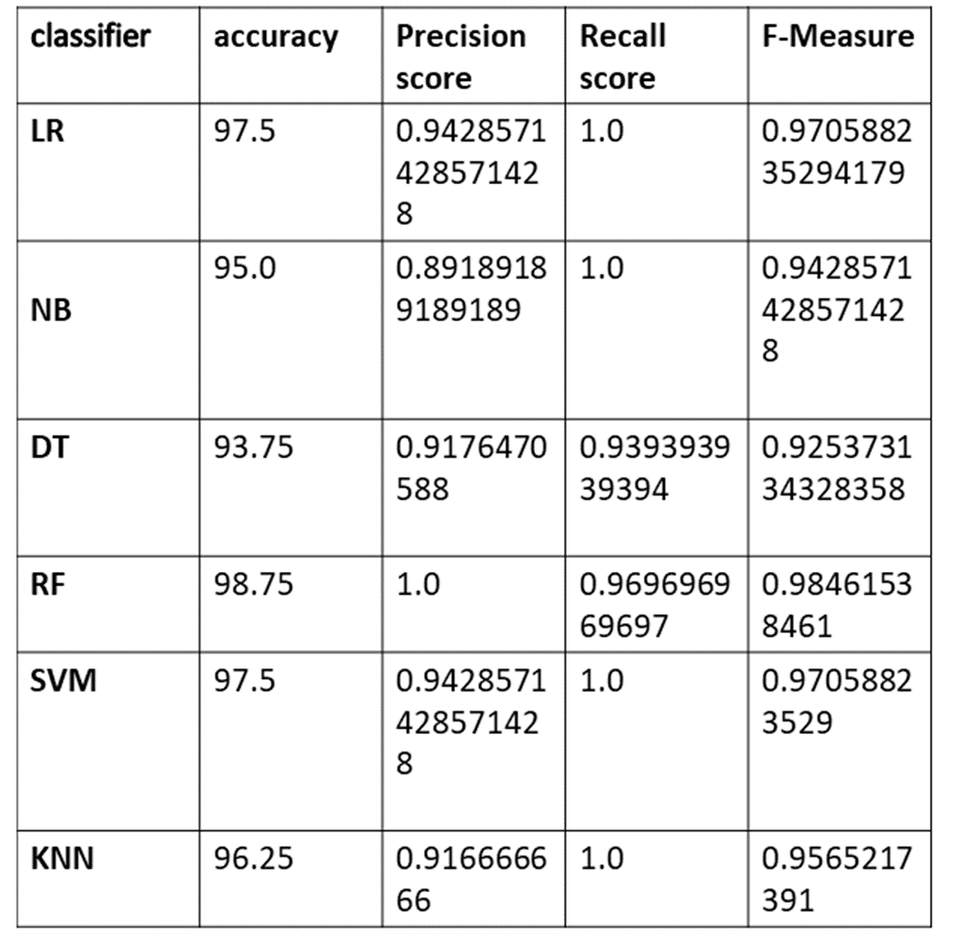
Machine learning model – Model analysis

Slide 19
Future work
In the end we can see it was an idea from the beginning and we just wanted to flash the light on it, We didn’t expect that it would work with us but we believed in it.
We also believe that it can be done on other more diseases that have relations between each other, We just gave the hint to start this journey

Slide 20

Thank You

