Slide 1

Intel Image Classification
Data Science project
Dr/ Eman Amin

Slide 2
Introduction
There are 6 types of images that need to be classified
The 6 types are {buildings, forest , glacier, mountain , sea, street}
Building a model using (CNN – Keras and VGG ImageNet)

Slide 3
Dataset
 | training data | testing data | Prediction data
buildings | 2191 | 437 | found 7301 unseen image
forest | 2271 | 474
glacier | 2404 | 553
mountain | 2512 | 525
sea | 2274 | 510
street | 2382 | 501
Total: | 14034 | 3000
the source of the data: Kaggle
Target: assign test images into one of 6 types

Slide 4
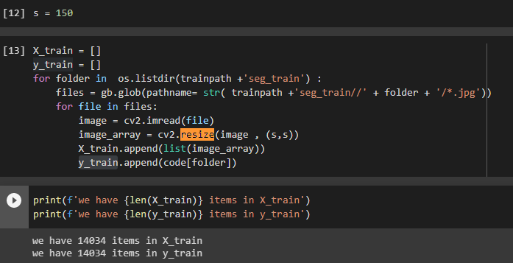
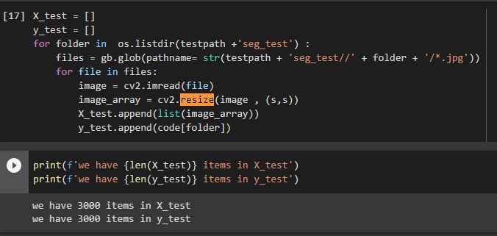
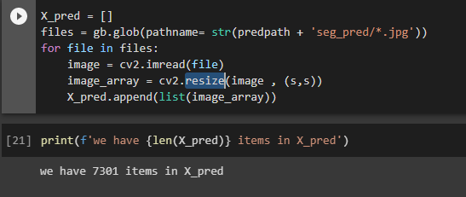
Training=>
Data preprocessing
Set image resize to (150 * 150) and store it in file and made it array, shuffled all data
Test(Validation)=>
Prediction=>

Slide 5
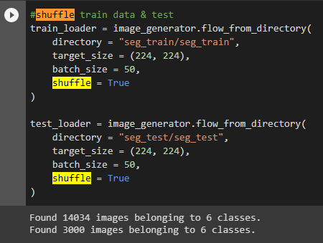
Data preprocessing(Cont…)
Set image resize to (150 * 150) and store it in file and made it array, shuffled all data

Slide 6
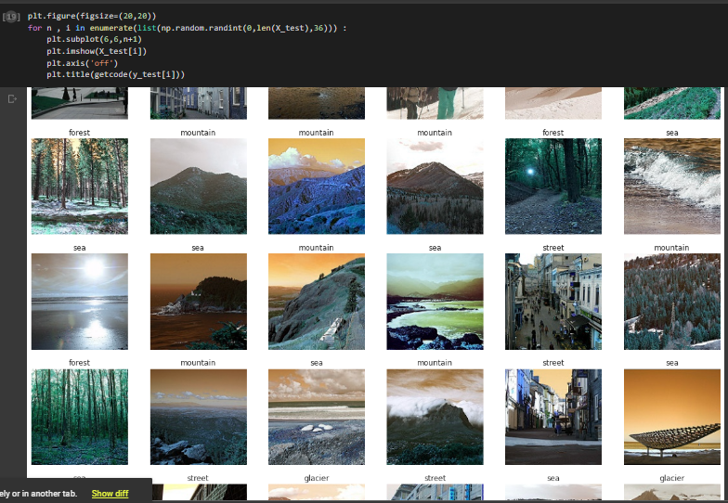
Some Training Data Labeled

Slide 7
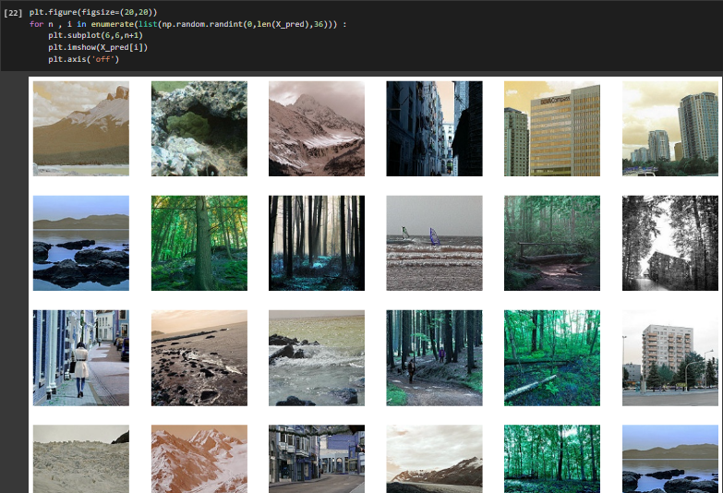
Some Predicted Data Unlabeled

Slide 8
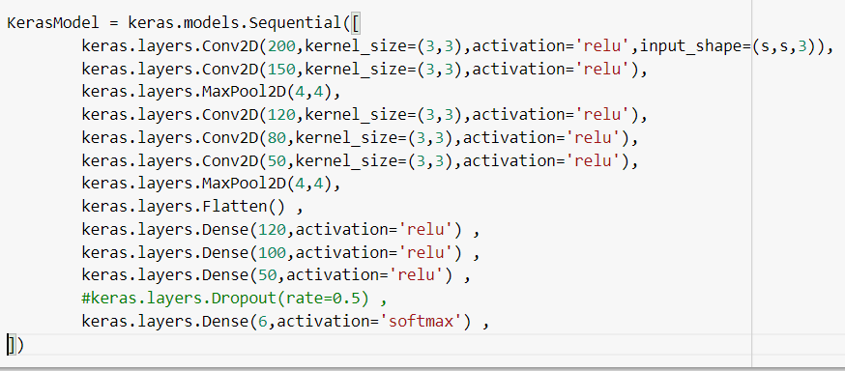
CNN=>
Models
Convolutional neural network because it extract features in images.
Modification: VGG16 imageNet
VGG16 is a pre-trained CNN model which is used for image classification. It is trained on a large and varied dataset and fine-tuned to fit image classification datasets with ease. Now, import a VGG16 model. You must initialize the model and add input and output layers

Slide 9
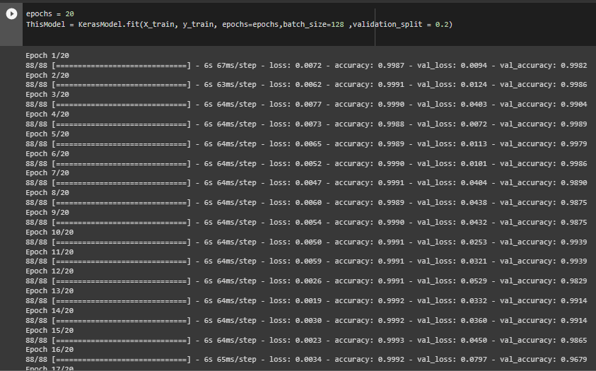
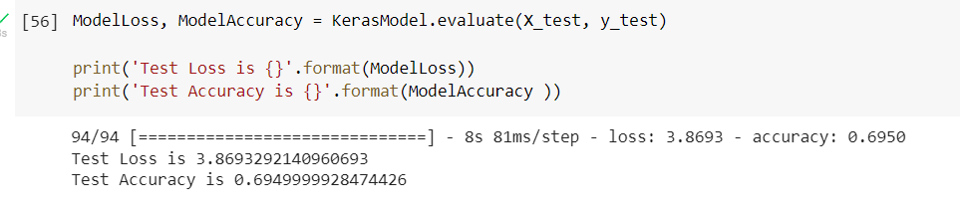
CNN=>
Models(Cont…)
Convolutional neural network because it extract features in images.
Modification: VGG16 imageNet
Accuracy=>

Slide 10
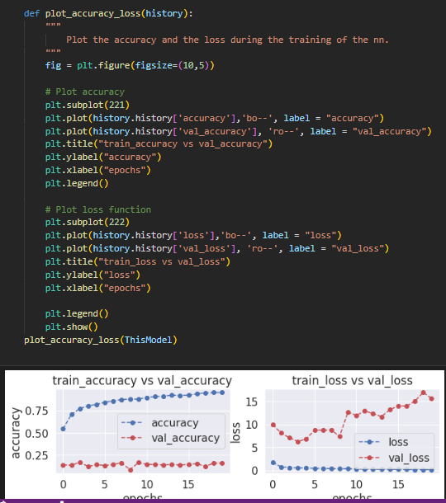
Models(Cont…)
Convolutional neural network because it extract features in images.
Modification: VGG16 imageNet

Slide 11
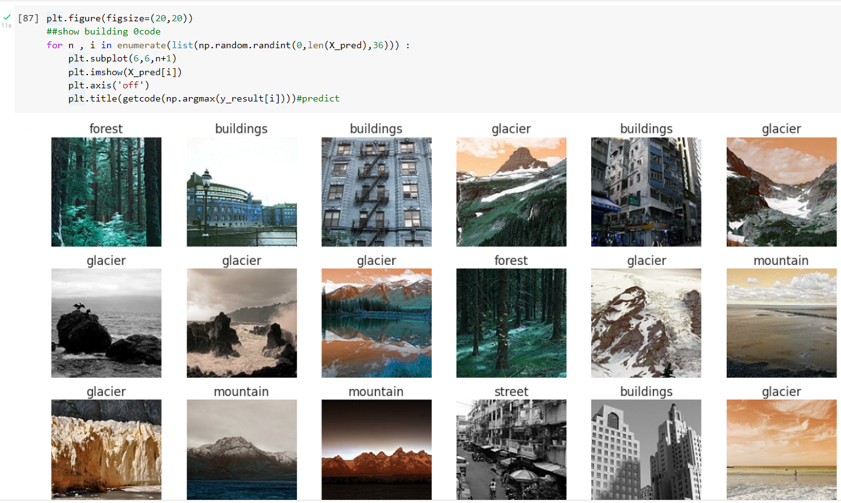
Example of Predicted CNN

Slide 12
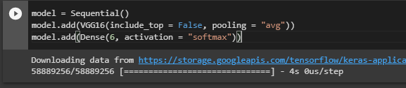
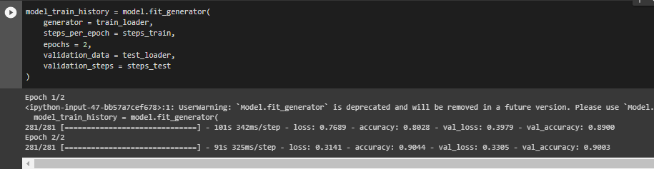

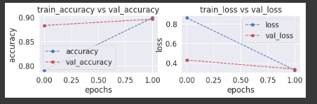
Models(Cont…)
Modification: VGG16 imageNet

Slide 13
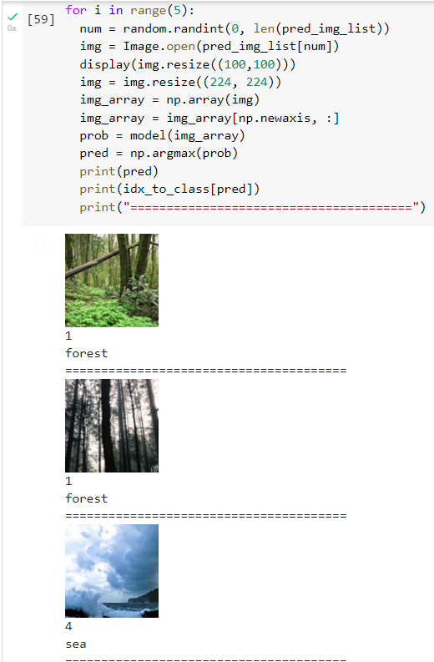
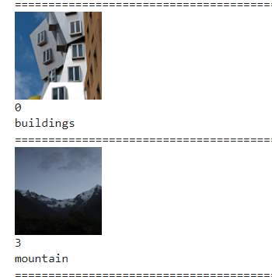
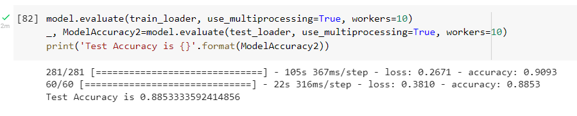
Example of Predicted VGG16 imageNet
Accuracy

Slide 14
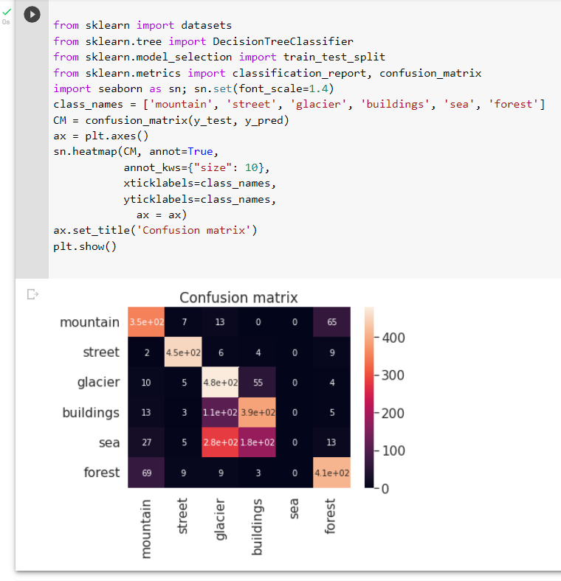
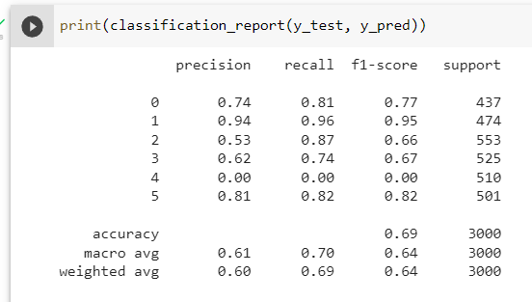
confusion matrix

Slide 15
Thank You

